Slide 1
RichRail
René van Aerle
Patterns and Frameworks – Assignment 2
16 march 2011

Slide 2
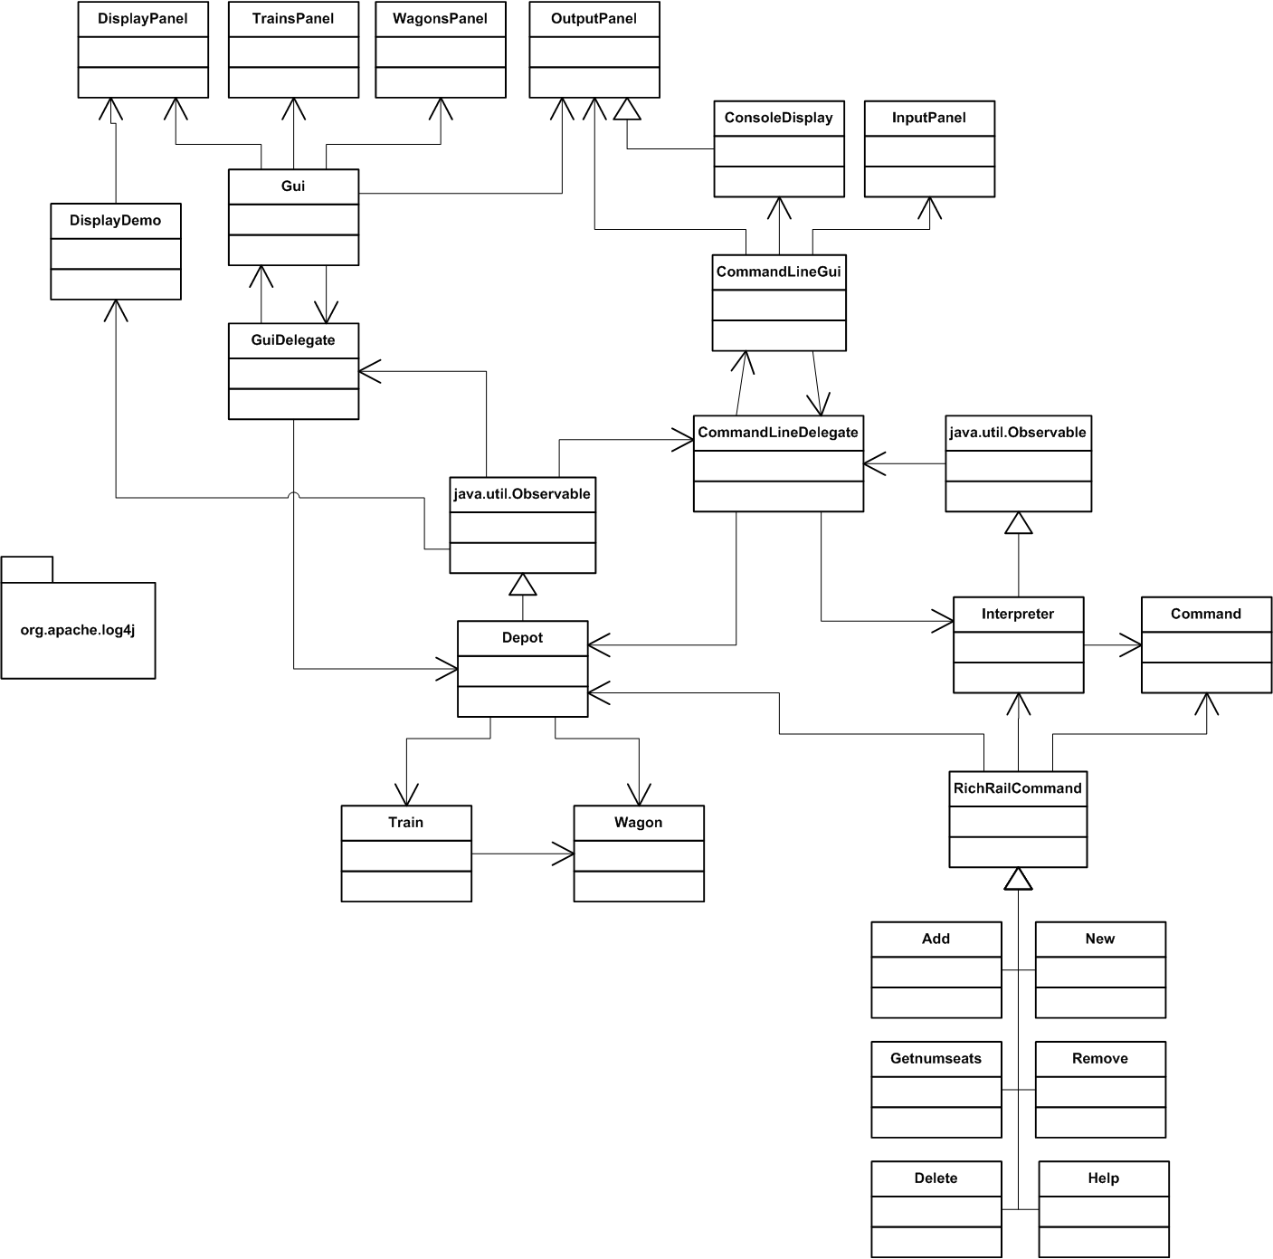
UML - Overview

Slide 3
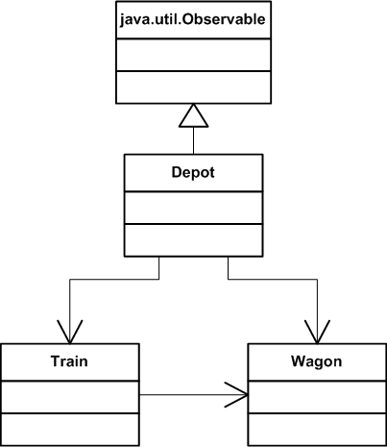
UML - Domain

Slide 4
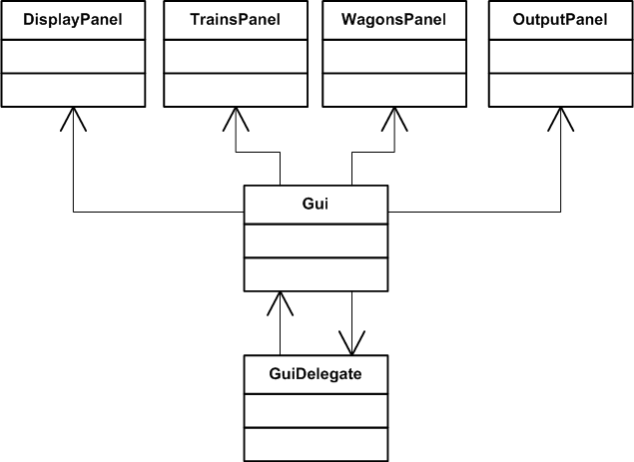
UML – GUI

Slide 5
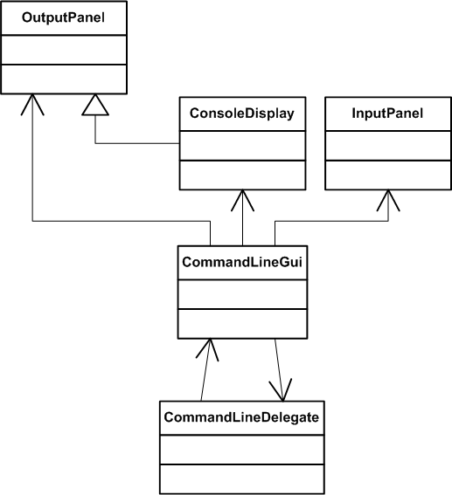
UML – CommandLine GUI

Slide 6
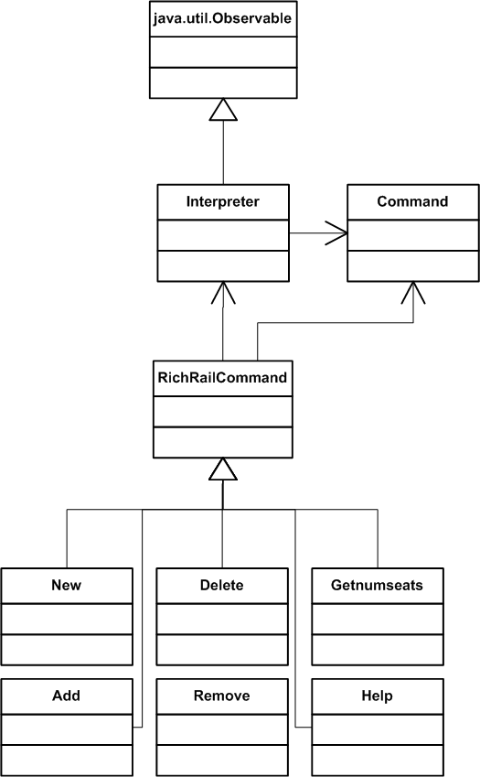
UML –Interpreter

Slide 7
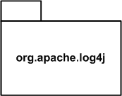

UML - Logger
Log4j - Apache Logging Services for Java
http://logging.apache.org/

Slide 8
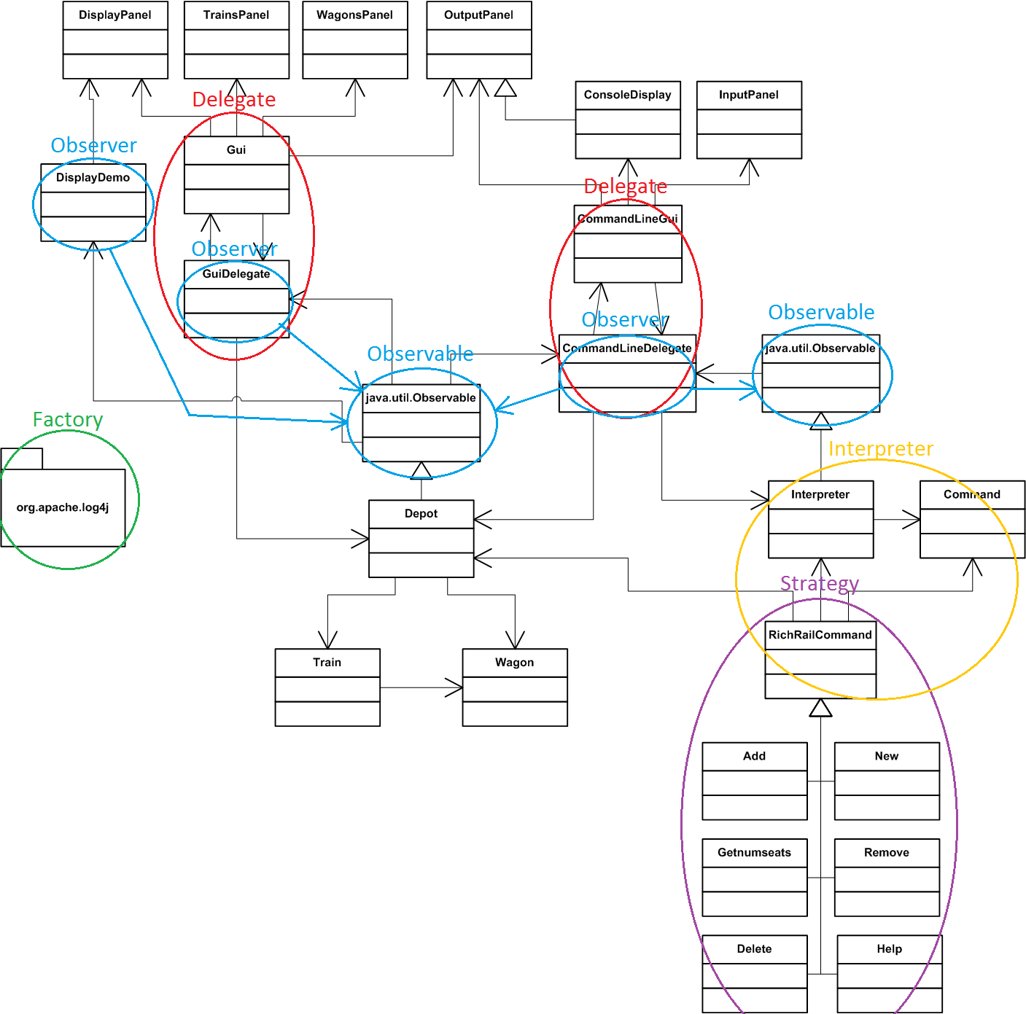
Patterns used

Slide 9
RichRail Demo

