Slide 1
TRACK
FINTECH & FINANCIAL INCLUSION
IDEA NAME
TRUSTBRIDGE
Portable Credit / Financial Passport
Cross-Border Financial Transition Assistant
NRI Banking, Tax & Residency Guidance
Notes:
Cover slide added for presentation use.
Track: FinTech & Financial Inclusion.
Idea name: TrustBridge.
All nine content slides that follow retain their existing information.

Slide 2
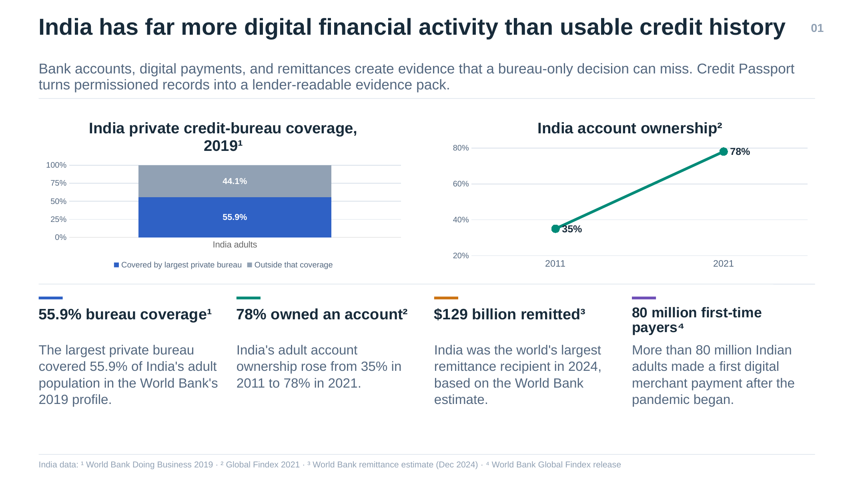
Notes:
Original slide 1 reproduced from the user-supplied reference PDF.
/Users/rydamsinghchauhan/Downloads/credit passport working (1).pdf

Slide 3
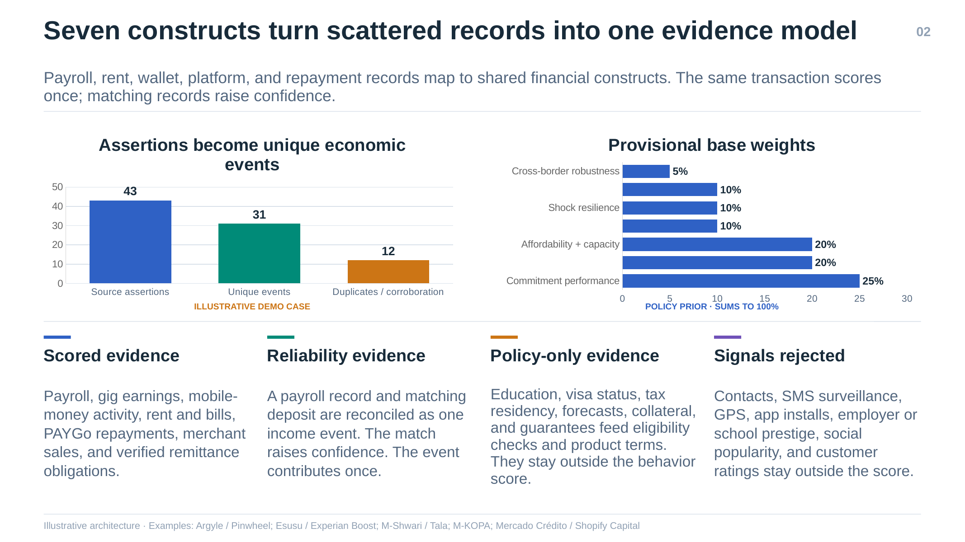
Notes:
Original slide 2 reproduced from the user-supplied reference PDF.
/Users/rydamsinghchauhan/Downloads/credit passport working (1).pdf

Slide 4
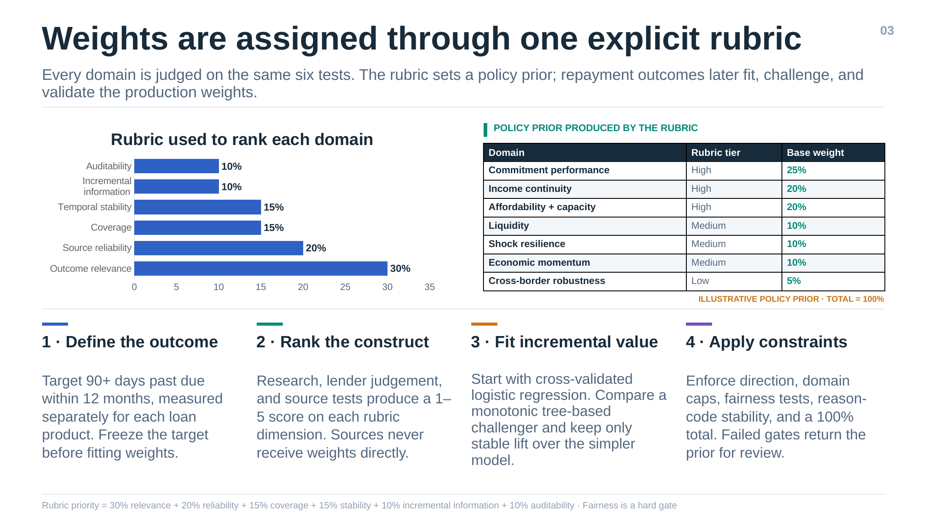
Notes:
Original slide 3 reproduced from the user-supplied reference PDF.
/Users/rydamsinghchauhan/Downloads/credit passport working (1).pdf

Slide 5
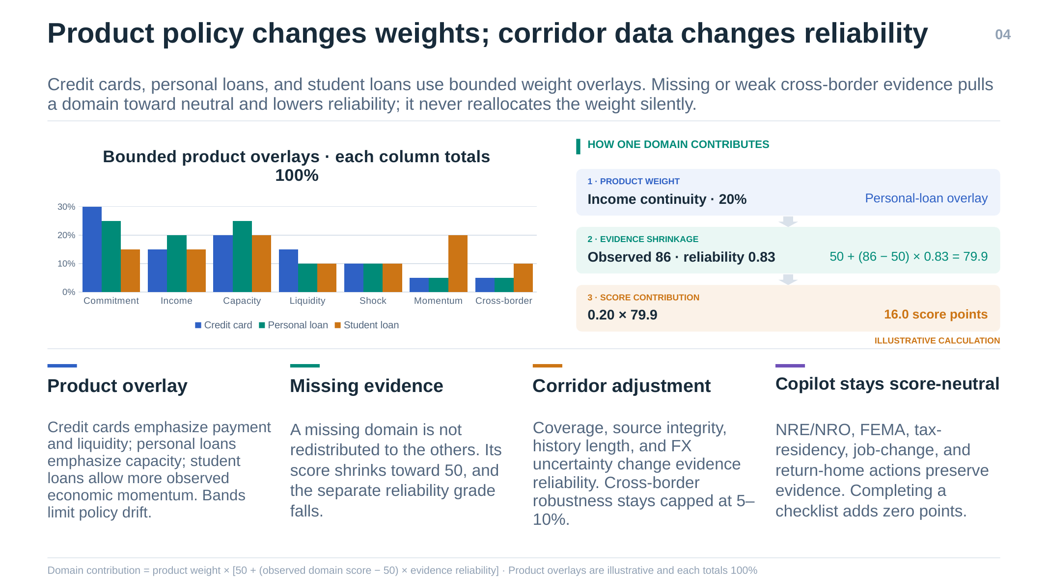
Notes:
Original slide 4 reproduced from the user-supplied reference PDF.
/Users/rydamsinghchauhan/Downloads/credit passport working (1).pdf

Slide 6
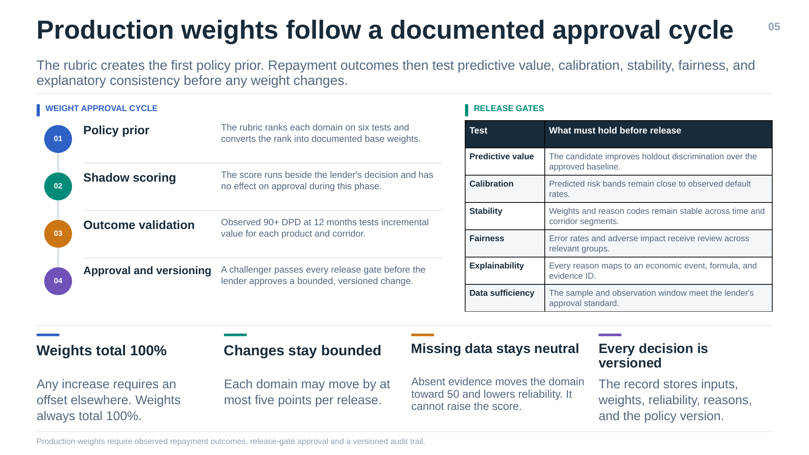
Notes:
Original slide 5 reproduced from the user-supplied reference PDF.
/Users/rydamsinghchauhan/Downloads/credit passport working (1).pdf

Slide 7
One assistant follows the worker through four financial transitions
06
Each life event refreshes the banking, residency, tax, remittance and evidence checklist. The assistant explains the next action and routes execution to the responsible institution.
01
Moving abroad
02
Living abroad
03
Job change or loss
04
Returning to India
TRIGGER
TRIGGER
TRIGGER
TRIGGER
Offer accepted and departure date confirmed
Employment and overseas income begin
Employer, contract or salary status changes
Temporary or permanent return is planned
FACTS COLLECTED
FACTS COLLECTED
FACTS COLLECTED
FACTS COLLECTED
Destination, employer, contract, departure date, Indian accounts, loans, investments and dependants
Salary credits, employer status, remittances, Indian income, account use and days in India
Last salary, end date, new employer, visa position, savings runway and continuing obligations
Return date, intended stay, foreign balances, continuing overseas income and Indian account inventory
ACTIONS ACTIVATED
ACTIONS ACTIVATED
ACTIONS ACTIVATED
ACTIONS ACTIVATED
Residency review, resident-account check, NRE/NRO options, KYC refresh, EMI continuity and remittance setup
Track verified income, flag missing evidence, monitor account suitability and keep residency facts current
Reprioritise EMIs, remittances and insurance, preserve proof of work, and prepare a new-job or return plan
Reassess FEMA and tax status, review NRE/NRO/FCNR(B), consider RFC eligibility and update KYC
Departure checklist with documents, owner and due date
Live plan plus an updated financial passport
Urgent actions separated from optional actions
Return checklist and bank-ready evidence pack
Life-event trigger
Versioned rule engine
Trust Receipt
Institutional handoff
The user reports a move, job event or return. Connected data can confirm dates and financial activity.
Approved rules evaluate the user facts. AI explains the result but does not invent the rule.
Every recommendation records the facts used, source, policy version, missing information and next owner.
The bank executes account changes. A qualified professional handles complex tax or legal interpretation.
Proposed product workflow. Completing a checklist does not change the financial-passport score or guarantee a financial product.
Notes:
Product workflow proposed for the Cross-Border Financial Transition Assistant.
Banking and residency actions remain conditional on the user's facts and the institution's review.
RBI non-resident account FAQ: https://www.rbi.org.in/commonman/Upload/English/FAQs/PDFs/Accountresidents16012025.pdf
Income Tax Department non-resident guidance: https://www.incometax.gov.in/iec/foportal/help/all-topics/e-filing-services/non-resident

Slide 8
Banking, FEMA and tax status are evaluated separately
07
The same person can have different classifications under FEMA, tax law and bank-product rules. The platform keeps those tracks separate and produces conditional guidance rather than a single NRI label.
THREE INDEPENDENT STATUS TRACKS
ACCOUNT GUIDANCE MATRIX
01
FEMA residence
Account
Typical role while non-resident
Return or status-change prompt
Determines whether the person is resident in India or resident outside India for foreign-exchange rules.
NRE
Rupee account for eligible funds from outside India and permitted credits
Review immediately. Bank may redesignate it as a resident account or transfer eligible funds to RFC
Inputs: purpose of departure, intended stay, return circumstances and current facts
02
Tax residence
Rupee account often used for permitted India-source receipts and redesignated resident accounts
Review continuing India income, tax documentation and repatriation requirements with the bank
NRO
Determined for each tax year from day counts and applicable statutory conditions.
Inputs: India stay calendar, prior-year history and relevant income facts
FCNR(B)
Foreign-currency term deposit for eligible non-resident depositors
Bank confirms treatment after return and at maturity based on account terms and status
03
Account status
Each account must match the holder's status and the account's permitted purpose.
RFC
Resident foreign-currency account for eligible returning residents
Assess eligibility and which foreign-currency balances can move into the account
Inputs: account inventory, source of funds, currency, tenure and bank records
The account name alone does not determine tax treatment. The platform shows conditions, effective date, source and escalation path.
HOW THE GUIDANCE IS PRODUCED
01
Collect facts
02
Classify tracks
03
Apply rules
04
Create plan
05
Handoff
Dates, purpose, accounts and income
FEMA, tax and account status
Versioned official-source logic
Priority, documents and deadlines
Bank or qualified professional
Sources: RBI Accounts in India by Non-residents FAQ, 16 Jan 2025, and Income Tax Department non-resident guidance. Links in speaker notes.
Notes:
Sources:
RBI Accounts in India by Non-residents FAQ, as on 16 January 2025: https://www.rbi.org.in/commonman/Upload/English/FAQs/PDFs/Accountresidents16012025.pdf
RBI FAQ page: https://m.rbi.org.in/commonman/English/Scripts/FAQs.aspx?Id=3
Income Tax Department non-resident guidance: https://www.incometax.gov.in/iec/foportal/help/all-topics/e-filing-services/non-resident
The guidance matrix summarizes common product roles. Banks and qualified professionals confirm the treatment for the user's specific facts.

Slide 9
Raj's five-year India-Saudi journey produces one continuous record
08
Illustrative case: Raj is an Indian construction worker, sends money to his family each month and returns permanently after five years. The platform updates the plan whenever his circumstances change.
01
Before departure
02
Arrival in Saudi
03
Years 1 to 4
04
Job ends
05
Return in year 5
Build the baseline
Activate non-resident review
Preserve verified evidence
Switch to shock plan
Complete the return plan
INFORMATION CAPTURED
INFORMATION CAPTURED
INFORMATION CAPTURED
INFORMATION CAPTURED
INFORMATION CAPTURED
Collect passport, employment contract, departure date, bank accounts, EMIs, dependants and expected salary.
Confirm employment start, salary account, first salary and remittance channel. Record actual days outside India.
Track consented salary credits, employer continuity, remittances, loan payments, cash flow and gaps in evidence.
Record the final salary, contract end, severance evidence, remaining savings and continuing family obligations.
Confirm permanent return date, foreign balances, continuing overseas income and current Indian accounts.
SYSTEM RESPONSE
SYSTEM RESPONSE
SYSTEM RESPONSE
SYSTEM RESPONSE
SYSTEM RESPONSE
Create the departure checklist. Flag account-status review, KYC, insurance, nominations and remittance setup.
Explain NRE and NRO options. Prepare documents for bank confirmation and any resident-account redesignation.
Refresh the passport and show the source, period, currency, verification level and missing months for each claim.
Prioritise EMIs and essential remittances. Preserve proof of employment and prepare new-job and return scenarios.
Reassess FEMA and tax status. Review NRE, NRO and FCNR(B), consider RFC eligibility, and update bank KYC.
One verified history
Actions match the stage
Bank-ready handoff
No automatic credit promise
Five years of work and remittances remain connected to Raj's identity instead of staying in separate documents.
Raj sees only the tasks activated by his current move, employment event or return decision.
The bank receives an organised fact set and document list. It retains KYC and account-conversion authority.
The passport preserves evidence. A lender independently decides whether it supports eligibility or pricing.
Illustrative persona and workflow. Actual account, residency and tax treatment depends on Raj's facts, effective rules and institutional review.
Notes:
Raj is a synthetic illustrative persona. No real customer's data is shown.
RBI non-resident account FAQ: https://www.rbi.org.in/commonman/Upload/English/FAQs/PDFs/Accountresidents16012025.pdf
Income Tax Department non-resident guidance: https://www.incometax.gov.in/iec/foportal/help/all-topics/e-filing-services/non-resident

Slide 10
The product coordinates the journey while institutions retain authority
09
TrustBridge prepares facts, explains approved rules and manages the checklist. Banks, lenders and qualified professionals execute regulated actions and make final decisions.
RESPONSIBILITY BOUNDARY
WHO BUYS IT
Activity
User
TrustBridge
Bank or professional
Bank
Provide facts and consent
Confirms purpose and data access
Records scope, expiry and revocation
Receives only approved fields
NRI acquisition, prepared handoffs and customer retention
Generate transition checklist
Answers missing questions
Applies versioned rules and priorities
Reviews exceptions when required
Employer or recruiter
Relocation support and lower HR service burden
Change or redesignate account
Submits requested documents
Prepares the handoff
Bank verifies and executes
Remittance or fintech
Determine tax treatment
Provides day-count and income facts
Shows conditions and source links
Qualified professional resolves complexity
Deeper engagement around the transfer journey
Make a credit decision
Applies and reviews explanation
Shares consented evidence
Lender sets eligibility and pricing
Insurer or wealth firm
Hold funds or credentials
Keeps PIN, OTP and passwords private
Never stores sensitive credentials or moves money
Regulated institution safeguards the account
Timely reviews after income and residency events
PILOT OPERATING MODEL
Distribution
Commercial model
Pilot measures
Safety measures
Bank, employer or remittance partner embeds the journey
Annual licence plus per active journey or API usage
Checklist completion, time to handoff, evidence coverage and correction rate
Consent withdrawals, escalations, rule exceptions and fairness review
Proposed B2B2C operating model. TrustBridge does not claim custody, account execution, tax representation or autonomous lending authority.
Notes:
Proposed operating model and responsibility boundary.
The regulated bank or lender retains KYC, account execution, product eligibility, credit approval, pricing, explanation and grievance responsibility.
TrustBridge should not collect passwords, PINs, OTPs or CVVs and should not hold or transfer customer funds.

