Slide 1

Efficiency and Compression Experiments on a Baseline FashionMNIST Model
Mixed Precision, Quantization, QAT, Weight Pruning, and Structured Sparsity-style Pruning
Notes:
Today I will summarize the efficiency experiments I implemented on the same FashionMNIST baseline model.
The focus is on mixed precision, quantization, QAT, weight pruning, and structured pruning.
The goal is to compare them on the same codebase and the same experimental setup.

Slide 2
Objective of this work
Start from one fixed baseline model
Study the mentioned concepts
Implement each technique on the same codebase
Compare the impact on accuracy, loss, model size, sparsity, and practical usefulness
Hardware context: Tesla P100 was used for all experiments
Notes:
The goal was not to run unrelated experiments.
The goal was to keep one baseline fixed and apply each requested efficiency method on top of it so the comparison stays meaningful.

Slide 3
Baseline: what it is and why it matters
The baseline is the original reference model before any optimization or compression method is applied
It serves as the control condition for all later comparisons
Without a stable baseline, later conclusions are not trustworthy
The baseline defines the original trade-off between performance and model cost
Notes:
I first established the baseline because every later result depends on it.
If the baseline changes between experiments, the comparison becomes invalid.

Slide 4
Baseline: setup and implementation
Dataset: FashionMNIST
Input resized to 224×224
Batch size: 64
Epochs: 5
Optimizer: Adam
Loss: CrossEntropyLoss
Architecture: multiple Conv2d layers, pooling, dropout, flatten, and fully connected classification head
Evaluation code added: confusion matrix, classification report, metrics export, accuracy/loss curves
Notes:
The model architecture itself stayed fixed.
What I added beyond basic training was a stronger evaluation pipeline, so that all later methods could be compared in a consistent way.

Slide 5
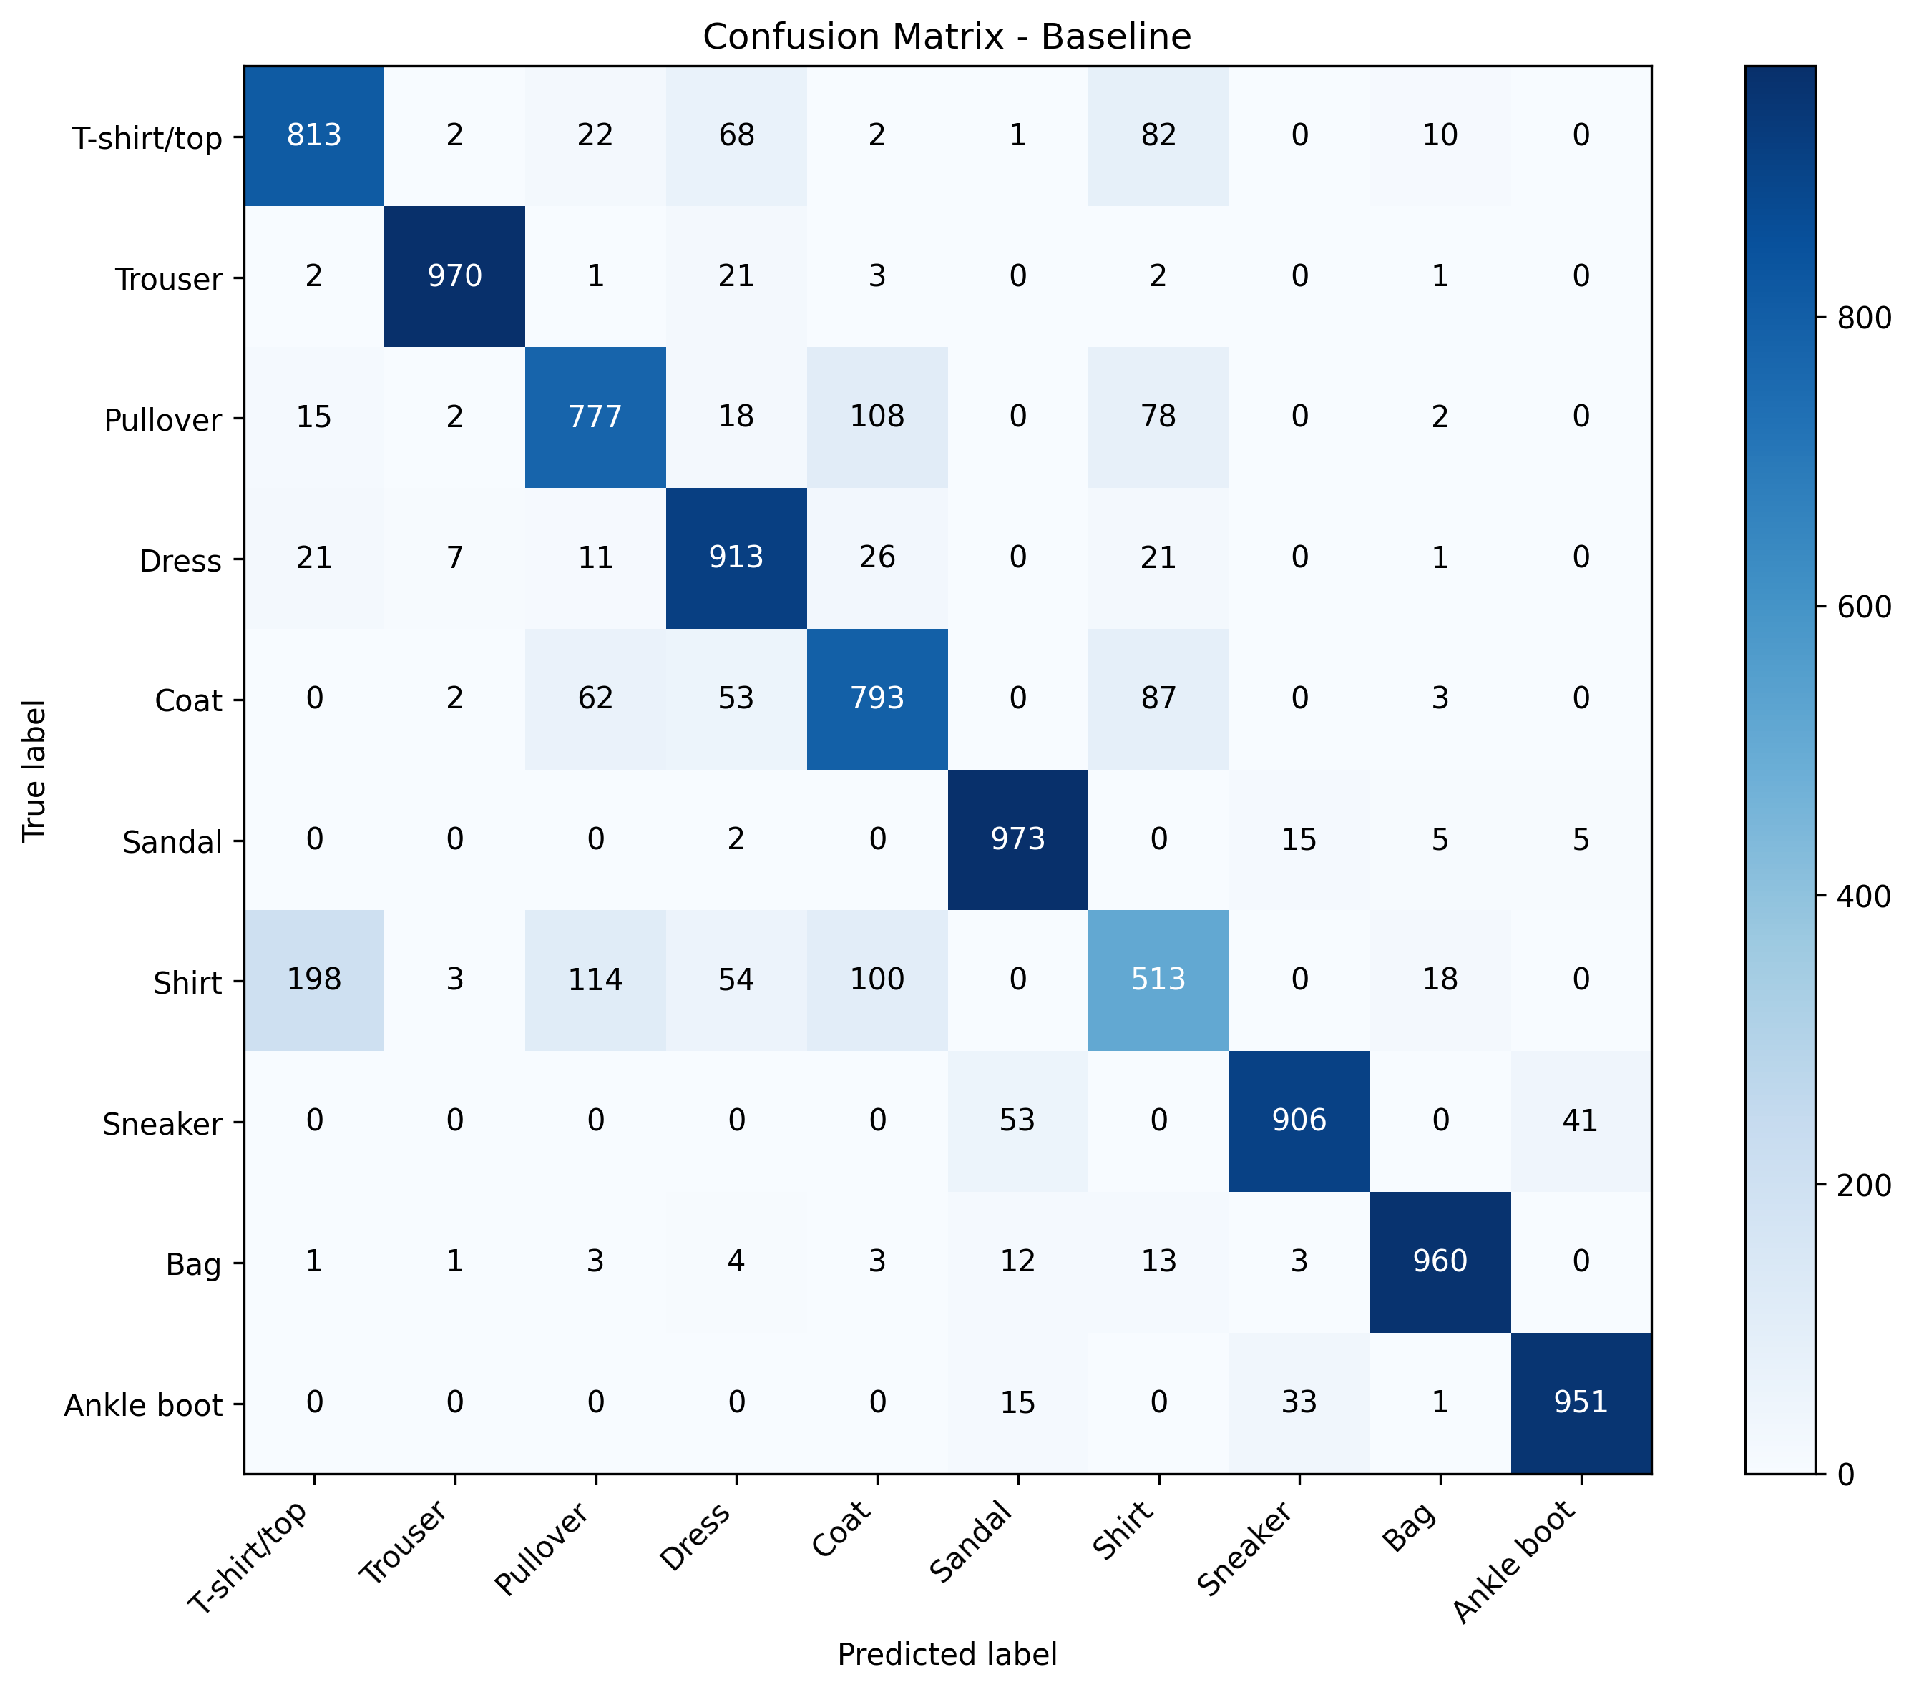
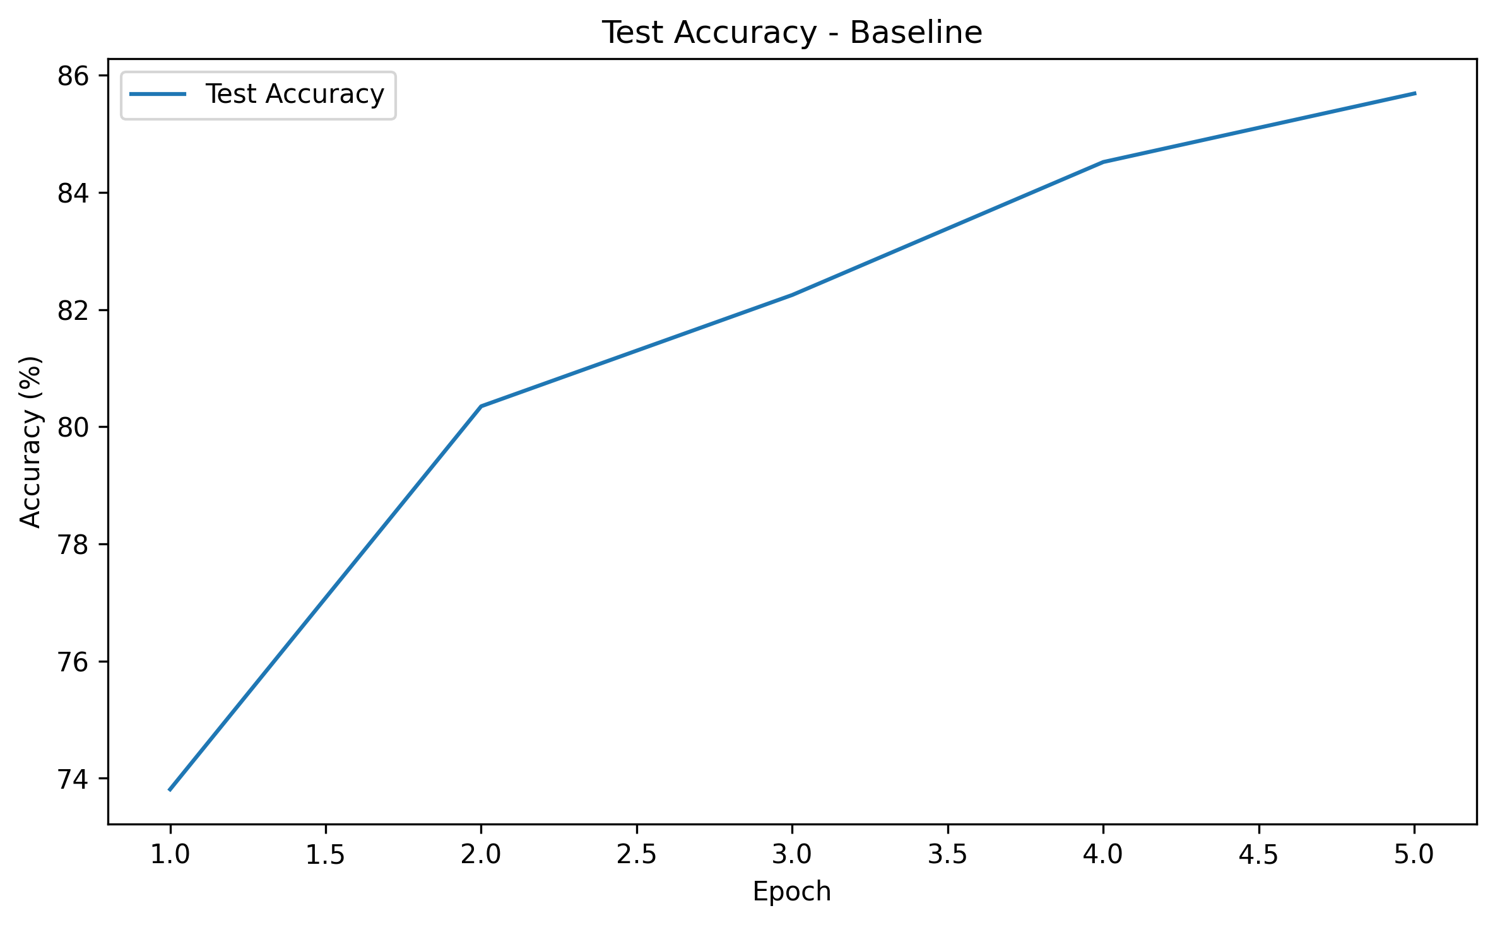
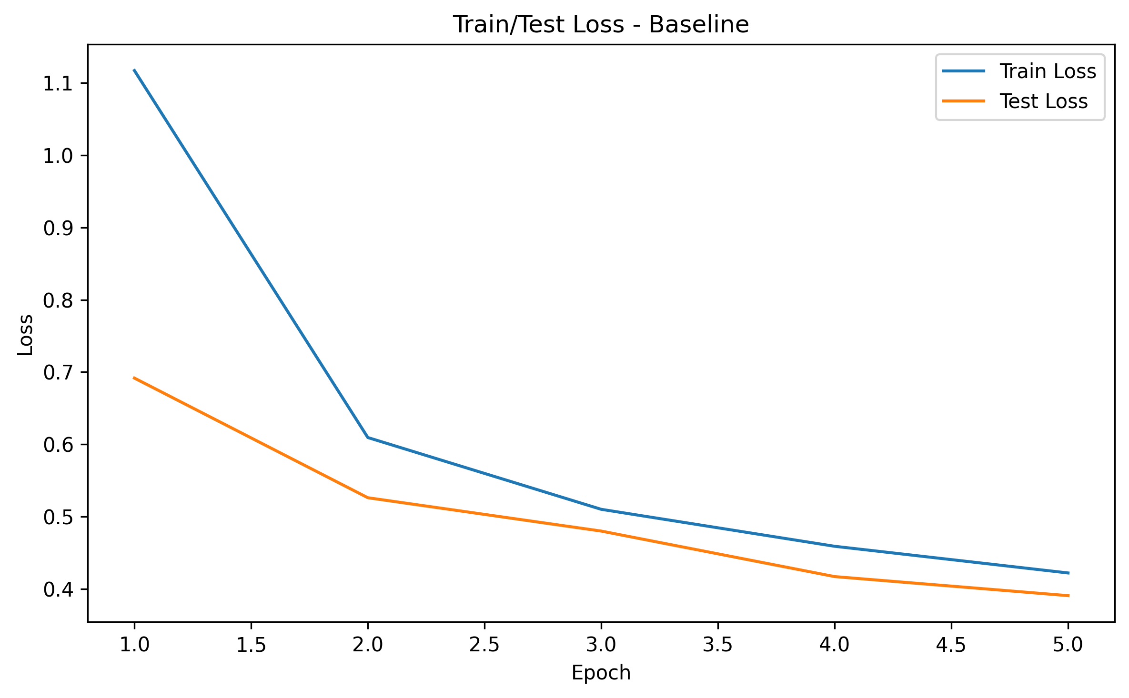
Baseline: experiment result
Accuracy: 85.69%
Loss: 0.390833
Good performance on distinctive classes such as Trouser, Bag, Sandal, and Ankle boot
Main confusion appears among similar upper-body classes: T-shirt/top, Pullover, Coat, and Shirt
Notes:
This result became the reference for all later experiments.
The baseline was already reasonably strong, so later methods had to justify themselves relative to this point.

Slide 6
Mixed Precision: concept, purpose, strengths, limitations
Mixed precision training uses more than one numeric precision during training, typically FP16 and FP32
Purpose: reduce memory usage and potentially improve training efficiency
Advantages: lower memory pressure, possible throughput improvement, relatively clean integration
Disadvantages: hardware-dependent benefit, possible numerical instability, no guarantee of better final accuracy
Notes:
The point of mixed precision is not accuracy by itself.
The point is to reduce computational cost while keeping enough numerical stability during training.
throughpout of the model? which memory

Slide 7
Mixed Precision: implementation in this code
The model architecture was not redesigned
The main computation path was modified using autocast and GradScaler
The training loop changed around forward pass, loss computation, and backward scaling
Data pipeline and optimizer remained the same
Code-level summary
training forward pass moved into mixed precision context
loss scaling added for stable optimization
Implementation idea
baseline architecture stays the same
optimizer stays the same
data pipeline stays the same
only the precision handling changes
Notes:
This was a fair comparison because I changed the precision handling, not the actual model design.
So any difference mainly reflects the effect of mixed precision itself. Do mixed precitious manually

Slide 8
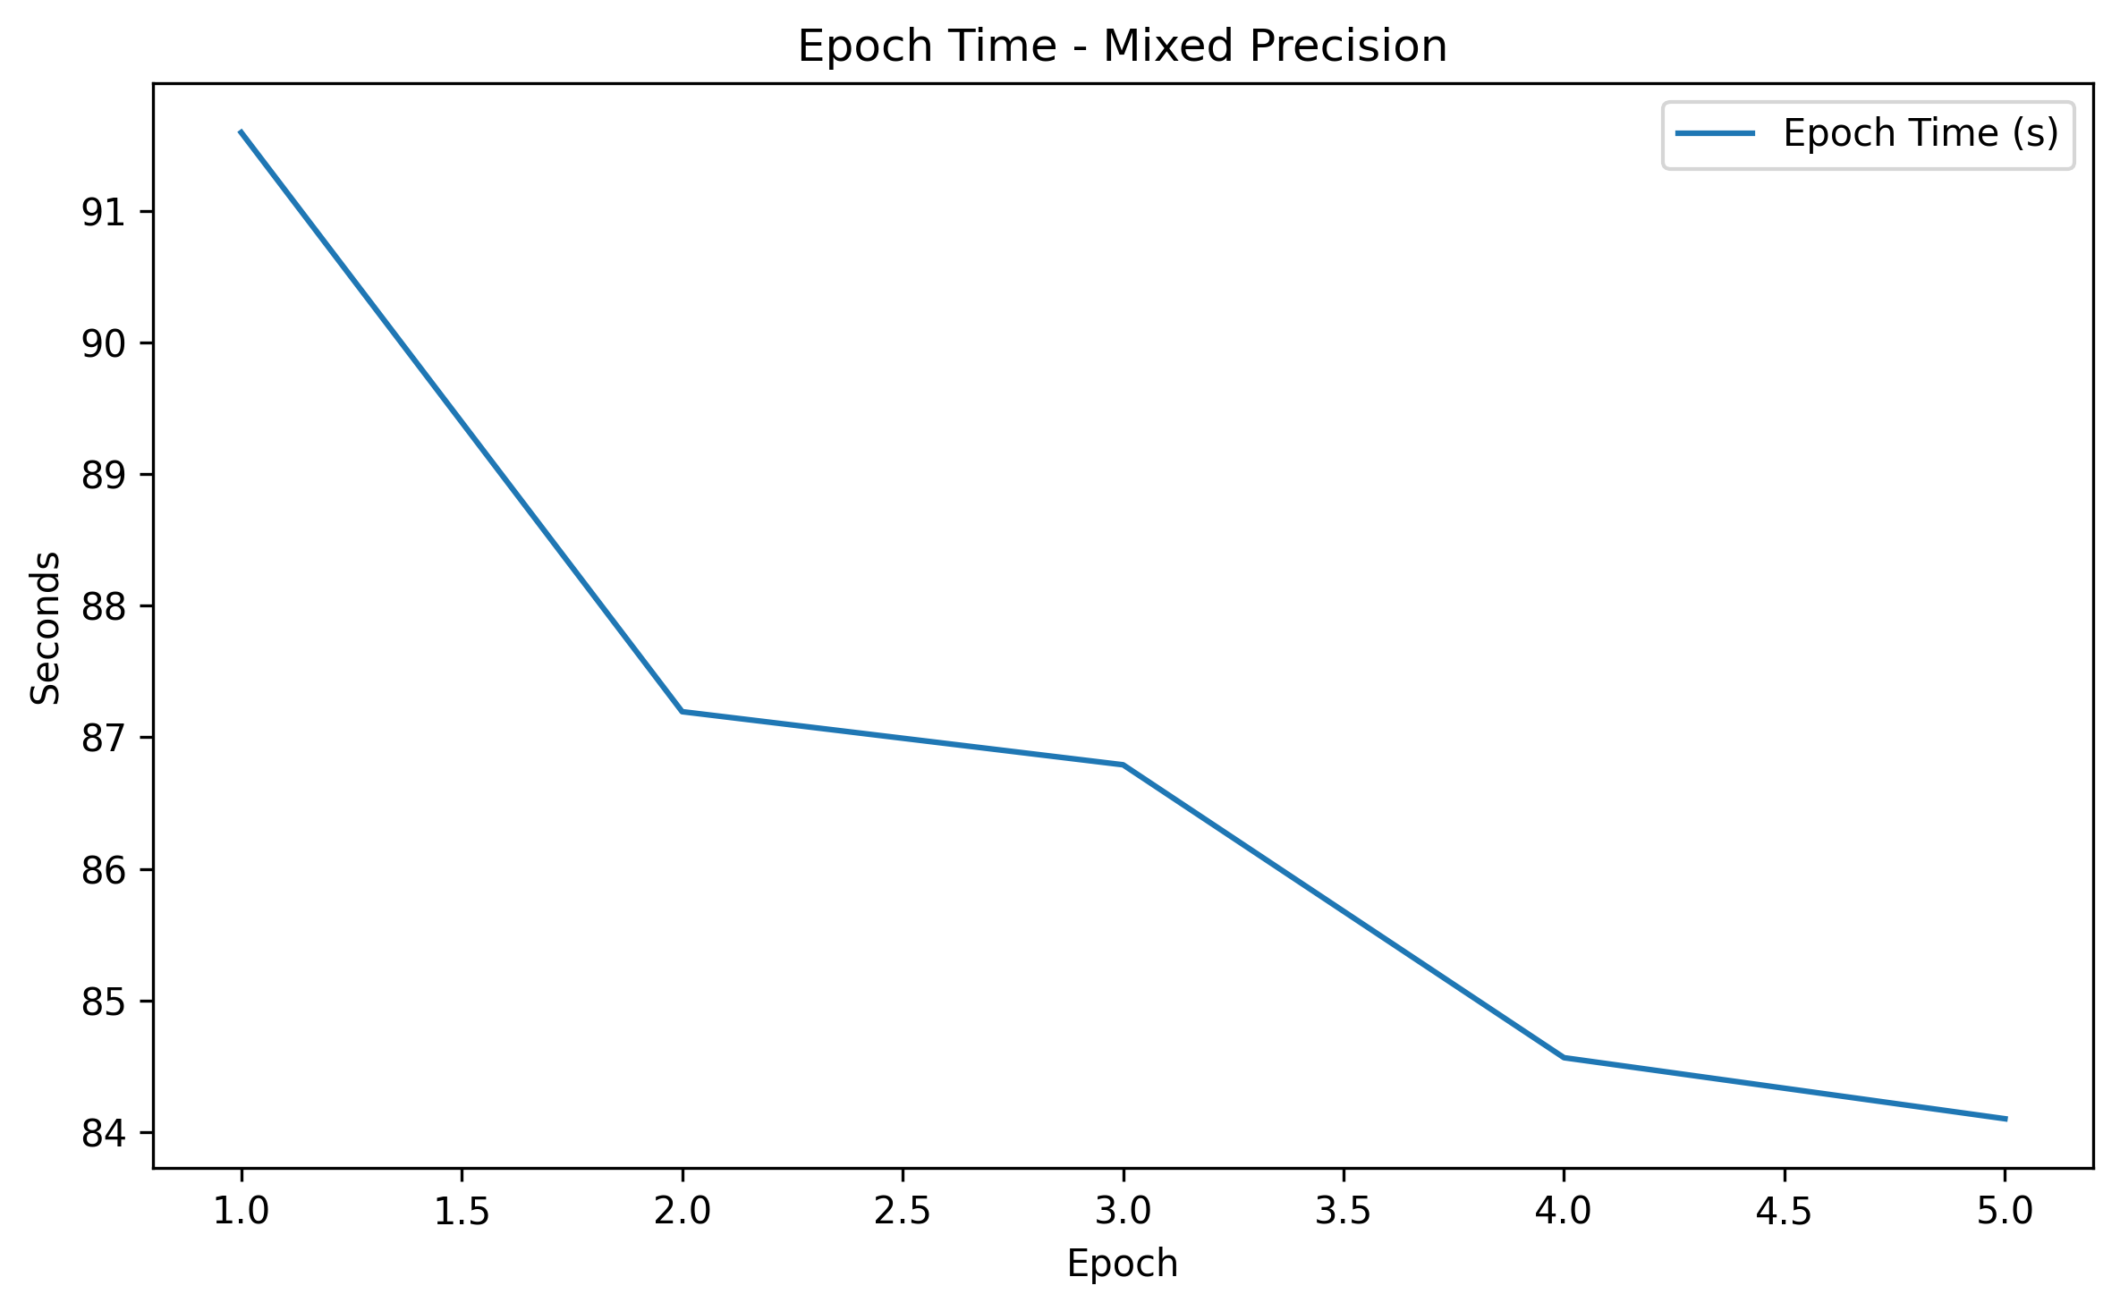
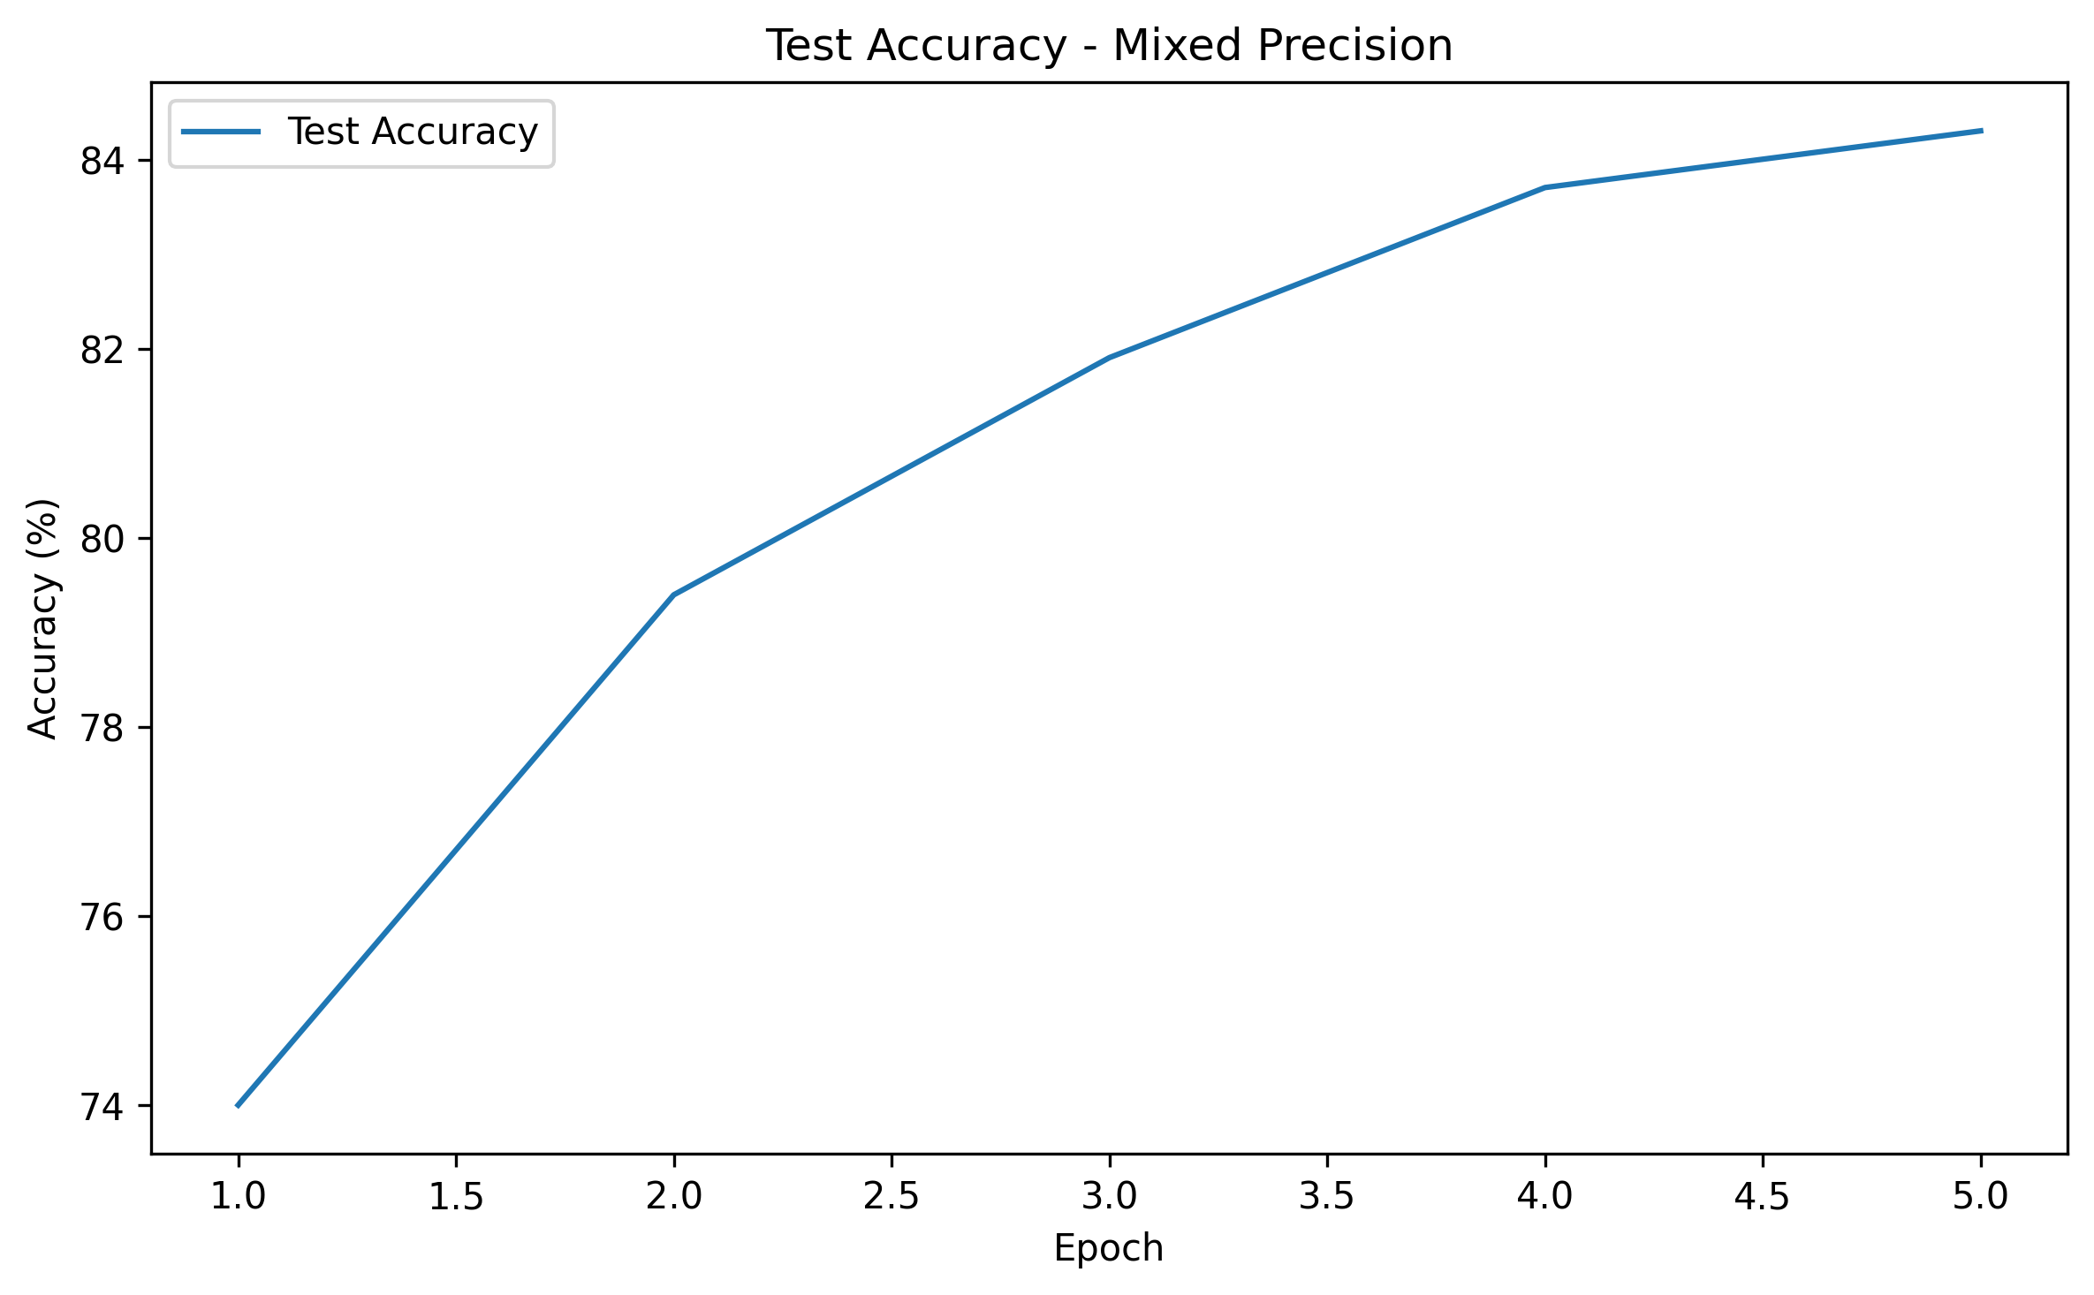
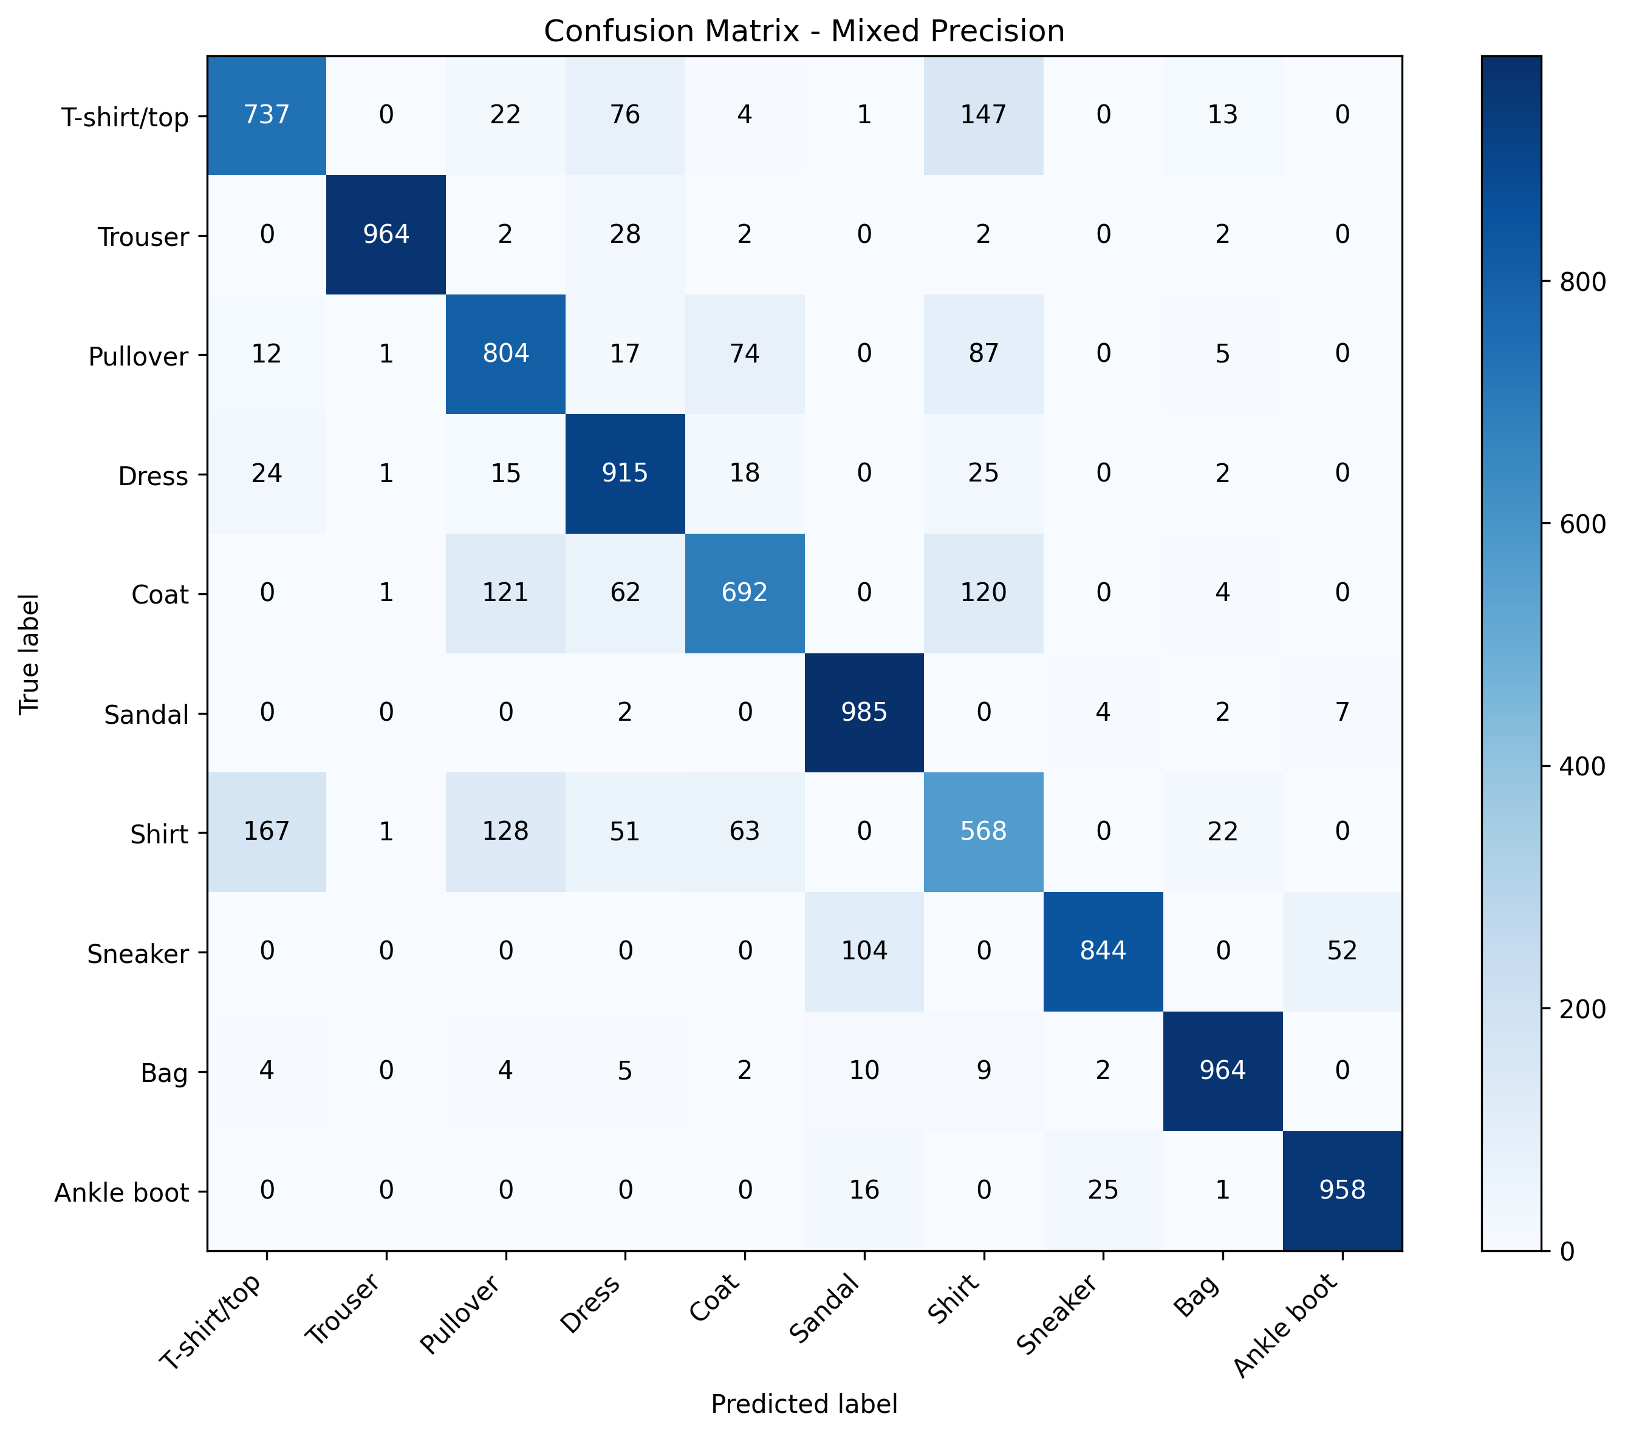
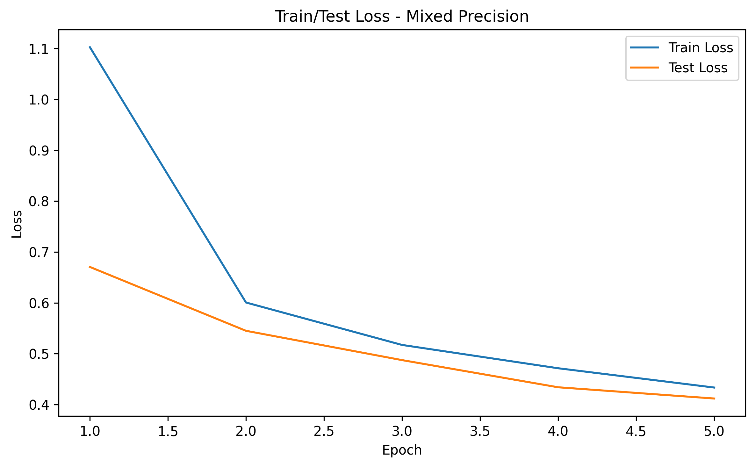
Mixed Precision: experiment result
Accuracy: 84.31%
Loss: 0.411789
Average epoch time: about 86.85 seconds
Slightly worse than baseline
No strong practical advantage in this setup
On Tesla P100, mixed precision was feasible, but it was not the best-performing direction here
Notes:
Mixed precision was feasible on the hardware, but in this experiment it did not improve the final result relative to the baseline.

Slide 9
Quantization: concept, purpose, strengths, limitations
Quantization reduces numerical precision of model parameters, and sometimes activations, to smaller representations such as INT8
Purpose: smaller model, cheaper inference, lower memory footprint, better deployability
Advantages: can reduce model size and inference cost
Disadvantages: may reduce accuracy, may depend on hardware support, and may affect only part of the architecture depending on method
Notes:
Quantization was one of the main topics the professor specifically asked me to study because it directly connects to deployment on smaller devices.

Slide 10
Dynamic Quantization: implementation in this code
I first trained the float baseline model normally
After training, I applied post-training dynamic quantization (PTQ)
The main function used was quantize_dynamic(...)
It was applied only to Linear layers
This was selected as the simpler quantization baseline before moving to QAT
Notes:
This method required relatively little code change compared to QAT.
It was a clean first step to test quantization on the same baseline.

Slide 11
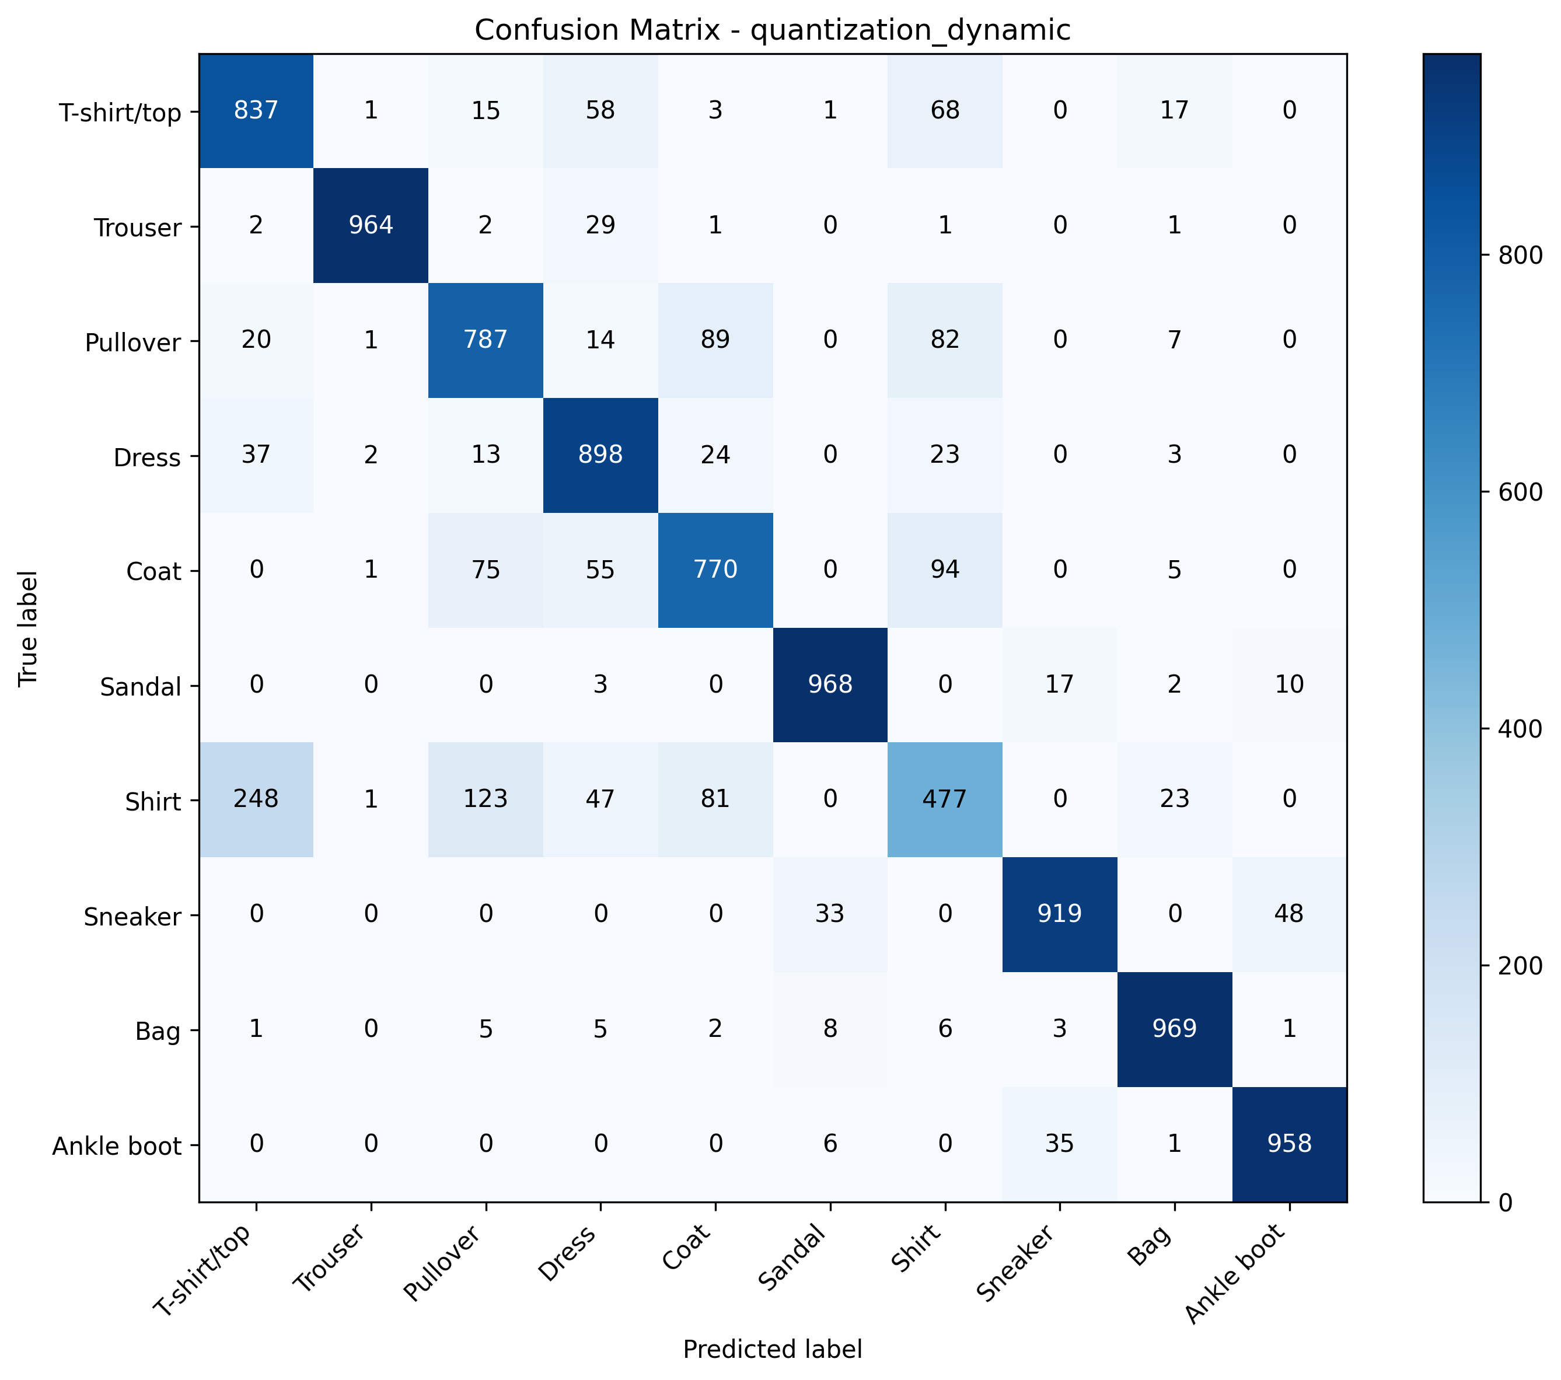
Dynamic Quantization: Experiment result
Float model accuracy: 85.47%
Float model loss: 0.388511
Dynamic quantized model accuracy: 85.47%
Dynamic quantized model loss: 0.389446
Size reduction: 0.41%
Accuracy was preserved, but compression was negligible
Notes:
The likely reason for the weak compression is that the architecture is dominated by convolutional layers, while dynamic quantization only affected the fully connected layers.

Slide 12
QAT: concept, purpose, strengths, limitations
QAT stands for Quantization-Aware Training
Instead of quantizing only after training, the model is trained while simulating quantization effects
Purpose: preserve or improve final quantized accuracy while still achieving real compression
Advantages
can preserve or improve quantized performance
often yields real compression
better suited for deployment than naive post-training quantization
Disadvantages
more code changes than dynamic quantization
more complex to set up
requires explicit quantization preparation logic
Notes:
QAT is a more serious quantization workflow because the model learns under quantization constraints during training rather than being quantized only afterward.

Slide 13
QAT: implementation in this code
Implementation flow
define QAT-capable model
fuse compatible modules
assign QAT config
run prepare_qat(...)
train
convert to final quantized model
QAT required structural preparation of the model
Main additions: QuantStub and DeQuantStub
F.relu was replaced with nn.ReLU
Fusion was introduced where needed
The model was prepared using prepare_qat(...)
After training, the model was converted using convert(...)
Why these changes were necessary
the model must become quantization-aware during training
some operations must be represented in a form compatible with QAT preparation and conversion
Where the changes happened
in model definition
in model preparation before training
in conversion after training
Notes:
Unlike mixed precision or dynamic quantization, QAT required real model-level preparation.
This was not just a wrapper around the training loop.

Slide 14
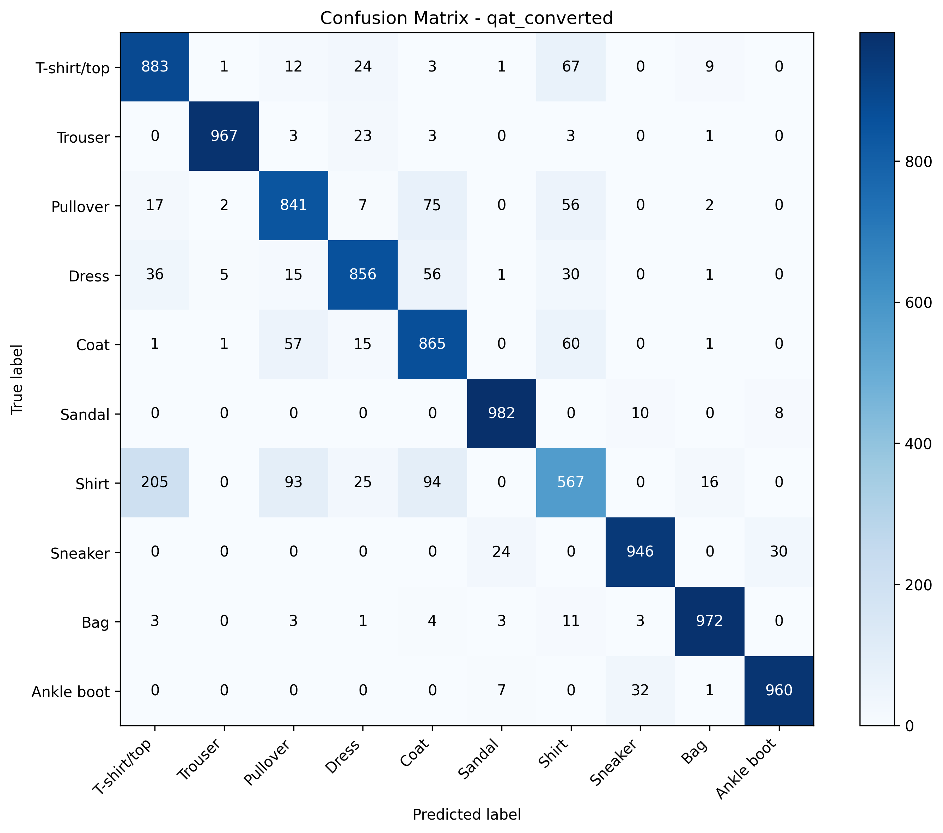

QAT: experiment result
QAT pre-convert accuracy: 88.32%
QAT pre-convert loss: 0.316716
QAT converted accuracy: 88.39%
QAT converted loss: 0.315377
Size reduction: 74.75%
Model size dropped from 16.8257 MB to 4.2491 MB
Best result in the entire study
higher accuracy than baseline
strong compression
best trade-off between performance and deployability
Notes:
QAT gave the best trade-off in the whole study.
It improved both predictive performance and model compression.

Slide 15
Weight Pruning: concept, purpose, strengths, limitations
Weight pruning removes low-importance weights, usually based on small magnitude
Purpose: introduce sparsity and test whether many connections are unnecessary
Advantages
can preserve accuracy surprisingly well
reveals redundancy in the model
often easy to add after training
Disadvantages
zero weights do not automatically mean smaller saved files
sparsity does not always produce real speedup
effect depends on storage format and hardware support
Notes:
This matches the professor’s explanation well: some connections have very small values, and pruning asks whether those connections are really needed.

Slide 16
Weight Pruning: implementation in this code
After baseline-style training, I applied global unstructured pruning
The pruning method used was L1Unstructured and global_unstructured
Pruning was applied to both Conv2d and Linear layers
After pruning, prune.remove(...) was used to remove the reparameterization masks
Implementation logic
train dense model
identify prunable modules
apply global magnitude-based pruning
remove pruning reparameterization
evaluate sparsity and accuracy
Notes:
This experiment isolates pruning as a post-training modification to the same baseline model.

Slide 17


Weight Pruning: experiment result
Dense model accuracy: 85.79%
Dense model loss: 0.380213
Pruned model accuracy: 85.78%
Pruned model loss: 0.381173
Global sparsity: 30.00%
File size reduction: approximately 0%
Accuracy was preserved almost perfectly
30% sparsity was created
But storage size did not decrease meaningfully
Reason: the model remained stored in dense format even though many values became zero
Notes:
So pruning worked as a sparsity method, but not as a true file-level compression method in this implementation because the tensors were still stored in dense format.

Slide 18
Structured Sparsity: concept, purpose, strengths, limitations
Structured sparsity means the sparsity follows an organized structure rather than isolated scattered zero values
Typical structured units include channels, filters, and full neurons
Structured pruning is a practical way to create structured sparsity
Advantages
structured pattern is easier to exploit than scattered zeros
conceptually closer to deployment-oriented sparsity
Disadvantages
much more aggressive than unstructured pruning
can destroy model performance if applied directly
hardware support matters a lot
On Tesla P100, this is only a structured pruning / structured sparsity-style study
It is not Ampere sparse tensor acceleration
Notes:
This was another topic the professor specifically wanted me to understand.
The key point is that structured sparsity is conceptually different from scattered unstructured zero weights.

Slide 19
Structured Pruning: implementation in this code
After training, I applied structured pruning using ln_structured(...)
Pruning was applied along dim=0
This affected output channels in Conv2d layers and structured output units in Linear layers
After pruning, prune.remove(...) was used
Important limitation: on Tesla P100 this should be interpreted as structured pruning / structured sparsity-style behavior, not Ampere sparse acceleration
Implementation flow
train dense model
apply structured pruning
remove masks
compute structured sparsity
evaluate performance
Notes:
This point is important because the professor explicitly mentioned the hardware limitation.
I can study the concept here, but I should not claim Ampere-style sparse tensor acceleration on this GPU.

Slide 20
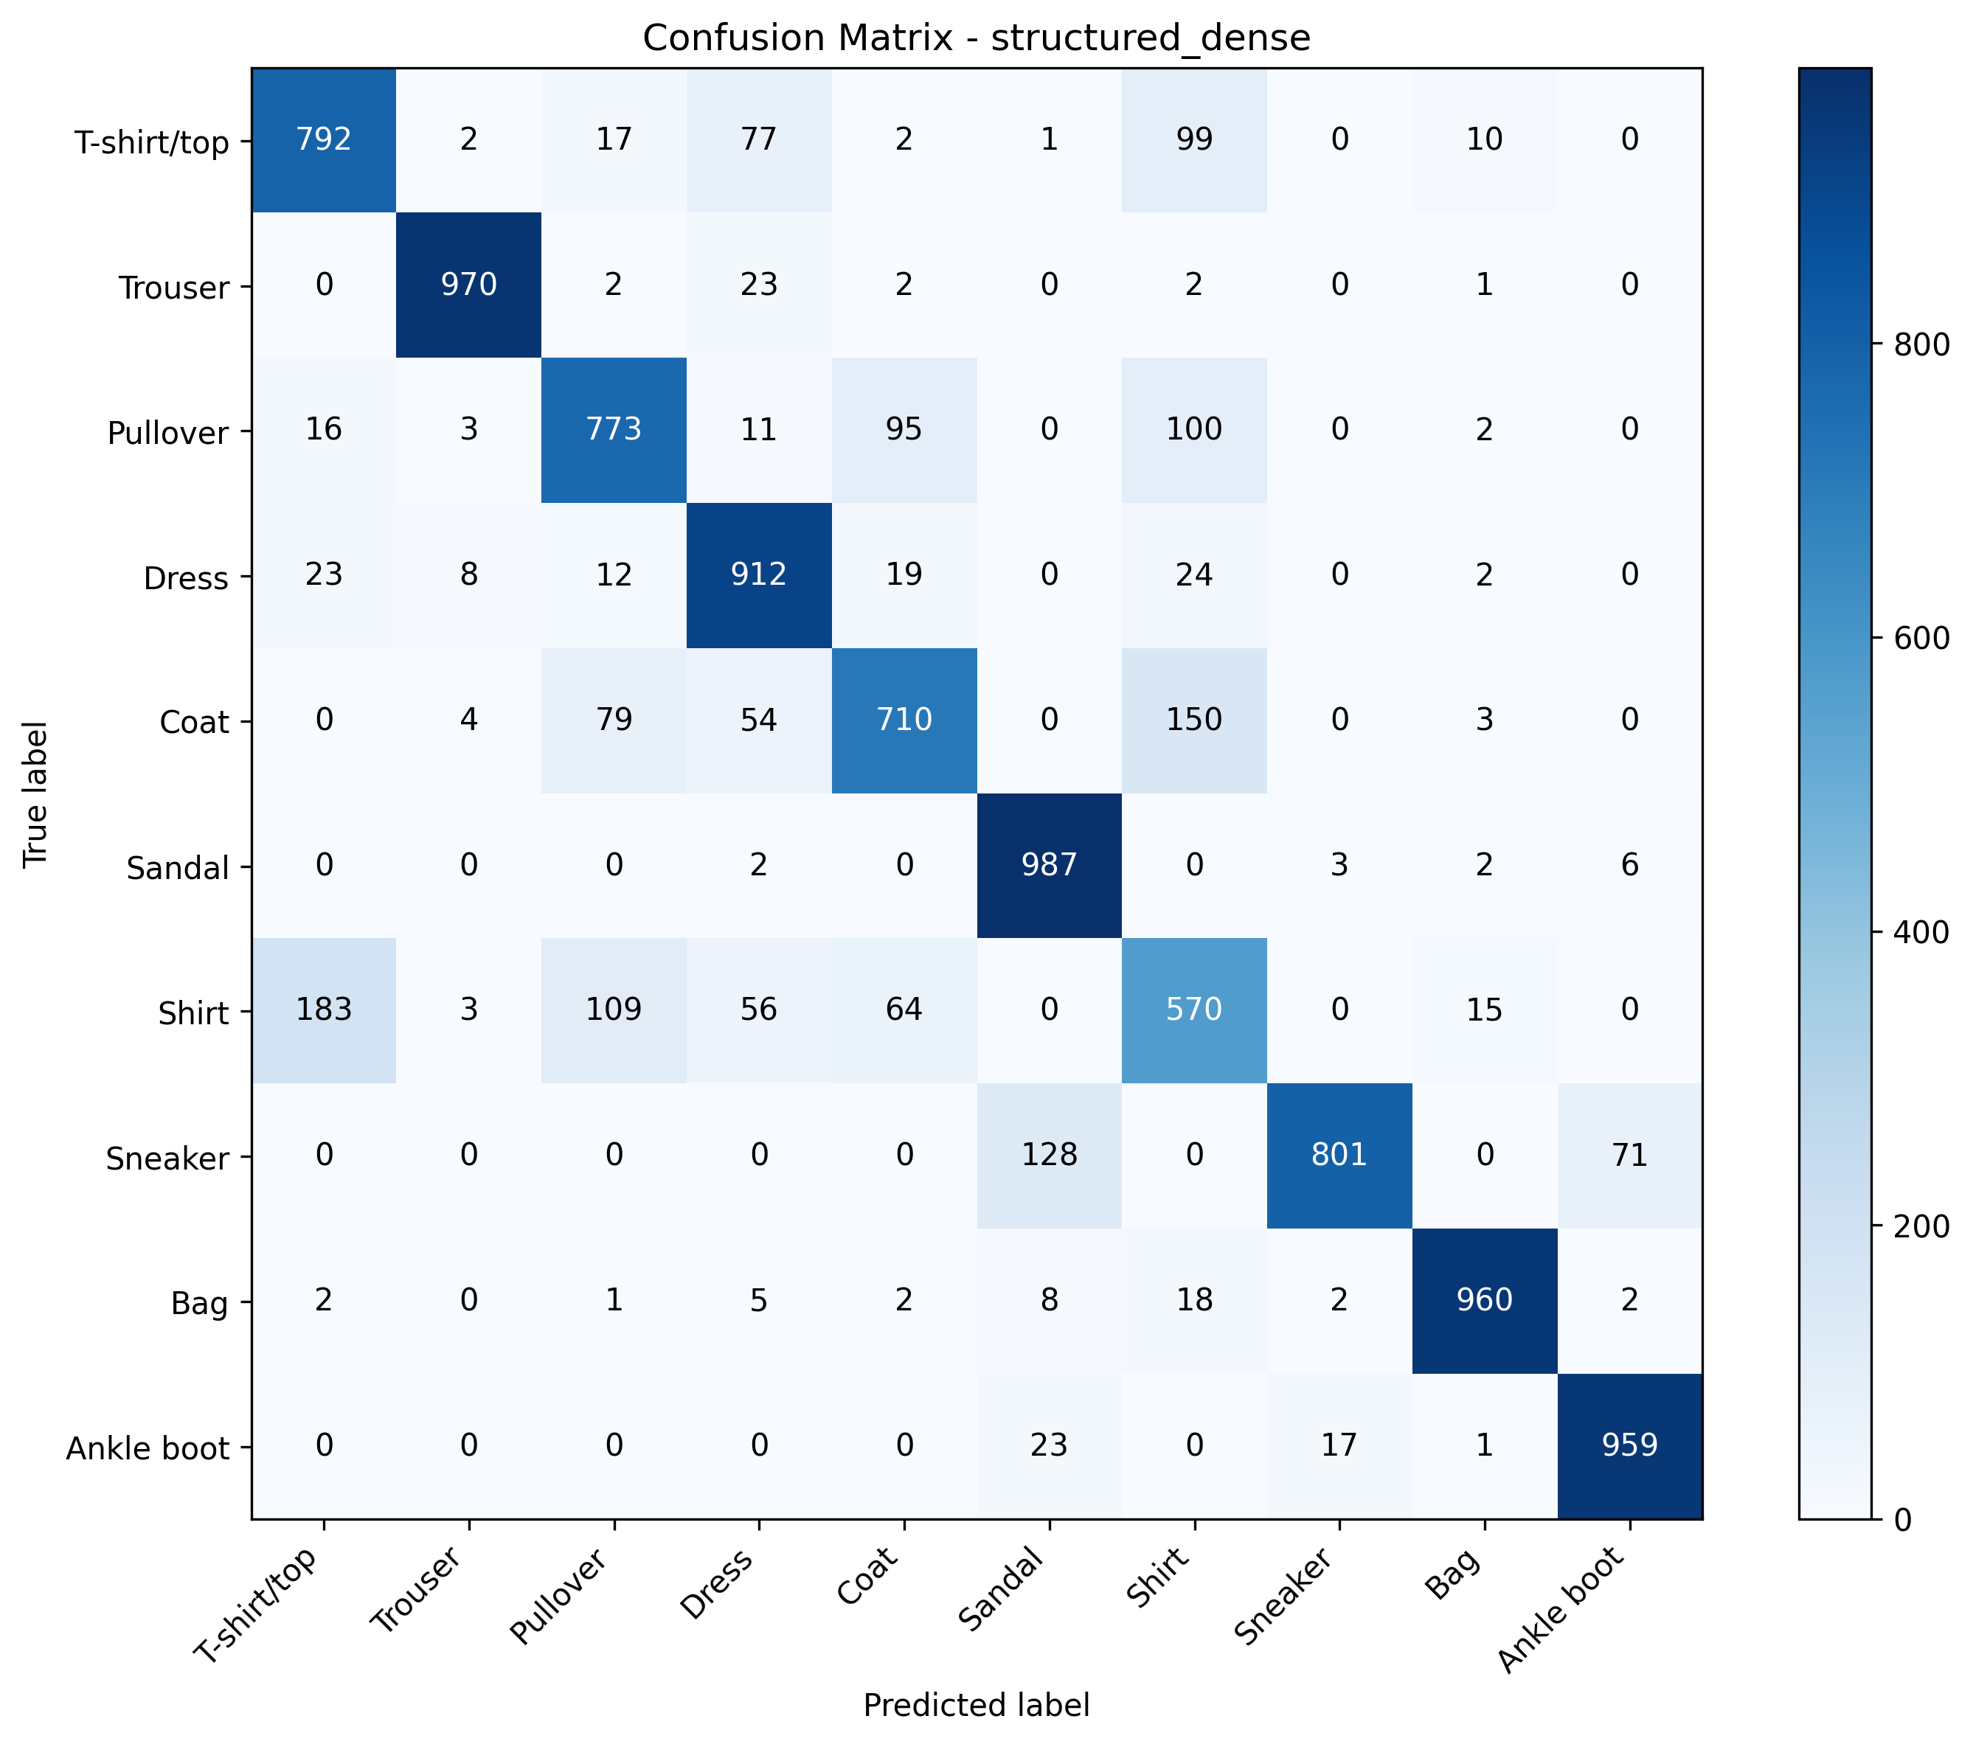
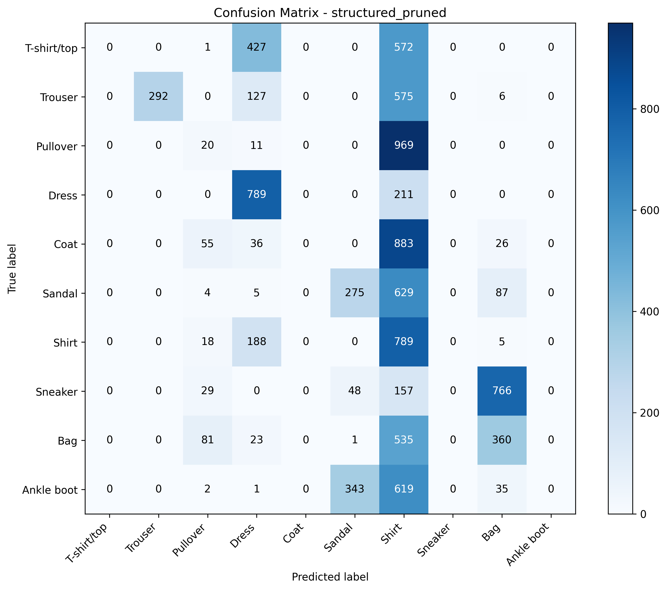
Structured Pruning: experiment result
Dense model accuracy: 84.34%
Dense model loss: 0.426328
Structured-pruned model accuracy: 25.25%
Structured-pruned model loss: 2.179118
Zero-weight sparsity: 30.04%
Structured sparsity: 30.02%
File size reduction: approximately 0%
Performance collapsed
Structured pruning was too destructive in this form
Without recovery or fine-tuning after pruning, the model lost too much representational capacity
Notes:
This result shows that direct structured pruning was too aggressive for this baseline.
Without a recovery or fine-tuning stage, the model lost too much representational capacity.

Slide 21
Final comparison
Method | Accuracy | Loss | Compression / Sparsity | Main takeaway
Baseline | 85.69% | 0.390833 | Reference | Control model
Mixed Precision | 84.31% | 0.411789 | No strong gain | Slightly worse on this GPU
Dynamic Quantization | 85.47% | 0.389446 | 0.41% size reduction | Accuracy preserved, compression weak
QAT Converted | 88.39% | 0.315377 | 74.75% size reduction | Best overall
Weight Pruning | 85.78% | 0.381173 | 30% sparsity | Accuracy preserved, no real file compression
Structured Pruning | 25.25% | 2.179118 | 30.02% structured sparsity | Too destructive without recovery
Notes:
The comparison shows that these methods are not interchangeable.
They affect the model in very different ways, and QAT was clearly the strongest method in this setup.

Slide 22
Best and worst methods in this study
Best overall method: QAT
Accuracy: 88.39%
Loss: 0.315377
Size reduction: 74.75%
Reason: it achieved both stronger predictive performance and substantial compression
Worst-performing method: Structured Pruning
Accuracy: 25.25%
Loss: 2.179118
Structured sparsity: 30.02%
Reason: it removed full structured units and was too destructive without recovery or fine-tuning
Notes:
If I summarize the study very directly:
QAT was the best overall method because it improved both accuracy and compression.
Structured pruning was the worst-performing method because it caused a severe collapse in model performance.

Slide 23
Final conclusion
Main findings
Mixed precision was feasible, but not beneficial enough in this setup
Dynamic quantization preserved accuracy, but compression was weak
Weight pruning created meaningful sparsity while preserving accuracy
Structured pruning was too destructive without recovery
QAT gave the strongest result
best accuracy
strongest compression
best deployment trade-off
Final conclusion
Under this baseline, hardware, and dataset, QAT was the most effective method.
Notes:
If I had to select one method from this study as the most practically useful, it would be QAT.

Slide 24
Method | Main code change
Baseline | standard train/test + metrics export
Mixed Precision | autocast, GradScaler
Dynamic Quantization | quantize_dynamic(...) after training
QAT | QuantStub, DeQuantStub, nn.ReLU, fusion, prepare_qat, convert
Weight Pruning | global_unstructured, L1Unstructured, prune.remove
Structured Pruning | ln_structured(..., dim=0), then prune.remove
Code-level summary of modifications
Notes:
This slide makes it clear that every method was implemented by modifying a specific part of the same baseline code, rather than replacing the entire experiment.

