Slide 1



(we starting off small)
WHY YOU SHOULD
BUY ME STUFF
FOR CHRISTMAS
A presentation by Your Favourite Child 😇
(the other one is also fine)
Notes:
Open with a big dramatic pause. Cube spin. Then: "Mum, Dad, sit down. This is important."

Slide 2


FIRST: HOW GOOD I'VE BEEN
Source: trust me 📊
Notes:
Fake statistics are the whole point. Say "Source: trust me" with a straight face.

Slide 3

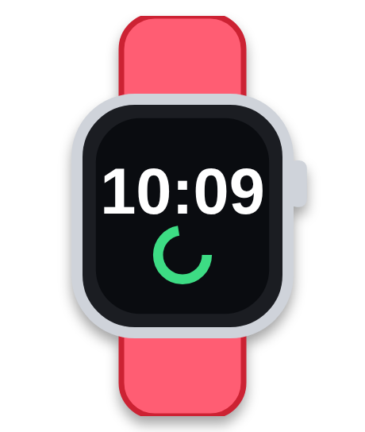





THE LIST
(it's honestly not that long)
Apple Watch Series 8 (used)
AirPods Pro, 1st gen (used)
MagSafe Charger (used)
£80–£100
£40–£50
~£20–£25
Nail buffer
Eyebrow razor
Mouse pad
~£3
£3–£5
£5–£15
Notes:
Quick overview. Keep it light: "It is honestly not that long."

Slide 4

Item #1: Apple Watch Series 8 (used, £80–£100)
THE APPLE WATCH
✅ Tells the time (revolutionary)
✅ Counts my steps. Fitness era. 🏃
✅ Makes me 14% cooler*
✅ I will take SO much care of it
*scientifically proven by me
Notes:
Reason #1: the watch. Keep it silly but sincere.

Slide 5

Item #2: AirPods Pro (used, £40–£50)
THE AIRPODS
🎵 Pair with an iPhone in ONE TAP. Like magic.
🔊 "Dinner's ready" but in 3D surround sound
🚗 Car journey playlist (I will be a great DJ)
🧘 Peace and quiet. For everyone. Honestly.
Notes:
Reason #2: AirPods. The one-tap pairing is the real reason, remember it for later.

Slide 6


BUT WAIT!!!
🚨 FAKE AIRPODS ARE EVERYWHERE 🚨
9 out of 10 fake AirPods are fake*
*I did the maths
Notes:
Slam the energy up. The siren is the point. Say the stat like a news reporter.

Slide 7


HOW TO SPOT A FAKE
REAL ✅
FAKE ❌
A serial number you can check
Pop-up on an iPhone
Sounds like music
Serial number: "trust me bro"
Sounds like a bin
Arrives in a sandwich bag
That's why I need to be THERE when we buy them 👀
Notes:
This is why she needs to be there in person when they are bought.

Slide 8



THE PLAN
Money, not merch
You give me the MONEY
Later, we go shopping TOGETHER
We pick the REAL ones
I set them up on my iPhone
(Apple Watch + AirPods only. Everything else on the list can just be wrapped. Please wrap.)
Notes:
The big idea: money instead of the actual items, for the watch and AirPods only.

Slide 9


THE iPHONE PROBLEM
An Apple Watch has to be set up with an iPhone.
AirPods work BEST with an iPhone (one tap, done).
iPhones owned by Mum & Dad: 0. Owned by me: 1.
Notes:
Keep this one quick and factual-but-funny. The Watch literally needs an iPhone to set up.

Slide 10


WHY NOT ASK BIG BRO?
He DOES own an iPhone. 📱
But he's BOOKED and BUSY all holiday 📅
(He said sorry. I said it's fine. It is not fine.)
Calendar status: FULL
Notes:
Nothing against Big Bro: he is just busy. Say it with dramatic sadness.

Slide 11


HOW THE SHOPPING TRIP WORKS
1
We go together (you can carry the bags 🛍️)
2
We check the serial number is REAL 🔍
3
You pay. I say THANK YOU. Loudly.
4
I set it up on my iPhone. Done. ✨
Notes:
Reassure them: they stay in control and can come along.

Slide 12
THE SMALL STUFF
MagSafe Charger
Nail buffer
~£20–£25
~£3
Wires are so last decade.
Three pounds. Basically free.
Eyebrow razor
Mouse pad
£3–£5
£5–£15
Eyebrows: tidy. Confidence: 100%.
Every mouse deserves a home.
Notes:
Quickfire round: one joke each.

Slide 13


TOTAL COST
£151 – £198
That's less than 55p a day for a whole year*
*£198 ÷ 365 days = 54p. I did the maths. Twice.
Notes:
Do the maths out loud: 198 divided by 365 is about 54p.

Slide 14

WHAT PEOPLE ARE SAYING
⭐⭐⭐⭐⭐
⭐⭐⭐⭐⭐
⭐⭐⭐⭐⭐
"Best child ever. Would buy presents for again."
"Very responsible. Super polite. Great hair."
"Terms & conditions: includes extra hugs and thank-yous in 3 languages."
— Mum (probably)
— Dad (hopefully)
— Me, the child
Notes:
Read these in a posh voice.

Slide 15


SO... IS THAT A YES?
YES
NO
Notes:
Pause. Make eye contact. Click YES (or NO, if you want to see what happens).

Slide 16


THANK YOU!!!
You're the best parents ever. (And I mean it.) ❤️
Thank you for coming to my TED Talk 🎤
Notes:
Big finish. Hug time.

Slide 17
WRONG BUTTON 😭
TRY AGAIN
Notes:
Only shows up if someone clicks NO.

