Slide 1
Text Summarization
Using deep learning
Ibrahim (011213204)
Tarun Chandra Das (011221498)
Md. Mahmud Hasan (0112230995)
Sanjida Hossin (0112231039)
Md. Rezwan Al Refat (01124110442)

Slide 2
Introduction:
Text summarization aims to condense lengthy text into concise, meaningful summaries while retaining the key information. Traditional extractive methods, which select sentences from the original text, are often less coherent than abstractive methods. Seq2Seq models, especially with attention mechanisms, have demonstrated significant potential in generating fluent and meaningful summaries, making them a cornerstone for abstractive summarization tasks.

Slide 3
Previous Research Works
Numerous studies have explored text summarization using machine learning: Extractive Approaches: Early methods, such as TextRank and LexRank, relied on graph-based ranking to identify the most important sentences. Abstractive Approaches: Neural networks introduced Seq2Seq models (e.g., Sutskever et al., 2014) for machine translation, later adapted for text summarization.

Slide 4
Research Gap
Existing Seq2Seq models often struggle with coherence and factual consistency in abstractive summarization.
There is limited work on optimizing Seq2Seq models for resource-constrained environments or domain-specific datasets.

Slide 5
Motivation
This project addresses the need for:
A lightweight yet effective abstractive summarization model. Improved contextual understanding using attention mechanisms in Seq2Seq architectures. Enhanced performance on domain-specific datasets (e.g., news, medical, or legal documents), bridging the gap between state-of-the-art research and practical applications.

Slide 6
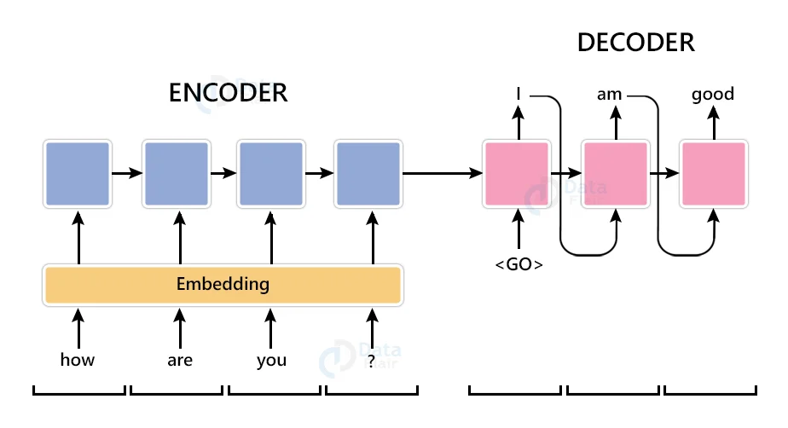
Proposed Machine Learning Model:
Encoder: Embedding layer for input tokens.
Decoder: LSTM layers with initial hidden states passed from the encoder.
Output Layer: Dense layer with a softmax activation to predict the next token.

Slide 7
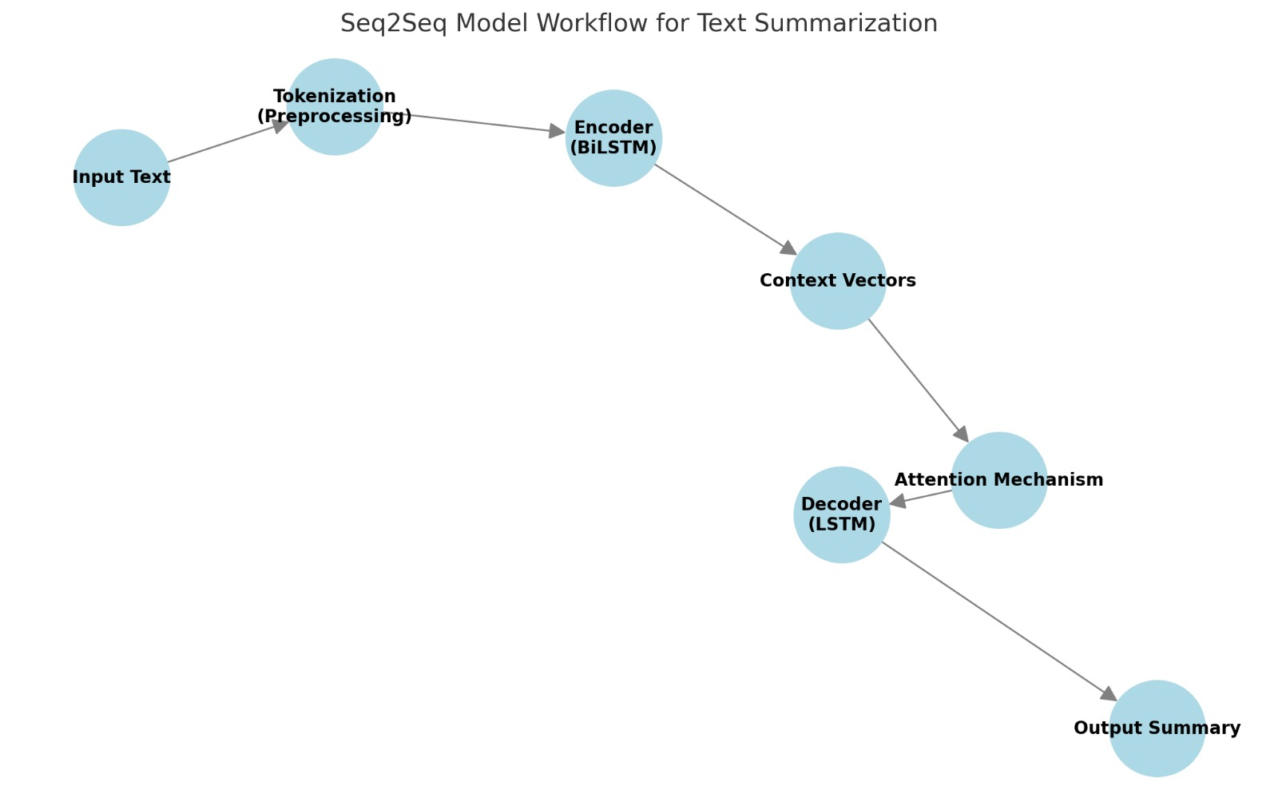
Workflow:
Input text is tokenized and fed into the encoder.
The encoder produces context vectors, passed to the decoder along with attention scores.
The decoder generates the summary iteratively, conditioned on the previously generated token.

Slide 8
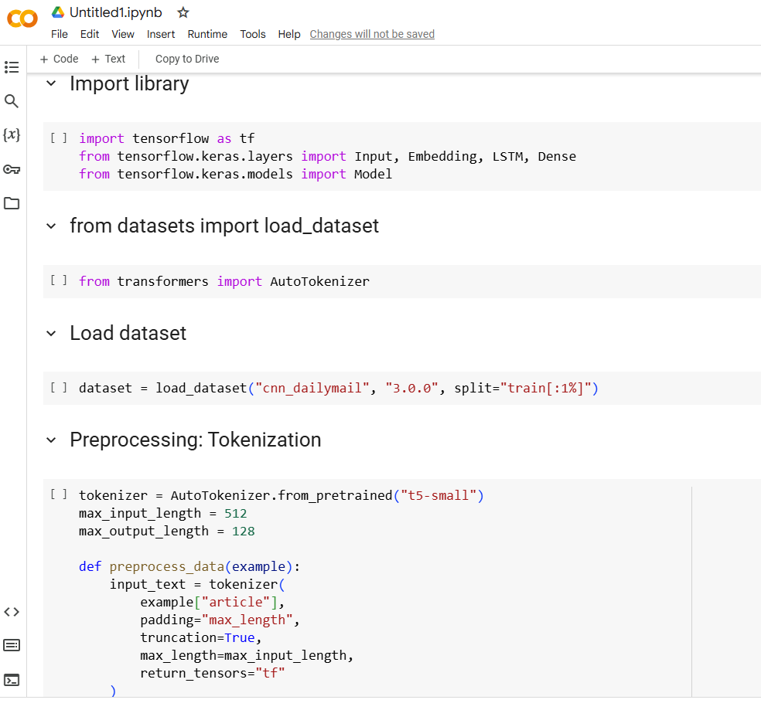
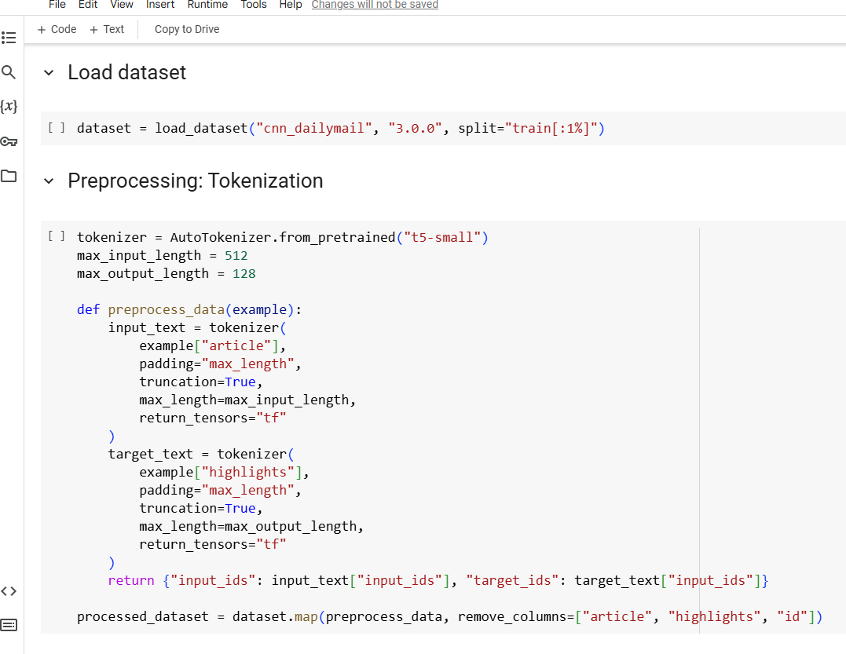
Coding…

Slide 9
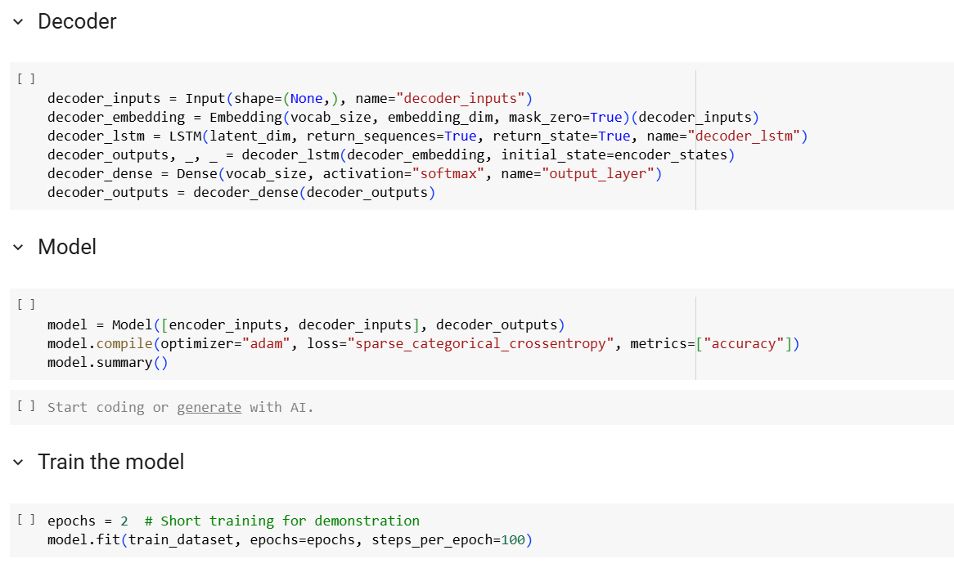
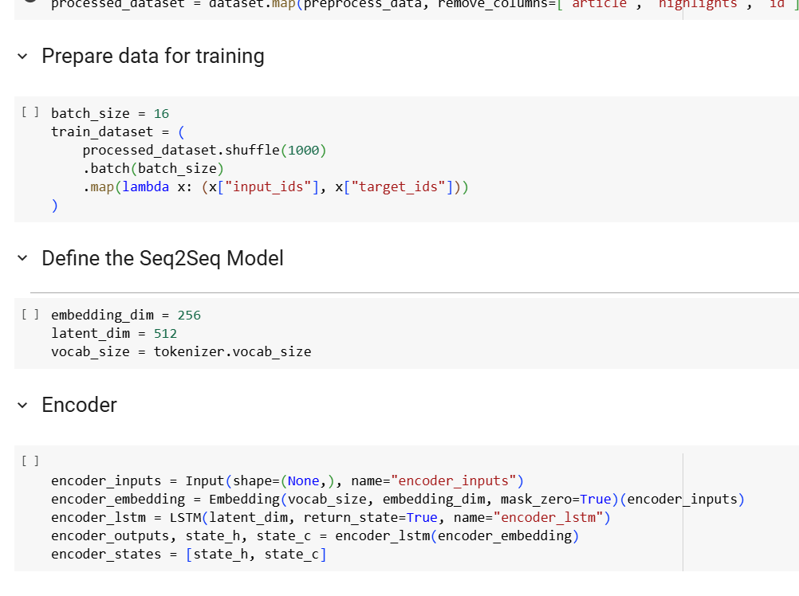
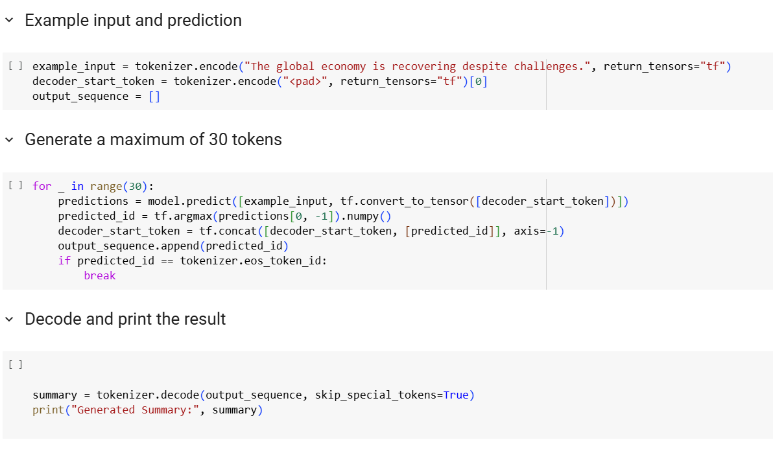
Coding…

Slide 10
Thank you, Everyone

