Slide 1

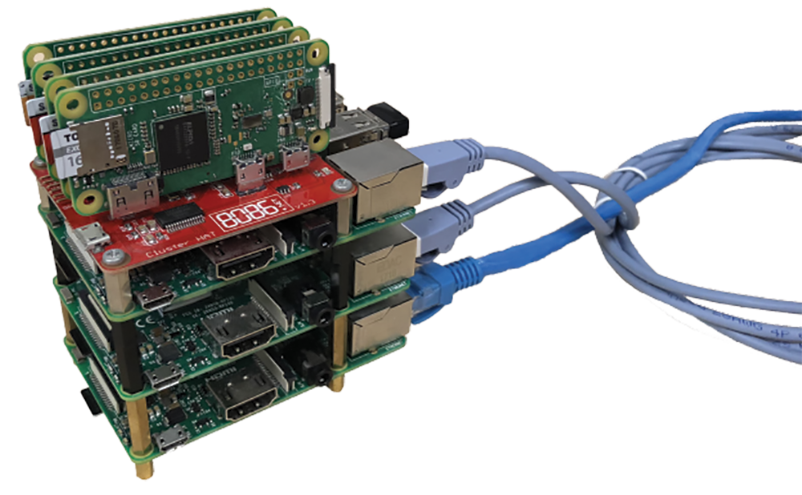
# ./prowler
Timothy Liu
Wong Chi Seng
Faith See
>>> always_on_guard()
PROWLER is always monitoring your network and searching for devices with weak security.
|
|
|
|
|
|
|
>>> why_prowler()
Many security breaches are caused by weak device passwords. We built a tool to alert our users of vulnerable devices on their network.
Cluster Nodes
4 × Raspberry Pi Zero
Controller
Raspberry Pi 3
Cluster Nodes
2 × Raspberry Pi 3
External Network
>>> prowler.get_software()
- python3
- dispy (distributed computing for python)
- Raspbian (Debian Stretch)
01
02
03
04
05
SCAN
Scan network for any online devices and log them for testing
DETERMINE
Determine the open ports and type/OS of device
ASSOCIATE
Associate the open ports and the OS to common services e.g. SSH or VNC
TEST
Test devices against a dictionary of factory default and common credentials
NOTIFY
Notify the network administrator of any potential security issues

