Slide 1
Prowler
Network Vulnerability Scanner
Timothy Liu
Wong Chi Seng
Faith See
SINGAPORE UNIVERSITY OF TECHNOLOGY AND DESIGN
https://tlkh.github.io/prowler

Slide 2
Prowler
Early stage development project
Distributed Network vulnerability scanner
Detect and notify network admins of weakly secured devices
Overall network report (prevent unpleasant surprises)

Slide 3
Prowler
List of addresses/hostname to scan
Specific subnet, or by passively monitoring traffic
Controller distribute list of targets to worker nodes
Controller
Worker Node
Network
Worker Node
Worker Node
Worker Node
Worker Node
Worker Node

Slide 4
Prowler
List of addresses/hostname to scan
Specific subnet, or by passively monitoring traffic
Controller distribute list of targets to worker nodes
Worker node performs the scan and evaluation
PING
Device
online
NMAP
EVAL
DASHBOARD
Fingerprint
Report

Slide 5
Prowler
List of addresses/hostname to scan
Specific subnet, or by passively monitoring traffic
Controller distribute list of targets to worker nodes
Worker node performs the scan and evaluation
PING
Device
online
NMAP
EVAL
DASHBOARD
Fingerprint
Report

Slide 6
Evaluation
Current “toy” implementation
Detect if 22/SSH is open, perform dictionary attack with common credentials
Planned full implementation
Determine vendor/device from MAC address
Perform more curated attack (device/vendor/OS wordlist)
If other ports e.g. 80/HTTP is open, perform webapp vulnerability assessment
Etc, etc…

Slide 7
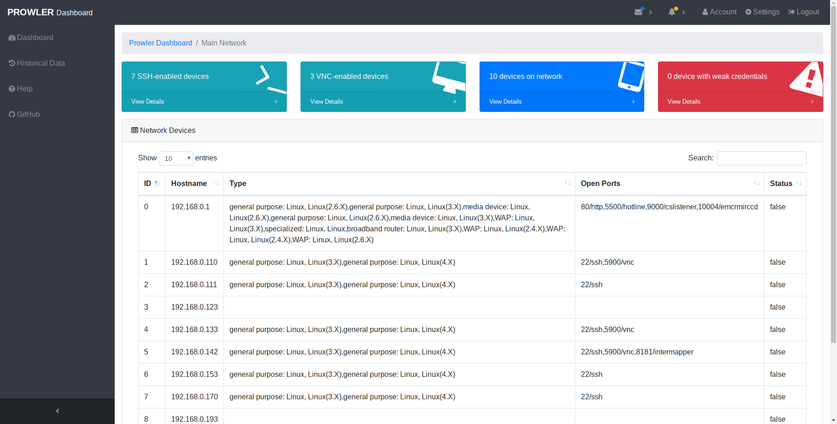
Prowler Dashboard

Slide 9
Summary of Network devices

Slide 10
Number of SSH Devices

Slide 11
List of Network devices

Slide 12
Linux Device
exposed SSH and VNC ports

Slide 13
ROUTER

