Slide 1

Senses.
Are.
Precious.

Slide 2
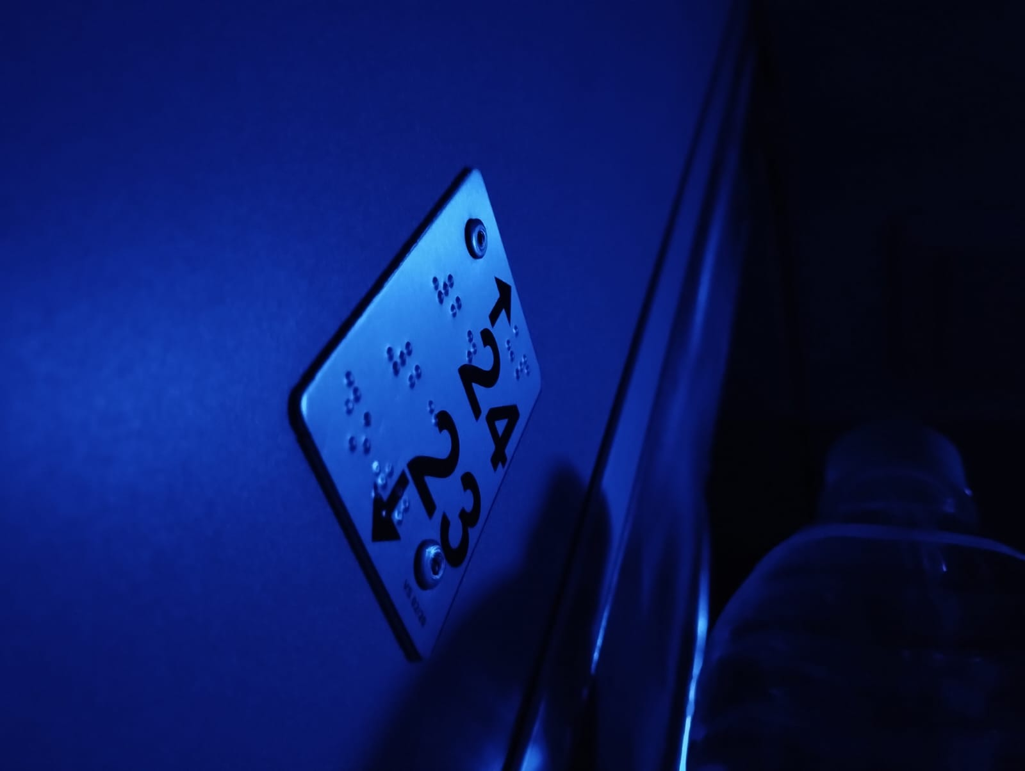

Slide 3
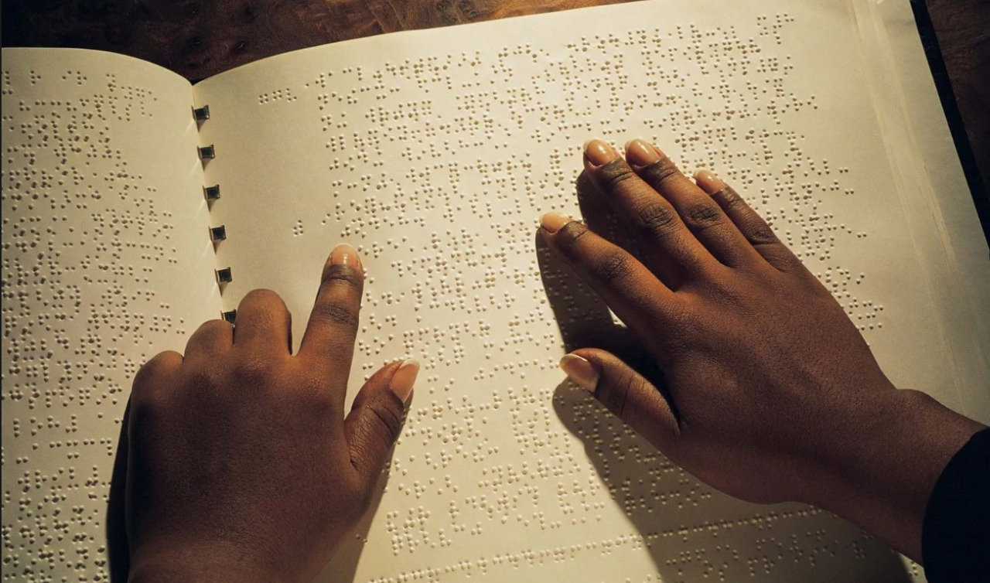

Slide 4
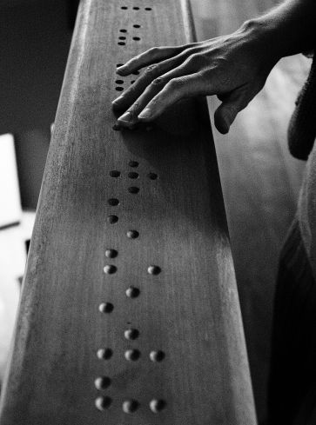

Slide 5
S.E.N.S.E
SERVO ENABLED NAVIGATION SYSTEM FOR EMPOWERMENT
Under The Supervision of
Mr. Soumya Suvra Khan, Assistant Professor, MSIT
Neeraj P Pillai
Kuntal Barik
Harshil D Sheth
Abdul Basit
Ahona Banerjee
Aryan Singh

Slide 6
Content
Introduction
Field Survey
Proposed Work
Experimental Result
Performance Analysis
Conclusion
Reference

Slide 7
Introduction
This project transforms website text into tactile Braille in real time for visually and auditory impaired users
A Python script scrapes text from a given URL and sends it to an Arduino, which uses servo motors to raise and lower pins to form 3x2 Braille cells.
Each letter appears sequentially on a tactile display, enabling interactive, accessible reading.

Slide 8
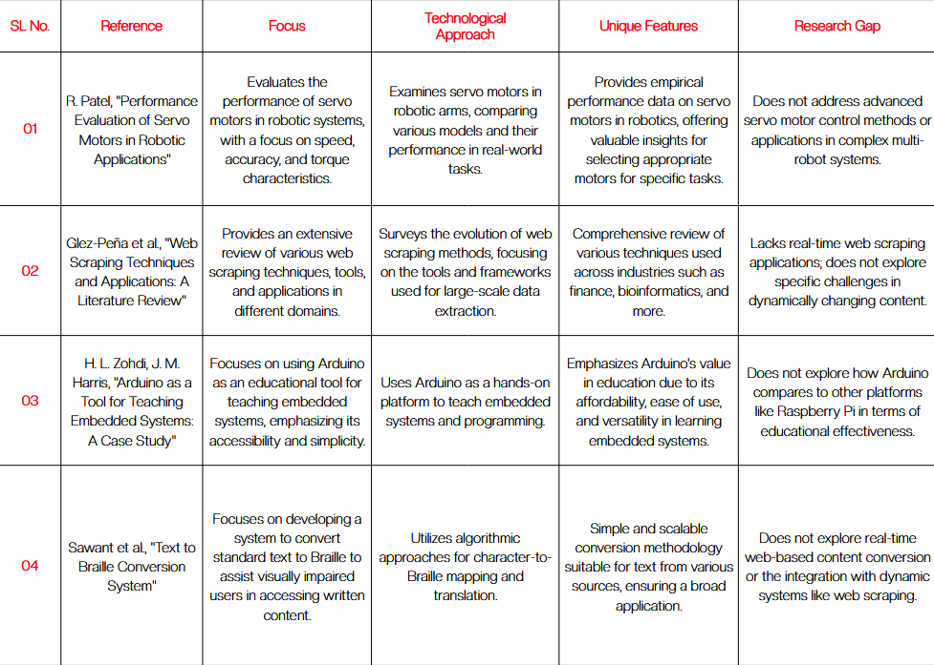
Field Survey

Slide 9
Proposed Work
This project presents an innovative assistive technology that extracts textual content from websites and converts it into tactile Braille output , It does so by executing the following steps:-
Web Scraping - Takes URL as input and extracts all the text from the website and stores it in a text file (python code).
Send to Arduino - processes the scrapped text and sends it to Arduino line by line (python code).
Braille representation- the line is then represented in braille with the help of servo motors (c code).

Slide 10
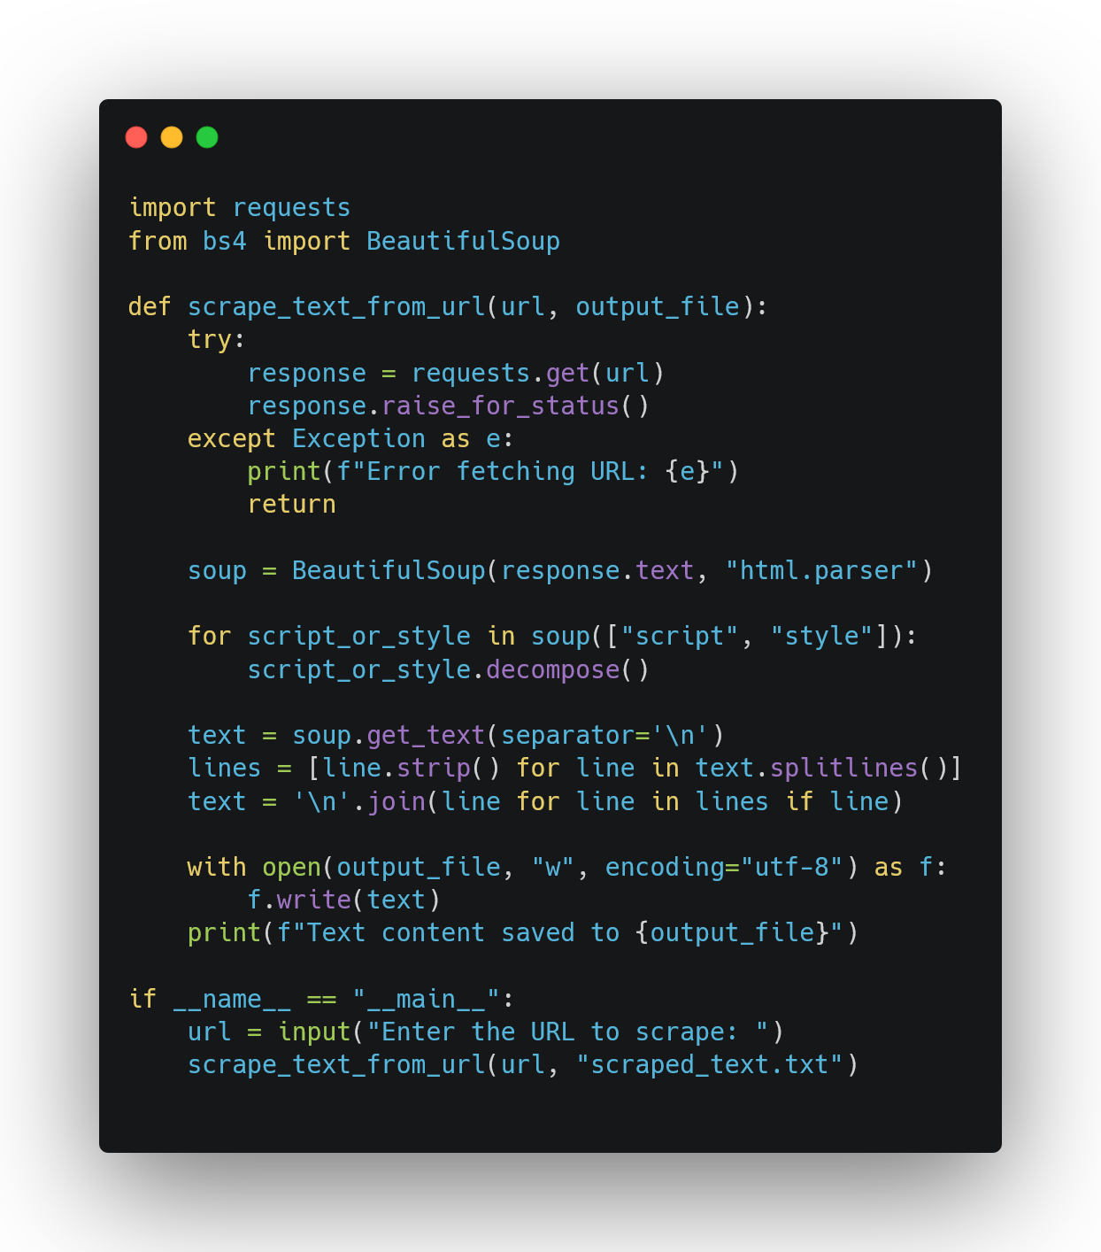
sense/web_scrapping.py

Slide 11
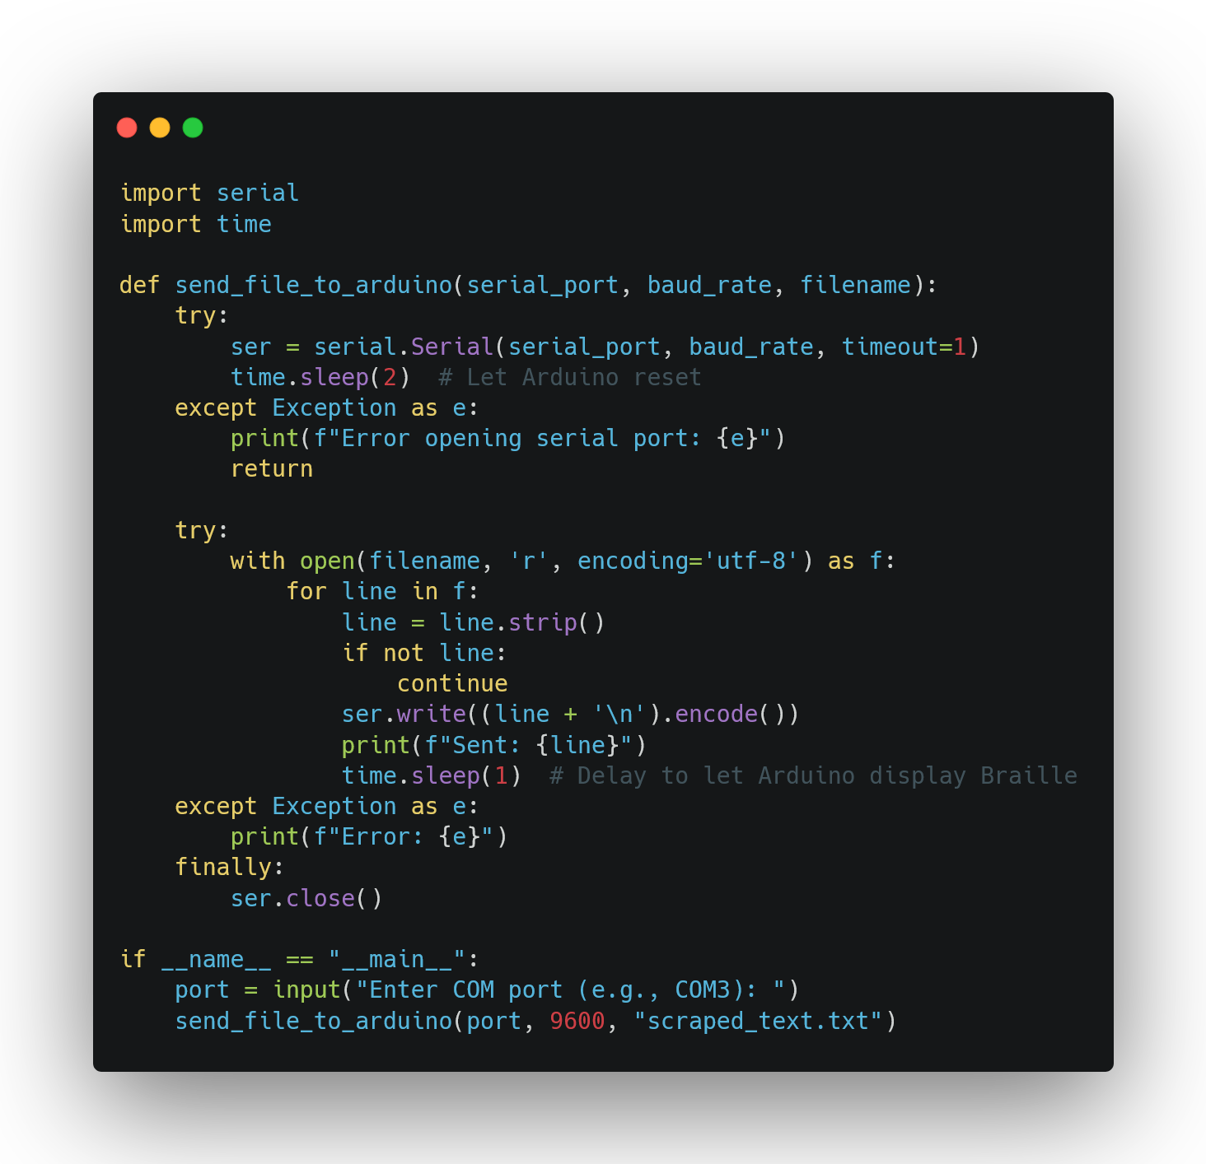
sense/send_to_ard.py

Slide 12
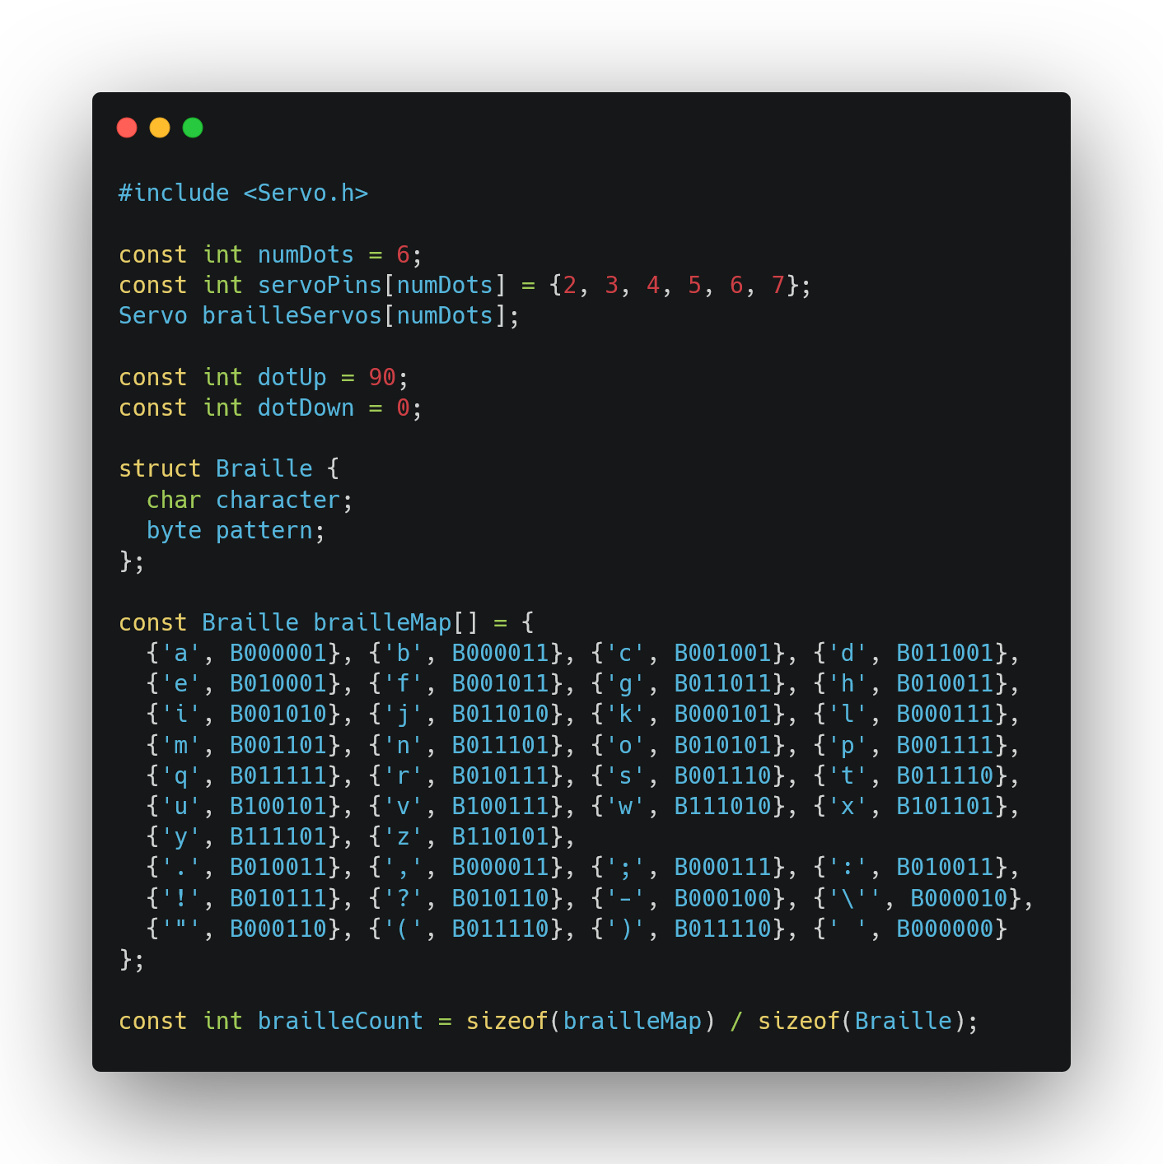
sense/main/main.ino

Slide 13
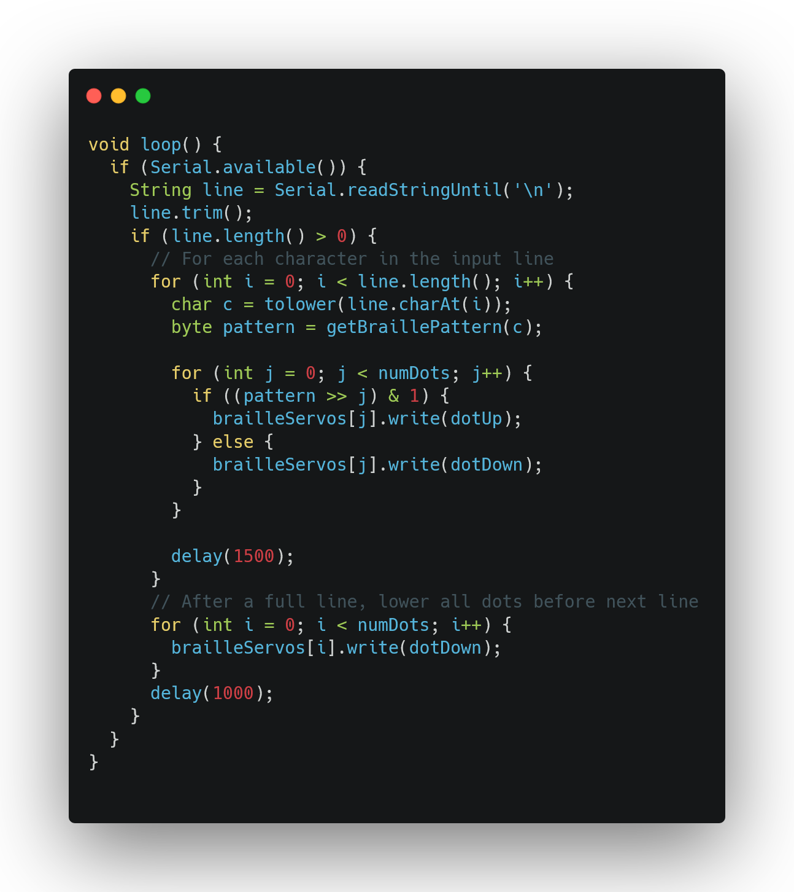
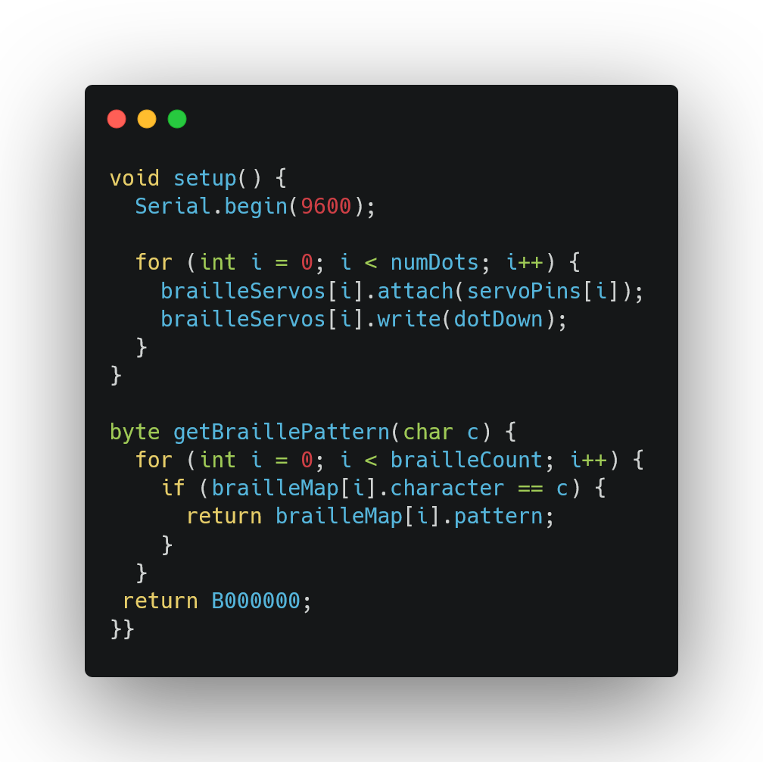

Slide 14
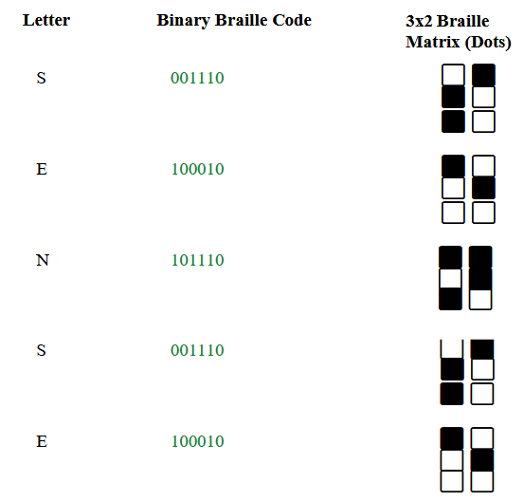

Experimental Result:
During the demonstration of our Braille output device using the sample web page
https://0thorderlogic.github.io/sense , the following key steps and corresponding outputs were observed:
Input URL
Web Scraping and Text Processing
Text sent to circuit for Braille output
Output corresponding to input

Slide 15
Performance Analysis
The performance analysis of the S.E.N.S.E prototype showcases promising outcomes in transforming web content into tactile Braille output. Our testing phase validated the system's core functionality—accurately scraping, processing, and converting real-time online text into mechanical Braille letters using servo-actuated hardware. The integration of Python scripting with Arduino-based control ensured precise signal translation, resulting in consistent and responsive Braille representation. Despite hardware limitations, such as restricted character output and latency in servo response, the device successfully demonstrated real-time tactile translation, indicating the feasibility of scalable implementation. These findings reinforce the potential of combining web technologies and embedded systems to create accessible solutions for deaf-blind users.

Slide 16
Limitations and Improvements
Can display only one word at a time(can be solved using Arduino Mega)
Requires intervention to run initially
Although produced in accordance with first principles, the cost can still be a limiting factor to adoption
Lack of funding for such programs
Limited to ‘Latin script’
Present prototype has much margin between the braille representation dots
Traversal is only one way, which can be a limiting factor.

Slide 17
Conclusion
The S.E.N.S.E project bridges accessibility gaps by converting web content into tactile Braille for users with visual and hearing impairments. It combines web scraping, a Python script, and Arduino-controlled servo motors to render 3x2 Braille in real time. This cost‑effective, scalable device empowers users with independence and seamless access to vast online information, promoting digital inclusion and equity.

Slide 18
Reference
A. Morgavi and A. Morando, "Dynamic Braille Translation: A Real-Time Assistive Web Tool for the Visually Impaired," Journal of Assistive Technologies, vol. 15, no. 2, pp. 100–112, 2019.
M. Rivera and E. Morales, "IoT-Based Educational Braille Display for Visually Impaired Students," International Conference on Human-Centered Computing, pp. 89–95, 2021.
N. Sawant and M. Deshmukh, "A Rule-Based Text-to-Braille Converter Using Java for Low-Resource Environments," International Journal of Assistive Technology, vol. 4, no. 1, pp. 27–34, 2022.
S. Khandare and S. Dorle, "Braille Accessibility through OCR-Based Printed Material Interpretation," IEEE Int. Conf. on Smart Systems and Applications, pp. 225–231, 2020.
J. Zhang, L. Chen, and W. Liu, "A Compact Electromagnetic Braille Display Using Layered Actuators," Sensors and Actuators A: Physical, vol. 316, pp. 112–119, 2021.
R. Teixeira, M. Silva, and A. Dias, "Survey on Tactile Technologies for Refreshable Braille Displays," ACM Computing Surveys, vol. 53, no. 4, pp. 1–29, 2020.

