Slide 1
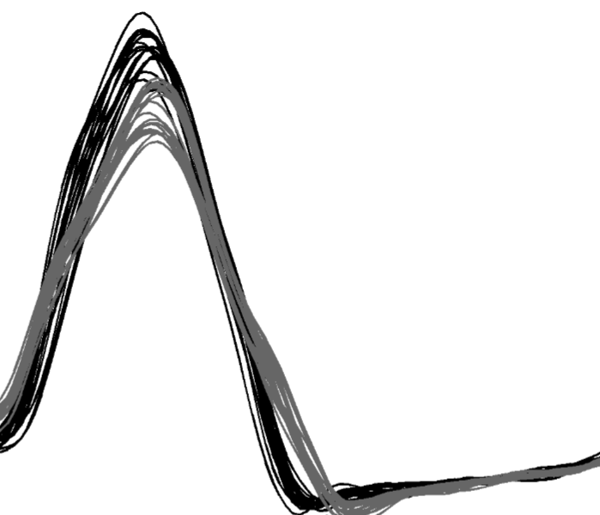
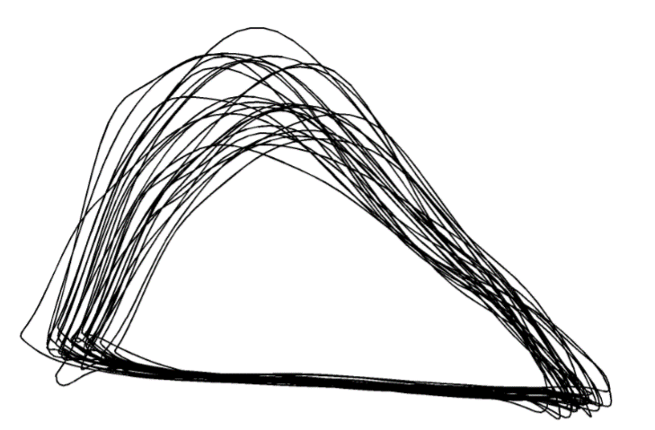
Advanced Statistical Analysis of Biomechanical Time Series
Principal Components Analysis
Functional Data Analysis
Statistical Parametric Mapping
Drew Harrison
Todd Pataky
Mark Robinson
Jos Vanrenterghem
John Warmenhoven
Physical Education and Sport Sciences, University of Limerick
Health and Human Sciences, Kyoto University
Research Institute for Sport and Exercise Sciences, Liverpool John Moores University
Rehabilitation Sciences, KU Leuven
Exercise & Sports Science, University of Sydney

