Slide 1
Module 6 Examples
TAs: Nihal Reddy
Email: nireddy@ucsd.edu
OH: Thursdays 6-7pm Slide Credits: Kira Fleischer

Slide 2
Problem #: Key topics from problem
Problem setup and description.
Question
Key notes from readings/lectures needed to answer the question
Solution: written with as much detail as we expect you to give on your homework sets

Slide 3
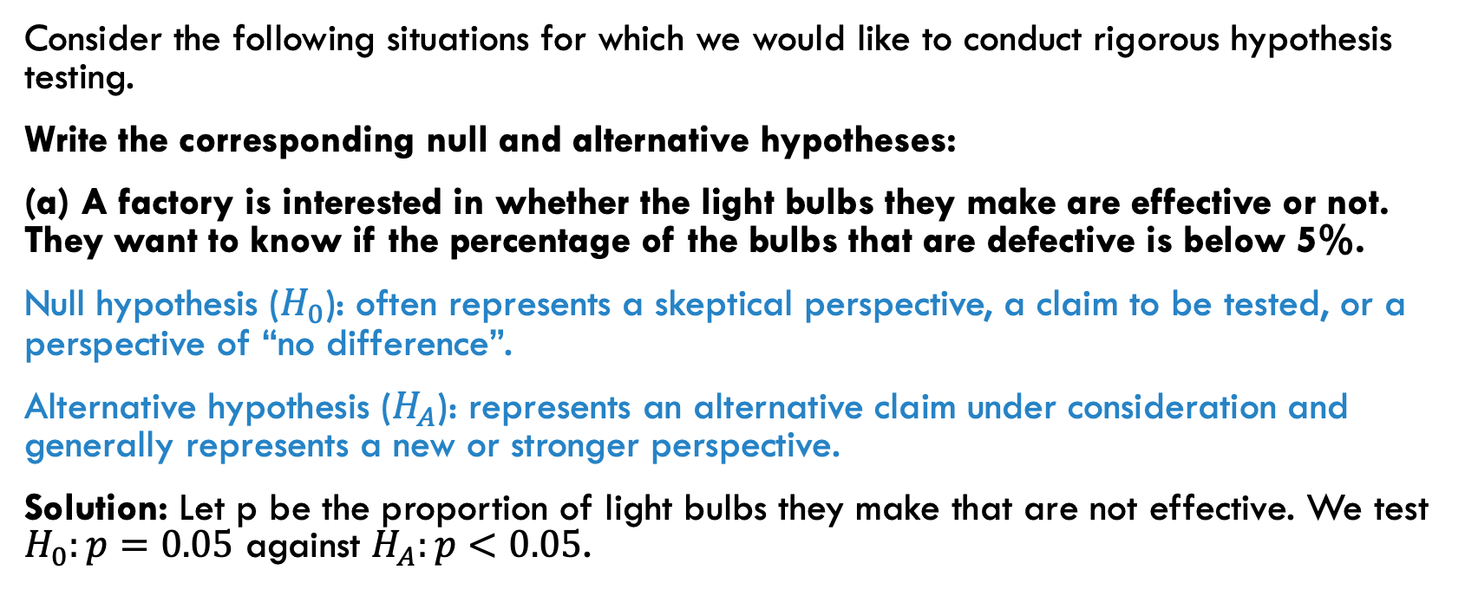
PROBLEM 1: defining hypotheses for testing
Consider the following situations for which we would like to conduct rigorous hypothesis testing.
Write the corresponding null and alternative hypotheses:
(a) A factory is interested in whether the light bulbs they make are effective or not. They want to know if the percentage of the bulbs that are defective is below 5%.
Null hypothesis ($H_{0}$): often represents a skeptical perspective, a claim to be tested, or a perspective of “no difference”.
Alternative hypothesis ($H_{A}$): represents an alternative claim under consideration and generally represents a new or stronger perspective.
Solution: Let p be the proportion of light bulbs they make that are not effective. We test $H_{0}:p=0.05$ against $H_{A}:p<0.05$.

Slide 4
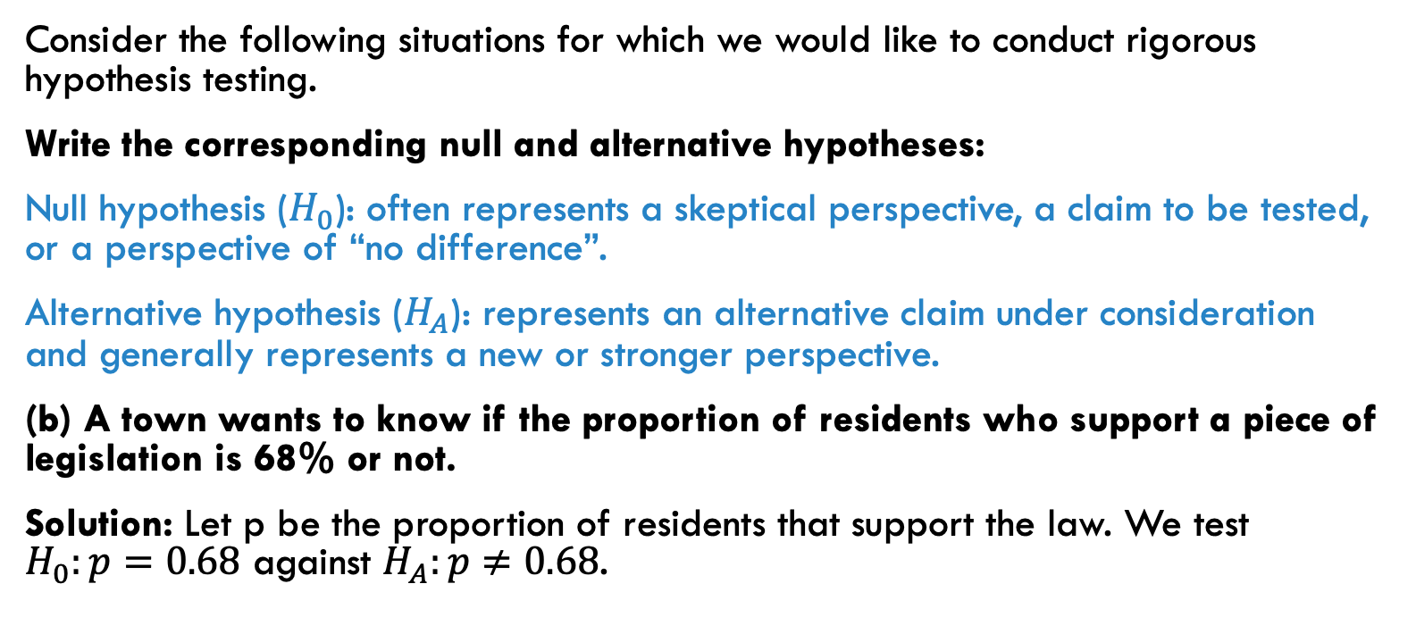
PROBLEM 1: defining hypotheses for testing
Consider the following situations for which we would like to conduct rigorous hypothesis testing.
Write the corresponding null and alternative hypotheses:
Null hypothesis ($H_{0}$): often represents a skeptical perspective, a claim to be tested, or a perspective of “no difference”.
Alternative hypothesis ($H_{A}$): represents an alternative claim under consideration and generally represents a new or stronger perspective.
(b) A town wants to know if the proportion of residents who support a piece of legislation is 68% or not.
Solution: Let p be the proportion of residents that support the law. We test $H_{0}:p=0.68$ against $H_{A}:p≠0.68$.

Slide 5
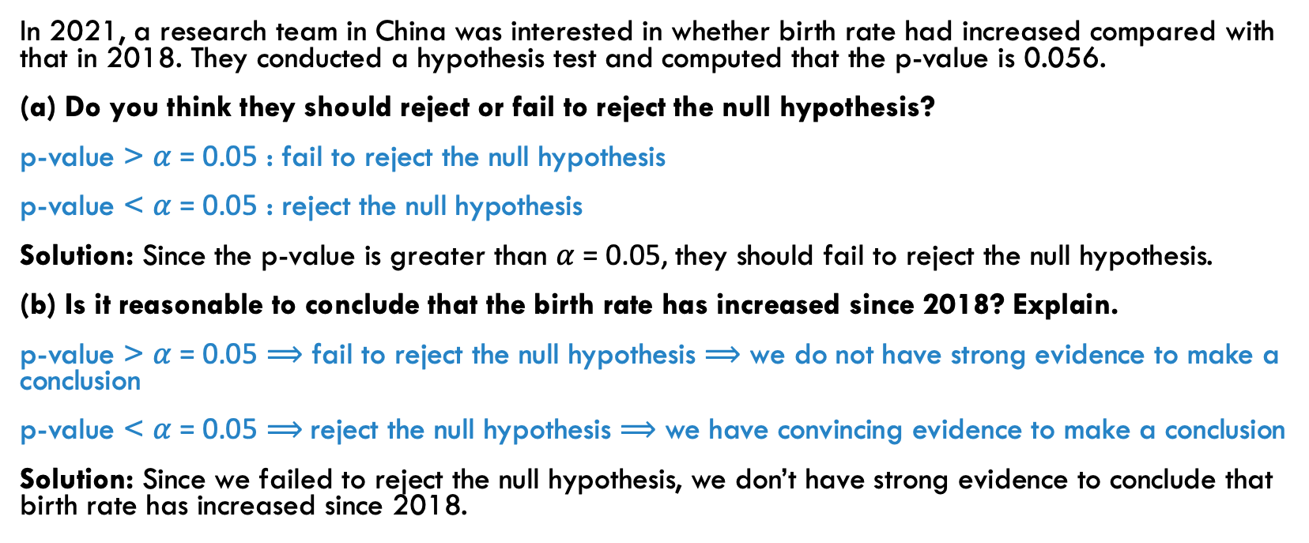
PROBLEM 2: drawing conclusions from hypothesis tests
In 2021, a research team in China was interested in whether birth rate had increased compared with that in 2018. They conducted a hypothesis test and computed that the p-value is 0.056.
(a) Do you think they should reject or fail to reject the null hypothesis?
p-value > $α$ = 0.05 : fail to reject the null hypothesis
p-value < $α$ = 0.05 : reject the null hypothesis
Solution: Since the p-value is greater than $α$ = 0.05, they should fail to reject the null hypothesis.
(b) Is it reasonable to conclude that the birth rate has increased since 2018? Explain.
p-value > $α$ = 0.05 $⟹$ fail to reject the null hypothesis $⟹$ we do not have strong evidence to make a conclusion
p-value < $α$ = 0.05 $⟹$reject the null hypothesis $⟹$ we have convincing evidence to make a conclusion
Solution: Since we failed to reject the null hypothesis, we don’t have strong evidence to conclude that birth rate has increased since 2018.

Slide 6
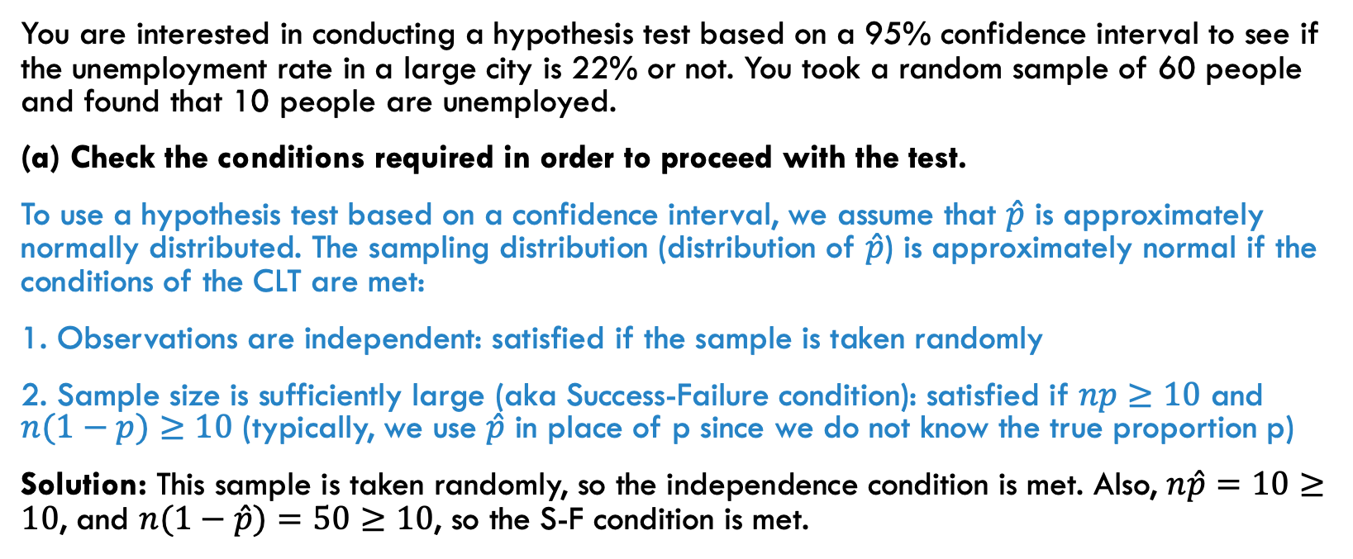
PROBLEM 3: constructing a confidence interval
You are interested in conducting a hypothesis test based on a 95% confidence interval to see if the unemployment rate in a large city is 22% or not. You took a random sample of 60 people and found that 10 people are unemployed.
(a) Check the conditions required in order to proceed with the test.
To use a hypothesis test based on a confidence interval, we assume that $\hat{p}$ is approximately normally distributed. The sampling distribution (distribution of $\hat{p}$) is approximately normal if the conditions of the CLT are met:
1. Observations are independent: satisfied if the sample is taken randomly
2. Sample size is sufficiently large (aka Success-Failure condition): satisfied if $np≥10$ and $n(1−p)≥10$ (typically, we use $\hat{p}$ in place of p since we do not know the true proportion p)
Solution: This sample is taken randomly, so the independence condition is met. Also, $n\hat{p}=10≥10$, and $n(1−\hat{p})=50≥10$, so the S-F condition is met.

Slide 7
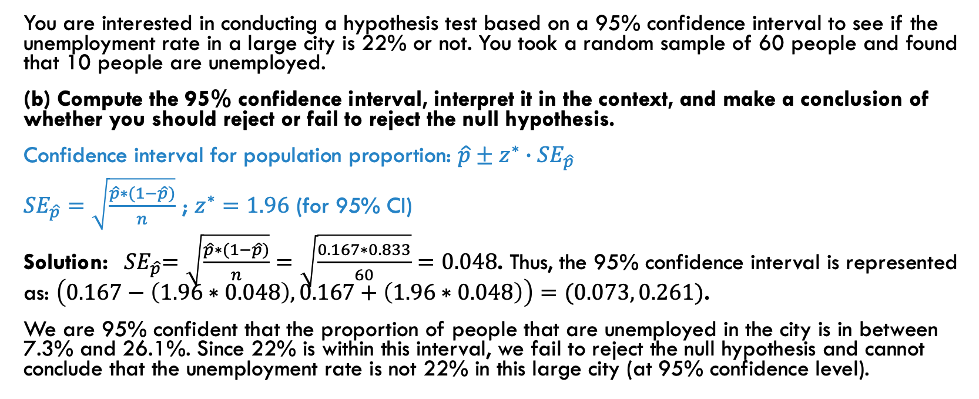
PROBLEM 3: constructing a confidence interval
You are interested in conducting a hypothesis test based on a 95% confidence interval to see if the unemployment rate in a large city is 22% or not. You took a random sample of 60 people and found that 10 people are unemployed.
(b) Compute the 95% confidence interval, interpret it in the context, and make a conclusion of whether you should reject or fail to reject the null hypothesis.
Confidence interval for population proportion: $\hat{p}±z^{∗}∙{SE}_{\hat{p}}$
${SE}_{\hat{p}}=\sqrt{\frac{\hat{p}∗(1−\hat{p})}{n}}$ ; $z^{∗}=1.96$ (for 95% CI)
Solution: ${ SE}_{\hat{p}}=\sqrt{\frac{\hat{p}∗(1−\hat{p})}{n}}=\sqrt{\frac{0.167∗0.833}{60}}=0.048$. Thus, the 95% confidence interval is represented as: $\left(0.167−\left(1.96∗0.048\right), 0.167+\left(1.96∗0.048\right)\right)=(0.073, 0.261)$.
We are 95% confident that the proportion of people that are unemployed in the city is in between 7.3% and 26.1%. Since 22% is within this interval, we fail to reject the null hypothesis and cannot conclude that the unemployment rate is not 22% in this large city (at 95% confidence level).

Slide 8
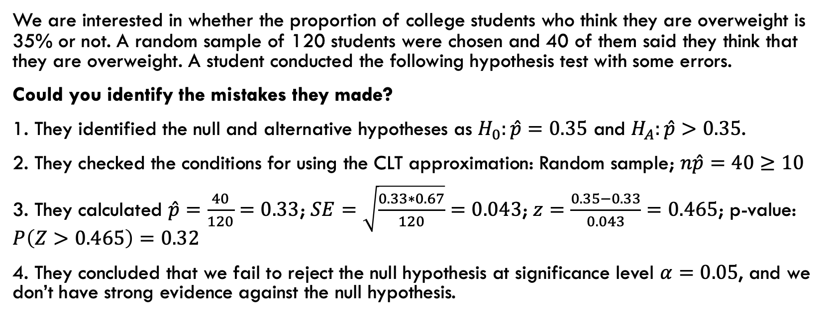
PROBLEM 4: evaluating a hypothesis test
We are interested in whether the proportion of college students who think they are overweight is 35% or not. A random sample of 120 students were chosen and 40 of them said they think that they are overweight. A student conducted the following hypothesis test with some errors.
Could you identify the mistakes they made?
1. They identified the null and alternative hypotheses as $H_{0}:\hat{p}=0.35$ and $H_{A}:\hat{p}>0.35$.
2. They checked the conditions for using the CLT approximation: Random sample; $n\hat{p}=40≥10$
3. They calculated $\hat{p}=\frac{40}{120}=0.33$; $SE=\sqrt{\frac{0.33∗0.67}{120}}=0.043$; $z=\frac{0.35−0.33}{0.043}=0.465$; p-value: $P\left(Z>0.465\right)=0.32$
4. They concluded that we fail to reject the null hypothesis at significance level $α=0.05$, and we don’t have strong evidence against the null hypothesis.

Slide 9
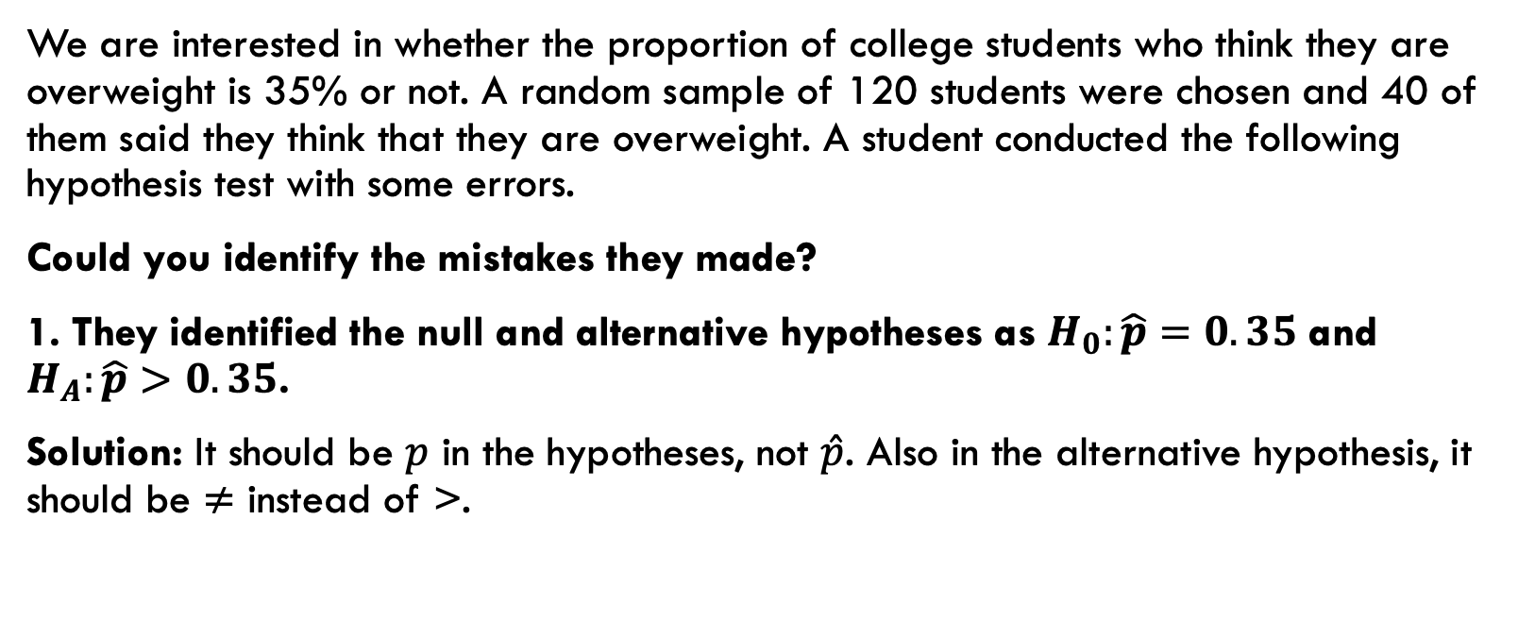
PROBLEM 4: evaluating a hypothesis test
We are interested in whether the proportion of college students who think they are overweight is 35% or not. A random sample of 120 students were chosen and 40 of them said they think that they are overweight. A student conducted the following hypothesis test with some errors.
Could you identify the mistakes they made?
1. They identified the null and alternative hypotheses as $H_{0}:\hat{p}=0.35$ and $H_{A}:\hat{p}>0.35$.
Solution: It should be $p$ in the hypotheses, not $\hat{p}$. Also in the alternative hypothesis, it should be $≠$ instead of >.

Slide 10
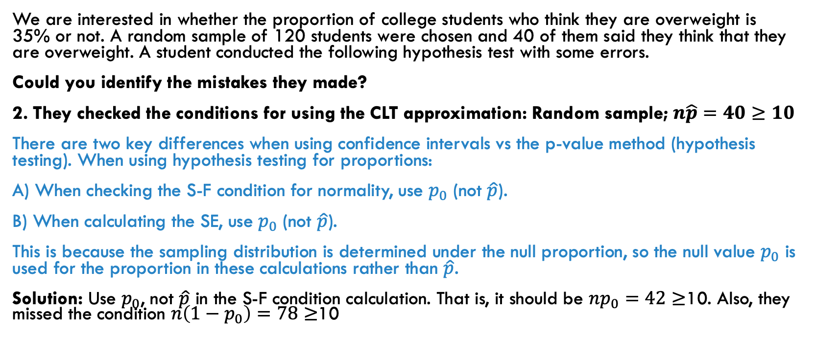
PROBLEM 4: evaluating a hypothesis test
We are interested in whether the proportion of college students who think they are overweight is 35% or not. A random sample of 120 students were chosen and 40 of them said they think that they are overweight. A student conducted the following hypothesis test with some errors.
Could you identify the mistakes they made?
2. They checked the conditions for using the CLT approximation: Random sample; $n\hat{p}=40≥10$
There are two key differences when using confidence intervals vs the p-value method (hypothesis testing). When using hypothesis testing for proportions:
A) When checking the S-F condition for normality, use $p_{0}$ (not $\hat{p}$).
B) When calculating the SE, use $p_{0}$ (not $\hat{p}$).
This is because the sampling distribution is determined under the null proportion, so the null value $p_{0}$ is used for the proportion in these calculations rather than $\hat{p}$.
Solution: Use $p_{0}$, not $\hat{p}$ in the S-F condition calculation. That is, it should be $np_{0}=42≥$10. Also, they missed the condition $n\left(1−p_{0}\right)=78≥$10

Slide 11
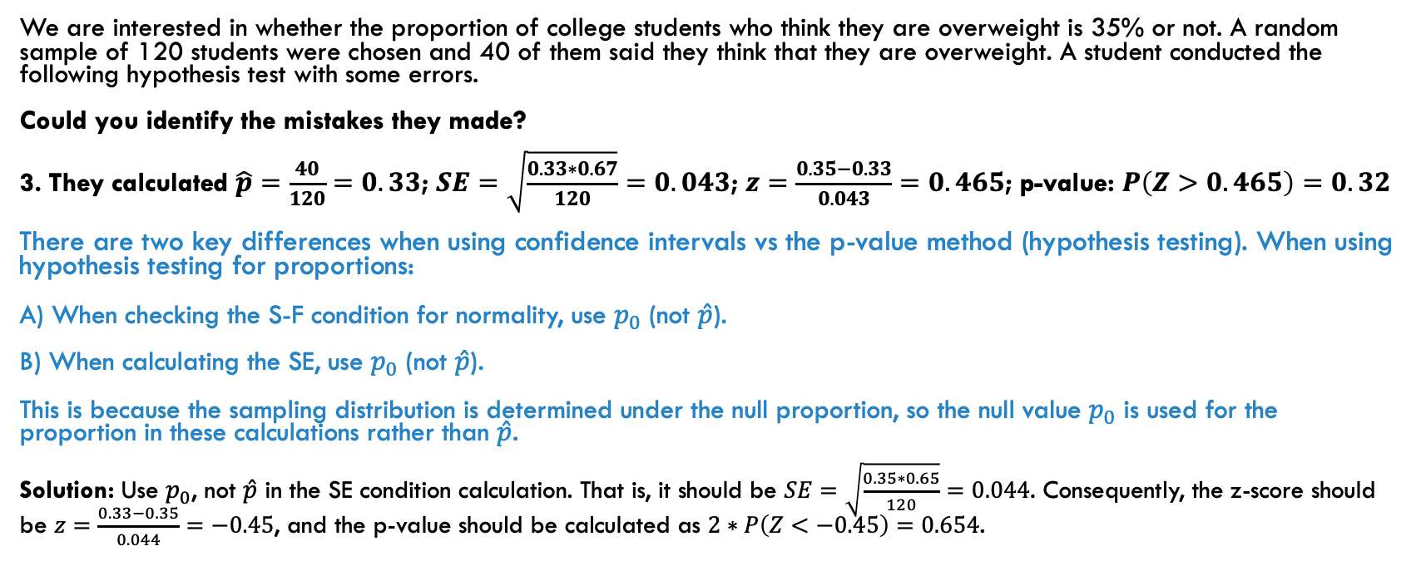
PROBLEM 4: evaluating a hypothesis test
We are interested in whether the proportion of college students who think they are overweight is 35% or not. A random sample of 120 students were chosen and 40 of them said they think that they are overweight. A student conducted the following hypothesis test with some errors.
Could you identify the mistakes they made?
3. They calculated $\hat{p}=\frac{40}{120}$ $=0.33$; $SE=\sqrt{\frac{0.33∗0.67}{120}}=0.043$; $z=\frac{0.35−0.33}{0.043}=0.465$; p-value: $P\left(Z>0.465\right)=0.32$
There are two key differences when using confidence intervals vs the p-value method (hypothesis testing). When using hypothesis testing for proportions:
A) When checking the S-F condition for normality, use $p_{0}$ (not $\hat{p}$).
B) When calculating the SE, use $p_{0}$ (not $\hat{p}$).
This is because the sampling distribution is determined under the null proportion, so the null value $p_{0}$ is used for the proportion in these calculations rather than $\hat{p}$.
Solution: Use $p_{0}$, not $\hat{p}$ in the SE condition calculation. That is, it should be $SE=\sqrt{\frac{0.35∗0.65}{120}}=0.044$. Consequently, the z-score should be $z=\frac{0.33−0.35}{0.044}=−0.45$, and the p-value should be calculated as $2∗P\left(Z<−0.45\right)=0.654$.

Slide 12
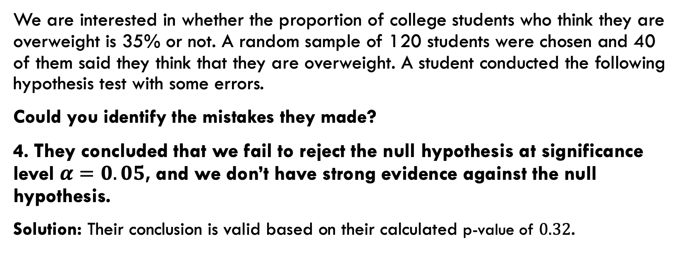
PROBLEM 4: evaluating a hypothesis test
We are interested in whether the proportion of college students who think they are overweight is 35% or not. A random sample of 120 students were chosen and 40 of them said they think that they are overweight. A student conducted the following hypothesis test with some errors.
Could you identify the mistakes they made?
4. They concluded that we fail to reject the null hypothesis at significance level $α=0.05$, and we don’t have strong evidence against the null hypothesis.
Solution: Their conclusion is valid based on their calculated p-value of $0.32$.

Slide 13
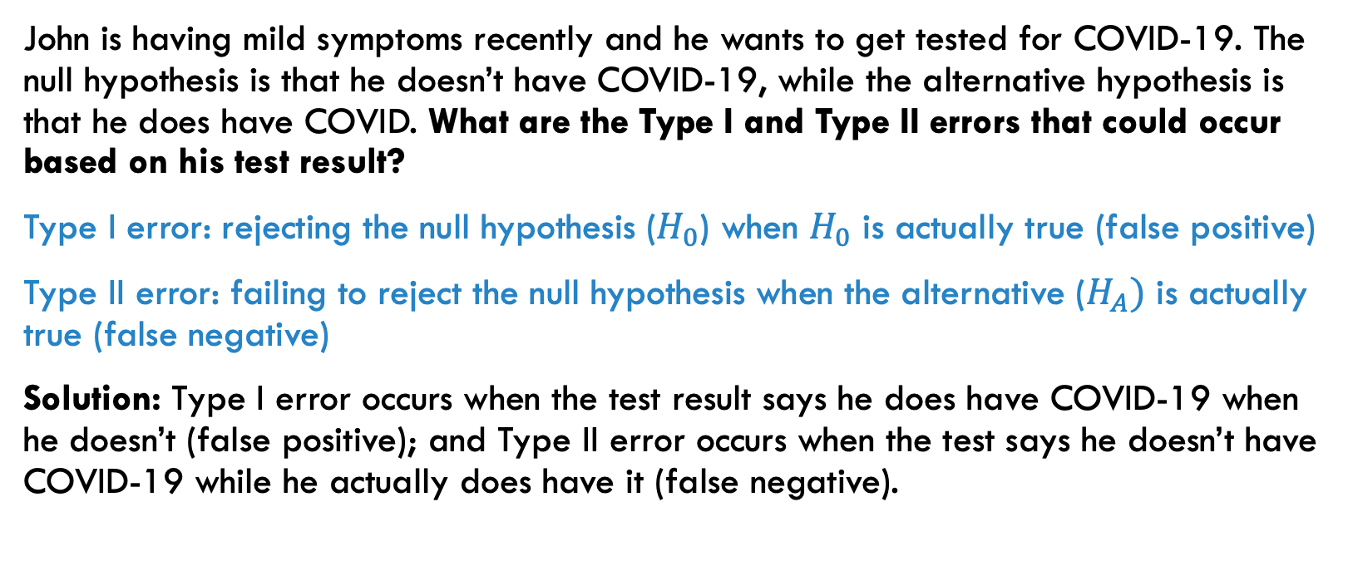
PROBLEM 5: type I and ii errors
John is having mild symptoms recently and he wants to get tested for COVID-19. The null hypothesis is that he doesn’t have COVID-19, while the alternative hypothesis is that he does have COVID. What are the Type I and Type II errors that could occur based on his test result?
Type I error: rejecting the null hypothesis ($H_{0}$) when $H_{0}$ is actually true (false positive)
Type II error: failing to reject the null hypothesis when the alternative ($H_{A})$ is actually true (false negative)
Solution: Type I error occurs when the test result says he does have COVID-19 when he doesn’t (false positive); and Type II error occurs when the test says he doesn’t have COVID-19 while he actually does have it (false negative).

Slide 14
PROBLEM 6: identifying type I and ii errors
A hypothesis test is conducted to find out whether students in a university prefer Coke over Diet Coke. The study finds no evidence that the proportion of the people who prefer Coke is not 0.5. Later a company surveys all the students and finds that there is no difference in student preference. Do you think a Type I error occurred, a Type II error occurred, or neither?
Solution: No error has been made since the true proportion is 0.5, which wasn’t rejected.

