Slide 1

Project 3: Deep & Wide Nets,
RNNs, Kernels & Regressions
Neural Networks vs. Classical Methods
Tyler James
James Anderson
Shajeel Rehman

Slide 2

Data & Setup
Two crash datasets (≥3000 rows each, ≥5 features)
Collected one dataset via API
Cleaning: missing values, outlier detection, categorical encoding, scaling.
Feature engineering: interaction terms, ratios, rolling counts

Slide 3
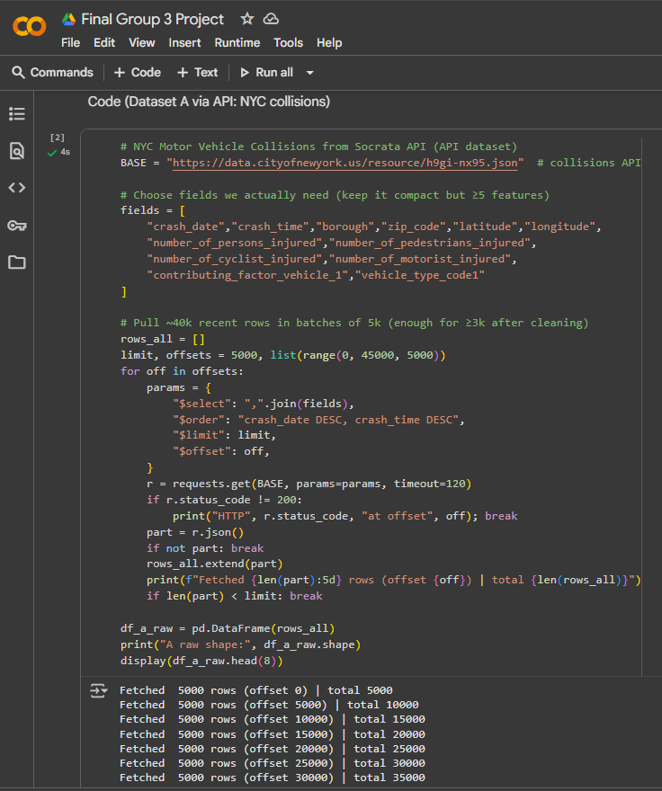
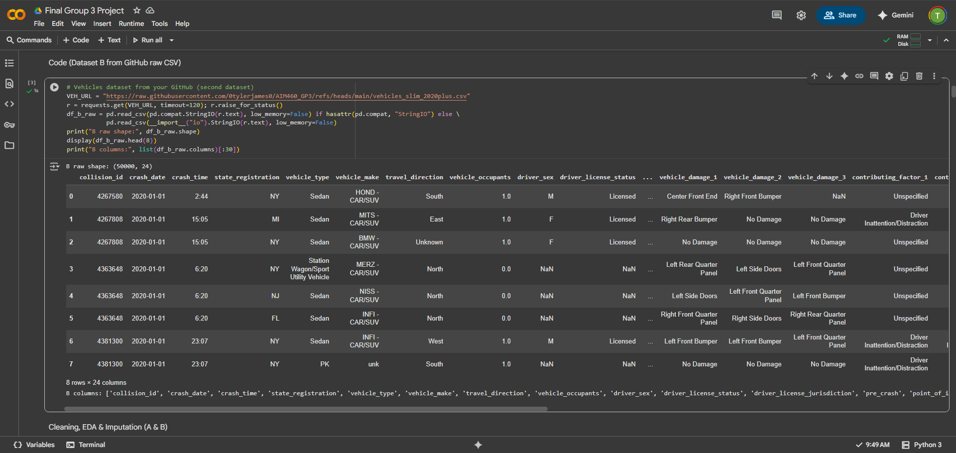
Dataset A (API): NYC Motor Vehicle - Collisions (API).
Dataset B (GitHub): NYC Motor Vehicle - Vehicle records

Slide 4

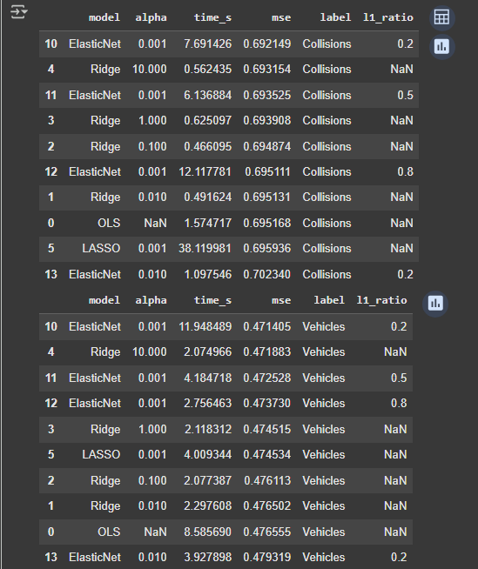
Linear & Regularized Models
OLS, Ridge, LASSO, Elastic Net
Hyperparameter tuning (alpha, lambda, etc.)
Ridge improved stability; LASSO performed feature selection
Baseline performance: R² lower than NN-based methods

Slide 5

Data background and context
Crashes in NYC are much more common at night when visibility is low. Additionally, crashes between midnight and 6am tend to cause more severe or fatal injuries. This is why we used the engineered feature “hour”. Citation: https://www.nyc.gov/html/dot/downloads/pdf/nyc_ped_safety_study_action_plan_technical_supplement.pdf
Month of the year and seasonal cycles also directly contribute to the number of crashes. Earlier sunsets in Fall/winter correspond to moree crashes, with accidents peaking in October and dropping to their lowest in march. This is why we used the engineered feature “month” Citation: https://injuryfacts.nsc.org/motor-vehicle/overview/crashes-by-month
Pedestrian crashes are more often than not at intersections: “Crashes at intersections typically comprise 51 percent of all fatalities and 68 percent of all injuries in a year. For pedestrians, the dangers are more pronounced: 59 percent of pedestrian fatalities and 77 percent of pedestrian traffic injuries occur at intersections.” This resulted in our engineered feature “is_intersection” Citation: https://www.nyc.gov/html/dot/html/pr2024/dot-enhances-pedestrian-safety.shtml

Slide 6

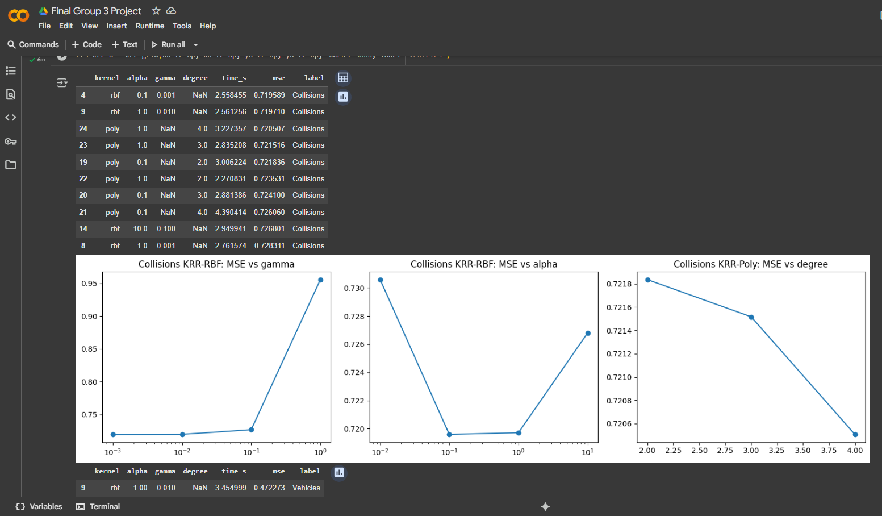
Kernel Ridge Regression
Explored RBF & Polynomial kernels
Manual grid search across gamma, degree, alpha
Better capture of nonlinear relationships
Higher compute cost but improved accuracy

Slide 7
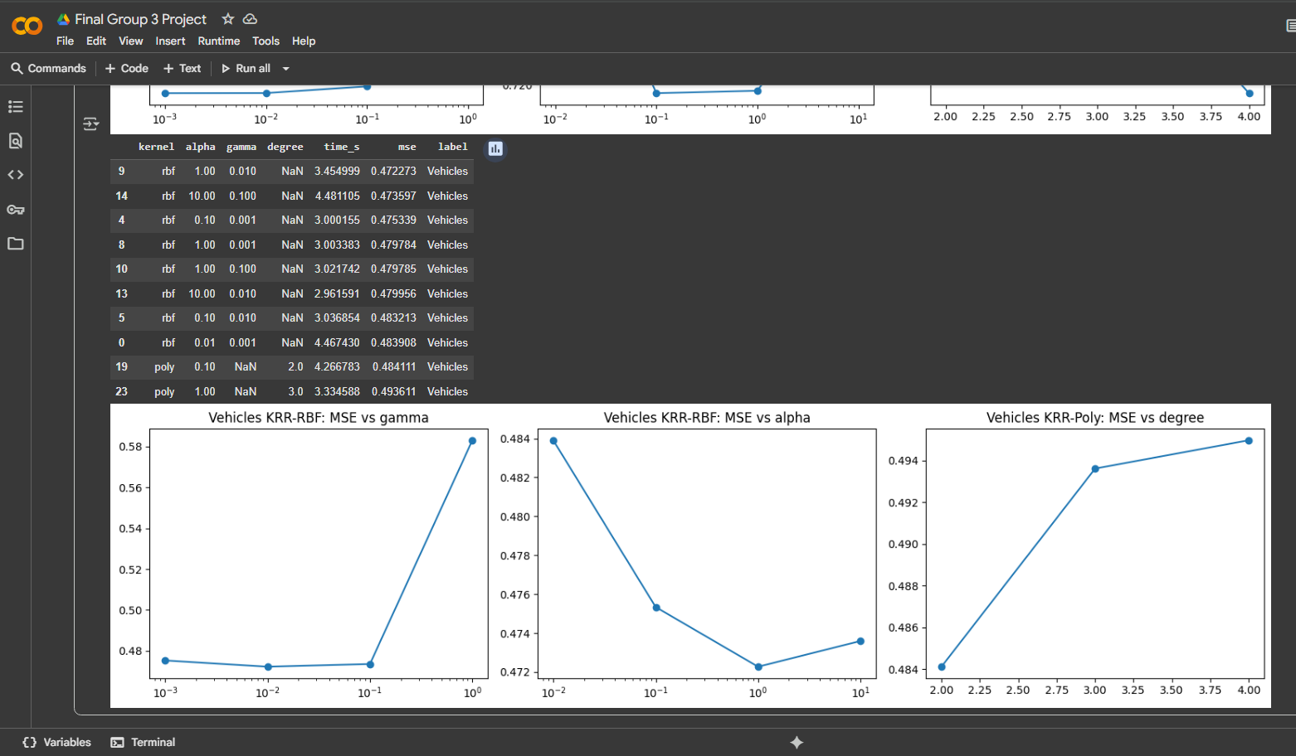
Kernel Ridge Regression

Slide 8

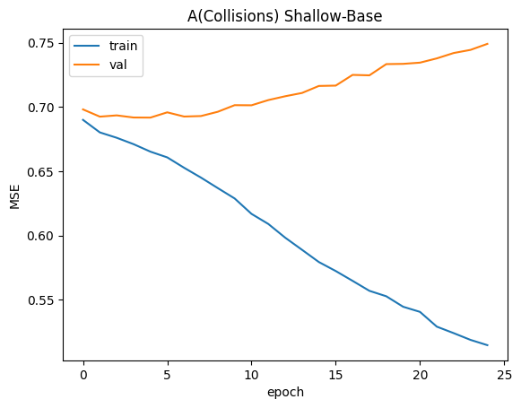
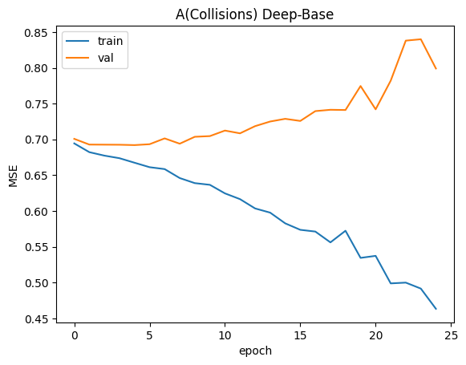
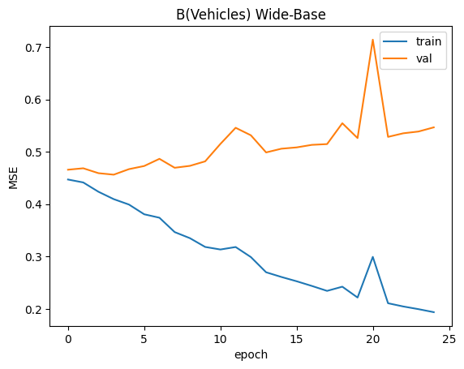
Neural Networks
Shallow (1 hidden layer), Deep (4+ layers), Wide (single wide layer)
Baseline vs. Enhanced (batch norm, dropout, custom activation)
Improvements, but prone to overfitting vs. kernel methods

Slide 9

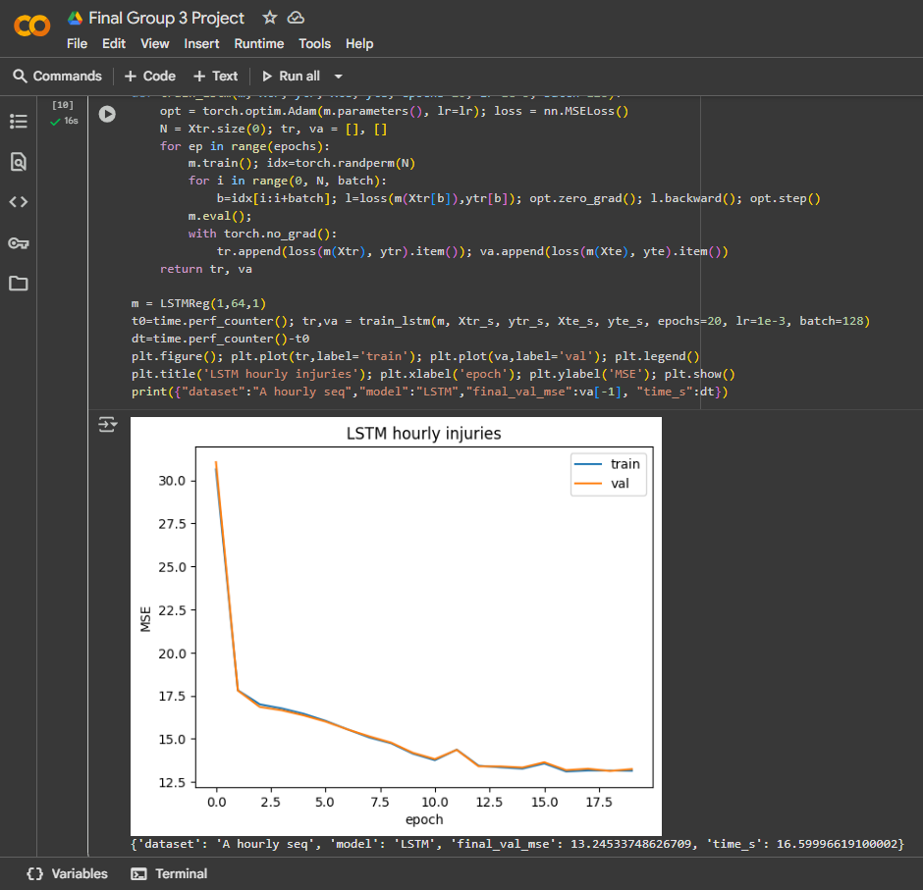
Recurrent Neural Networks
Reframed crash data as sequences (time windows)
Built LSTM regression for temporal prediction
Converged but slower and less accurate than MLP/KRR
Useful for capturing trends over time

Slide 10

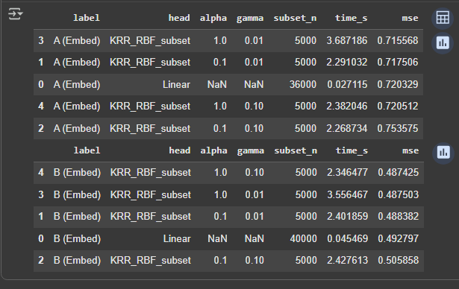
Feature Transfer Experiment
Extracted embeddings from NN penultimate layer
Trained Ridge, RBF, Polynomial regressors on embeddings
Best model overall: Kernel Ridge (RBF) on embeddings

Slide 11
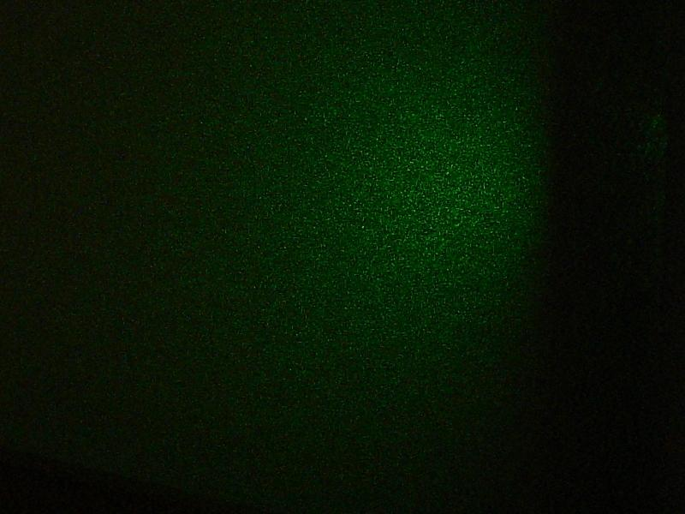
Final Results and Reflections
Hardest issue: The hardest issue was the fact that the website the API was being pulled from was undergoing maintenance while trying to rerun the project.
New insight: Combining neural embeddings with classical regressors can outperform standalone deep nets.
Final deliverables uploaded:
RESULTS_SUMMARY.md
model_results_summary_all.csv
model_comparison_all.png

Slide 12

THANK
YOU!

