Slide 1
Road Runner
“A simulation environment for computer models representing chemical and biological processes”

Slide 2
Content
RoadRunner overview
Dependencies: 3rd Party libs
Source code core
How to manage: SVN, CMake, Swig
CMake
Project preparation/setup
CMake concepts
Instructions on how to build Roadrunner from scratch
Clapack
Sundials
LibSBML
RoadRunner
How to make Roadrunner (or any library) useful and accessible
The API
Swig
Improving RoadRunner

Slide 3
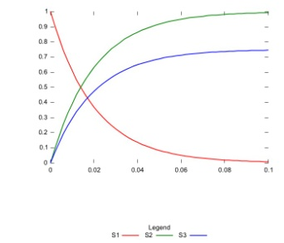
RoadRunner Overview
SBML
Semantics
(XML)
Input
Output
RoadRunner
Parameters&
Settings

Slide 4
more details
Create internal model representation
model.xml
model.h model.c
C-Code source Files
Compile model representation to DLL using tcc compiler
Load dll and simulate
Data output
model.csv
model.dll

Slide 5
RoadRunner Dependencies
RoadRunner
(C++)
libSBML
(C++)
libStruct
(C++)
libXML2
Iconv
Zlib
… + others
clapack
(C)
blas
f2c
lapack
Sundials
(C)
cvode
kinsol
nvector
NOMSupport
(C++)
(libSBML)
C/C++ library for analyzing the structural properties of
stoichiometric networks
API for libSBML
C++ library that handles
SBML semantics
SUite of Nonlinear and DIfferential/Algebraic
equation Solvers

Slide 6
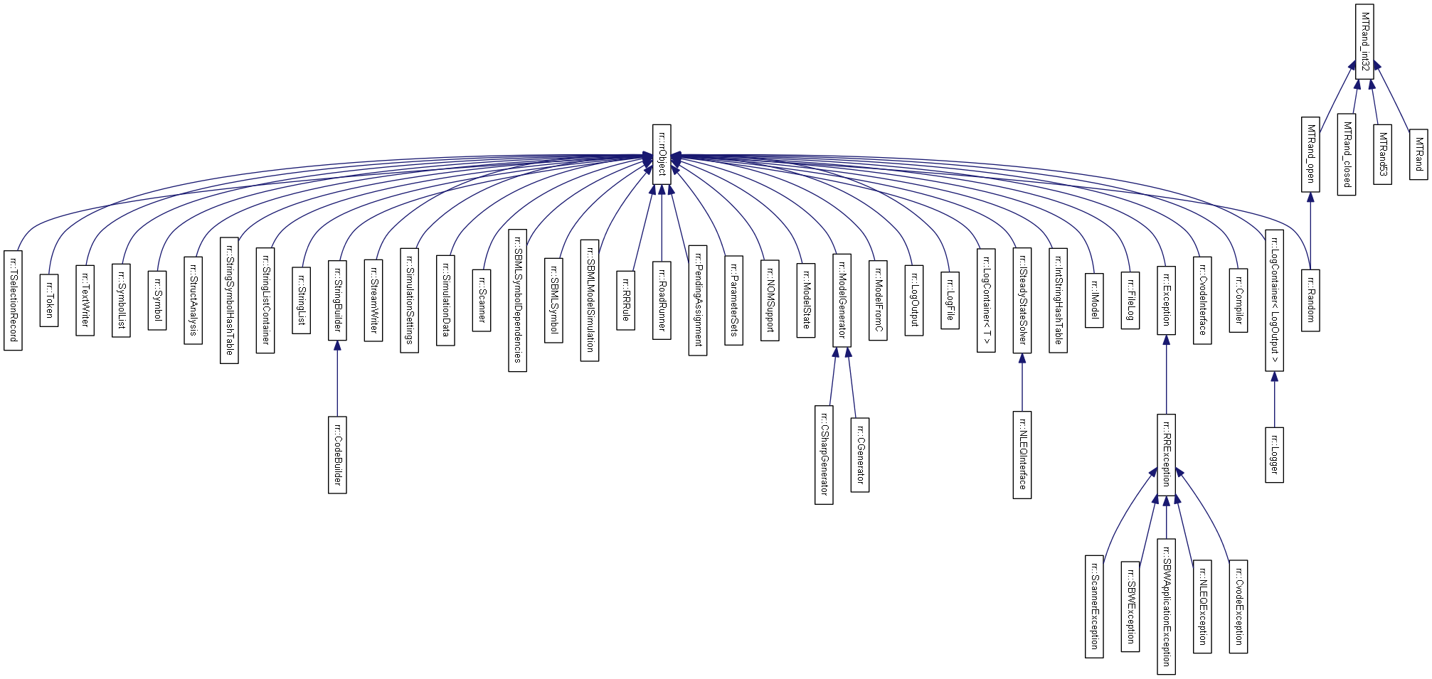
RoadRunner Conversion
About 50 classes was translated.
Added quite a few new ones
C#
C++

Slide 7
Main C++ class - RoadRunner
Hundreds of properties and methods, e.g
Properties
Compiler
CVodeInterface
ModelGenerator
Functions
LoadSBML()
CreateModelSourceCode()
Simulate()
Other characteristics
Lot of code/functionality
Complex
Many dependencies
libSBML
cvode
tcc
clapack etc..
How to manage?

Slide 8
Manage RoadRunner Library
Use conventional software management tools
Subversion (svn)
CMake (Cross-platform Make)
Swig
Doxygen

Slide 9
RoadRunner sandbox url: https://roadrunnerwork.googlecode.com/svn/trunk
/trunk
/Apps
/Doxygen
/src
RoadRunner C++ Header and Source files
/ThirdParty
/Wrappers
/Examples
/Docs
/rr
/libSBML
/sundials
/clapack
/C
/Python
/Examples
/libStruct

Slide 10
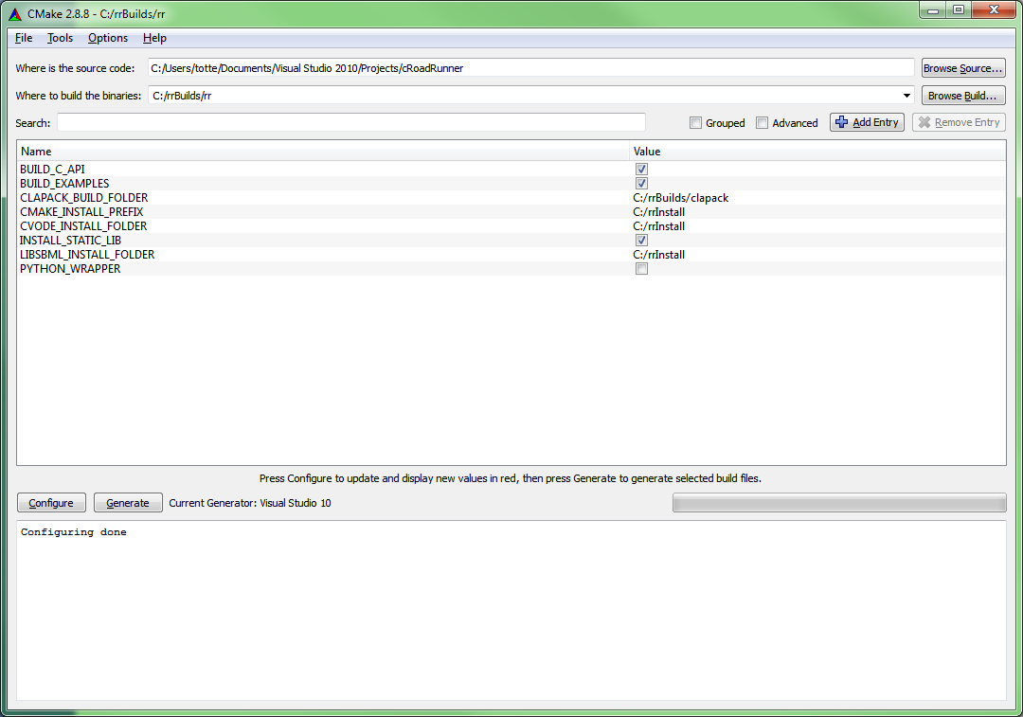
CMake UI
1
2
3
4
5
5
Generates .sln files for the project in the ‘Where to
Build the binaries folder’ (if using Visual Studio)

Slide 11
Setting up RoadRunner development
Suggestion of a build folder
structure
C:\rrBuild
\Sundials
\clapack
\libSBML
\rr
\VS
\XE
\clapack
\sundials
….

Slide 12
Setting up more
CMAKE_INSTALL_PREFIX is the ‘final’ folder for installing anything worth
delivering to the end user, such as
.h .lib .dll, as well as documentation files
In setting up a RoadRunner development platform it is encouraged to have all
3rd party deliverables, as well as roadrunner itself using the same install folder,
i.e the same setting for CMAKE_INSTALL_PREFIX
C:\rrInstall
\Sundials
\include
\libSBML
\lib
\VS
\XE
\include
\lib
\bin
\clapack
Contains all .lib files
\bin
Contains all vs binary files (.dll, .exe)
\rr

Slide 13
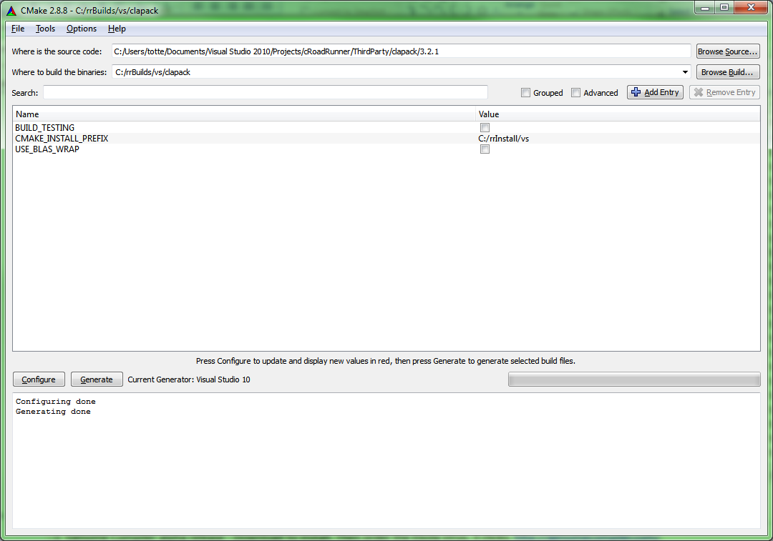
CMake - Clapack (3.2.1)

Slide 14
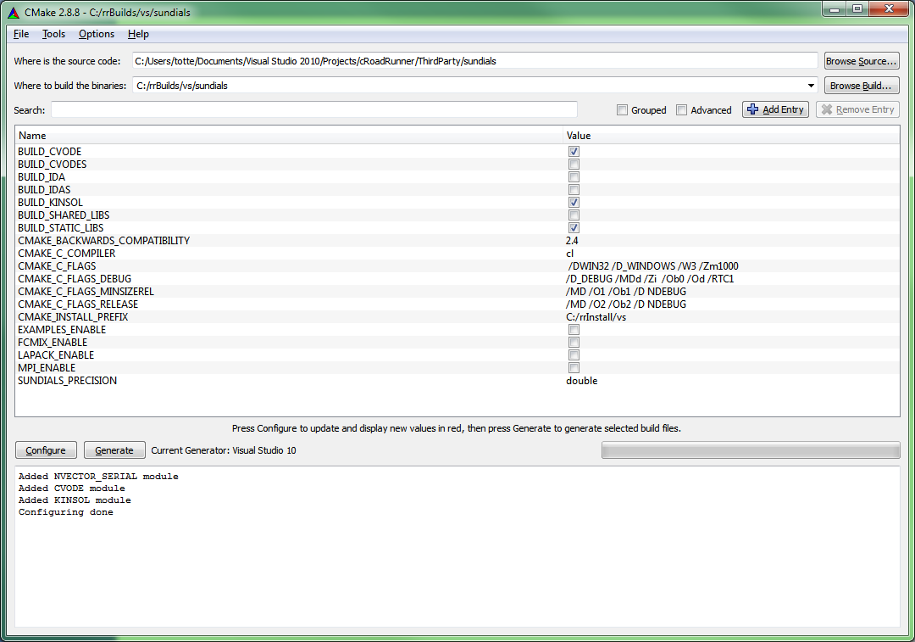
CMake - Sundials
RoadRunner seem only to need
BUILD_CVODE and BUILD_KINSOL

Slide 15
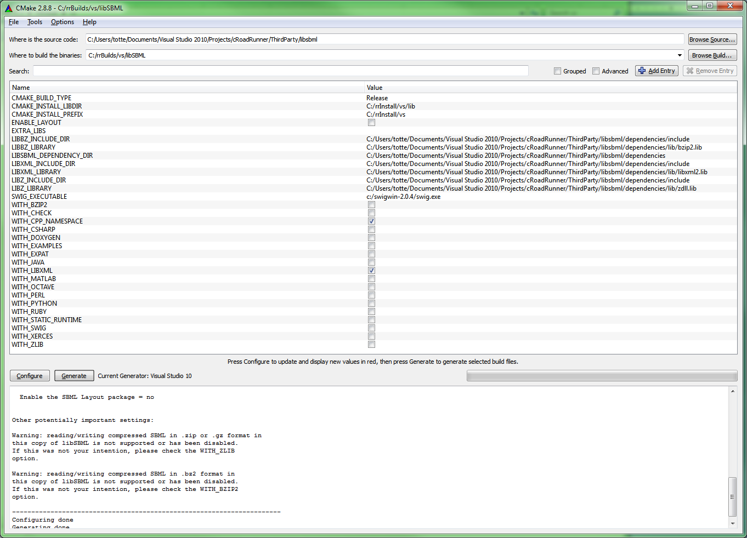
Cmake - libSBML
Setup CMAKE_INSTALL_LIBDIR
Uncheck all, except WITH_CPP_
NAMESPACE and WITH_LIBXML

Slide 16
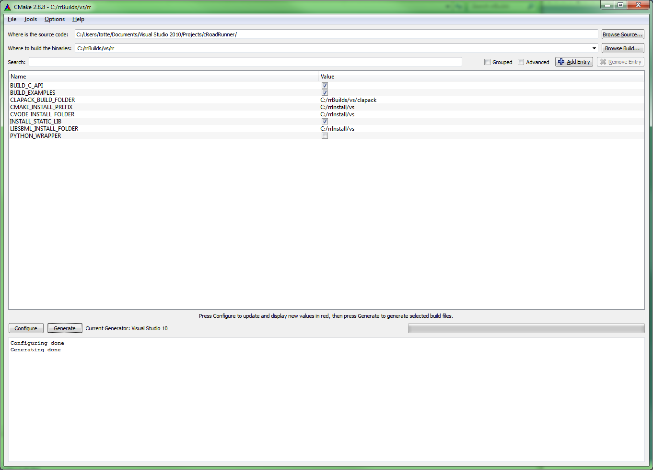
CMake - RoadRunner
Setup clapack build folder
and CVODE, LIBSML install folders

Slide 17
After setting up using CMake UI
Open Visual Studio solution files in build folders, or for command line compilers cd into the actual build folder and type ‘make install’
Compile the ‘All’ target.
Compile the ‘Install’ target -> copies all deliverables to the “install” folder.
(Clapack don’t have an install target)
RoadRunner also have a PACKAGE target -> creates a roadrunner installer
as well as a docs target -> creates doxygen documentation.

Slide 18
How to make the RoadRunner (or any) library useful?
Application
Programming
Interface
Create an API
Hide complexity
Make the API OS platform independent
Expose the API to any programming
language

Slide 19
API creation
RoadRunner
(C++)
libSBML
(C++)
libStruct
(C++)
libXML2
Iconv
Zlib
… + others
clapack
(C)
blas
f2c
lapack
Sundials
(C)
cvode
kinsol
nvector
NOMSupport
(C++)
(libSBML)
loadSBMLFromFile(fileName)
Simulate()
GetResult()
Hundreds of functions and attributes
Building/Compiling/Managing
all this is complex
Building/Compiling/Managing
one single library with a few functions
is easy

Slide 20
Improving RoadRunner
Aim for a C- API deliverable having only one shared library.
Would requires to build libSBML with no ‘shared’ dependencies (not easy ?)
Cmake
Create bindings for Python, Delphi(?), C#(?)
Incorporate 3rd party build file generation into RoadRunners CMake system.
Then one build, builds everything.
The Core
Still need (much) work to conform to libSBML specifications and to pass
libSBML test cases.

