Slide 1
Network Analysis
0v3rByt3

Slide 2
Helps With:
Analysing the network at a low level
Understanding network packets
Information Gathering
Man In the Middle Attacks
etc…

Slide 3
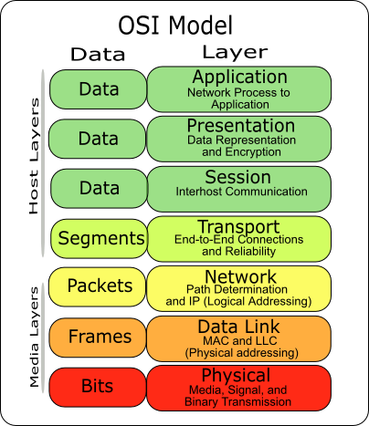

Slide 4
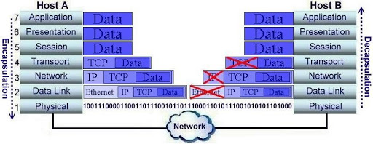
OSI Model

Slide 5
Tools To Use:
tcpdump https://wizardzines.com/zines/tcpdump/
WireShark
tshark
chaosreader (summarizes the pcap file)
Common Unix* CLI tools
The one that works

Slide 6
Common Network Capture Logs:
pcap
pcapng (next generation)
libpcap
winpcap
npcap
The difference between these varies little but some tools only work with certain file types.

Slide 7
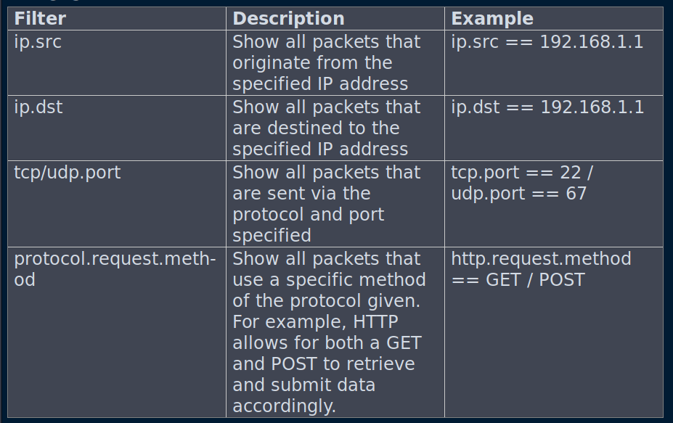
WireShark Filters:

Slide 8
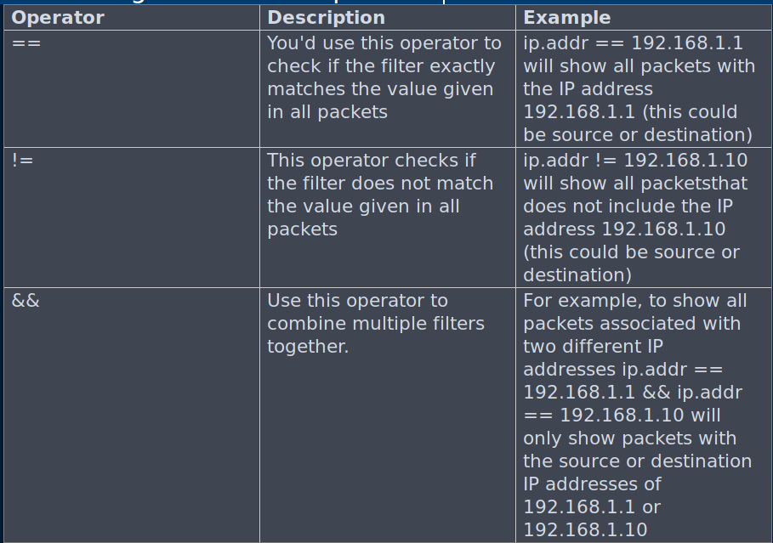
WireShark Combining Filters With Operators:

Slide 9
Resources
File Extraction:
https://www.rubyguides.com/2012/01/four-ways-to-extract-files-from-pcaps/
Tcpdump:
https://wizardzines.com/zines/tcpdump/
WireShark:
https://wiki.wireshark.org/TLS

Slide 10
Practice:
https://github.com/0v3rByt3/network-analysis-challenges
git clone https://github.com/0v3rByt3/network-analysis-challenges.git

