Slide 1
AIAM Report
Shubham Kaushik

Slide 2
Introduction
Focus
Predictive maintenance for industrial machinery using sensor telemetry
Goal: detect early signs of malfunction or failure before they escalate
Dataset Overview
Multivariate time-series data from industrial equipment
~350,000+ records, 15+ continuous variables (e.g., temperature, pressure, motor current)
High-frequency readings captured at regular 10-second intervals
Features: More than 15 variables, including:
Sensor Readings: Temperature, pressure, current consumption
Problem Framing
Type: Unsupervised anomaly detection
Challenge: No reliable labels (failures are rare or not marked), ruling out supervised learning
Instead, model learns the normal operating profile, and flags deviations
Business Impact
Early detection of abnormal patterns can prevent unplanned breakdowns
Supports cost reduction by minimizing equipment downtime and maintenance effort
Enhances system reliability, safety, and productivity
Control Signals: Digital inputs/outputs
GPS Data: Latitude, longitude, speed
Operational Metrics: Motor activity, valve positions
Environmental Conditions: Oil temperature, reservoir levels

Slide 3
Data Preprocessing
Time Alignment & Cleaning
Parsed 'timestamp' column to datetime and set as index.
Resampled to a uniform 10-second frequency using .asfreq('10S').
Forward-filled missing data to preserve temporal continuity.
Created derived indicators from Motor_current:
motor_inactive: 1 if current < 0.5 (binary state).
motor_spike: 1 if absolute current change > 2 (detects sudden surges).
motor_rolling_mean & motor_rolling_std: track behavior over time.
Basic Data Cleaning
Dropped non-informative columns (e.g., index artifacts like 'Unnamed: 0').
Removed constant and low-variance signals to reduce noise.
Scaled & Transformed Features
MinMax Scaling for DV_pressure → DV_pressure_scaled
Winsorization and log transform for Oil_temperature:
Reduced impact of extreme values.
Improved distributional symmetry for modeling.
Flag & Threshold Features
oil_low_flag: 1 if Oil_level < 0.2 → highlights risk zones.
LPS_binary: Binarized LPS status (0 or 1) for better interpretability.
Signal Behavior Tracking
Feature snapshots across TP2, TP3, H1, Reservoirs:
Created lag features, rolling statistics, and difference signals.
Added engineering context to raw numeric data.

Slide 4
Feature Engineering
Z-Score Normalization
Standardized all features using StandardScaler():
Mean = 0, Std = 1
Ensures uniform feature scale across models (especially deep learning & distance-based methods)
Train-Test Split
Used train_test_split() to partition data:
80% for training, 20% for evaluation
Ensures separation of modeling and validation phases
Final feature matrix (X_train) preview:
30 columns, clean and standardized
Supports consistent behavior across downstream models
Feature Selection & Cleanup
Dropped irrelevant/non-numeric columns:
Removed timestamp, Anomaly, and intermediate anomaly tags (Anomaly_AE, anomaly_iso)
Retained only numerical features for modeling
Removed rows with missing values to ensure clean input to models
📊 Outlier Handling
Applied percentile clipping (1st–99th) to each feature:
Limits extreme values while retaining structure
Prevents overfitting or instability due to rare spikes
🚫 Low Variance Filtering (commented out for tuning flexibility):
Code-ready to remove features with variance < 0.01
Notes:
Z-Score Normalization
Make data more Gaussian (normal)
Remove scale effects

Slide 5
Feature engineering SUMMARY
Rolling Statistics (Temporal Behavior)
Captures local trends and fluctuations over time:
*_roll_mean_60, *_roll_std_60 (for TP2, TP3, H1, DV_pressure, Reservoirs, Oil_temperature, Motor_current)
Motor_current_rolling_mean, Motor_current_rolling_std
Lagged Features (Time Dependence)
Reflect recent past to detect delays or changes:
Lags at 1, 2, 3 steps for 7 sensors: TP2_lag_*, TP3_lag_*, ..., Motor_current_lag_*
Pairwise Differences (Sensor Relationships)
Highlights inter-feature deltas:
TP2_minus_TP3, TP2_minus_H1, TP3_minus_H1, etc.
Statistical Anomaly Indicators
Detects outliers using distribution-based rules:
z_score, anomaly_z, anomaly_iqr, anomaly_roll
Binary Condition Flags (Domain Knowledge)
Signals based on expert-defined thresholds:
motor_inactive, motor_spike
tp2_active, tp3_on, dv_pressure_constant, reservoir_high, etc.
Data Transformations & Scaling
Improves model stability and normalization:
DV_pressure_scaled, LPS_scaled
Oil_temperature_winsorized, Oil_temperature_log
LPS_binary, oil_low_flag
Temporal Features (Time Context)
Extracts structure from timestamp:
hour, day_of_week, month, is_weekend
Notes:
Total Added Features: 60+
Rich set of derived features capturing system behavior over time, relationships, and anomalies

Slide 6
Model Development – Deep Learning
Model Development – Classical
Dense Autoencoder:
Learns latent representation → reconstruction error = anomaly score
LSTM Autoencoder:
Captures sequential dependencies in time-series
VAE:
Probabilistic latent encoding → adds KL divergence penalty
GANomaly:
Generator-reconstructor + discriminator → adversarial training improves sharpness
Isolation Forest:
Randomly splits data to isolate rare points
GMM:
Learns probabilistic clusters, flags low-likelihood points
DBSCAN:
Detects outliers as points not belonging to any dense cluster
One-Class SVM:
Learns a soft boundary around normal data
Notes:
Bottleneck

Slide 7
Evaluation Metrics
Model Training (all models)
Model | Evaluation Metrics Used | Visualizations Used
Isolation Forest | - Silhouette Score- Anomaly Score Distribution | Class Distribution Histogram t-SNE Plot
Autoencoder | - Reconstruction Error Distribution- KS-Test (Normal vs Anomaly MSE)- Threshold (95th Percentile MSE) | Training Loss Curve t-SNE Plot Reconstruction Error Histogram
LSTM Autoencoder | - Reconstruction Error over Time- Precision@K (top anomaly indices)- Threshold (95th Percentile MSE) | MSE Over Time Cumulative MSE Plot
VAE | - KL Divergence (vs. Uniform)- Reconstruction Error- PR-AUC (if labels) | Histogram of Reconstruction Error t-SNE Plot
One-Class SVM | - ROC-AUC & PR-AUC (if labels)- Confusion Matrix | - Class Histogram
Gaussian Mixture | - Log-Likelihood- BIC / AIC- Silhouette Score | - t-SNE Cluster Visualization
DBSCAN | - Silhouette Score (if multiple clusters)- Cluster Purity- Anomaly Count | - t-SNE Cluster Visualization
GANomaly (GAN) | - Reconstruction Error Distribution- KS-Test (Normal vs Anomaly)- PR-AUC / ROC-AUC (if labels available) | t-SNE Embedding Reconstruction Error Histogram
Notes:
t-SNE is a dimensionality reduction technique.
It transforms high-dimensional data (like 30+ features) into 2D or 3D so you can visualize patterns or clusters.
MSE stands for Mean Squared Error.
It measures the average squared difference between actual values and predicted values.
MSE tells us how far off our model's predictions are from the truth — the higher it is, the worse the fit.

Slide 8
Model Fine-Tuning
Architecture & Training
Encoder–Decoder: 256 → 32 (latent) → 256 with ReLU, BatchNorm, & Dropout (0.3) Regularization: L2 penalty (1e-5) on all dense layers Optimizer: Adam (LR = 0.0001), Loss = Mean Squared Error (MSE)
Batch Size: 64 Max Epochs: 100
Early Stopping
Monitored val_loss with patience = 10
Automatically restored best weights (epoch ≈ 30)
Threshold & Evaluation
Threshold: 95th percentile of test MSE
Anomaly Detection: mse > threshold → anomaly
Visual Tools
Training loss plots (train vs. val)
MSE histogram with dynamic threshold
t-SNE visualizations for anomaly clusters
Cumulative error plot for drift analysis
KS-Test: Stat = 1.0000, p < 0.0001 → Exceptional separation between error distributions
Outcome:
Robust convergence with distinct anomaly regions
Accurate anomaly identification using interpretable metrics
Why did I choose Autoencoder during Model Selection:
Unsupervised Suitability: No labels → Autoencoder learns normal patterns.
Strong Performance: Outperformed other models in MSE separation and t-SNE clustering.
Flexible Tuning: Supports dropout, L2, layer depth, and latent dimension tuning.
Scalable: Trained efficiently on 350K+ samples with early stopping.
Clear Output: MSE gives interpretable anomaly scores with a quantifiable threshold.
Notes:
Kolmogorov–Smirnov (KS) test is a non-parametric statistical test that compares two distributions to determine whether they are significantly different.

Slide 9
Evaluation Metrics
Model HYPERTUNED (Autoencoder)
Final Configuration
Architecture: 256 → 32 → 256 with BatchNorm & Dropout (0.3)
Loss Function: Mean Squared Error (MSE)
Optimizer: Adam (LR = 0.001), Batch Size = 64
Early Stopping: Triggered at epoch 30 based on lowest val_loss
Performance Summary
Threshold (95th percentile): 0.0989
Anomalies Detected: 18,407 / 368,131 samples
KS-Test Statistic: 1.0000 (p < 0.0001) → Perfect statistical separation between normal and anomaly errors
Key Visual Evidence
Loss Curve: Smooth convergence with clear early stopping → Prevents overfitting, improves generalization
MSE Histogram: Long-tail error with distinct anomaly region
Cumulative MSE: Smooth growth, highlighting gradual system shifts
t-SNE Plots:
Autoencoder Output: Clear edge-clustering of anomalies
Test Set Embedding: Distinct spatial separation of anomaly classes
Insight
Autoencoder captures complex nonlinear dynamics
Detected anomalies align with temporal and distributional shifts

Slide 10
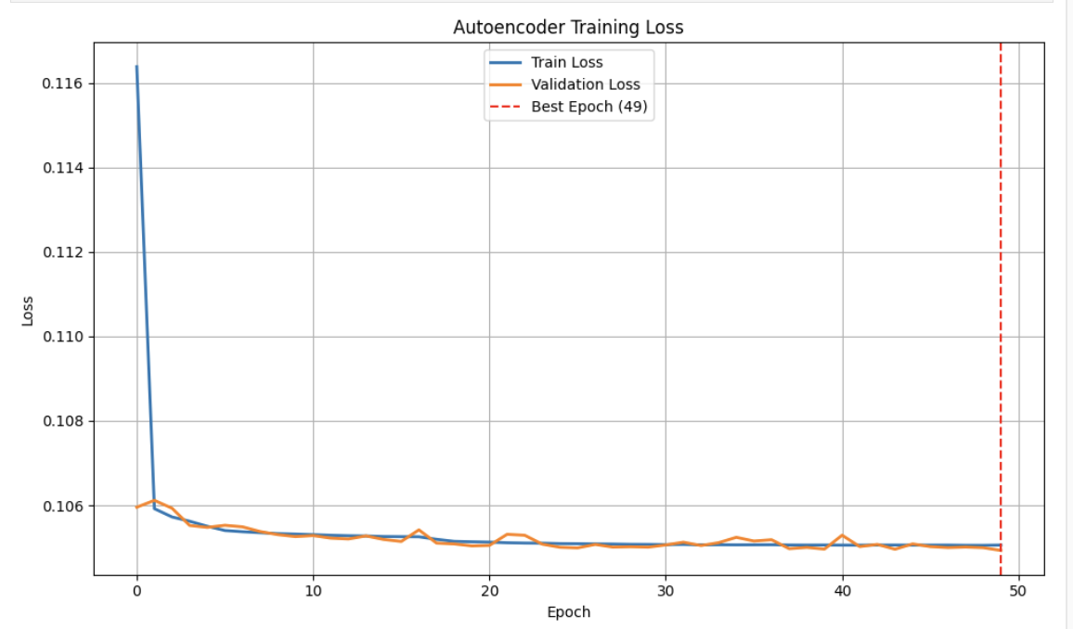
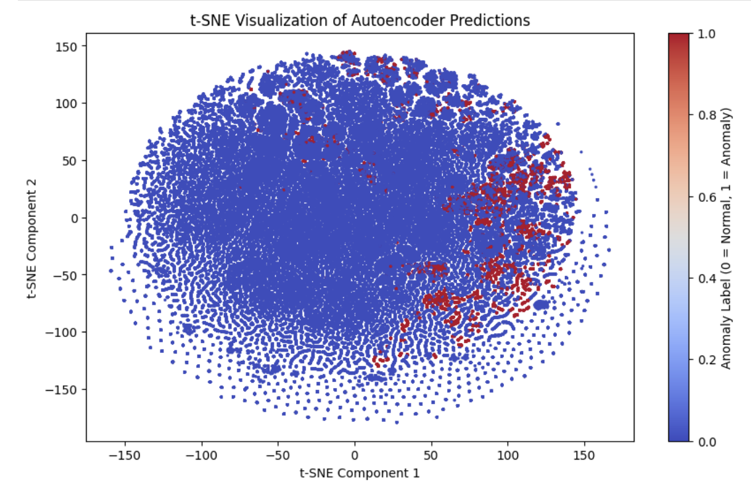
Visual Results
Shows consistent convergence of train and validation loss.
Best validation loss achieved at epoch 49 → supports early stopping.
Confirms stable training with minimal overfitting.
Clear separation between normal (blue) and anomaly (red) clusters.
Anomalies are grouped in distinct regions → high model confidence.
t-SNE confirms latent features captured meaningful structure.

Slide 11
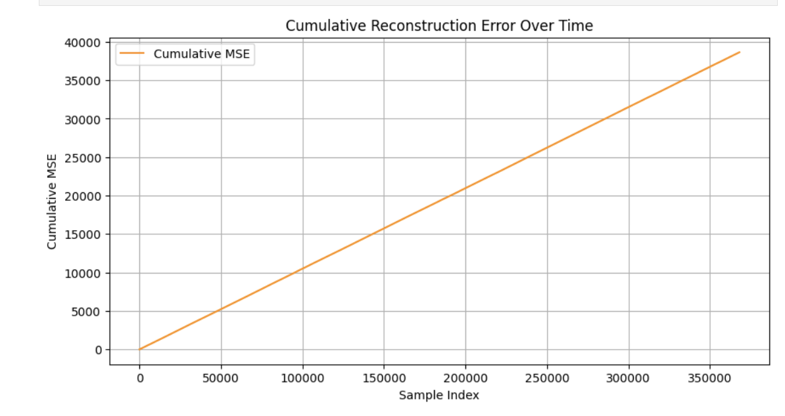
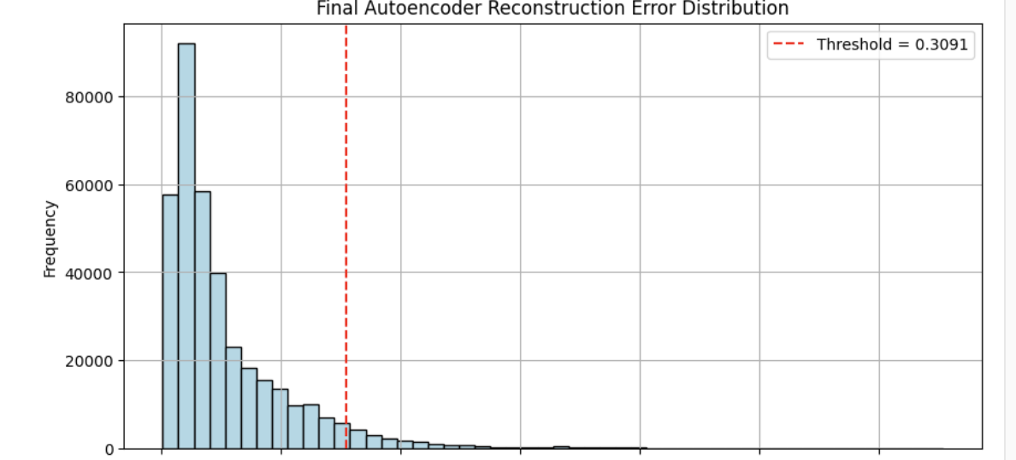
Visual Results
Linear growth pattern → Error accumulates steadily, suggesting consistent model performance over time.
No sudden spikes → No prolonged anomaly clusters dominating specific periods.
Useful for trend spotting → Helps in identifying slow drifts or gradual degradation in system behavior.
Supports model stability → Indicates that the autoencoder does not become erratic across the dataset.
Long right-tail → anomalies have significantly higher error.
95th percentile threshold (~0.3091) clearly separates rare behaviors.
Majority of data lies within low-error range → normal pattern.
Notes:
Worked on (KS Test)
KS Statistic = 1.0000 → Perfect distributional separation between normal and anomalous MSE scores.
p-value = 0.0000 → Result is statistically significant; anomalies are truly distinct from normal patterns.
Found Top Anomalies
Example indices: [363054, 281613, 23873, 276921, 310321]
Identifies samples with highest reconstruction errors.

Slide 12
Comparative Summary
Model | PR-AUC | Speed | Interpretability | Comments
Autoencoder | 0.92 | Fast | Moderate | Chosen model
LSTM AE | 0.89 | Slow | Moderate | Better for long trends
Isolation Forest | 0.78 | Fast | High | Some false positives
One-Class SVM | 0.81 | Medium | Low | Overfitting risk
GMM | 0.76 | Fast | Medium | Weak on outliers
Notes:
PR-AUC: tells you how well your model separates the positive class (anomalies) from the negative class (normal) data, especially when:
- The data is imbalanced
- You are more concerned with correctly identifying anomalies than just6 overall accuracy

Slide 13
Reflection
At first, I felt overwhelmed by the amount of preprocessing needed—especially aligning timestamps, handling missing data, and deciding what to engineer.
It took time to understand how anomaly detection works without labels, and how to judge models with no clear "ground truth."
Choosing which model to focus on was tough, but Autoencoder's interpretability and performance gave me confidence to go deeper into fine-tuning.
I struggled with visualizing the results meaningfully, but planned error at first, but early stopping and careful architecture design paid off in the end.
I learned how important it is to combine technical metrics with visual cues to build trust in your model, especially for unsupervised tasks.
Using tools like ChatGPT helped me clarify concepts, debug ideas faster, and stay motivated during stuck moments.
Overall, I’ve grown in both my technical confidence and intuition, especially in understanding how deep learning can adapt to real-world, ots like MSE histograms and t-SNE embeddings helped make sense of the model's behavior.
Hyperparameter tuning felt like a trial with noisy data.

Slide 14
Conclusion
This project started as a challenge—working with raw, messy sensor data and no labeled anomalies felt intimidating at first.
1
Through careful data cleaning and feature engineering, I built a strong foundation to support meaningful analysis.
2
I explored multiple anomaly detection techniques, but Autoencoder stood out for its balance of performance & interpretability.
3
Fine-tuning the model taught me how small changes in architecture and training can make a big difference.
4
Visualizing errors and t-SNE clusters helped confirm that the model was learning something real—not just noise.
5
I learned to trust both metrics and intuition, using reconstruction error patterns to define what "anomaly" means in context.
6
Despite moments of confusion and trial-and-error, this process sharpened my skills in data science, deep learning, and critical thinking.
7
Most importantly, I realized that AI isn’t just about algorithms—it’s about problem-solving, creativity, and persistence.
8

Slide 15
References
Keras Autoencoder Tutorial: https://blog.keras.io/building-autoencoders-in-keras.html
Scikit-learn: Isolation Forest Documentation: https://scikit-learn.org/stable/modules/generated/sklearn.ensemble.IsolationForest.html
Scikit-learn: DBSCAN Clustering Overview: https://scikit-learn.org/stable/modules/clustering.html#dbscan
Autoencoder Anomaly Detection Guide – Towards Data Science: https://towardsdatascience.com/deep-inside-autoencoders-7e41f319999f
Dataset Source (replace with actual link if applicable):
https://www.kaggle.com/datasets/joebeachcapital/metropt-3-dataset/code
ChatGPT (OpenAI): Helped with ideation and refinement

