Slide 1
Screenshot of AWS Services
Screenshot of AWS Service Usage

Slide 2
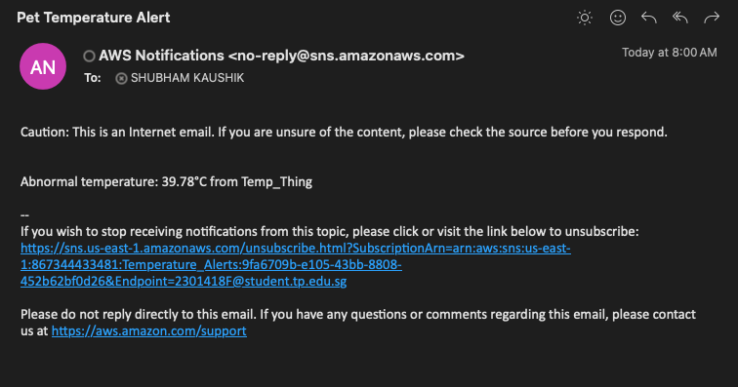
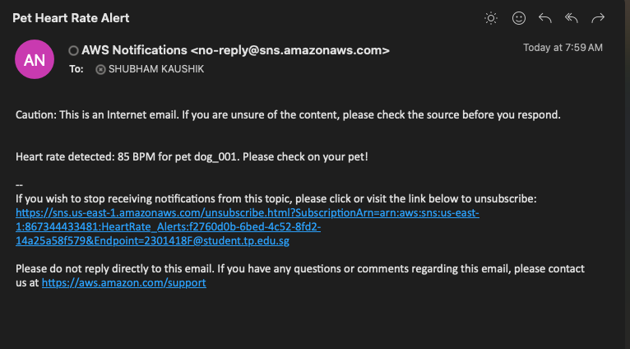
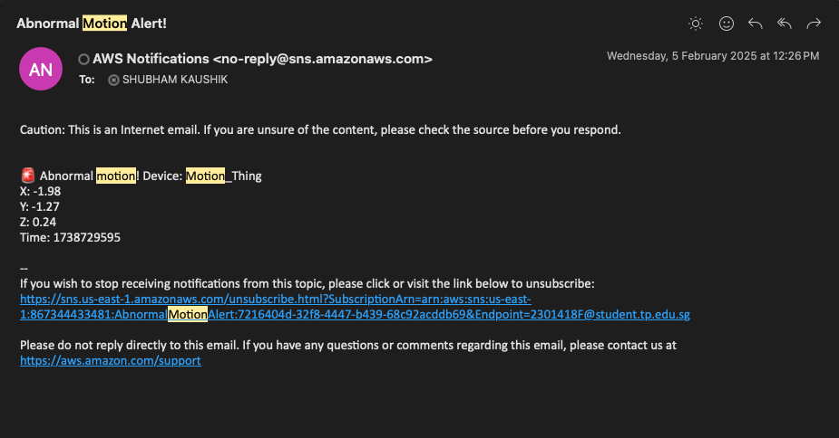
SNS

Slide 3
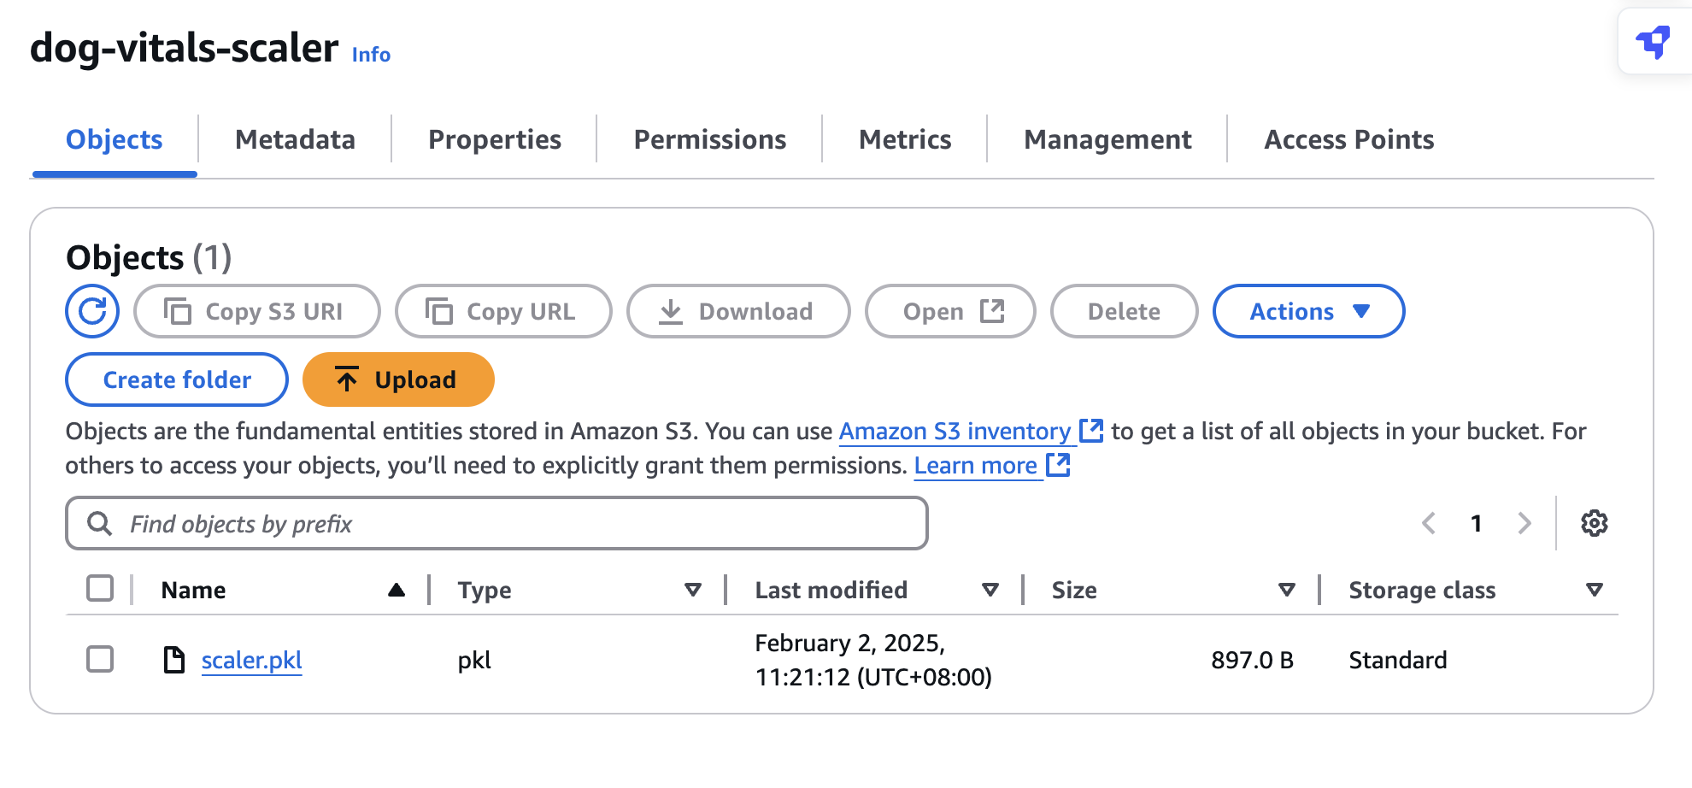
S3
Used for aws SageMaker AI

Slide 4
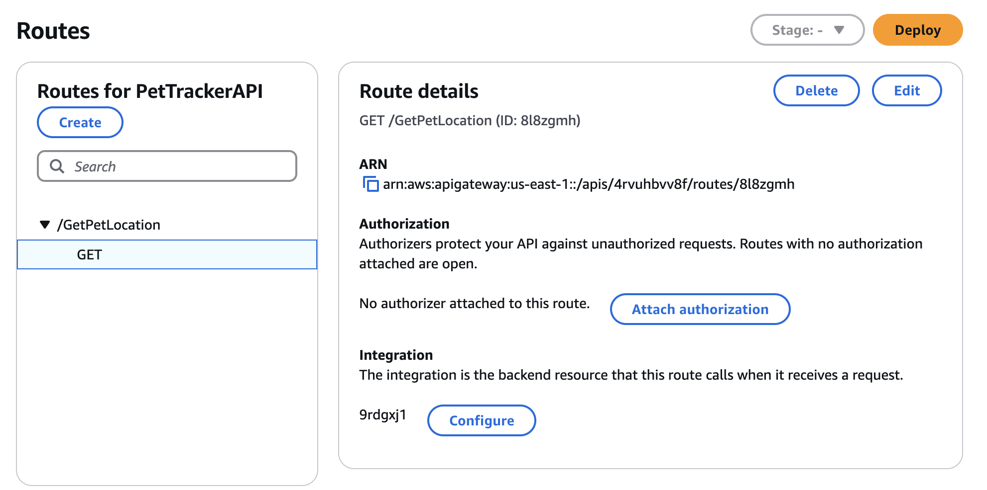
API gateway
Sends GPS data to the GPS_Map

Slide 5
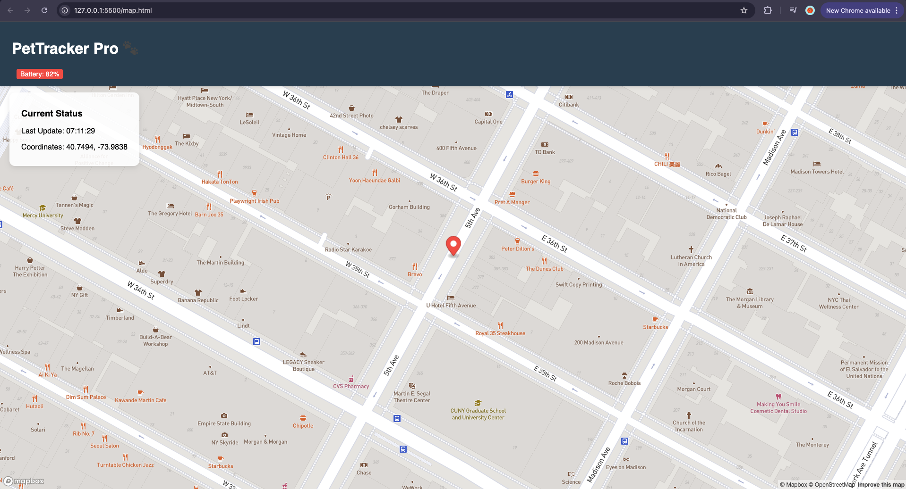
AWS Location sERVICE

Slide 6
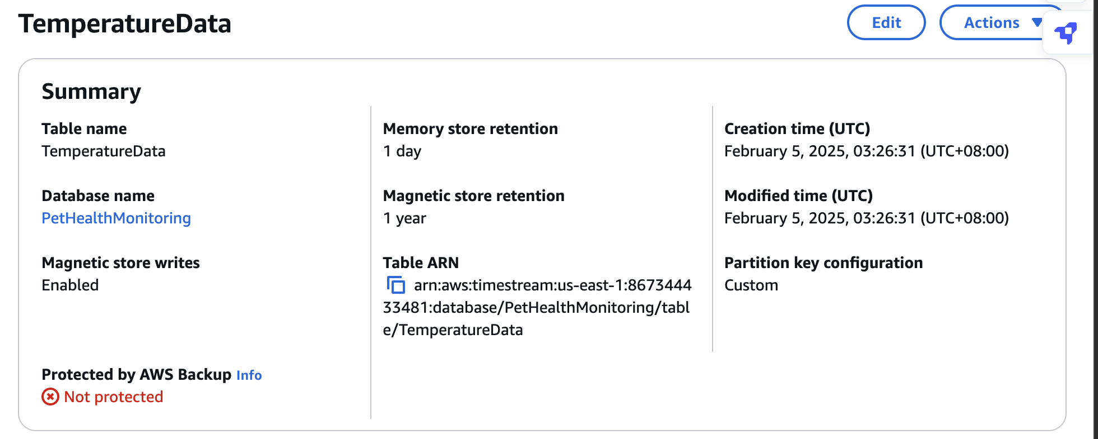
AWS tiMESTREAM

Slide 7
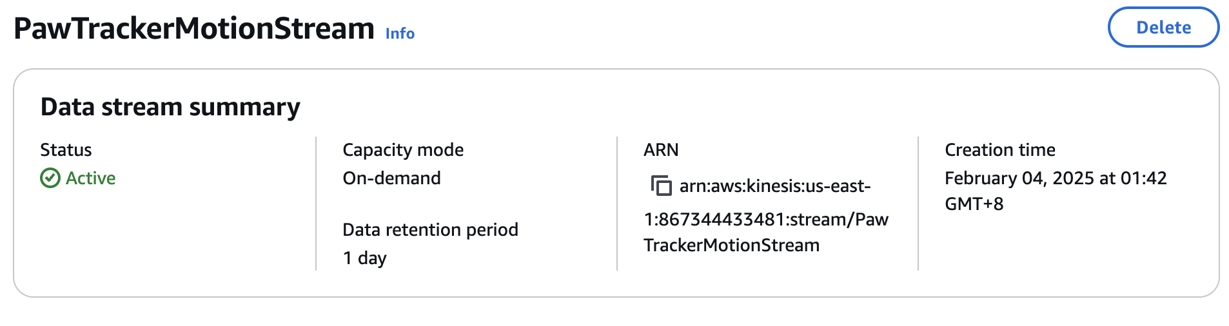
AWS KINESIS
Stores data for Motion Data

