Slide 1
I0T pRESENTATION
dONE BY: shubham kaushik

Slide 2

Solution Background
PawTracker, is worn around pet dog’s neck, addresses these challenges by enabling real-time monitoring of activity, health, and location, ensuring pets stay healthy, safe, and secure.
The IoT solution uses wearable sensors and cloud connectivity, seamlessly capturing and analysing data on movement, vital signs, and GPS location.
Alerts and insights are sent directly to the owner's device, empowering them to act promptly and provide optimal care for their pet.

Slide 3
Features
1. Detects the GPU data: The system also captures GPU data, likely to track the performance of embedded systems or real-time processing during activities like video streaming, facial recognition, or advanced AI model inference on the device.
2. Detects the HeartRate data: PawTracker tracks the pet’s heart rate in real time, providing insights into their cardiovascular health. This data can be analyzed to detect any irregularities, such as a sudden spike or drop in heart rate, which might indicate health issues.
3. Detects the Temperature data: PawTracker monitors the pet’s body temperature to ensure they are not overheating or experiencing fever. Temperature data can be crucial for detecting illness or environmental stress.
4. Detects the Motion data: PawTracker monitors the pet’s movement using sensors, capturing acceleration in different directions (X, Y, Z), and can identify unusual motion patterns that might indicate distress or abnormal behavior.

Slide 4
Target user/ business sector
Business Sector:
The pet care and pet technology sectors are rapidly growing, driven by the increasing humanization of pets.
Owners now view their pets as family members, fueling demand for advanced solutions like health monitors, activity trackers, and GPS-enabled devices.
This trend highlights the need for innovative products that enhance pet well-being and provide peace of mind to owners.
Target User:
PawTracker primarily targets pet owners of aging or special needs dogs.
These users seek reliable tools to monitor their pets' health and activity levels, ensuring timely medical intervention and improved quality of life.
The device appeals to owners who prioritize their pets' well-being and are willing to invest in technology for long-term care.

Slide 5






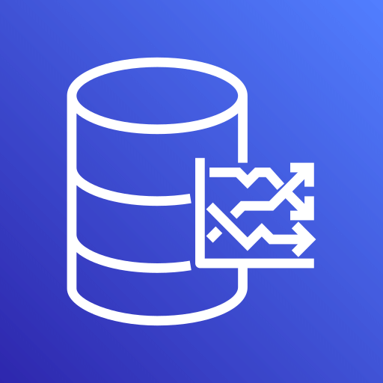



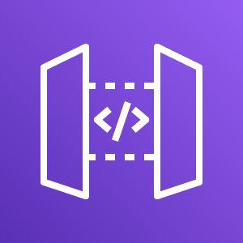
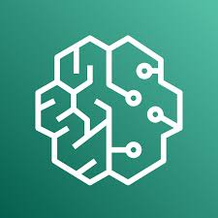
AWS SERVICES utilized
AWS IoT Core
AWS Lambda
AWS DynamoDB
AWS SNS
AWS S3
AWS Location Service
AWS Timestream
AWS CloudWatch
AWS KINESIS
AWS IAM
AWS API Gateway
AWS SageMaker AI

Slide 6
Sensor #1: Heartrate [SYSTEM ARCHITECTURE]
AWS DynamoDB
AWS IoT Core
AWS Lambda
AWS CloudWatch
AWS SNS
AWS SageMaker AI
AWS S3
AWS IAM

Slide 7
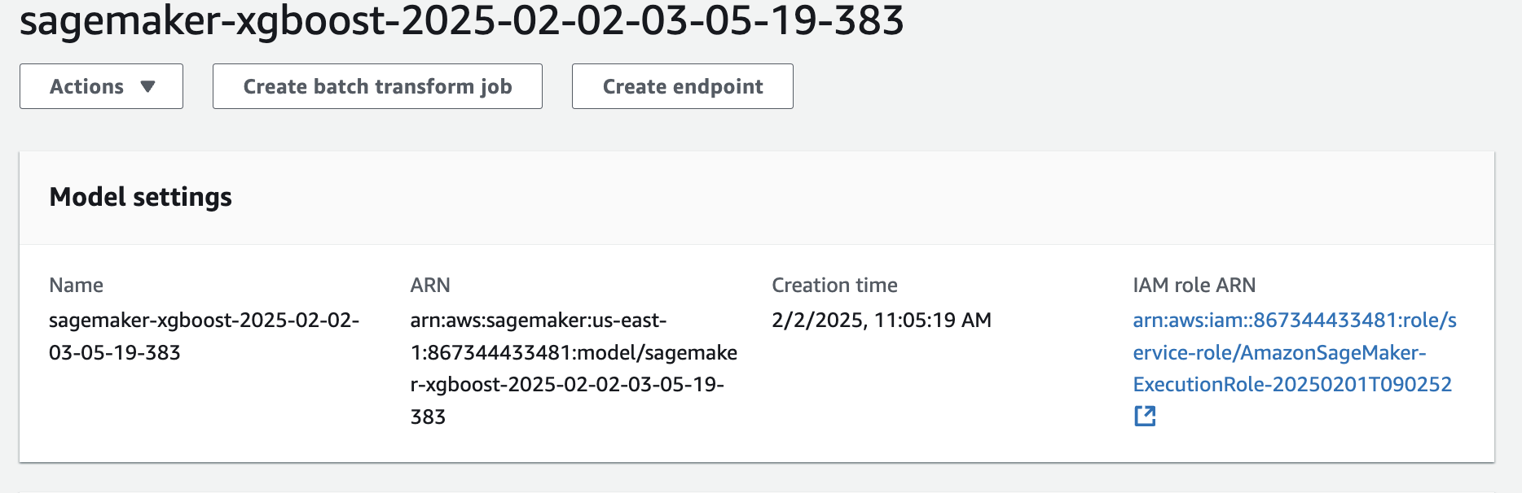
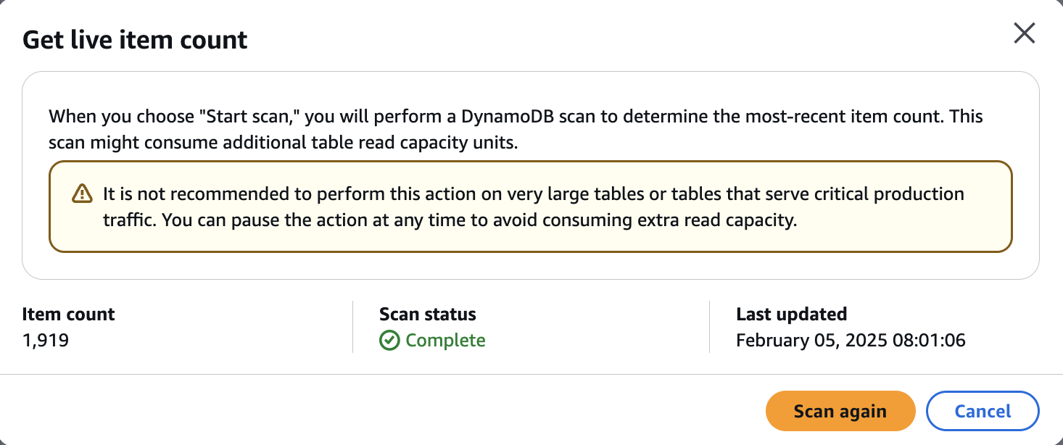
SAGEMAKER TRAINED MODEL
dYNAMO_DB table

Slide 8
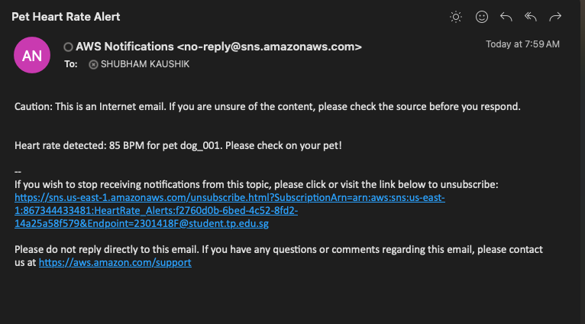
SNS Email alert - Heartrate

Slide 9
Sensor #2: TEMPERATURE [SYSTEM ARCHITECTURE]
AWS Timestream
AWS IoT Core
AWS Lambda
AWS CloudWatch
AWS SNS
AWS IAM
AWS Timestream is a fully managed time-series database service optimized for storing, querying, and analyzing time-stamped data at scale

Slide 10
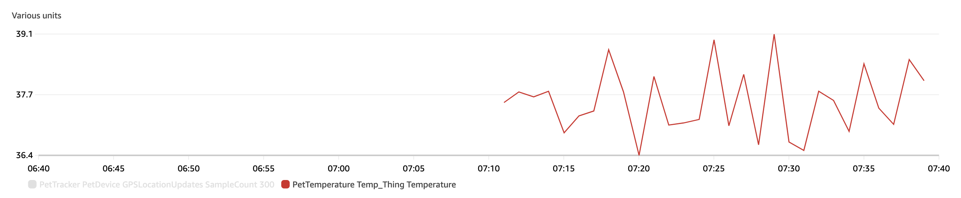
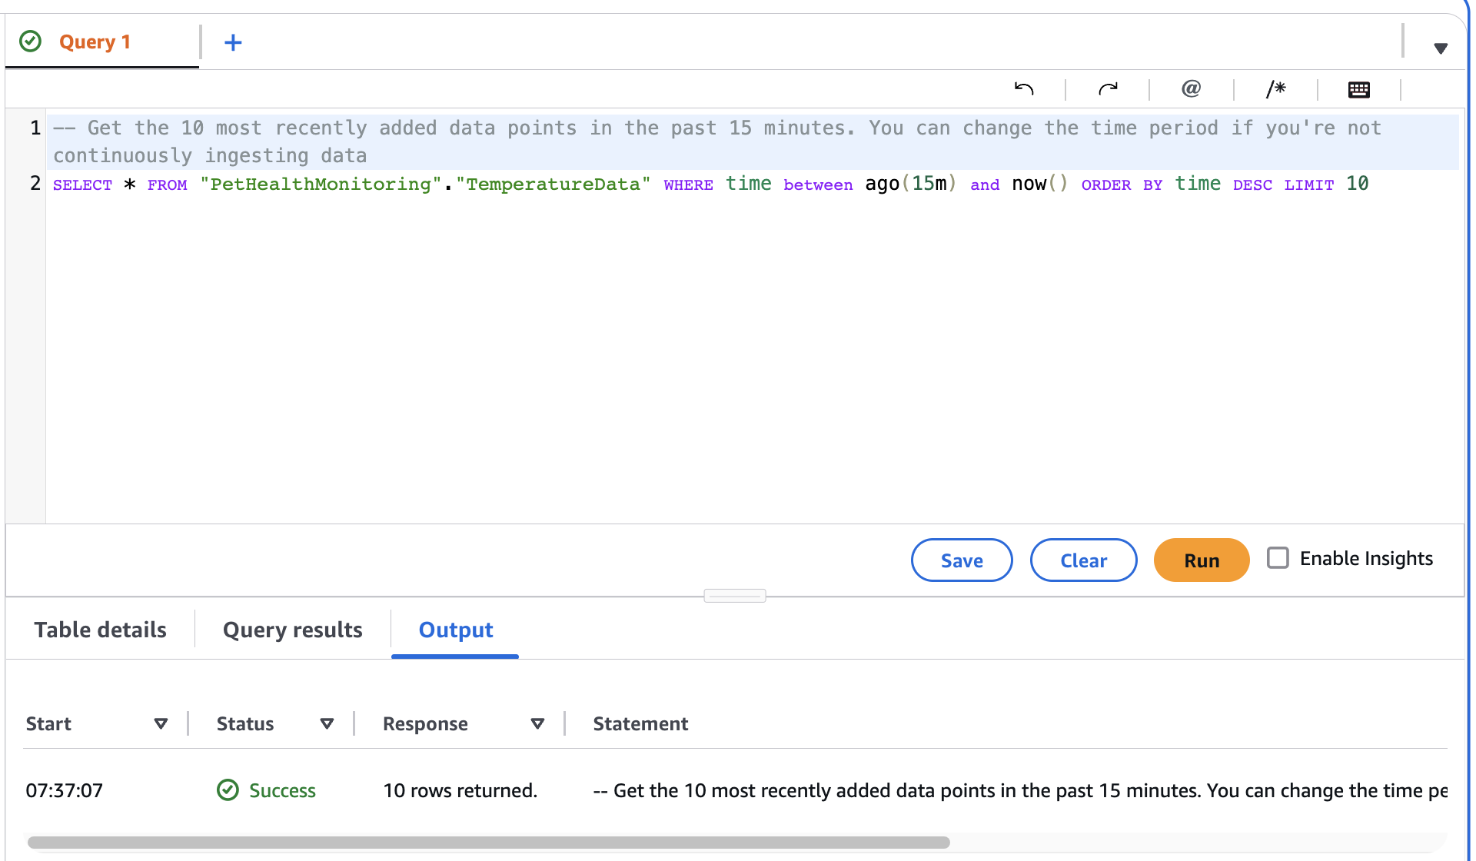
TEMPERATURE GRAPH - cLOUDWATCH
Average temperature
TIMESTREAM DATA - tIMESTREAM
AWS Timestream is a time-series database optimized for handling time-stamped data at scale. It's specifically designed for scenarios where data is collected in time series
Temperature data flow is at a higher frequency

Slide 11
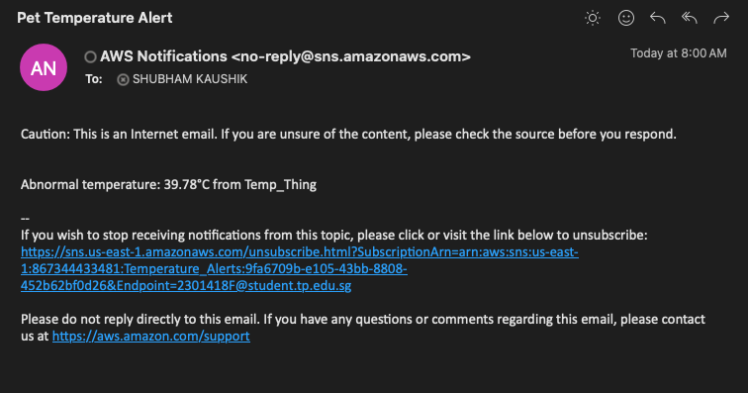
SNS Email alert – tEMPERATURE

Slide 12
Sensor #3: GPS [SYSTEM ARCHITECTURE]
AWS DynamoDB
AWS CloudWatch
AWS IoT Core
AWS Lambda
AWS Location Service
AWS API Gateway
AWS IAM
Webpage

Slide 13
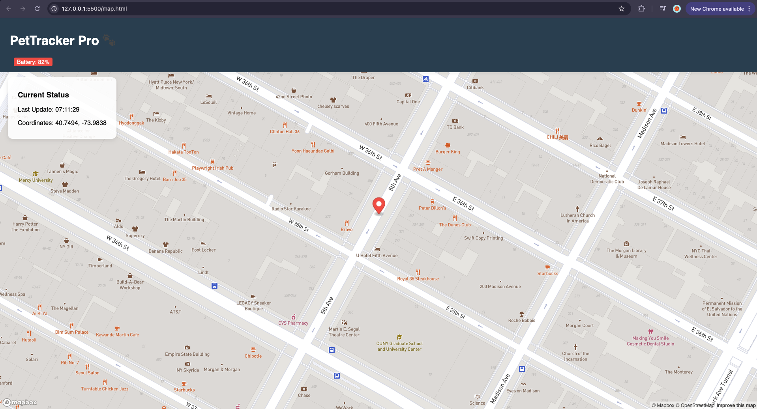
wEBPAGE – HTML Website

Slide 14
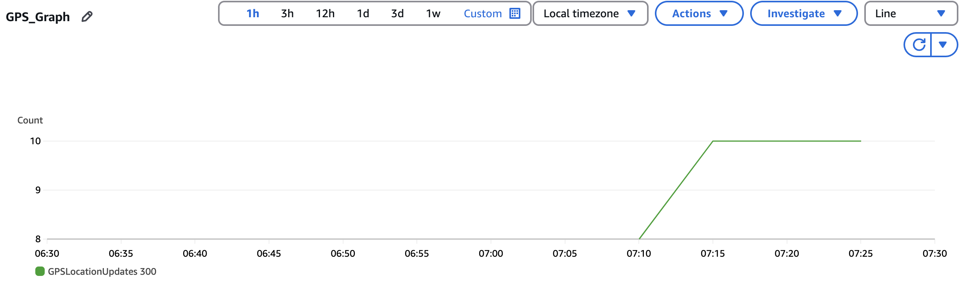
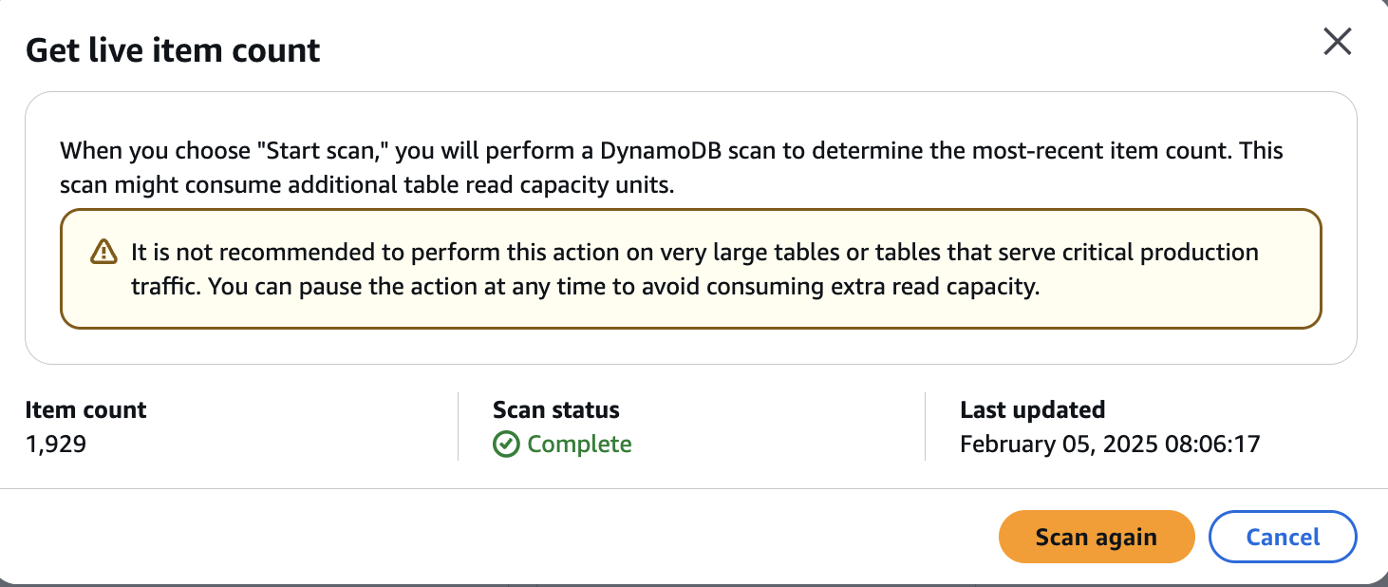
Gps_gRAPH – cloudwatch
The mean count of the GPS Location update
dYNAMO_DB table
Item count in DynamoDB table

Slide 15
Sensor #4: Motion [SYSTEM ARCHITECTURE]
AWS SNS
AWS CloudWatch
AWS IoT Core
AWS Lambda
AWS DynamoDB
AWS KINESIS
AWS IAM
AWS Kinesis is often preferred for real-time data streaming because it’s designed to handle large streams of data with low latency, scalability, and flexibility.

Slide 16
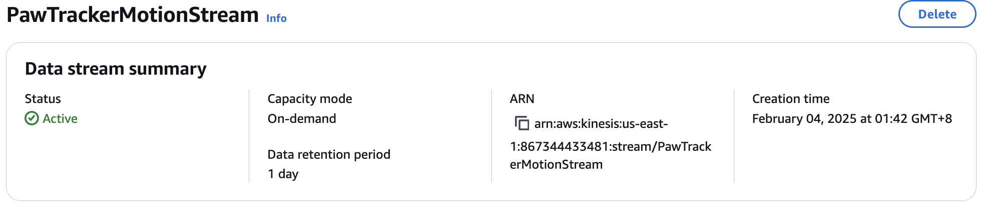
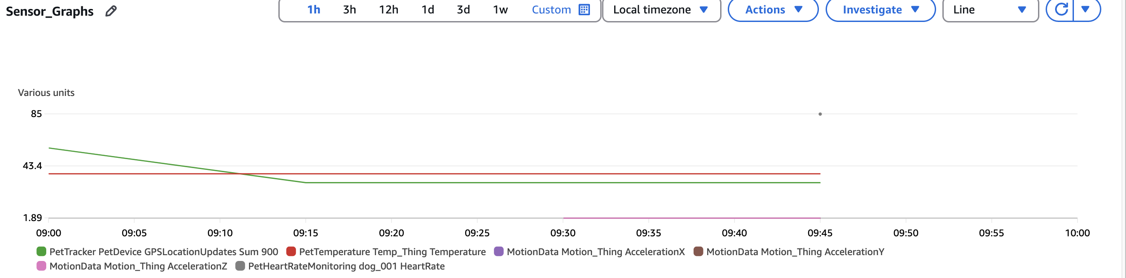
mOTION_DATA – AWS KINESIS Service
mOTION GRAPh – Cloudwatch

Slide 17

Motion_DATA – AWS dynamodb

Slide 18
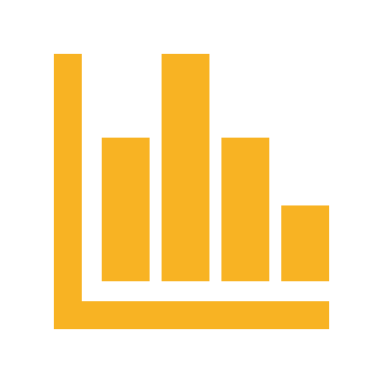
aSSUMPTIONS
Sensor Accuracy: Assumes sensors provide reliable and accurate data for effective monitoring and decision-making.
Real-Time Connectivity: Assumes continuous connectivity for seamless data transmission between IoT devices and AWS services.
Threshold Effectiveness: Assumes predefined thresholds for anomaly detection (e.g., motion, temperature) will be effective in identifying true events without too many false alarms.

Slide 19
LIMITATION
Data Inconsistencies: Handling sensor data that may have occasional inaccuracies or missing values, affecting model reliability and performance.
Scalability Challenges: As the number of IoT devices increases, managing large volumes of real-time data and maintaining low latency could become difficult.
Limited Testing Environment: Testing the solution with synthetic data and limited real-world scenarios may not fully reflect the behavior in actual deployment, potentially impacting its effectiveness.

Slide 20
FUTURE ENHANCEMENT
1. Security Improvements:
Expand the use of IAM roles and policies to ensure fine-grained access control and incorporate encryption at rest and in transit for sensitive data.
2. Edge Computing:
Implement edge processing with AWS IoT Greengrass for faster local processing of data before sending it to the cloud, improving responsiveness and reducing latency.

Slide 21
CHALLENGES/LESSON LEARNT
Reworking System Architecture
Initially, I built a system architecture with AWS EPS, VPC, IAM, S3, and CLI. However, the early design had inefficiencies that forced a redesign later. For example, I initially overcomplicated the integration with multiple AWS services, leading to unnecessary overhead.
Lesson Learned: It's crucial to start with a more modular, simple design and optimize for scalability and performance incrementally. Early testing and validation can help identify potential bottlenecks before committing to complex integrations.
Complex Integration of AWS Services:
Connecting different services like AWS IoT Core, DynamoDB, and SNS proved to be tricky, especially in managing real-time data flow across platforms.
Lesson Learned: A more thorough understanding of AWS documentation and better modularization of code could help streamline integration and reduce errors.

Slide 22
Thank you
sHUBHAM KAUSHIK

