Slide 1
Introduction to RESTful APIs with Flask
Subhajit Das

Slide 2
Agenda
intro to RESTful API
intro to Flask
setup virtual environment
setup flask and hello world API
create our first GET API

Slide 3
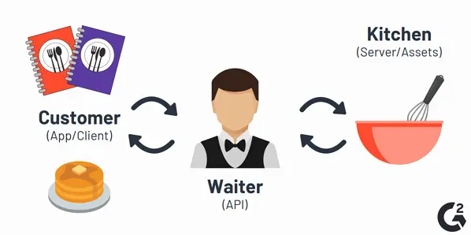
intro to RESTful API
intro to Flask and setup
hello world API
create our first GET API
test GET API using Postman
API (Application Programming Interface) is just a set of rules ( Interface) that enable different software components to communicate and transfer data. REST (REpresentational State Transfer) API architecture style -
Client and server are different
Stateless
‹#›

Slide 4
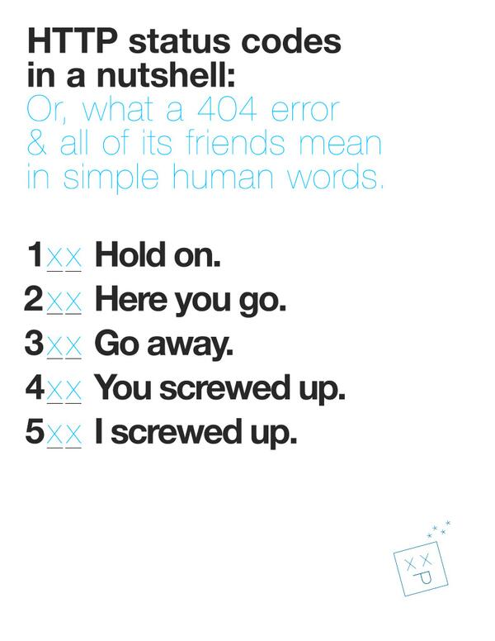
intro to RESTful API
intro to Flask and setup
hello world API
create our first GET API
test GET API using Postman
Communication between Client and Server
Making Requests
REST requires that a client make a request to the server in order to retrieve or modify data on the server. A request generally consists of:
HTTP Verbs
GET
POST
PUT
DELETE
Headers and Accept parameters
Paths
Sending Response
Response Codes
200 - ok
400 - BAD REQUEST
404 - NOT FOUND
500 - Internal Server error
‹#›

Slide 5
intro to RESTful API
intro to Flask and setup
hello world API
create our first GET API
test GET API using Postman
Flask is a Python micro-framework for building web applications and web APIs
Minimal, lightweight framework
Can build the whole app in one file
Virtual Environment:
isolates your application dependencies from rest of the system
Commands to create and activate:
python3 -m venv env
source env/bin/activate
Install Flask:
pip install Flask
‹#›

Slide 6
intro to RESTful API
intro to Flask and setup
hello world API
create our first GET API
test GET API using Postman
create a file call hello.py ( you can name it anything)
from flask import Flask
app = Flask(__name__)
@app.route("/hello", methods=[‘GET’] )
def hello_world():
return "Hello, World!"
to run the app: type on your terminal:
flask --app hello run
‹#›

Slide 7
intro to RESTful API
intro to Flask and setup
hello world API
test GET API using Postman
create our first GET API
Download and Install Postman:
https://www.postman.com/downloads/
Type the URL in the Postman
Select the method GET
‹#›

Slide 8
intro to RESTful API
intro to Flask and setup
hello world API
test GET API using Postman
create our first GET API
# app.py
from flask import Flask, jsonify
app = Flask(__name__)
# data
books = [
{"id": 1, "name": "War and Peace"},
{"id": 1, "name": "Crime and Punishment"},
{"id": 1, "name": "Anna Karenina"}
]
@app.route('/books', methods=['GET'])
def get_books():
return jsonify(books)
if __name__ == "__main__":
app.run(port=5000)
‹#›

