Slide 1
CHUCAR Project
201845004 김영웅

Slide 2
프론트 : ReactNative
백엔드 : NodeJS
신차/중고차 견적 요청 어플리케이션
(비대면 상담)

Slide 3
진도상황
IntroPage
LoginPage
MainPage
EstimatePage
ApplyPage
replyPage
profilePage

Slide 4
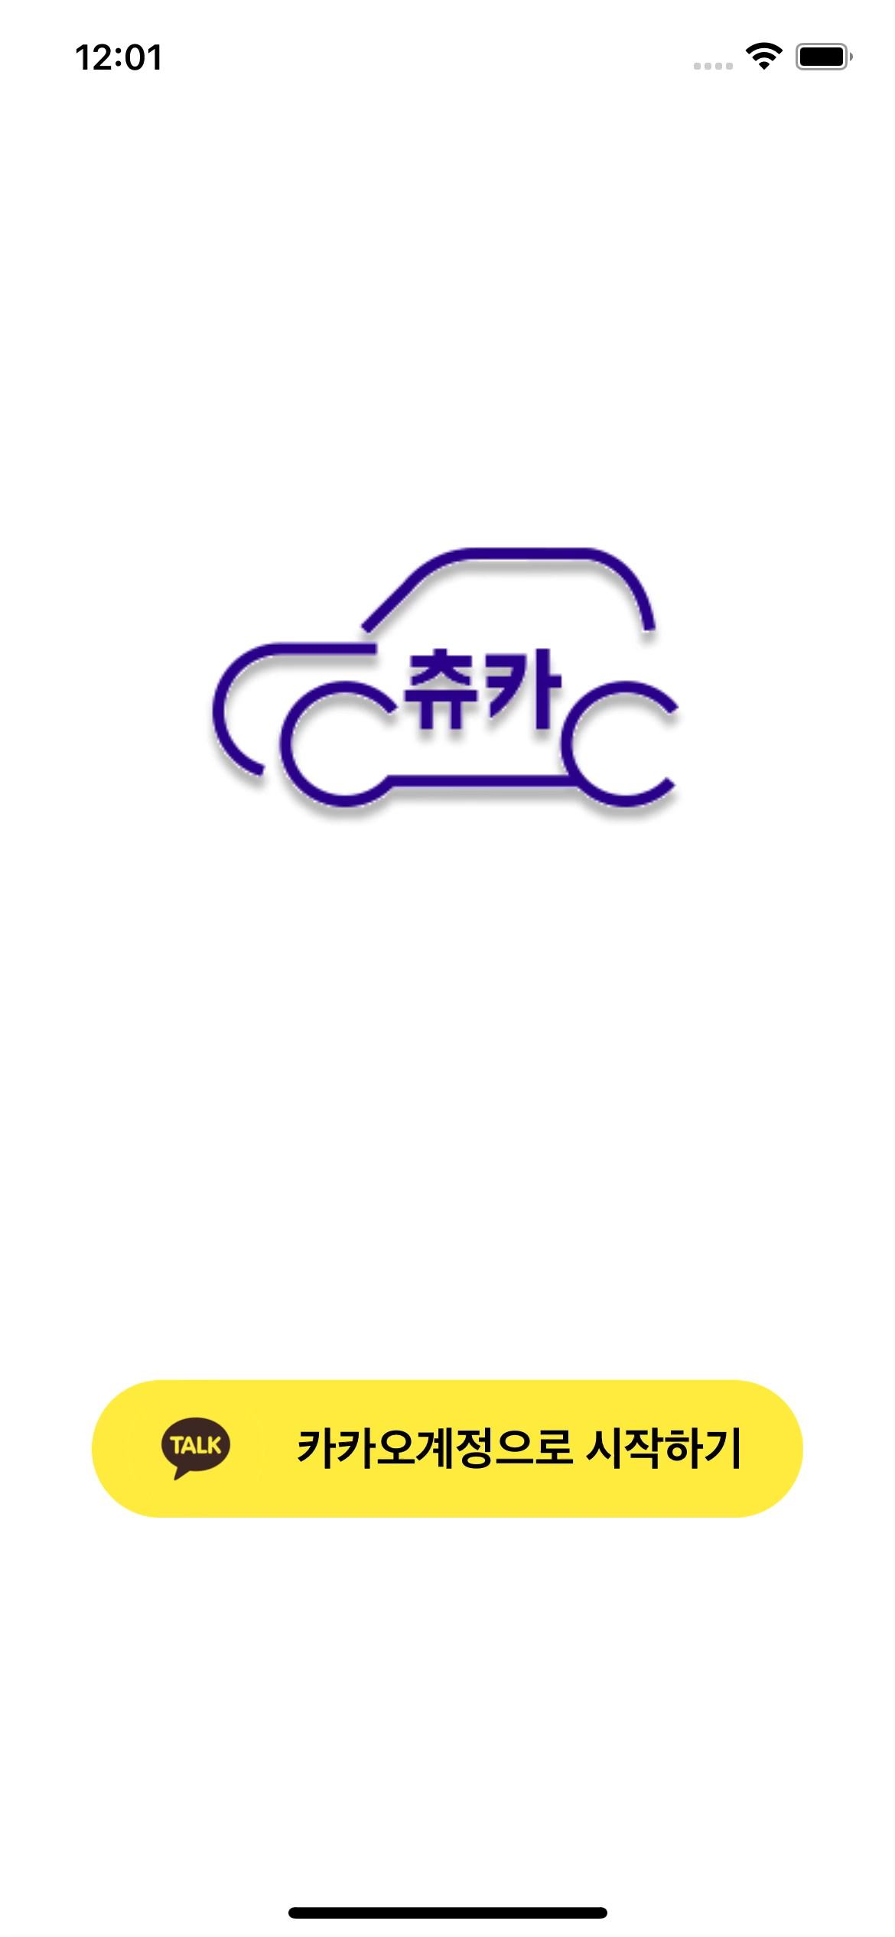

Slide 5
IntroPage
import React from 'react';
import { StyleSheet,View,Text,Image,TouchableOpacity } from 'react-native';
// img
import Titlelogo from '../../img/chucar-logoN1.png';
import kakaoTalk from '../../img/kakao-talk.png';
export default function IntroScreenPage({ navigation }) {
return (
<View
style={{
flex: 1,
backgroundColor: 'white',
alignItems: 'center',
justifyContent:'space-evenly',
}}>
<Image
source={Titlelogo} />
<TouchableOpacity
style={{
borderRadius:100,
backgroundColor:'#FFEB3B',
width:310,
height:60,
flexDirection:'row',
alignItems:'center',
justifyContent:'center',
}}
onPress={()=>navigation.navigate('LoginPage')}
>
<Image
source={kakaoTalk}
style={styles.introKImageStyle}
resizeMode='cover'
/>
<Text
style={{
fontWeight:'bold',
fontSize:20,
marginRight:10,
}}
> 카카오계정으로 시작하기</Text>
</TouchableOpacity>
</View>
);
};
const styles = StyleSheet.create({
introImageStyle: {
width: 200,
height: 200,
},
introKImageStyle: {
width: 60,
height: 60,
marginRight:10,
},
});

Slide 6
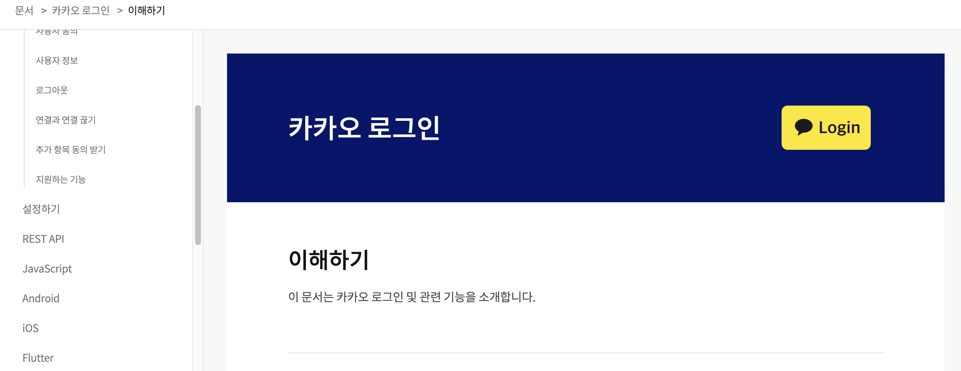

Slide 7
LoginPage
const requestToken = async (request_code) => { //토큰신청
console.log('requesttoken')
var request_token_url = "https://kauth.kakao.com/oauth/token";
try{
token = await axios({
method: 'POST',
url: request_token_url,
headers:{'content-type':'application/x-www-form-urlencoded;charset=utf-8'},
data:qs.stringify({
grant_type: 'authorization_code',//특정 스트링
client_id:'9e7627ff0adc857af4fd5e69de0222e6',
redirectUri:`${storage.chucar_url}/oauth`,
code:request_code,
client_secret:'9F00S9wCb8X6cggmdqesUVTYoQeD41P4'
})//객체를 string 으로 변환
})
const users = await axios({
method: 'GET',
url:`${storage.chucar_url}/showInfo`,
headers:{
'content-type':'application/x-www-form-urlencoded;charset=utf-8',
Authorization: `${token.data.access_token}`,
}
})
.catch(function (err) { //실패
console.log(err.data);
})
await storage.setData('id',users.data.id);
await storage.setData('name',users.data.nickname);
await storage.setData('access_token',token.data.access_token);
await storage.setData('refresh_token',token.data.refresh_token);
await storage.setData('expires_in',token.data.expires_in);
axios.get(`${storage.chucar_url}/showInfo`, {
headers:{
Authorization: `${token.data.access_token}`,
'content-type':'application/x-www-form-urlencoded;charset=utf-8'
}
})
.then(function (res) { //성공
navigation.popToTop();
navigation.replace('MainPage');
Alert.alert('알림','로그인이 완료되었습니다.')
})
.catch(function (err) { //실패
console.log('로그인에 실패했습니다.' + err);
})
}catch(err){
console.log('로그인에 실패했습니다.' + err);
}
};
return (
<View style={{ flex: 1 }}>
<WebView
originWhitelist={['*']}
scalesPageToFit={false}
source={{ uri: `https://kauth.kakao.com/oauth/authorize?client_id=9e7627ff0adc857af4fd5e69de0222e6&redirect_uri=${storage.chucar_url}/oauth&response_type=code&prompt=login`}}
injectedJavaScript={runFirst}
javaScriptEnabled={true}
onMessage={(event) => {LogInProgress(event.nativeEvent.url); }}
/>
</View>
);
};
import React from 'react';
import { View,TouchableOpacity,Text,Alert } from "react-native";
import storage from '../storage';
import { WebView } from 'react-native-webview';
import axios from 'axios';
import qs from 'qs'
const runFirst = `window.ReactNativeWebView.postMessage("this is message from web");`;
export default function KakaoLogin ({ navigation }){
navigation.setOptions({
headerShown: false,
swipeEnabled:false
})
self.onmessage = (event) => {
console.log(`${event.url}`);
};
const LogInProgress = async (data) => {
try{
// Alert.alert(data);
console.log('lgp')
console.log(data)
// access code는 url에 붙어 장황하게 날아온다.
// substring으로 url에서 code=뒤를 substring하면 된다.
const exp = "code=";
var condition = data.indexOf(exp);
if (condition != -1) {
var request_code = data.substring(condition + exp.length);
console.log("access code :: " + request_code);
// 토큰값 받기 함수 : 인가코드를 넘겨줌
await requestToken(request_code);
} else {
console.log('인가코드를 받지 못했습니다.');
}
} catch(err){
console.log(err.data)
}
};

