Slide 1
IILM UNIVERSITY
Greater Noida
ELK Centralized
Log Monitoring
INTERNSHIP
PROJECT
Cybersecurity Internship Project
Unlox • 1 June 2026 – 22 August 2026
Cyber Intern (Web Security)
Aanya Yadav
Roll No. 25SCS1003002388 | Class 2 CSE 11
IILM UNIVERSITY
Greater Noida

Slide 2
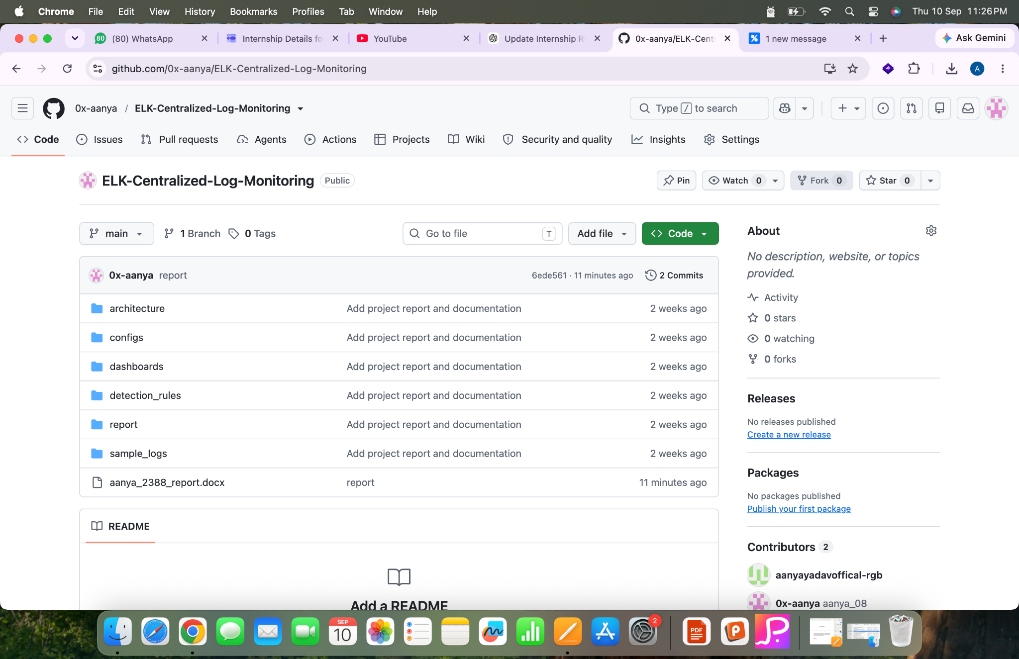
Project Overview
Why this project?
Centralized visibility for security logs
• Collects logs from multiple endpoints into a centralized monitoring pipeline.
• Processes and transforms security-relevant log data for analysis.
• Uses dashboards and detection rules to make suspicious activity easier to identify.
• Project repository is organized around architecture, configs, dashboards, detection rules, sample logs and reporting.
github.com/0x-aanya/ELK-Centralized-Log-Monitoring
IILM UNIVERSITY
Greater Noida
Aanya Yadav | 02

Slide 3
Problem Statement
Security monitoring challenge
Why centralized log monitoring is needed
Scattered logs
Endpoints generate security events in different locations and formats.
Slow investigation
Manual log review makes it harder to correlate events quickly.
Limited visibility
Important indicators can be missed when there is no unified view.
Detection gap
Repeated or suspicious patterns need consistent detection rules.
IILM UNIVERSITY
Greater Noida
Aanya Yadav | 03

Slide 4
Objectives
Project goals
What the project aims to achieve
01
02
03
04
Centralize
Normalize
Detect
Visualize
Bring endpoint logs into one monitoring workflow.
Process logs into a consistent, searchable structure.
Apply rules for failed logins, file integrity and suspicious activity.
Present security events through dashboards for faster analysis.
IILM UNIVERSITY
Greater Noida
Aanya Yadav | 04

Slide 5
System Architecture
ELK pipeline
Endpoint → Collection → Processing → Search → Visualization
Windows Endpoint
Winlogbeat
Logstash
Ingest + Transform
Elasticsearch
Index + Search
Kibana
Dashboards + Analysis
Linux Endpoint
Filebeat
The repository structure supports configuration, architecture documentation, dashboards, detection rules, sample logs and project reporting.
IILM UNIVERSITY
Greater Noida
Aanya Yadav | 05

Slide 6
Technology Stack
Core components
Tools and technologies
ELK Stack
Elasticsearch • Logstash • Kibana
Central log storage, processing and visualization
Beats
Winlogbeat • Filebeat
Endpoint log collection
Security Rules
Failed login • File integrity • SSH monitoring • Suspicious login
Rule-based event detection
Project Assets
Configs • Dashboards • Sample logs • Architecture • Report
Reproducible project organization
IILM UNIVERSITY
Greater Noida
Aanya Yadav | 06

Slide 7
Detection Rules
Security use cases
Examples of security events to monitor
Failed Login
Repeated authentication failures can indicate password guessing or brute-force activity.
File Integrity
Changes to monitored files can indicate unauthorized modification.
SSH Monitoring
Track SSH-related events for unusual access patterns.
Suspicious Login
Flag login behavior that matches defined suspicious conditions.
IILM UNIVERSITY
Greater Noida
Aanya Yadav | 07

Slide 8
Monitoring Workflow
From raw event to insight
How a security event moves through the system
1
2
3
4
5
6
Generate
Collect
Process
Index
Detect
Visualize
Endpoint creates an event/log
Beats forwards the log
Logstash parses/transforms it
Elasticsearch stores it for search
Rules identify relevant patterns
Kibana presents the result
IILM UNIVERSITY
Greater Noida
Aanya Yadav | 08

Slide 9
Project Value
Expected outcomes
What the solution provides
Unified visibility
Security logs become accessible through one centralized monitoring pipeline.
Faster investigation
Searchable and visualized events reduce the effort required to inspect raw logs.
Repeatable detection
Detection rules provide a consistent way to flag selected security patterns.
Scalable foundation
The architecture can be extended with more endpoints, rules and dashboards.
IILM UNIVERSITY
Greater Noida
Aanya Yadav | 09

Slide 10
My Internship Contribution
Unlox
My role in the project
• Worked as a Cyber Intern with a focus on Web Security.
• Built and organized a centralized log-monitoring project around the ELK stack.
• Worked with endpoint log collection, configurations, security detection rules and dashboards.
• Documented the architecture, sample logs and project report in a structured GitHub repository.
• Internship period: 1 June 2026 – 22 August 2026.
Aanya Yadav
B.Tech CSE
Class: 2 CSE 11
Roll No.: 25SCS1003002388
Project Repository
0x-aanya / ELK-Centralized-Log-Monitoring
IILM UNIVERSITY
Greater Noida
Aanya Yadav | 10

Slide 11
Future Scope
Possible extensions
Where the project can go next
1
More endpoints
Extend monitoring to additional servers, cloud workloads and applications.
2
Advanced detection
Add richer correlation, anomaly detection and alert prioritization.
3
Secure transport
Harden endpoint-to-collector communication and access controls.
4
Operational alerts
Integrate notifications and incident-response workflows.
5
Threat intelligence
Enrich events with external indicators and contextual security data.
IILM UNIVERSITY
Greater Noida
Aanya Yadav | 11

Slide 12
Conclusion
ELK Centralized Log Monitoring provides a structured approach to collecting, processing, detecting and visualizing security events. The project combines cybersecurity concepts with practical monitoring and documentation skills.
Aanya Yadav
Cyber Intern (Web Security) • Unlox
IILM UNIVERSITY
Greater Noida

