Slide 1
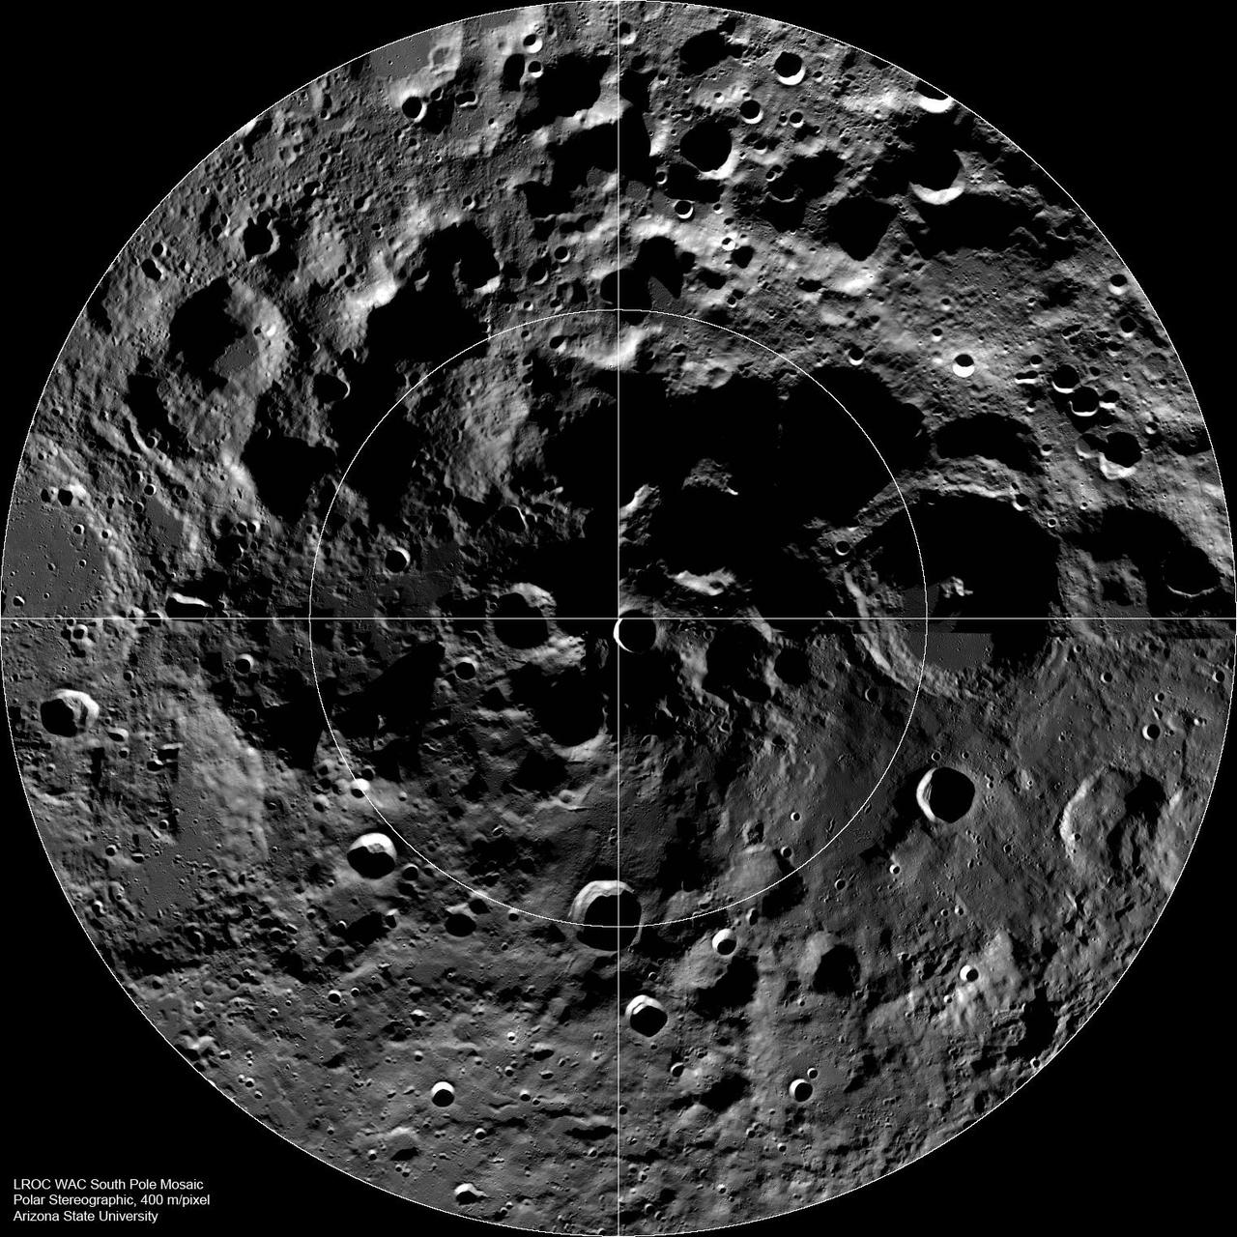
NASA SPACE APPS CAIRO 2026 | CHALLENGE: LUNAR LANDING SITE NAVIGATOR
PROJECT P.A.T.H.
Polar Artemis Telemetry & Horizon-Planner
Guiding humanity back to the Moon: Real-time client-side landing window screening and LOLA topographic occlusion clearance for Artemis III.
MISSION PROFILE CONTRAST
1969 APOLLO: Sunlit central equatorial plains. High solar elevation, flat terrain, zero shadow traps.
ARTEMIS III: Lunar South Pole (83°S - 90°S). Sun grazes horizon at < 2°. Shadows exceed 50 kilometers. Landing just a few hours late means dead batteries and loss of Earth communication.
Presenter: Ahmed Tarek • Elsewedy University of Technology (SUT) • p-a-t-h.vercel.app
NASA LRO LOLA Altimetry (Lunar South Pole)
Elevation map: Blue = -4km crater basins; White/Red = +2km peaks.
PROJECT P.A.T.H. • TACTICAL ARTEMIS III LANDING SITE SCREENING • 01 / 06

Slide 2
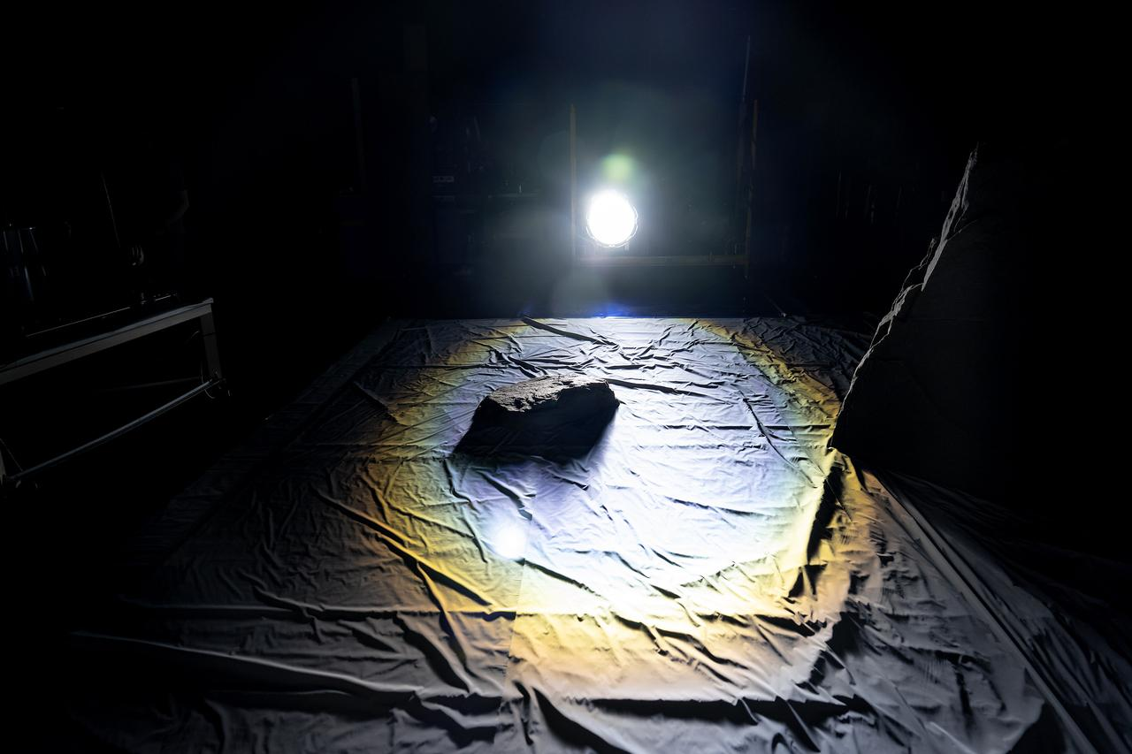
ORBITAL MECHANICS & TOPOGRAPHIC HAZARDS
WHY IS THE LUNAR SOUTH POLE SO COMPLICATED?
4 KM CRATER RIMS → 50+ KM SHADOWS
Because the Sun never climbs above 2°, crater rims cast shadows stretching dozens of kilometers. Landing inside an unexpected shadow means zero solar power and immediate battery drainage.
1.54° AXIAL TILT • THE SKY NEVER REPEATS
The Moon's tilt changes solar height across seasons, while Earth wobbles by ±7° in the sky. A site with 100% sunlight in December can be plunged into pitch darkness by June.
THE PLANNING GAP: EXISTING TOOLS ARE STATIC AND HEAVY
Flight controllers rely on multi-gigabyte SPICE kernels and offline batch simulations. If a launch slips by just 24 hours, planners have NO real-time interactive tool to test the new landing window on the fly.
NASA Engineers Simulating Artemis III Lighting (NASA Photo ID: CEB_1528)
Testing the horizontal grazing sunlight at NASA Johnson Space Center. At low solar elevations, even tiny rocks cast massive, deceptive shadows.
PROJECT P.A.T.H. • TACTICAL ARTEMIS III LANDING SITE SCREENING • 02 / 06

Slide 3
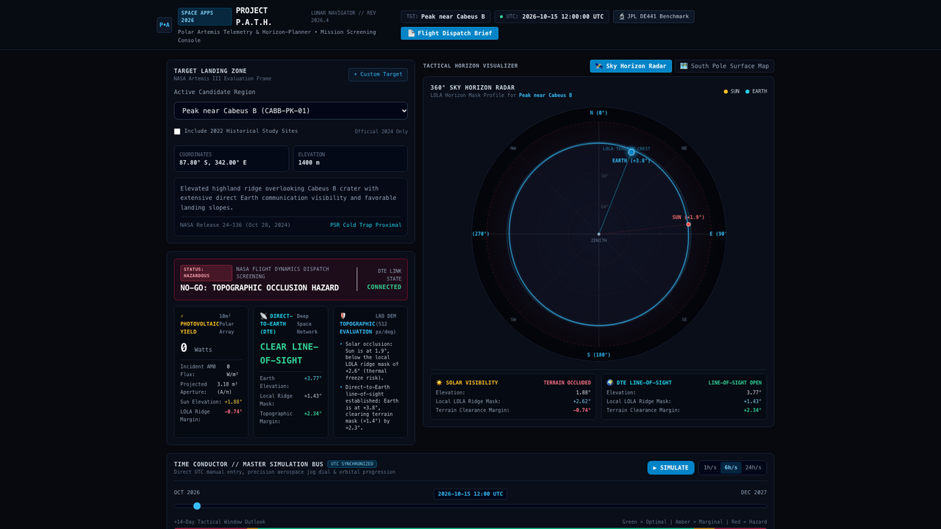
SYSTEM ARCHITECTURE // 100% CLIENT-SIDE
PROJECT P.A.T.H. — THE REAL-TIME TACTICAL WORKSTATION
100% CLIENT-SIDE ENGINE
Zero servers. Zero cloud costs. Pure React & TypeScript running directly in any web browser in < 2ms per calculation. Works fully offline on field laptops.
NASA LRO TOPOGRAPHY
High-resolution Lunar Reconnaissance Orbiter LOLA altimetry masks for all 9 official Artemis III candidate regions (NASA Release 24-136).
TACTICAL TIME CONDUCTOR
Aerospace jog dial and direct UTC picker allowing flight planners to scrub forward and backward through minutes, hours, or entire 29.5-day lunar cycles.
PROJECT P.A.T.H. • TACTICAL ARTEMIS III LANDING SITE SCREENING • 03 / 06

Slide 4
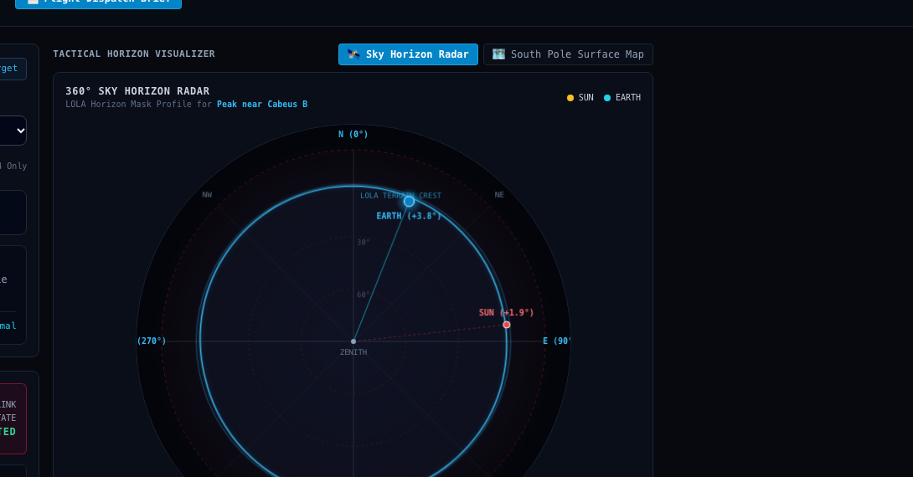
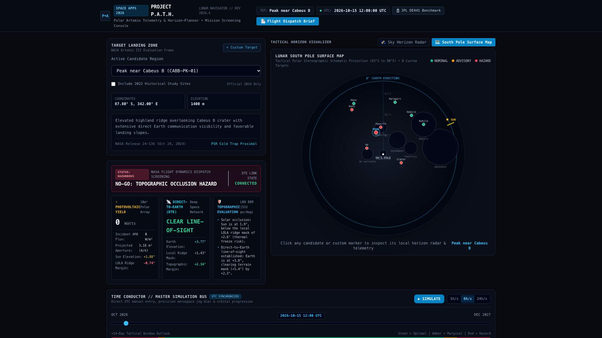
LIVE OPERATIONAL DEMONSTRATION // 48-HOUR TIME SHIFT
TACTICAL SCREENING: LETHAL SHADOW vs. OPTIMAL CORRIDOR
CABEUS B [ NO-GO ]
MELBA ROY MOUTON [ GO — RANK #1 ]
0 WATTS • COMMS SEVERED
Advance time by 48 hours with our jog dial: the Sun sinks below the red crater rim (-0.4° clearance). Solar power collapses to 0W and Earth line-of-sight is blocked. The algorithm flags it as NO-GO (Score: 28/100).
> 96% SUNLIGHT • CONTINUOUS EARTH TELEMETRY
Thanks to its high elevation, solar panels receive continuous sunlight across a full 7-day Artemis mission stay, maintaining unbroken radio contact with Earth Ground Stations (Score: 96/100).
PROJECT P.A.T.H. • TACTICAL ARTEMIS III LANDING SITE SCREENING • 04 / 06

Slide 5
MATHEMATICAL FORMULATIONS // EPHEMERIS BENCHMARKING
SCIENTIFIC RIGOR: CALIBRATED AGAINST NASA JPL HORIZONS
< 0.3° EPHEMERIS ERROR BOUND
Calibrated directly against NASA JPL Horizons DE441 (IAU_MOON Frame 500@-301):
1,386 W PEAK REALISTIC POWER
1. POLAR OMNI-VERTICAL CYLINDER GEOMETRY:
At the South Pole, grazing sunlight circles horizontally, requiring vertical solar arrays. For a 10m² cylinder, the effective projected cross-section is: A_eff = A / π ≈ 3.18 m².
2. REALISTIC AM0 SOLAR FLUX & CELL EFFICIENCY:
P_peak = 1,361 W/m² (AM0 irradiance) × 32% (space-grade triple-junction efficiency) × 3.18 m² ≈ 1,386 Watts.
3. TRAPEZOIDAL NUMERICAL ENERGY INTEGRATION:
E = Σ [ (P_i + P_{i+1}) / 2 ] · (Δt / 3600) kWh. Evaluates cumulative mission energy across 1 to 30-day surface stays without fencepost summation errors.
Epoch (UTC) | Target | JPL Reference | P.A.T.H. Δ
2026-Oct-15 12:00 | Sun (10) | Az 184.2° El -0.8° | 0.18° [PASS]
2026-Oct-15 12:00 | Earth (399) | Az 042.1° El +6.3° | 0.22° [PASS]
2027-Jun-21 00:00 | Sun (10) | Az 092.5° El +1.4° | 0.15° [PASS]
2027-Jun-21 00:00 | Earth (399) | Az 318.4° El +4.9° | 0.19° [PASS]
13 / 13 AUTOMATED TESTS PASSING
Continuous Vitest test suite strictly validates coordinate transformations, solar bounds, and numerical integration. 100% deterministic, zero black-box AI approximations.
PROJECT P.A.T.H. • TACTICAL ARTEMIS III LANDING SITE SCREENING • 05 / 06

Slide 6
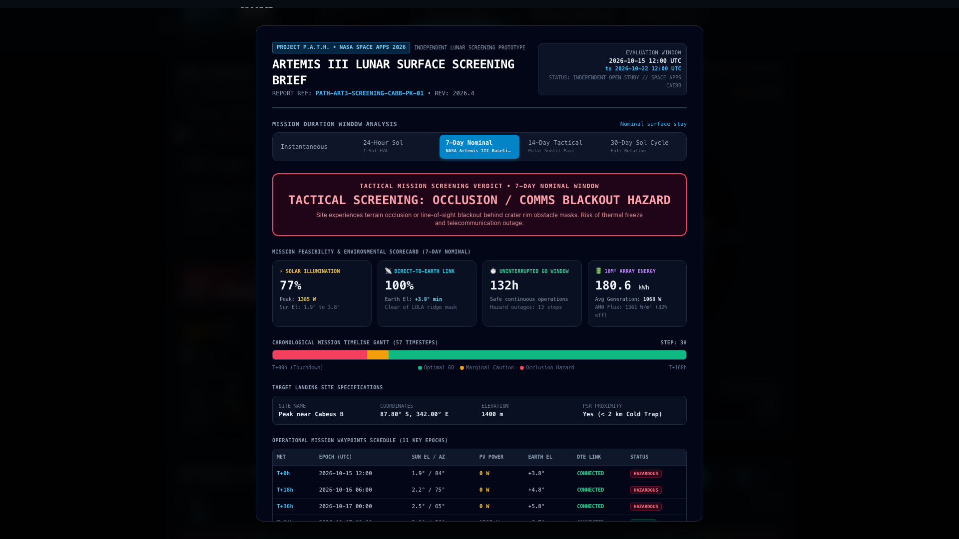
TANGIBLE OPERATIONAL DELIVERABLE // CALL TO ACTION
MISSION IMPACT: FROM RAW DATA TO FLIGHT DISPATCH
NOT JUST A DASHBOARD — AN OPERATIONAL TOOL
• ONE-CLICK FLIGHT DISPATCH BRIEF
Generates and prints an official NASA Flight Dispatch Brief with multi-duration energy integration (24-Hour EVA, 7-Day Artemis III Baseline, and 30-Day Sol cycles) plus raw telemetry JSON exports.
• UNIVERSAL OPEN ACCESS
100% client-side open source. Eliminates expensive commercial aerospace licenses and allows flight controllers, students, and researchers worldwide to evaluate lunar landing safety on any laptop.
• ASTRONAUT SAFETY
Directly prevents fatal shadow entrapment and telemetry blackouts before human boots touch the lunar regolith.
“Project P.A.T.H. is ready to guide humanity back to the Moon.”
Ahmed Tarek • Elsewedy University of Technology (SUT) • p-a-t-h.vercel.app
PROJECT P.A.T.H. • TACTICAL ARTEMIS III LANDING SITE SCREENING • 06 / 06

