Slide 1
Malware Development

Slide 2
Expectations
They should NOT be high
What can you expect?
Basic malware demos
Somewhat long presentation
What I expect from you?
Very basic knowledge in C and Assembly
Basic understanding of how an OS work

Slide 3
Procedure
Moving step by step
Defining problems
Trying solutions
Analyzing the consequences

Slide 4
Malware Types
Viruses
Worms
Spyware
...
Boring, no one cares...

Slide 5
Our Malware Sample
Could be a basic text output
But that would be boring
Let’s build a C2 Server

Slide 6
C2 Server
Stands for ‘Command and Control’
Basically a server which listens to attackers commands
Very easy to implement for our sandbox

Slide 7
The Plan
Create a socket
Listen to incoming connection(s)
Accept commands from the user (in text form)
Process these commands, more details
  Get the string data
  Tokenize into a vector
  Duplicate the standard output header
  Call exec with these arguments
Repeat step 4

Slide 8
Demo (srv.0.c)

Slide 9
Improvements
Since it does not implement its own protocol we can simplify the code
Remove string processing
Duplicate all standard handles
Get rid of the master loop

Slide 10
Demo (srv.1.c)

Slide 11
Problem
One can easily see that there is an unwanted process running the whole time
Would be better if we could run it on behalf of another process

Slide 12
Solutions
Rename the process. Very simple, but still can be detected
Create a rootkit. Good solution, but requires kernel access
Inject into another process. Has its own drawbacks
More...

Slide 13
Process Injection
Windows equivalent of basic injection methods like CreateRemoteThread, VirtualProtectEx, ... do “not” exist
But with a bit of creativity we can create our replacements
The basic options are: ptrace, process_vm_<oper>v, /proc/<pid>/mem, more...

Slide 14
PTrace
Requires capability CAP_SYS_PTRACE
Needs to attach to a process
Can only read WORD sized buffer
Can be restricted via LSM config CONFIG_SECURITY_YAMA
But...
Can manipulate registers (even the RIP register)
Can access non-readable memory pages
Can do whatever the debugger does

Slide 15
PTrace Functions
Attach to a process. ptrace(PTRACE_ATTACH, pid, …)
Wait for the operation to finish. waitpid(pid, 0, WUNTRACED)
Perform an operation
  Write memory. ptrace(PTRACE_POKEDATA, pid, addr, buf)
  Read memory. mem = ptrace(PTARCE_PEEKDATA, pid, addr)
  Get registers. ptrace(PTRACE_GETREGS, pid, 0, regs)
  Set registers. ptrace(PTRACE_SETREGS, pid, 0, regs)
Detach from the process. ptrace(PTARCE_DETACH, pid, ...)

Slide 16
process_vm
Requires capability CAP_SYS_PTRACE
Can only read/write memory
Can only access pages with read protection enabled
But...
Does not need to attach to a process
Asynchronous reads/writes
Can specify a whole buffer

Slide 17
process_vm Functions
Specify two I/O vectors. One for local buffer, one for remote buffer:
struct iovec local[1];
local.iov_base = buf;
local.iov_len = sizeof (buf);
struct iovec remote[1];
local.iov_base = addr;
local.iov_len = sizeof (buf);
Read. process_vm_readv(pid, local, 1, remote, 1, 0)
Write. process_vm_writev(pid, local, 1, remote, 1, 0)

Slide 18
/proc/<pid>/mem
Basically the same as process_vm functions
Just use regular read/write functions

Slide 19
Demo (inj.0.c, frk.0.c)

Slide 20
The Plan
Instead of running our C2 Server, let’s have a quick process injector
It will inject the C2 Server into a well known process which by definition is not malicious

Slide 21
The Problem
source
compiler
object
linker
binary
loader
process
No access to source files, compilers, linkers
The binary can be found on disk but patching and restarting is dangerous and suspicious
Need to patch it while the victim process is running
Need to know machine code
We are here
Actually here

Slide 22
The Solution
shellcode
malware
victim
Get the PID
Get the PID from process name or simply pass it to test it easier. You can iterate over the /proc/ folder
Get the memory pages by looking into /proc/<pid>/maps. Example:
$ cat /proc/1425/maps
55a60d1ce000-55a60d1da000 r--p 00000000 08:01 131095 libc.so
55a60d1da000-55a60d1fc000 r-xp 0000c000 08:01 131095 libc.so
55a60d1fc000-55a60d208000 r--p 0002e000 08:01 131095
Look for the nnxn in the protection column
Use previous methods (ptrace/process_vm) to write the “shellcode” at some address inside that memory page
Set the RIP register with ptrace to point to that address
Get the memory pages
Find an executable page
Insert the shell code there
Change the instruction pointer

Slide 23
Shellcode
It is a small executable payload
Usually the function in machine code
We can NOT use compilers. No high level languages, even Assembly
It is actually “harder” to write, because it forces some rules on us
  Position independent code. E.g.: no regular strings
  No libraries are allowed. Linking, loading is not available
  Binaries should be small to fit in memory pages
  Many more…
Often you’ll find on internet that these are hard to write, BUT it is not TRUE

Slide 24
The Goal
We know how to inject stuff in a process, but how to inject a function there?
Let’s start simple. Here is an example victim process code:
int
main(void)
{
while (1) {
printf("doing some work...\n");
sleep(3);
}
return 0;
}
How can I force it to do something else in that loop?
void
injected(void)
{
printf("hello\n");
}
int
main(void)
{
while (1) {
printf("doing some work...\n");
injected();
sleep(3);
}
return 0;
}

Slide 25
Analyzing
Let’s keep it as low-level as possible. Remove all dependencies. Understand what a function really is:
void
main(void)
{
printf("abc\n");
}
Remove printf and use a system call instead, like write
void
main(void)
{
write(STDOUT_FILENO, "abc\n", 4);
}
Or even better use syscall instead
void
main(void)
{
// #define SYS_write 1
// #define STDOUT_FILENO 1
syscall(SYS_write, STDOUT_FILENO, "abc\n", 4);
}

Slide 26
Demo (shl.0.c, shl.1.c, shl.2.c, shl.3.c)

Slide 27
Analyzing
Diving deeper, using inline assembly now:
void
main(void)
{
register long sys asm ("rax") = 1;
register long std asm ("rdi") = 1;
register char *buf asm ("rsi") = "abc\n";
register long len asm ("rdx") = 4;
asm volatile("syscall" : : "r" (sys), "r" (std), "r" (buf), "r" (len) : "memory", "rcx", "r11", "cc");
}
Using the GCC Inline Assembler
Declaring volatile to not skip some of the assignments during the optimizations
Using the register keyword to bind x86 registers with C variables
Specifying the clobber registers that will be used during a system call

Slide 28
Demo (shl.4.c)

Slide 29
Analyzing
Using “raw” assembly:
mov rax, 1
mov rdi, 1
lea rsi, SOME_REFERENCE_TO_STRING
mov rdx, 4
syscall
All according to the well-documented ABI
Putting the system call index in RAX register. In our case write, which is at index 1
Putting file handle number in the RDI register. Standard output handle is 1
Loading a memory address into RSI. This is where our “abc\n” string is
Copying the size of that string in the RDX register
All the setup is done. Fire up SYSCALL instruction

Slide 30
Demo (shl.5.s)

Slide 31
Analyzing
Observing the machine code:
$ objdump -d sample
0000000000000000 <_start>:
...
1b: 48 b8 01 00 00 00 00 00 00 00 movabs $0x1, %rax
25: 48 bf 01 00 00 00 00 00 00 00 movabs $0x1, %rdi
2f: 48 8d 75 fc lea -0x4(%rbp), %rsi
33: 48 ba 04 00 00 00 00 00 00 00 movabs $0x4, %rdx
3d: 0f 05 syscall
...
The syntax looks different because it is AT&T instead of “Intel”
The machine code is the actual data that is being executed by the CPU
Good news, we successfully “manually” compiled the original C function

Slide 32
The Goal
Now we can replace the abstract C code with real CPU machine code. Meaning, we can go from this:
void
injected(void)
{
printf("abc\n");
}
With this:
static unsigned char injected[] = {
0x55,
0x48, 0x89, 0xe5,
0x48, 0x81, 0xec, 0x04, 0x00, 0x00, 0x00,
0xc6, 0x44, 0x24, 0xfc, 0x61,
0xc6, 0x44, 0x24, 0xfd, 0x62,
0xc6, 0x44, 0x24, 0xfe, 0x63,
0xc6, 0x44, 0x24, 0xff, 0x0a,
// here is our syscall code
0x48, 0xb8, 0x01, 0x00, 0x00, 0x00, 0x00, 0x00, 0x00, 0x00,
0x48, 0xbf, 0x01, 0x00, 0x00, 0x00, 0x00, 0x00, 0x00, 0x00,
0x48, 0x8d, 0x74, 0x24, 0xfc,
0x48, 0xba, 0x04, 0x00, 0x00, 0x00, 0x00, 0x00, 0x00, 0x00,
0x0f, 0x05,
0xc9,
0xc3,
};
Before injecting let’s test it on a normal program.
One problem arises: the array is not in a executable memory page. Need to make it executable for testing
The compiler (or rather loader) puts functions automatically in an executable memory page
We can use mprotect to do it

Slide 33
Demo (shl.6.c, shl.7.c)

Slide 34
Summary
We know how to inject a buffer into a process
We know how to get the machine code from a function
We have “proved” that a function is basically an array
Let’s finally test it on our original simple function

Slide 35
Demo (spl.0.c, inj.1.c)

Slide 36
The Problem
We saw our injected function being executed
However, the victim program crashed
Semi-success was achieved

Slide 37
A Possible Solution
shellcode
malware
victim
Get the PID
Backup the data at that address
Insert the shellcode
Restore the backup
Get the memory pages
Find an executable page
Read the original data & RIP
Insert the shellcode there
Change the instruction pointer
Restore the original data

Slide 38
More Problems
How do we know when to restore?
If we restore after injection then the shell code might be still executing?
What happens to the old RIP will the original function be canceled, crashed or restored in the victim process?
Should we somehow notify the malware process when it is allowed to restore it?
Even if we restore the original bytes, our injected function gets destroyed. How can we be persistent?
And more...

Slide 39
Mental gymnastics
initiator
server
malware
victim
Inject the initiator shellcode
Inject the initiator shellcode
Allocate a new memory page
Poll for memory pages, look for that signature
Write a signature in that memory
Restore the original code and RIP
Inject the C2 server in that new page
Provide a backdoor server

Slide 40
Demo (mlw.c, vm.c, mm.c, shl.s, srv.s)

Slide 41
Static Analysis
Our functionality can be reverse engineered very easily
The program is very basic
Has no protections
  No anti-VM
  No anti-Debug
  No anti-RE
  No anti-Attach
  No anti-Disassembly
  …

Slide 42
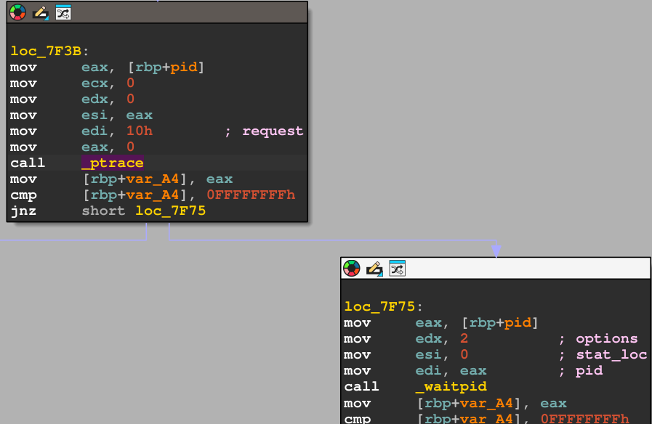
The Problem
Everyone can see the symbol table and guess what it does
$ readelf -s mlw | grep ptrace
18: 0000000000000000 0 FUNC GLOBAL DEFAULT UND ptrace
61: 0000000000000000 0 FUNC GLOBAL DEFAULT UND ptrace
But we need these functions
We can strip function variable names but it won’t help against RE

Slide 43
Packers
Help making static analysis (also dynamic) much harder
The idea is to ‘encrypt’ the malware and ‘decrypt’ on dynamically when running
Encrypt & Decrypt are technically not correct
Pack & Unpack should be used here

Slide 44
Packing
Embed the malware in another program as a section
  Compress the malware
  Encrypt the malware
  Obfuscate the malware
  More...
Load that section dynamically
  Create a new file and copy section content there. Can be detected
  Write an ELF loader. Best solution, won’t have time
  Create a memory file and map the content. Harder to detect
  More...

Slide 45
Choosing a mechanism
Keep it simple:
  Encrypt it with custom function. For simplicity f(x) = xor(x, k)
  Use in-memory files. Use memfd_create or memfd_secret*
*memfd_secret is a bit tricky, will skip it for now

Slide 46
The Plan
Encrypt the malware
Use the linker to create and object file out of that binary
Link the object file with the packer program
Packer program will do eventually the following:
  Get the attached section data
  Decrypt it with an embedded key
  Load the data into a memory file
  Call exec on it

Slide 47
Demo (pkr.c, xor.c, makefile)

Slide 48
Bonus: VDSO
The ELF binaries contain VDSO segment
It is usually marked as [VDSO] in /proc/<pid>/maps
The format is ELF
Is used to speed up some of the syscalls
Can be used instead of actual syscalls

Slide 49
Demo (vdso.0.c)

Slide 50
Questions?

