Slide 1
Warnings

Slide 2
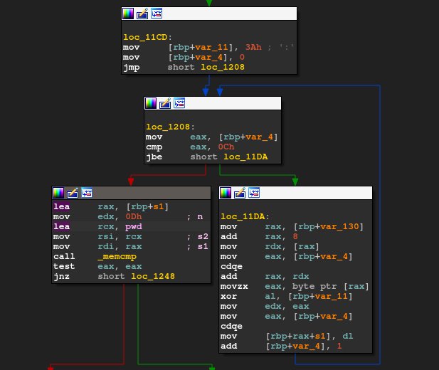
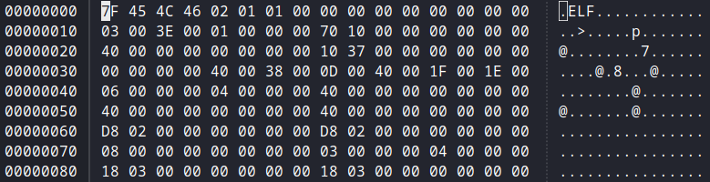
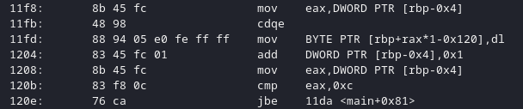
Representing the Binary information
Hex Dump
Disassembly
Graph View

Slide 3
Problems
Time consuming (too much repetitive/useless information)
Information is not generous enough (based on known definitions)
Based on primitive types (can not construct a DS without help)

Slide 4
Alternate ways
Plotting the binary
  Padding (e.g.: 0xFF, 0x00)
  ASCII (e.g.: ‘a’, ‘b’)
  Miscellaneous (e.g.: 0xAB, 0xCD)
Draw them in a linear fashion

Slide 5
Example

Slide 6
Preserving the locality
Space filling curves
Using Pseudo Hilbert Curves

Slide 7
How is it constructed
Order 1

Slide 8
How is it constructed
Order 2

Slide 9
Example

Slide 10
Why do we need this?
Preserving the locality, obviously
Ideally data should not change with window changes
Can be critical for graphical data

Slide 11
Example

Slide 12
Realistic assumptions
Raw data is rather rare?
Compression gets into our way?
Metadata is attached to it?
Intentional modifications?

Slide 13
Realistic assumptions
‘Obfuscation’ usually happens while data is on DISK
Eventually the data needs to be parsed

Slide 14
Solution
Let’s look into RAM
Examine memory pages
This will break some of the rules

Slide 15
Example

Slide 16
Moving into 3D Space
Taking a different approach
Pick the consecutive bytes and plot them in 3D space
Repeat for every byte

Slide 17
Example

Slide 18
Using the tools
Linear plotting
Hilbert Curves
3D Space

Slide 19
Finding Patterns
32bit vs 64bit
Data vs Code
X86 vs ARM vs AVR vs RISC-V vs MIPS ...

Slide 20
Questions?

