Slide 1

Parametric Approach
Image
function with a certain form determined by parameters
10 numbers giving class scores
f(x,W)
Array of 32x32x3 numbers (3072 numbers total)
W
parameters
or weights
Lecture 2 -

Slide 2
f(x,W) = Wx
Parametric Approach: Linear Classifier
Image
10 numbers giving class scores
f(x,W)
Array of 32x32x3 numbers (3072 numbers total)
W
parameters
or weights
Lecture 2 -

Slide 3
Parametric Approach: Linear Classifier
3072x1
f(x,W) = Wx
10x1 10x3072
f(x,W)
Image
10 numbers giving class scores
Array of 32x32x3 numbers (3072 numbers total)
W
parameters
or weights
Lecture 2 -

Slide 4
Parametric Approach: Linear Classifier
3072x1
f(x,W) = Wx +
b
10x1
Image
10x1 10x3072
f(x,W)
10 numbers giving class scores
Array of 32x32x3 numbers (3072 numbers total)
W
parameters
or weights
Lecture 2 -

Slide 5
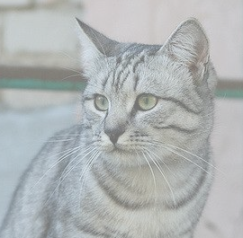
Example with an image with 4 pixels, and 3 classes (cat/dog/ship)
Stretch pixels into column
56
231
24
2
56 | 231
24 | 2
Input image
Lecture 2 -

Slide 6
Example with an image with 4 pixels, and 3 classes (cat/dog/ship)
Stretch pixels into column
56
231
24
2
0.2 | -0.5 | 0.1 | 2.0
1.5 | 1.3 | 2.1 | 0.0
0 | 0.25 | 0.2 | -0.3
1.1
3.2
-1.2
-96.8
437.9
61.95
56 | 231
24 | 2
Cat score
+ =
Dog score
Ship score
Input image
W
b
Lecture 2 -

Slide 7
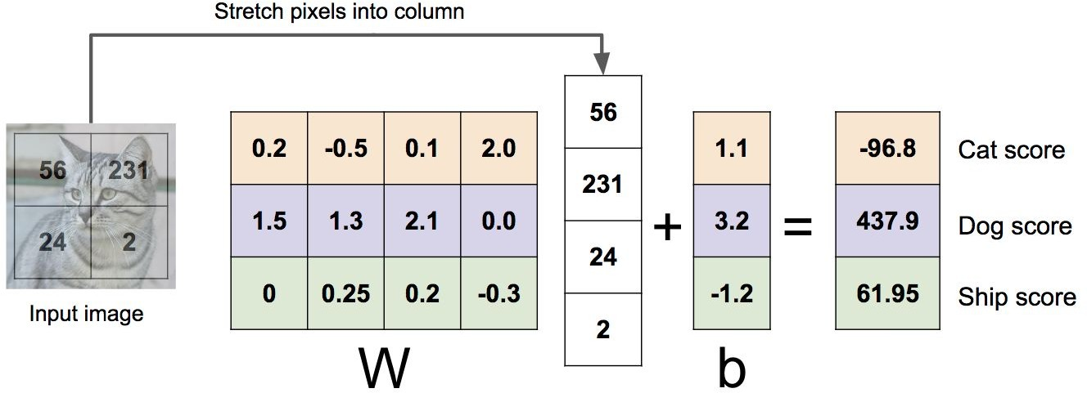
Example with an image with 4 pixels, and 3 classes (cat/dog/ship)
Algebraic Viewpoint
f(x,W) = Wx
Lecture 2 -

Slide 8

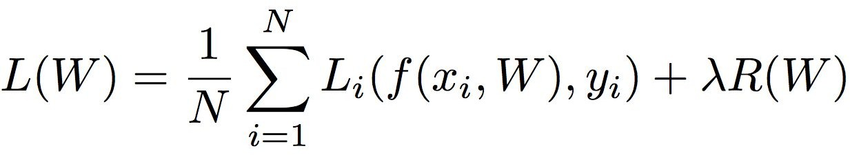
Regularization
= regularization strength (hyperparameter)
Data loss: Model predictions should match training data
Regularization: Prevent the model from doing too well on training data
Why regularize?
Express preferences over weights
Make the model simple so it works on test data

Slide 9





Regularization: Expressing Preferences
L2 Regularization

Slide 10
Regularization: Expressing Preferences
L2 Regularization
L2 regularization likes to “spread out” the weights, L1 encourages sparse weights
When minimize L2 norm you are more likely to focus on big weights, smaller weights will get less attention and hence will not be moved to zero, in L1 we focus equally on all weights whether big or small and hence have better chance of reaching zero on some (hence having a sparse solution)

Slide 11
Regularization: Prefer Simpler Models
y
x

Slide 12
Regularization: Prefer Simpler Models
f₁
f₂
y
x

Slide 13
Regularization: Prefer Simpler Models
f₁
f₂
y
x
Regularization pushes against fitting the data
too well so we don’t fit noise in the data

Slide 14
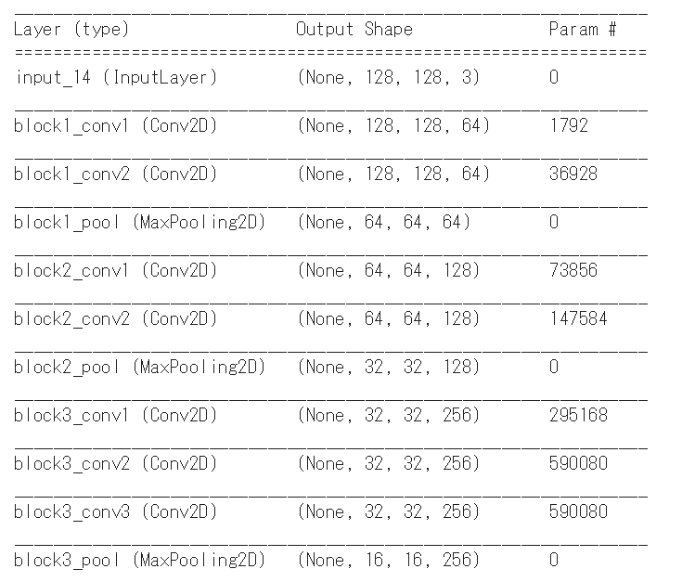

Slide 15
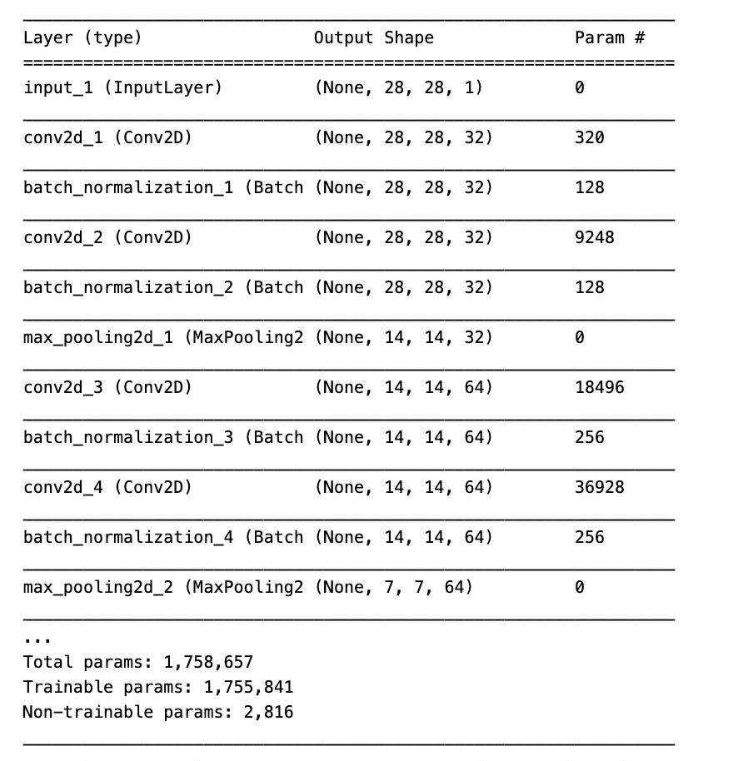

Slide 16
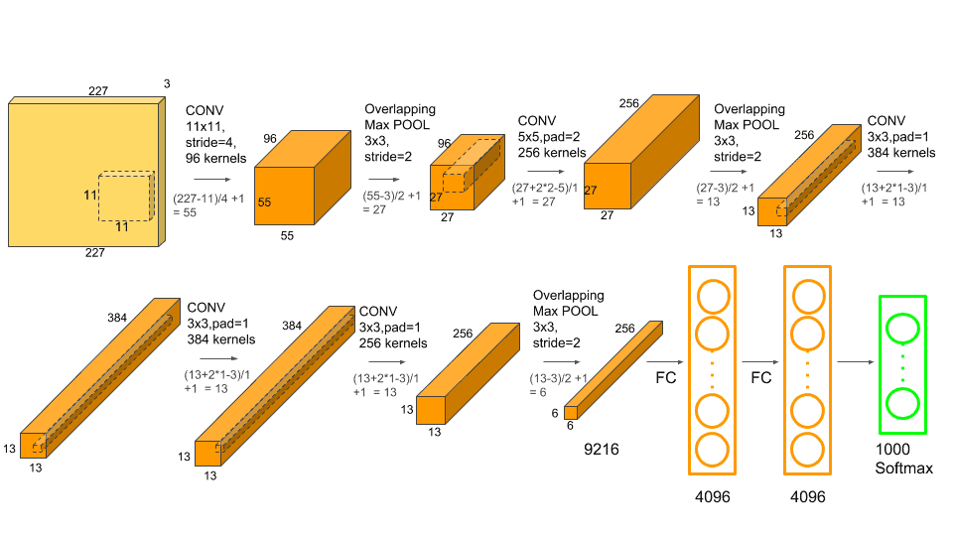
s

Slide 17
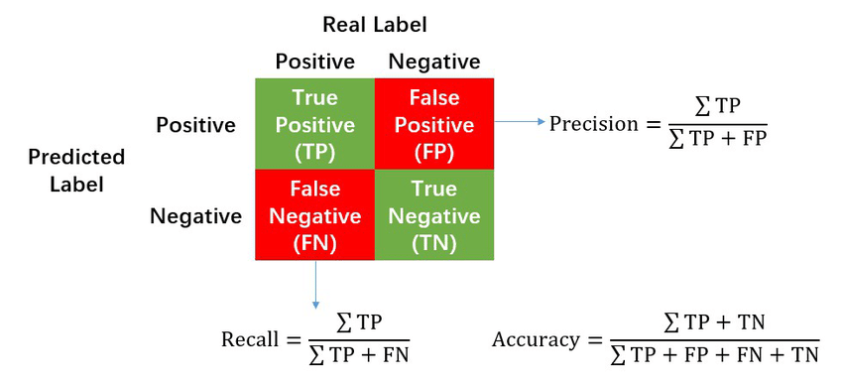

Slide 18
