Slide 1
Hadoop – Technical Introduction
Notes:
We've all heard so much about Hadoop. Hadoop is synonymous with big data.
Doug Cutting at Yahoo (Apache Hadoop)
Worked at Apple, Excite, Yahoo etc
Open source Guru has contributed a lot to the open source.
Lucene, a search indexer, and Nutch, a spider or crawler, are the two key components of an open-source general search platform, which first crawls the Web for content, and then structures it into a searchable index.
Extending Lucene into the realm of extremely large search problems, created the open-source Hadoop framework that allows applications based on the MapReduce paradigm to be run on large clusters of commodity hardware. Cutting was an employee of Yahoo!, where he led the Hadoop project full-time; he has since moved on to Cloudera.

Slide 2

Elephant in the room
Notes:
It is kind of elephant in the room. We cannot ignore it.

Slide 3

What is Hadoop?
Hadoop is an open source framework that allows for distributed processing (Parallel) of large data sets across clusters of commodity computers (No Super Computer) using a simple programming model.
Doug Cutting @ Yahoo
Notes:
providing both storage and processing resources for large and disparate data sources.
It is not one software that you have downloaded on your computer and say that you have downloaded Hadoop.
—not to mention a platform for third-party software vendors to build upon.
It is designed to scale up from single servers to thousands of machines, each offering local computation and storage

Slide 4
Hadoop Framework Capabilities
Scalable
It is designed to scale up from single servers to thousands of machines, each offering local computation and storage
Flexible
Hadoop manages data whether structured or unstructured, encoded or formatted, or any other type of data.
Fault Tolerant
In Hadoop, the data is stored in HDFS where data automatically gets replicated at two other locations. So, even if one or two of the systems collapse, the file is still available on the third system at least. This brings a high level of fault tolerance.
Faster Processing
Hadoop can perform batch processes 10 times faster than on a single thread server or on the mainframe.
Notes:
Scalability: This is a huge feature of Hadoop. It is an open source platform and runs on industry-standard hardware. That makes Hadoop extremely scalable platform where new nodes can be easily added in the system as and data volume of processing needs grow without altering anything in the existing systems or programs.
Flexible: One of the biggest challenges organizations have had in that past was the challenge of handling unstructured data. Let’s face it, only 20% of data in any organization is structured while the rest is all unstructured whose value has been largely ignored due to lack of technology to analyze it.
Hadoop manages data whether structured or unstructured, encoded or formatted, or any other type of data. Hadoop brings the value to the table where unstructured data can be useful in decision making process.
Fault Tolerant: Rather than rely on hardware to deliver high-availability, the library itself is designed to detect and handle failures at the application layer, so delivering a highly-available service on top of a cluster of computers, each of which may be prone to failures.
Faster Processing: While traditional ETL and batch processes can take hours, days, or even weeks to load large amounts of data, the need to analyze that data in real-time is becoming critical day after day.
Hadoop is extremely good at high-volume batch processing because of its ability to do parallel processing. Hadoop can perform batch processes 10 times faster than on a single thread server or on the mainframe.

Slide 5
Hadoop Framework Capabilities
Cost Effective
Hadoop generates cost benefits by bringing massively parallel computing to commodity servers, resulting in a substantial reduction in the cost per terabyte of storage, which in turn makes it reasonable to model all your data
Robust Ecosystem
Hadoop has a very robust ecosystem that is well suited to meet the analytical needs of developers and small to large organizations.
Notes:
Cost: Hadoop generates cost benefits by bringing massively parallel computing to commodity servers, resulting in a substantial reduction in the cost per terabyte of storage, which in turn makes it reasonable to model all your data.
Apache Hadoop was developed to help Internet-based companies deal with prodigious volumes of data. According to some analysts, the cost of a Hadoop data management system, including hardware, software, and other expenses, comes to about $1,000 a terabyte–about one-fifth to one-twentieth the cost of other data management technologies.
Robust Ecosystem:
Hadoop has a very robust ecosystem that is well suited to meet the analytical needs of developers and small to large organizations. Hadoop Ecosystem comes with a suite of tools and technologies making i a very much suitable to deliver to a variety of data processing needs.

Slide 6
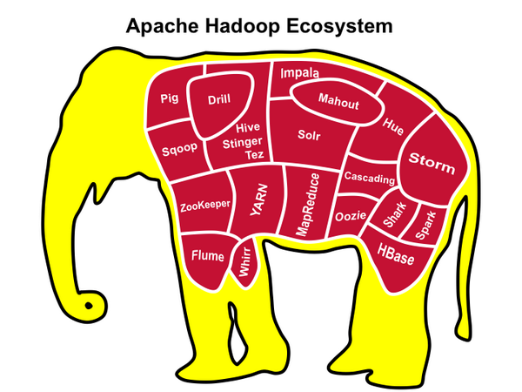
Notes:
It is not one software that you have downloaded on your computer and say that you have downloaded Hadoop.
Actually it is a very rich eco system/framework of tools, it is actually set of open source tools (software library) under Apache License. (((( not to mention a platform for third-party software vendors to build upon.))))
Now if you download each of these..then which version works with which version…(compatibility)
Just to name a few, Hadoop ecosystem comes with projects such as MapReduce, Hive, HBase, Zookeeper, HCatalog, Apache Pig etc. and many new tools and technologies are being added to the ecosystem as the market grows.
We will go through each of these in the tool, what it does and where it is being used.
DO I have to download whole Elephant to work with Hadoop???????
Lets quickly goes to the Technical stuff…

Slide 7
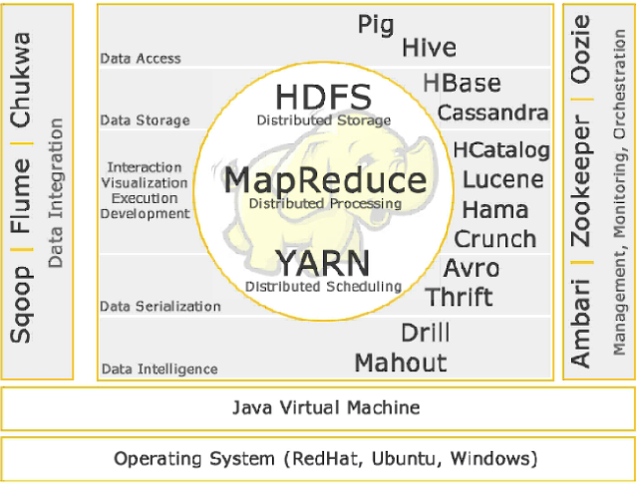
Hadoop Technology Stack
V 2.0

Slide 8
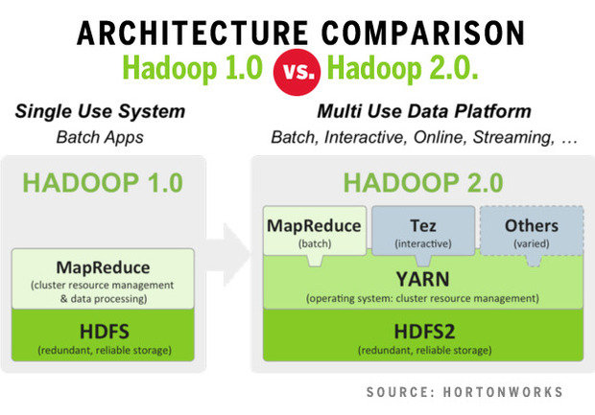
Hadoop Core

Slide 9
What is Hadoop What Makes it So Special
Hadoop has basically 2 things,
a FS (Hadoop Distributed File System)
it’s a way of storing enormous data sets across distributed clusters of servers
A computation framework (MapReduce)
running “distributed” analysis applications in each cluster.
All other things (tools) are there
Notes:
What exactly is Hadoop, and what makes it so special? Basically, it’s a way of storing enormous data sets across distributed clusters of servers and then running “distributed” analysis applications in each cluster.

Slide 10
HDFS
HDFS (Hadoop Distributed File System) used to store files in Hadoop environment.
HDFS mainly works on a master-slave architecture where one device (master) controls one or more devices.
HDFS provides high high-performance access to data across Hadoop clusters.
Files in HDFS are write-once* and have strictly one writer at any time
*Is this a feature or a defect
Notes:
Once Google gave the concept of GFS (Google file system) and MapReduce on paper (yes not implemented yet)
Yahoo took the idea from Google’s paper and started working and came up with a working model known as HDFS (Hadoop distributed file system).

Slide 11
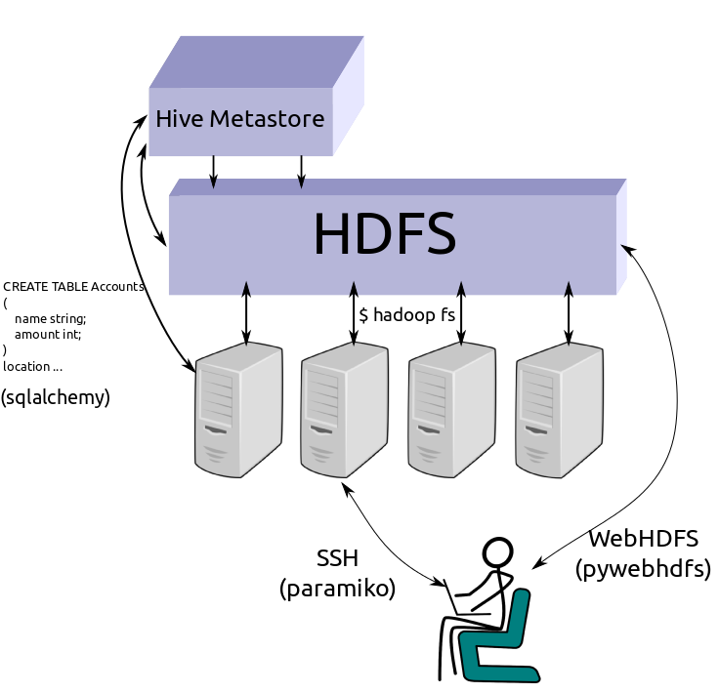
Apache Hadoop the default block size is 64 MB and in the Cloudera Hadoop the default is 128 MB.
Notes:
Since HFDS does not do raw disk block storage, there are two block sizes in use when writing a file in HDFS: the HDFS blocks size and the underlying file system's block size.
HDFS will create files up to the size of the HDFS block size as well as a meta file that contains CRC32 checksums for that block. The underlying file system store that file as increments of its block size on the actual raw disk, just as it would any other file.
If block size was set to less than 64, there would be a huge number of blocks throughout the cluster, which causes NameNode to manage an enormous amount of metadata.

Slide 12

HBASE

Slide 13
HBase
Apache HBase™ when you need random, realtime read/write access to your Big Data.
HDFS: It is good for sequential data access.
Apache HBase provides Bigtable-like capabilities on top of Hadoop and HDFS.
Google File System BigTable
Notes:
Inroads from Doug Cutting and team at Yahoo and Apache Hadoop project resulted in popularizing MapReduce programming – which is intensive in I/O and is constrained in interactive analysis and graphics support. This paved the way for further evolving of Hadoop 1 to Hadoop 2.

Slide 14
HBase Feature
Linear and modular scalability.
Strictly consistent reads and writes.
Automatic and configurable sharding of tables
Automatic failover support between RegionServers.
Convenient base classes for backing Hadoop MapReduce jobs with Apache HBase tables.
Easy to use Java API for client access.
Block cache and Bloom Filters for real-time queries.
Notes:
Instead of small tables there are big tables.

Slide 15

Components of Hadoop EcoSystem
HIVE
Notes:
Apache Hive is a component of Hortonworks Data Platform (HDP). Hive provides a SQL-like interface to data stored in HDP. In the previous tutorial, we used Pig, which is a scripting language with a focus on data flows. Hive provides a database query interface to Apache Hadoop.
The tables in Hive are similar to tables in a relational database, and data units are organized in a taxonomy from larger to more granular units. Databases are comprised of tables, which are made up of partitions. Data can be accessed via a simple query language and Hive supports overwriting or appending data.
Within a particular database, data in the tables is serialized and each table has a corresponding Hadoop Distributed File System (HDFS) directory. Each table can be sub-divided into partitions that determine how data is distributed within sub-directories of the table directory. Data within partitions can be further broken down into buckets.

Slide 16
Hive
Apache Hive is considered the defacto standard for interactive SQL queries over petabytes of data in Hadoop.
Hive is a to process structured ( we enforce schema) data in Hadoop
Pig is better than Hive to process unstructured data. So, the data first cleansed with Pig and then processed with Hive.
Notes:
Whereas in hive we enforce a schema

Slide 17

Pig
Apache Pig is a platform for analyzing large data sets that consists of a high-level language for expressing data analysis programs, coupled with infrastructure for evaluating these programs.
Pig is built to processes schema less (unstructured) data sets.

Slide 18
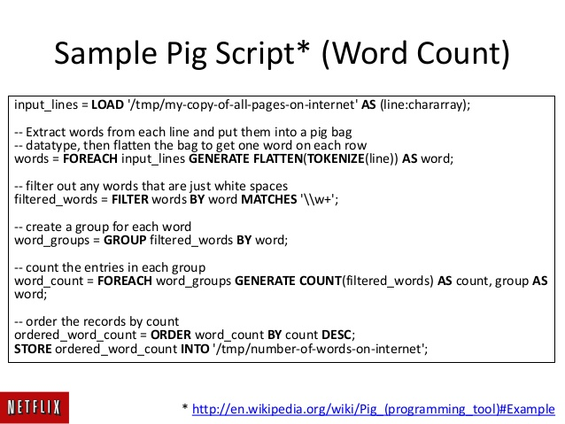
Putting Lipstick on a Pig

Slide 19
Advantage of using Hive SQL
Familiar | Query data with a SQL-based language
Fast | Interactive response times, even over huge datasets
Scalable and Extensible | As data variety and volume grows, more commodity machines can be added, without a corresponding reduction in performance
Compatible | Works with traditional data integration and data analytics tools.
* JDBC Interface Hive Query: http://demo.gethue.com/notebook/editor?editor=7

Slide 20
Components of Hadoop EcoSystem
HCatalog

Slide 21
HCatalog
Apache™ HCatalog is a table management layer that exposes Hive metadata to other Hadoop applications.
HCatalog’s table abstraction presents users with a relational view of data in the Hadoop Distributed File System (HDFS) and ensures that users need not worry about where or in what format their data is stored.
Notes:
HCatalog is a component of Hive. It is a table and storage management layer for Hadoop that enables users with different data processing tools — including Pig and MapReduce — to more easily read and write data on the grid. HCatalog displays data from RCFile format, text files, or sequence files in a tabular view. It also provides REST APIs so that external systems can access these tables’ metadata.

Slide 22
WebHCat
WebHCat provides a service that you can use to run Hadoop MapReduce (or YARN), Pig, Hive jobs or perform Hive metadata operations using an HTTP (REST style) interface.

Slide 23
HBase

Slide 24
Map Reduce
Map Reduce is a method for distributing a task across multiple nodes. Each node processes data stored on that node to the extent possible.
A running Map Reduce job consists of various phases such as
Map -> Sort -> Shuffle -> Reduce

Slide 25
MapReduce
Most MapReduce programs are written in Java. It can also be written in any scripting language using the Streaming API of Hadoop. MapReduce abstracts all the low level plumbing away from the developer such that developers can concentrate on writing the Map and Reduce functions.

Slide 26
MapReduce
MapReduce is as a 5-step parallel and distributed computation
Prepare the Map() input – the "MapReduce system" designates Map processors, assigns the input key value K1 that each processor(node) would work on, and provides that processor (node) with all the input data associated with that key value. [Splitting]
Run the user-provided Map() code – Map() is run exactly once for each K1 key value, generating output organized by key values K2.[Mapping]
Notes:
As a developer we need to input data, load data (Key, Value) and provide code for Map() and Reduce()

Slide 27
MapReduce
"Shuffle" the Map output to the Reduce processors – the MapReduce system designates Reduce processors, assigns the K2 key value each processor should work on, and provides that processor with all the Map-generated data associated with that key value.
Run the user-provided Reduce() code – Reduce() is run exactly once for each K2 key value produced by the Map step.
Produce the final output – the MapReduce system collects all the Reduce output, and sorts it by K2 to produce the final outcome.
Notes:
As a developer we need to input data, load data (Key, Value) and provide code for Map() and Reduce()

Slide 28
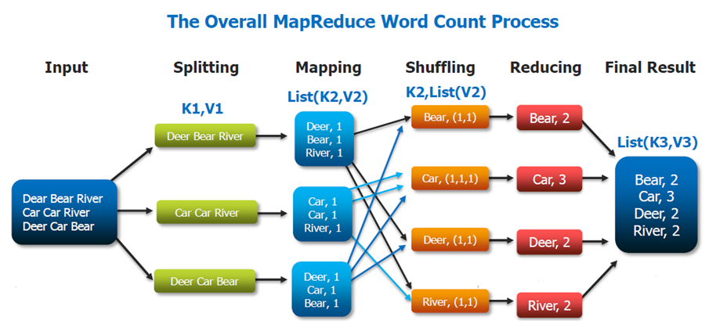
Map(k1,v1) → list(k2,v2)
Reduce(k2, list (v2)) → list(v3)
Notes:
As a developer we need to input data, load data (Key, Value) and provide code for Map() and Reduce()

Slide 29
MapReduce Example
Imagine that for a database of 1.1 billion people (facebook), one would like to compute the average number of social contacts a person has according to age.
SELECT age, AVG(contacts) FROM social.person GROUP BY age ORDER BY age

Slide 30
Using MapReduce, the K1 key values could be the integers 1 through 1100, each representing a batch of 1 million records, the K2 key value could be a person’s age in years, and this computation could be achieved using the following functions:
function Map is
input: integer K1 between 1 and 1100, representing a batch of 1 million social.person records
for each social.person record in the K1 batch do
let Y be the person's age
let N be the number of contacts the person has
produce one output record (Y,(N,1))
repeat
end function
---------------------------------------------------------
function Reduce is
input: age (in years) Y
for each input record (Y,(N,C)) do
Accumulate in S the sum of N*C
Accumulate in Cnew the sum of C
repeat
let A be S/Cnew
produce one output record (Y,(A,Cnew))
end function
1100 batches/Nodes/ MAP Processors
96 batches/Nodes/ REDUCE Processors by performing shuffling operation
Notes:
The MapReduce System would line up the 1100 Map processors, and would provide each with its corresponding 1 million input records. The Map step would produce 1.1 billion (Y,(N,1)) records, with Y values ranging between, say, 8 and 103. The MapReduce System would then line up the 96 Reduce processors by performing shuffling operation of the key/value pairs due to the fact that we need average per age, and provide each with its millions of corresponding input records. The Reduce step would result in the much reduced set of only 96 output records (Y,A), which would be put in the final result file, sorted by Y.

Slide 31
Performance
MapReduce programs are not guaranteed to be fast.
Optimized shuffle operation
The amount of data written by the Map function can have a large impact on the performance and scalability.
Combiner function can help to reduce the amount of data written to disk, and transmitted over the network. MapReduce applications can achieve sub-linear speedups under specific circumstances.
Notes:
They called its interface too low-level and questioned whether it really represents the paradigm shift its proponents have claimed it is.^{[30]} They challenged the MapReduce proponents' claims of novelty, citing Teradata as an example of prior art that has existed for over two decades. They also compared MapReduce programmers to CODASYL programmers, noting both are "writing in a low-level language performing low-level record manipulation."^{[30]} MapReduce's use of input files and lack of schema support prevents the performance improvements enabled by common database system features such as B-trees and hash partitioning, though projects such as Pig (or PigLatin), Sawzall, Apache Hive,^{[31]} YSmart,^{[32]} HBase^{[33]} and BigTable^{[33][34]} are addressing some of these problems.

Slide 32
Uses
MapReduce is useful in a wide range of applications:
Including distributed pattern-based searching
distributed sorting
web link-graph reversal
web access log stats, inverted index construction
document clustering,
machine learning and
statistical machine translation etc etc

Slide 33
Questions
Hadoop vs. Traditional Database
Hadoop is not a database but a framework built to handle large volumes of Structured and semi structured

Slide 34
Tools for Hadoop Environment
The Apache Ambari project is aimed at making Hadoop management simpler by developing software for provisioning, managing, and monitoring Apache Hadoop clusters. Ambari provides an intuitive, easy-to-use Hadoop management web UI backed by its Restful APIs. https://ambari.apache.org/
Oozie is a workflow scheduler system to manage Apache Hadoop jobs. Oozie Coordinator jobs are recurrent, workflow jobs triggered by time (frequency) and data availability.
http://demo.gethue.com/oozie/list_oozie_workflows/
http://oozie.apache.org/
YARN: Yet another resource negotiator
The fundamental idea of YARN is to split up the functionalities of resource management and job scheduling/monitoring into separate daemons.

Slide 35
Tools for Hadoop Environment
Apache Ranger delivers a comprehensive approach to security for a Hadoop cluster. It provides a centralized platform to define, administer and manage security policies consistently across Hadoop components. (Hadoop HDFS, Hive, HBase, Storm, Knox, Solr, Kafka, NiFi, YARN)
Falcon is a feed and process management platform over hadoop. Falcon essentially transforms user's feed and process configurations into repeated actions through a standard workflow engine.
Notes:
http://demo.gethue.com/oozie/list_oozie_workflows/
Solr is a standalone enterprise search server with a REST-like

Slide 36
References
https://hortonworks.com/hadoop-tutorial/introducing-apache-hadoop-developers/
https://wikis.nyu.edu/display/NYUHPC/Big+Data+Tutorial+1%3A+MapReduce
http://hive.apache.org/
https://hortonworks.com/apache/hive
https://cwiki.apache.org/confluence/display/Hive/Home

