Slide 1
第九章 机器无关的优化

Slide 2
主要内容
引言
优化的来源
数据流分析
循环的识别、分析和优化

Slide 3
引言
代码优化或者代码改进
在目标代码中消除不必要的指令
把一个指令序列替换为一个完成相同功能的更快的指令序列
全局优化
有哪些可能的优化或改进机会？
具体的优化实现基于数据流分析技术
用以收集程序相关信息的算法。

Slide 4
优化的来源
程序的冗余
冗余是使用高级程序设计语言编程的副产品
通过抽象的易于书写的方式编程和程序的高效之间存在矛盾。
给编译器提供了优化的机会。

Slide 5
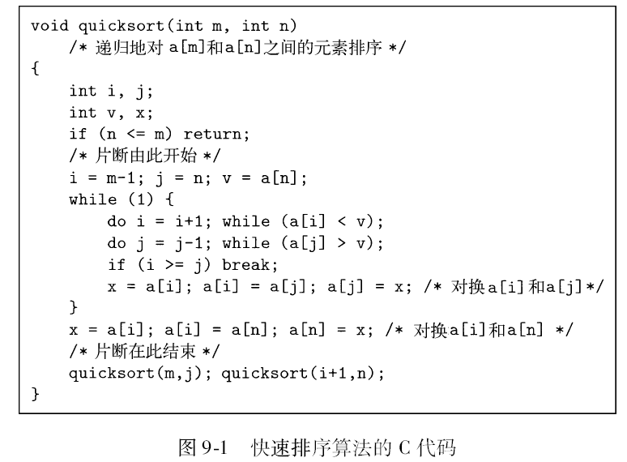
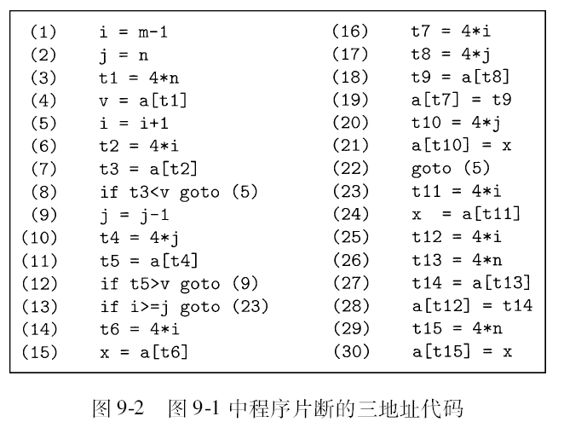
优化的示例
快速排序

Slide 6
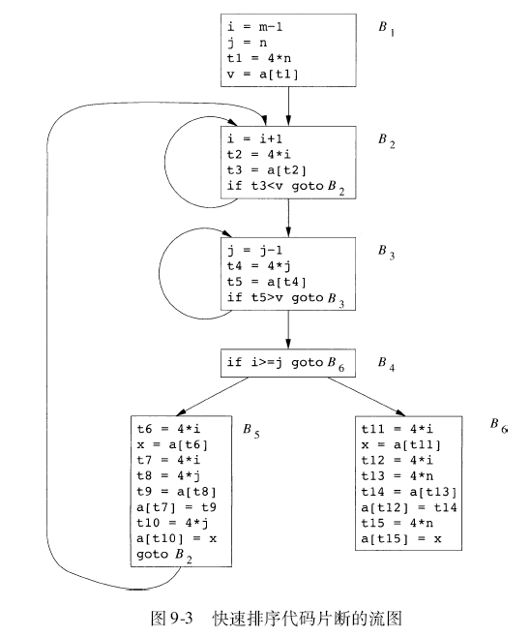
优化的示例（续）

Slide 7
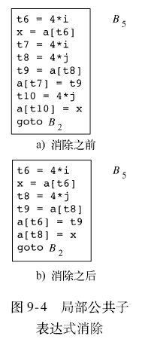
优化的示例（续）
全局公共子表达式
表达式E之前出现过，其中的变量值都没有改变过，多次出现这样的E可以被称为公共子表达式。
如果E上一次计算结果赋予变量x，且x的值中间没有被改变，那么就可以使用x而避免重新计算E。
例9.1:局部优化
例9.2: 考虑B2、B3和B5、B6中
的公共子表达式

Slide 8
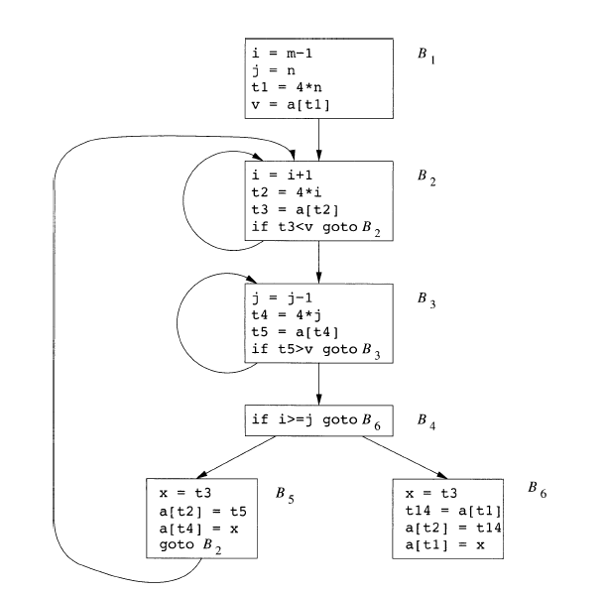
优化的示例（续）
消除公共子表达式后的流图

Slide 9
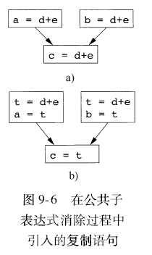
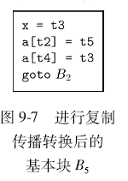
优化 - 复制传播
复制语句：形如u=v这样的复制表达式
复制语句的产生，有时是由其公共子表达式消除优化引入的。
复制传播转换的基本思想
是在复制语句u=v之后尽
可能的用v来替代u。

Slide 10
优化 - 死代码的消除
活跃：一个变量在一个程序点上的值可能会在以后被使用，那么这个变量在该点活跃。
死：不活跃
死代码：其计算结果用于不会被使用的语句。
常量折叠会产生一些死代码。
复制传播也会把一些复制语句变成死代码。

Slide 11

优化 - 代码移动
尽可能减少内部循环的指令可能，即使可能增加循环外的指令个数也是值得的。
循环不变表达式：无论循环多少次，表达式的值都不会变化的表达式。
代码移动：在进入循环前，对循环不变表达式进行求值。

Slide 12
优化 - 归纳变量和强度削减
归纳变量：对于一个变量x，如果存在一个正的或负的常数c使得每次x被赋值时它的值总是增加c，那么x被称为归纳变量。
例如图9.5 B2中的i和t2。
强度削减：把一个高代价的运算（比如乘法）替换为一个代价较低的运算（比如加法）的转换称为强度削减。
如果有一组归纳变量的值的变化保持步调一致，常常可以将这组变量删除只剩一个。

Slide 13
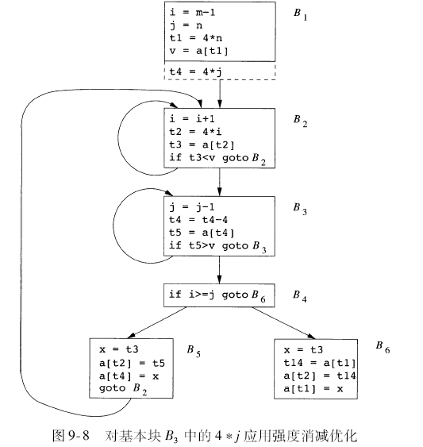
优化 - 归纳变量和强度削减(例)
例9.6

Slide 14
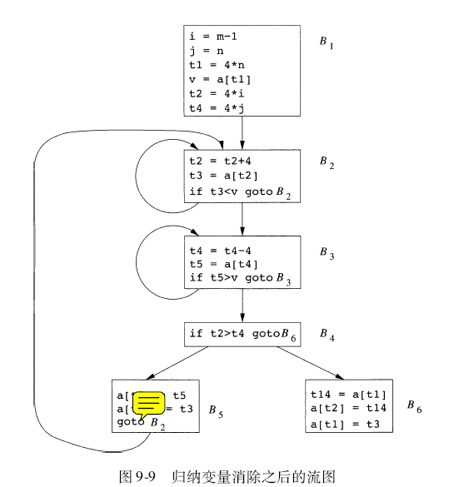
优化 - 归纳变量和强度削减(例)
删除具有同步调变化的归纳变量

Slide 15
Three Address Code of Quick Sort
1
2
3
4
5
6
7
8
9
10
11
12
13
14
15
i = m - 1
j = n
t₁ =4 * n
v = a[t₁]
i = i + 1
t₂ = 4 * i
t₃ = a[t₂]
if t₃ < v goto (5)
j = j – 1
t₄ = 4 * j
t₅ = a[t₄]
if t₅ > v goto (9)
if i >= j goto (23)
t₆ = 4 * i
x = a[t₆]
16
17
18
19
20
21
22
23
24
25
26
27
28
29
30
t₇ = 4 * I
t₈ = 4 * j
t₉ = a[t₈]
a[t₇] = t₉
t₁₀ = 4 * j
a[t₁₀] = x
goto (5)
t₁₁ = 4 * I
x = a[t₁₁]
t₁₂ = 4 * i
t₁₃ = 4 * n
t₁₄ = a[t₁₃]
a[t₁₂] = t₁₄
t₁₅ = 4 * n
a[t₁₅] = x

Slide 16
Find The Basic Block
1
2
3
4
5
6
7
8
9
10
11
12
13
14
15
i = m - 1
j = n
t₁ =4 * n
v = a[t₁]
i = i + 1
t₂ = 4 * i
t₃ = a[t₂]
if t₃ < v goto (5)
j = j – 1
t₄ = 4 * j
t₅ = a[t₄]
if t₅ > v goto (9)
if i >= j goto (23)
t₆ = 4 * i
x = a[t₆]
16
17
18
19
20
21
22
23
24
25
26
27
28
29
30
t₇ = 4 * I
t₈ = 4 * j
t₉ = a[t₈]
a[t₇] = t₉
t₁₀ = 4 * j
a[t₁₀] = x
goto (5)
t₁₁ = 4 * i
x = a[t₁₁]
t₁₂ = 4 * i
t₁₃ = 4 * n
t₁₄ = a[t₁₃]
a[t₁₂] = t₁₄
t₁₅ = 4 * n
a[t₁₅] = x

Slide 17
Flow Graph
B1
i = m - 1
j = n
t₁ =4 * n
v = a[t₁]
B5
B6
B2
t₆ = 4 * i
x = a[t₆]
t₇ = 4 * i
t₈ = 4 * j
t₉ = a[t₈]
a[t₇] = t₉
t₁₀ = 4 * j
a[t₁₀] = x
goto B₂
t₁₁ = 4 * i
x = a[t₁₁]
t₁₂ = 4 * i
t₁₃ = 4 * n
t₁₄ = a[t₁₃]
a[t₁₂] = t₁₄
t₁₅ = 4 * n
a[t₁₅] = x
i = i + 1
t₂ = 4 * i
t₃ = a[t₂]
if t₃ < v goto B₂
B3
j = j – 1
t₄ = 4 * j
t₅ = a[t₄]
if t₅ > v goto B₃
B4
if i >= j goto B6

Slide 18
Common Subexpression Elimination
B1
i = m - 1
j = n
t₁ =4 * n
v = a[t₁]
B5
B6
B2
t₆ = 4 * i
x = a[t₆]
t₇ = 4 * i
t₈ = 4 * j
t₉ = a[t₈]
a[t₇] = t₉
t₁₀ = 4 * j
a[t₁₀] = x
goto B₂
t₁₁ = 4 * i
x = a[t₁₁]
t₁₂ = 4 * i
t₁₃ = 4 * n
t₁₄ = a[t₁₃]
a[t₁₂] = t₁₄
t₁₅ = 4 * n
a[t₁₅] = x
i = i + 1
t₂ = 4 * i
t₃ = a[t₂]
if t₃ < v goto B₂
B3
j = j – 1
t₄ = 4 * j
t₅ = a[t₄]
if t₅ > v goto B₃
B4
if i >= j goto B6

Slide 19
Common Subexpression Elimination
B1
i = m - 1
j = n
t₁ =4 * n
v = a[t₁]
B5
B6
B2
t₆ = 4 * i
x = a[t₆]
t₈ = 4 * j
t₉ = a[t₈]
a[t₆] = t₉
t₁₀ = 4 * j
a[t₁₀] = x
goto B₂
t₁₁ = 4 * i
x = a[t₁₁]
t₁₂ = 4 * i
t₁₃ = 4 * n
t₁₄ = a[t₁₃]
a[t₁₂] = t₁₄
t₁₅ = 4 * n
a[t₁₅] = x
i = i + 1
t₂ = 4 * i
t₃ = a[t₂]
if t₃ < v goto B₂
B3
j = j – 1
t₄ = 4 * j
t₅ = a[t₄]
if t₅ > v goto B₃
B4
if i >= j goto B6

Slide 20
Common Subexpression Elimination
B1
i = m - 1
j = n
t₁ =4 * n
v = a[t₁]
B5
B6
B2
t₆ = 4 * i
x = a[t₆]
t₈ = 4 * j
t₉ = a[t₈]
a[t₆] = t₉
a[t₈] = x
goto B₂
t₁₁ = 4 *i
x = a[t₁₁]
t₁₂ = 4 * i
t₁₃ = 4 * n
t₁₄ = a[t₁₃]
a[t₁₂] = t₁₄
t₁₅ = 4 * n
a[t₁₅] = x
i = i + 1
t₂ = 4 * i
t₃ = a[t₂]
if t₃ < v goto B₂
B3
j = j – 1
t₄ = 4 * j
t₅ = a[t₄]
if t₅ > v goto B₃
B4
if i >= j goto B6

Slide 21
Common Subexpression Elimination
B1
i = m - 1
j = n
t₁ =4 * n
v = a[t₁]
B5
B6
B2
t₆ = 4 * i
x = a[t₆]
t₈ = 4 * j
t₉ = a[t₈]
a[t₆] = t₉
a[t₈] = x
goto B₂
t₁₁ = 4 * i
x = a[t₁₁]
t₁₂ = 4 * i
t₁₃ = 4 * n
t₁₄ = a[t₁₃]
a[t₁₂] = t₁₄
t₁₅ = 4 * n
a[t₁₅] = x
i = i + 1
t₂ = 4 * i
t₃ = a[t₂]
if t₃ < v goto B₂
B3
j = j – 1
t₄ = 4 * j
t₅ = a[t₄]
if t₅ > v goto B₃
B4
if i >= j goto B6

Slide 22
Common Subexpression Elimination
B1
i = m - 1
j = n
t₁ =4 * n
v = a[t₁]
B5
B6
B2
t₆ = 4 * i
x = a[t₆]
t₈ = 4 * j
t₉ = a[t₈]
a[t₆] = t₉
a[t₈] = x
goto B₂
t₁₁ = 4 * i
x = a[t₁₁]
t₁₃ = 4 * n
t₁₄ = a[t₁₃]
a[t₁₁] = t₁₄
t₁₅ = 4 * n
a[t₁₅] = x
i = i + 1
t₂ = 4 * i
t₃ = a[t₂]
if t₃ < v goto B₂
B3
j = j – 1
t₄ = 4 * j
t₅ = a[t₄]
if t₅ > v goto B₃
B4
if i >= j goto B6

Slide 23
Common Subexpression Elimination
B1
i = m - 1
j = n
t₁ =4 * n
v = a[t₁]
B5
B6
B2
t₆ = 4 * i
x = a[t₆]
t₈ = 4 * j
t₉ = a[t₈]
a[t₆] = t₉
a[t₈] = x
goto B₂
t₁₁ = 4 * i
x = a[t₁₁]
t₁₃ = 4 * n
t₁₄ = a[t₁₃]
a[t₁₁] = t₁₄
a[t₁₃] = x
i = i + 1
t₂ = 4 * i
t₃ = a[t₂]
if t₃ < v goto B₂
B3
j = j – 1
t₄ = 4 * j
t₅ = a[t₄]
if t₅ > v goto B₃
B4
if i >= j goto B6

Slide 24
Common Subexpression Elimination（全局）
B1
i = m - 1
j = n
t₁ =4 * n
v = a[t₁]
B5
B6
B2
t₆ = 4 * i
x = a[t₆]
t₈ = 4 * j
t₉ = a[t₈]
a[t₆] = t₉
a[t₈] = x
goto B₂
t₁₁ = 4 * i
x = a[t₁₁]
t₁₃ = 4 * n
t₁₄ = a[t₁₃]
a[t₁₁] = t₁₄
a[t₁₃] = x
i = i + 1
t₂ = 4 * i
t₃ = a[t₂]
if t₃ < v goto B₂
B3
j = j – 1
t₄ = 4 * j
t₅ = a[t₄]
if t₅ > v goto B₃
B4
if i >= j goto B6

Slide 25
Common Subexpression Elimination
B1
i = m - 1
j = n
t₁ =4 * n
v = a[t₁]
B5
B6
B2
x = a[t₂]
t₈ = 4 * j
t₉ = a[t₈]
a[t₂] = t₉
a[t₈] = x
goto B₂
t₁₁ = 4 * i
x = a[t₁₁]
t₁₃ = 4 * n
t₁₄ = a[t₁₃]
a[t₁₁] = t₁₄
a[t₁₃] = x
i = i + 1
t₂ = 4 * i
t₃ = a[t₂]
if t₃ < v goto B₂
B3
j = j – 1
t₄ = 4 * j
t₅ = a[t₄]
if t₅ > v goto B₃
B4
if i >= j goto B6

Slide 26
Common Subexpression Elimination
B1
i = m - 1
j = n
t₁ =4 * n
v = a[t₁]
B5
B6
B2
x = t₃
t₈ = 4 * j
t₉ = a[t₈]
a[t₂] = t₉
a[t₈] = x
goto B₂
t₁₁ = 4 * i
x = a[t₁₁]
t₁₃ = 4 * n
t₁₄ = a[t₁₃]
a[t₁₁] = t₁₄
a[t₁₃] = x
i = i + 1
t₂ = 4 * i
t₃ = a[t₂]
if t₃ < v goto B₂
B3
j = j – 1
t₄ = 4 * j
t₅ = a[t₄]
if t₅ > v goto B₃
B4
if i >= j goto B6

Slide 27
Common Subexpression Elimination
B1
i = m - 1
j = n
t₁ =4 * n
v = a[t₁]
B5
B6
B2
x = t₃
t₉ = a[t₄]
a[t₂] = t₉
a[t₄] = x
goto B₂
t₁₁ = 4 * i
x = a[t₁₁]
t₁₃ = 4 * n
t₁₄ = a[t₁₃]
a[t₁₁] = t₁₄
a[t₁₃] = x
i = i + 1
t₂ = 4 * i
t₃ = a[t₂]
if t₃ < v goto B₂
B3
j = j – 1
t₄ = 4 * j
t₅ = a[t₄]
if t₅ > v goto B₃
B4
if i >= j goto B6

Slide 28
Common Subexpression Elimination
B1
i = m - 1
j = n
t₁ =4 * n
v = a[t₁]
B5
B6
B2
x = t₃
a[t₂] = t₅
a[t₄] = x
goto B₂
t₁₁ = 4 * i
x = a[t₁₁]
t₁₃ = 4 * n
t₁₄ = a[t₁₃]
a[t₁₁] = t₁₄
a[t₁₃] = x
i = i + 1
t₂ = 4 * i
t₃ = a[t₂]
if t₃ < v goto B₂
B3
j = j – 1
t₄ = 4 * j
t₅ = a[t₄]
if t₅ > v goto B₃
B4
if i >= j goto B6

Slide 29
Common Subexpression Elimination
B1
i = m - 1
j = n
t₁ =4 * n
v = a[t₁]
B5
B6
B2
x = t₃
a[t₂] = t₅
a[t₄] = x
goto B₂
x = t₃
t₁₄ = a[t₁]
a[t₂] = t₁₄
a[t₁] = x
i = i + 1
t₂ = 4 * i
t₃ = a[t₂]
if t₃ < v goto B₂
B3
Similarly for B6
j = j – 1
t₄ = 4 * j
t₅ = a[t₄]
if t₅ > v goto B₃
B4
if i >= j goto B6

Slide 30
Copy Propogation & Dead Code Elimination
B1
i = m - 1
j = n
t₁ =4 * n
v = a[t₁]
B5
B6
B2
x = t₃
a[t₂] = t₅
a[t₄] = x
goto B₂
x = t₃
t₁₄ = a[t₁]
a[t₂] = t₁₄
a[t₁] = x
i = i + 1
t₂ = 4 * i
t₃ = a[t₂]
if t₃ < v goto B₂
B3
j = j – 1
t₄ = 4 * j
t₅ = a[t₄]
if t₅ > v goto B₃
B4
if i >= j goto B6

Slide 31
Dead Code Elimination
B1
i = m - 1
j = n
t₁ =4 * n
v = a[t₁]
B5
B6
B2
a[t₂] = t₅
a[t₄] = t₃
goto B₂
t₁₄ = a[t₁]
a[t₂] = t₁₄
a[t₁] = t₃
i = i + 1
t₂ = 4 * i
t₃ = a[t₂]
if t₃ < v goto B₂
B3
j = j – 1
t₄ = 4 * j
t₅ = a[t₄]
if t₅ > v goto B₃
B4
if i >= j goto B6

Slide 32
Reduction in Strength
B1
i = m - 1
j = n
t₁ =4 * n
v = a[t₁]
B5
B6
B2
a[t₂] = t₅
a[t₄] = t₃
goto B₂
t₁₄ = a[t₁]
a[t₂] = t₁₄
a[t₁] = t₃
i = i + 1
t₂ = 4 * i
t₃ = a[t₂]
if t₃ < v goto B₂
B3
j = j – 1
t₄ = 4 * j
t₅ = a[t₄]
if t₅ > v goto B₃
B4
if i >= j goto B6

Slide 33
Reduction in Strength
i = m - 1
j = n
t₁ =4 * n
v = a[t₁]
t₂ = 4 * i
t₄ = 4 * j
B1
B5
B6
B2
a[t₂] = t₅
a[t₄] = t₃
goto B₂
t₁₄ = a[t₁]
a[t₂] = t₁₄
a[t₁] = t₃
i = i + 1
t₂ = t₂ + 4
t₃ = a[t₂]
if t₃ < v goto B₂
B3
j = j – 1
t₄ = t₄ - 4
t₅ = a[t₄]
if t₅ > v goto B₃
B4
if i >= j goto B6

Slide 34
Induction Variable Elimination
B1
i = m - 1
j = n
t₁ =4 * n
v = a[t₁]
t₂ = 4 * i
t₄ = 4 * j
B5
B6
a[t₂] = t₅
a[t₄] = t₃
goto B₂
t₁₄ = a[t₁]
a[t₂] = t₁₄
a[t₁] = t₃
B2
t₂ = t₂ + 4
t₃ = a[t₂]
if t₃ < v goto B₂
B3
t₄ = t₄ - 4
t₅ = a[t₄]
if t₅ > v goto B₃
B4
if t2>= t4 goto B6

