Slide 1


HANDOUT
Presenter
方盛俊
THE
BOOK
WE
ENJOY

Slide 2
OUTLINE
1 The basis of the book
2 The interesting plots about the book
3 The influence of the book

Slide 3
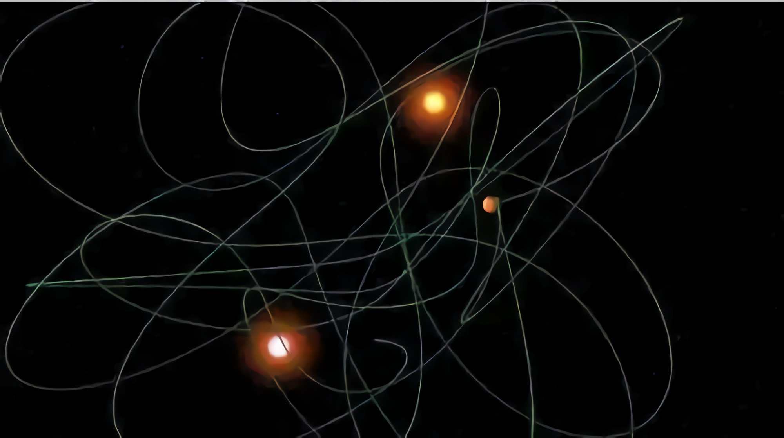

Slide 4
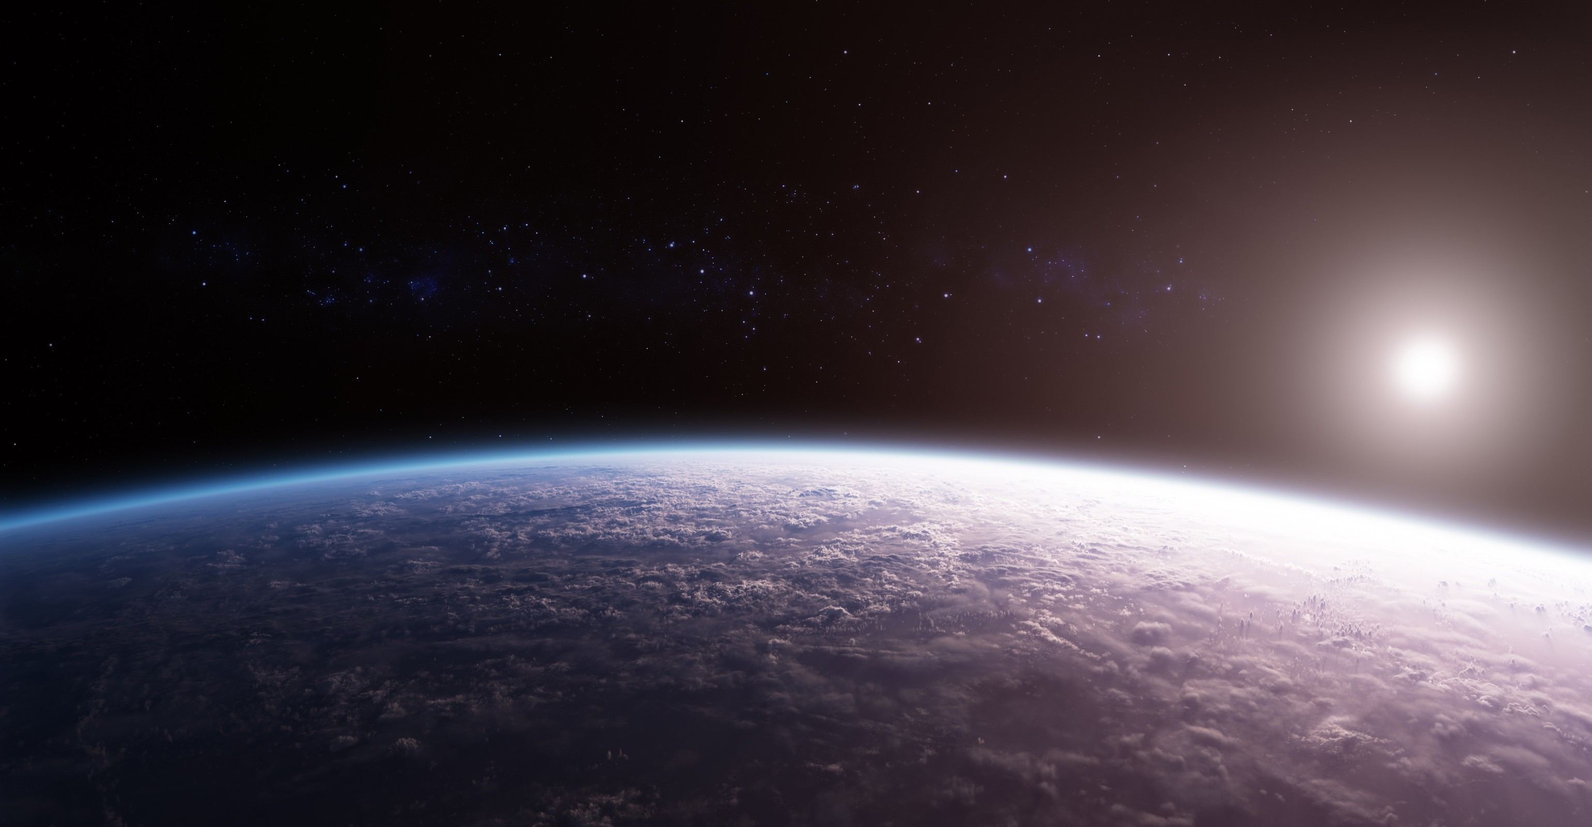
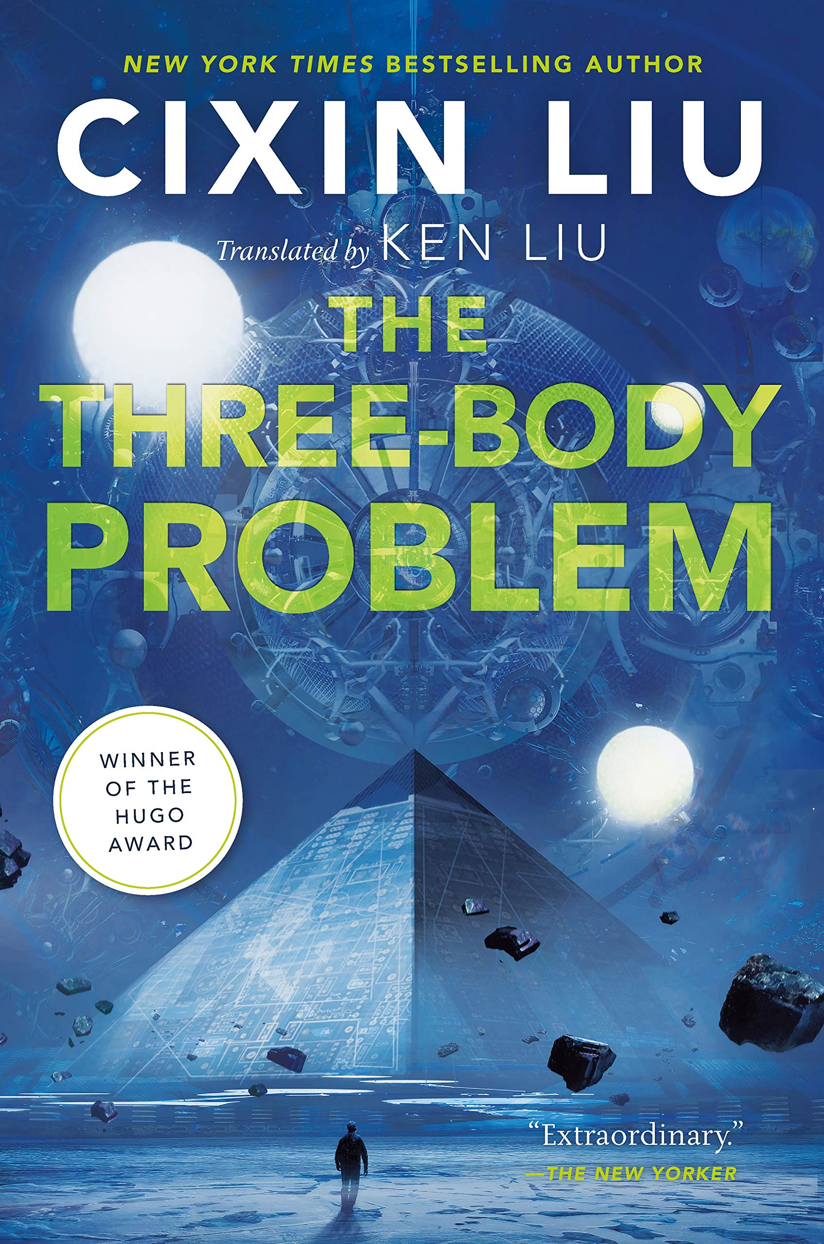
THE
THREE
BODY
PROBLEM

Slide 5

Have you read the science fiction
The Three Body Problem?

