Slide 1
Search Trees
Data Structures and Algorithms
Nanjing University, Fall 2021
郑朝栋

Slide 2

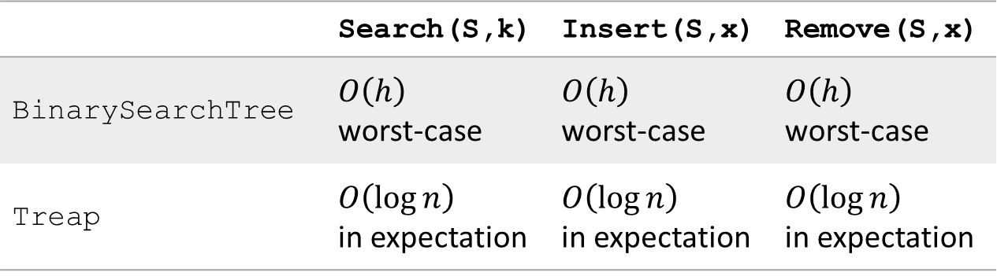
Efficient implementation of OSet
 | Search(S,k) | Insert(S,x) | Remove(S,x)
BinarySearchTree | $O\left(h\right)$ worst-case | $O\left(h\right)$ worst-case | $O\left(h\right)$ worst-case
Treap | $O\left(\log{n}\right)$ in expectation | $O\left(\log{n}\right)$ in expectation | $O\left(\log{n}\right)$ in expectation
A data structure supporting OSet operations in $O\left(\log{n}\right)$ time, even in worst-case?

Slide 3













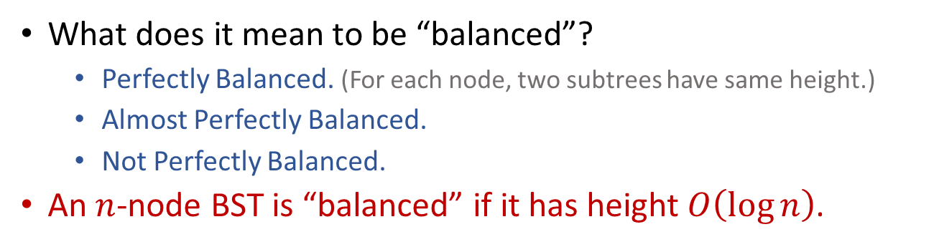























“Balanced” BST
What does it mean to be “balanced”?
Perfectly Balanced. (For each node, two subtrees have same height.)
Almost Perfectly Balanced.
Not Perfectly Balanced.
An $n$-node BST is “balanced” if it has height $O\left(\log{n}\right)$.
$$41$$
$$41$$
$$41$$
$$20$$
$$65$$
$$20$$
$$65$$
$$20$$
$$65$$
$$13$$
$$32$$
$$50$$
$$91$$
$$13$$
$$32$$
$$50$$
$$91$$
$$13$$
$$32$$
$$9$$
$$15$$
$$26$$
$$38$$
$$43$$
$$60$$
$$88$$
$$92$$
$$9$$
$$15$$
$$38$$
$$43$$
$$60$$
$$88$$
$$9$$
$$15$$
$$38$$
Perfectly Balanced
Almost Perfectly Balanced
Not Perfectly Balanced

Slide 4
“Balanced” Binary Search Trees
AVL tree (Adelson-Velsii & Landis, 1962)
B-tree (Bayer & McCreight, 1970)
Red-black tree (Bayer, 1972)
Splay tree (Sleator & Tarjan, 1985)
Treap (Seidel & Aragon, 1996)
Skip list (Pugh, 1989)
and so on …

Slide 5
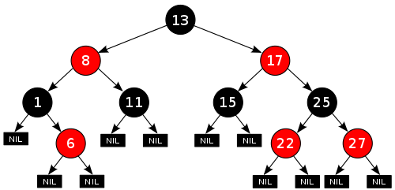
Red-black Tree (RB-Tree)
A Red-black Tree (RB-Tree) is a BST in which each node has a color, and satisfies the following properties:
Every node is either red or black.
The root is black.
Every leaf is black.
[no-red-edge] If a node is red, then both its children are black.
[black-height] For every node, all paths from the node to its descendant leaves contain same number of black nodes.

Slide 6





















Black Height
Call the number of black nodes on any simple path from, but not including, a node $x$ down to a leaf the black-height of the node, denoted by $bh\left(x\right)$.
Due to black-height property, from the black-height perspective, RB-Trees are “perfectly balanced”.
Due to no-red-edge property, actual height of a RB-Tree does not deviate a lot from its black-height.
RB-Trees are well balanced!
$$bh=2$$
$$8$$
$$13$$
$$17$$
$$bh=2$$
$$bh=2$$
$$bh=1$$
$$bh=1$$
$$bh=1$$
$$bh=1$$
$$1$$
$$6$$
$$11$$
$$15$$
$$22$$
$$25$$
$$27$$
$$bh=1$$
$$bh=1$$
$$bh=1$$

Slide 7
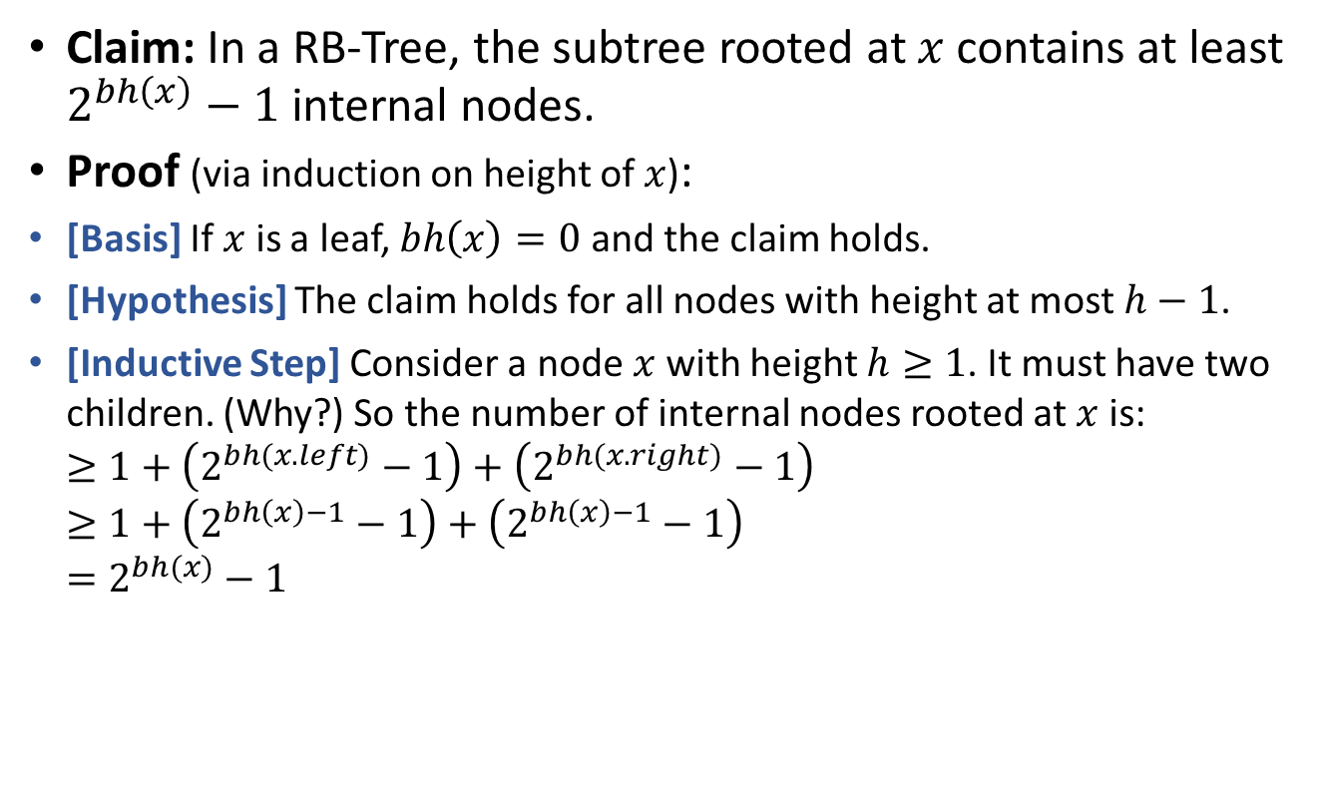
Height of RB-Trees
Claim: In a RB-Tree, the subtree rooted at $x$ contains at least $2^{bh\left(x\right)}−1$ internal nodes.
Proof (via induction on height of $x$):
[Basis] If $x$ is a leaf, $bh\left(x\right)=0$ and the claim holds.
[Hypothesis] The claim holds for all nodes with height at most $h−1$.
[Inductive Step] Consider a node $x$with height $h≥1$. It must have two children. (Why?) So the number of internal nodes rooted at $x$ is: $≥1+\left(2^{bh(x.left)}−1\right)+\left(2^{bh(x.right)}−1\right)$ $≥1+\left(2^{bh\left(x\right)−1}−1\right)+\left(2^{bh\left(x\right)−1}−1\right)$ $=2^{bh(x)}−1$

Slide 8
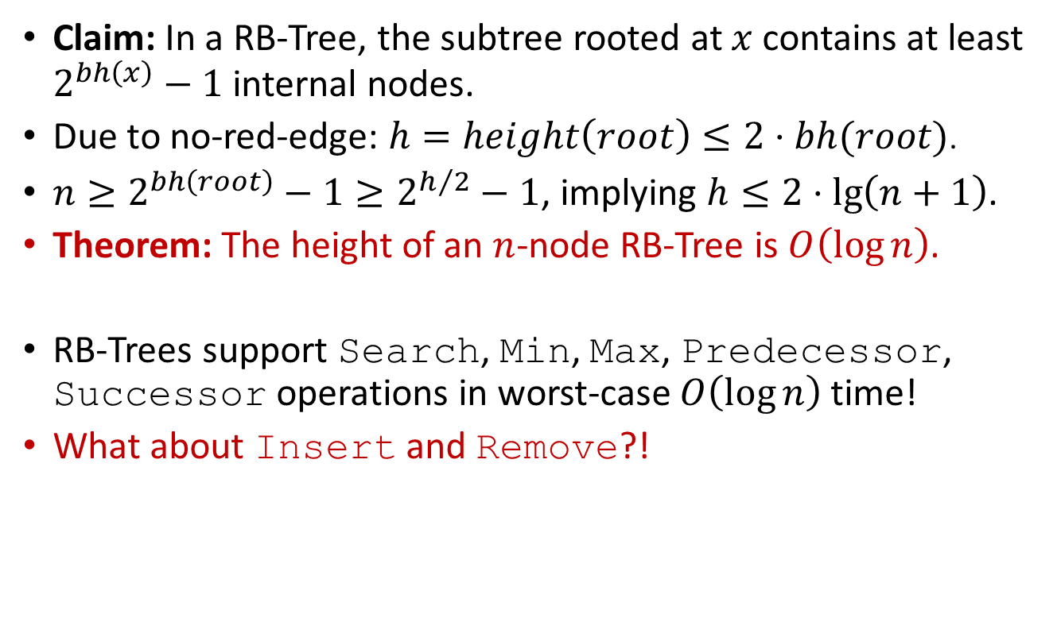
Height of RB-Trees
Claim: In a RB-Tree, the subtree rooted at $x$ contains at least $2^{bh\left(x\right)}−1$ internal nodes.
Due to no-red-edge: $h=height\left(root\right)≤2⋅bh(root)$.
$n≥2^{bh\left(root\right)}−1≥2^{h/2}−1$, implying $h≤2⋅\lg\left(n+1\right)$.
Theorem: The height of an $n$-node RB-Tree is $O\left(\log{n}\right)$.
RB-Trees support Search, Min, Max, Predecessor, Successor operations in worst-case $O\left(\log{n}\right)$ time!
What about Insert and Remove?!

Slide 9

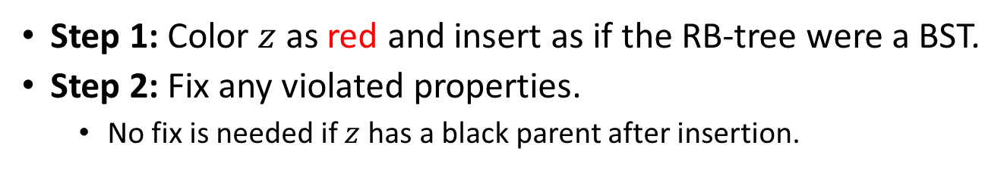









Insert node $z$ into an RB-Tree
Step 1: Color $z$ as red and insert as if the RB-tree were a BST.
Step 2: Fix any violated properties.
No fix is needed if $z$ has a black parent after insertion.
Maintain black-height, fix no-red-edge if necessary.
Example: Insert element with key 2.
$$11$$
$$3$$
$$14$$
RB-Tree Properties:
Each node is red or black.
Root is black.
Leaves are black.
No-red-edge property.
Black-height property.
$$1$$
$$7$$
$$15$$
$$2$$
$$5$$
$$8$$

Slide 10
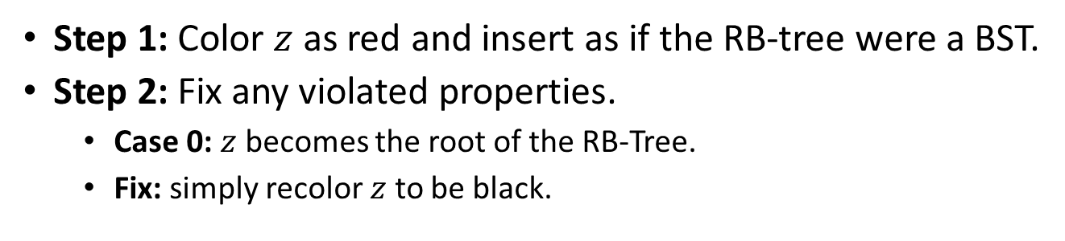
Insert node $z$ into an RB-Tree
Step 1: Color $z$ as red and insert as if the RB-tree were a BST.
Step 2: Fix any violated properties.
Case 0: $z$ becomes the root of the RB-Tree.
Fix: simply recolor $z$ to be black.
RB-Tree Properties:
Each node is red or black.
Root is black (easy fix).
Leaves are black.
No-red-edge property (fix).
Black-height property (maintain).

Slide 11
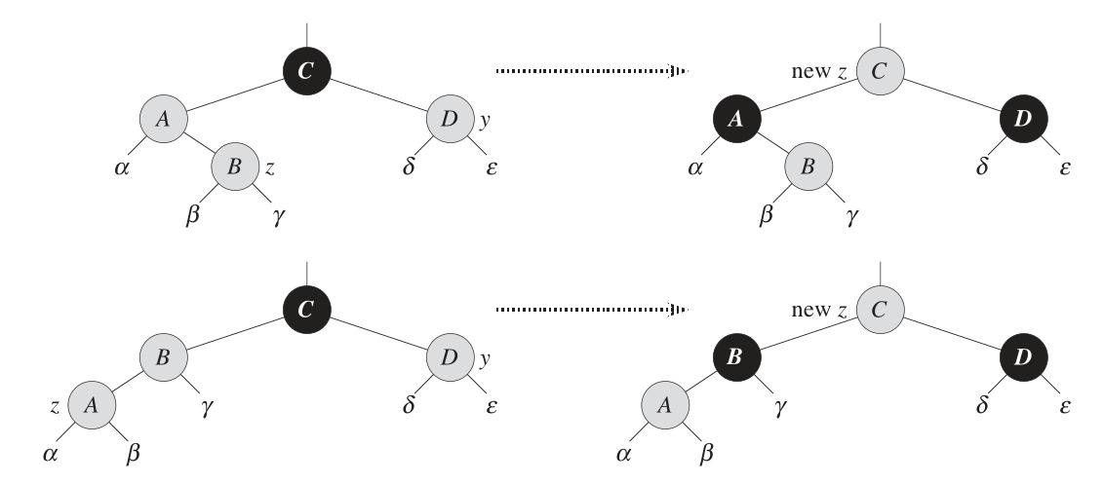


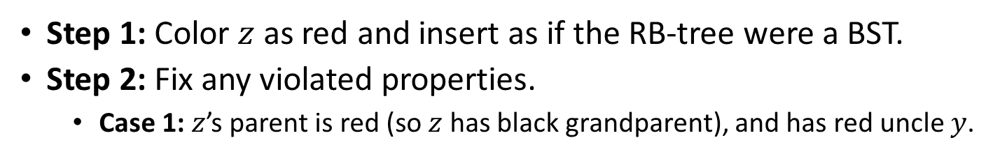









Insert node $z$ into an RB-Tree
Step 1: Color $z$ as red and insert as if the RB-tree were a BST.
Step 2: Fix any violated properties.
Case 1: $z$’s parent is red (so $z$ has black grandparent), and has red uncle $y$.
Black-height property maintained, and we “push-up” violation of no-red-edge property.
Black-height property satisfied for all nodes in subtree rooted at $C$.
Black-height unchanged for $C.parent$ (if it exists).
Example: Insert element with key 4.
$$11$$
RB-Tree Properties:
Each node is red or black.
Root is black (easy fix).
Leaves are black.
No-red-edge property (fix).
Black-height property (maintain).
$$3$$
$$14$$
$$1$$
$$7$$
$$15$$
$$y$$
$$5$$
$$8$$
$$z$$
$$4$$

Slide 12

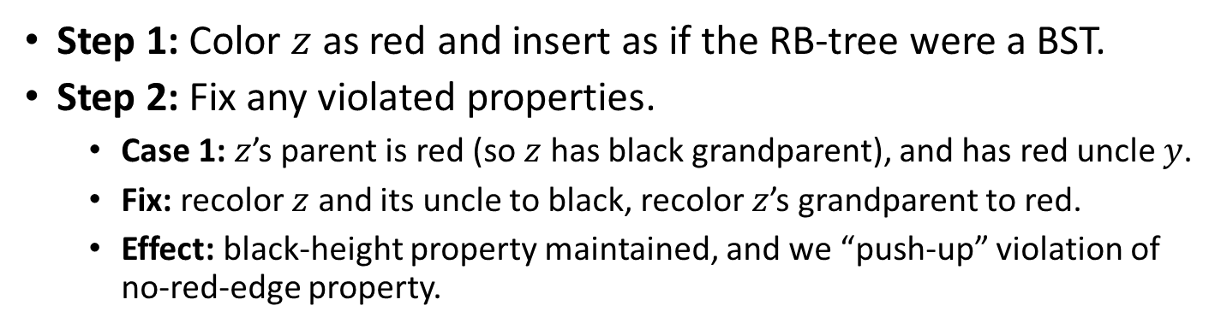



Insert node $z$ into an RB-Tree
Step 1: Color $z$ as red and insert as if the RB-tree were a BST.
Step 2: Fix any violated properties.
Case 1: $z$’s parent is red (so $z$ has black grandparent), and has red uncle $y$.
Fix: recolor $z$ and its uncle to black, recolor $z$’s grandparent to red.
Effect: black-height property maintained, and we “push-up” violation of no-red-edge property.
$$11$$
$$11$$
RB-Tree Properties:
Each node is red or black.
Root is black (easy fix).
Leaves are black.
No-red-edge property (fix).
Black-height property (maintain).
$$14$$
$$3$$
$$14$$
$$3$$
$$z$$
$$15$$
$$1$$
$$15$$
$$1$$
$$7$$
$$7$$
$$y$$
$$8$$
$$5$$
$$8$$
$$5$$
$$z$$
$$4$$
$$4$$

Slide 13
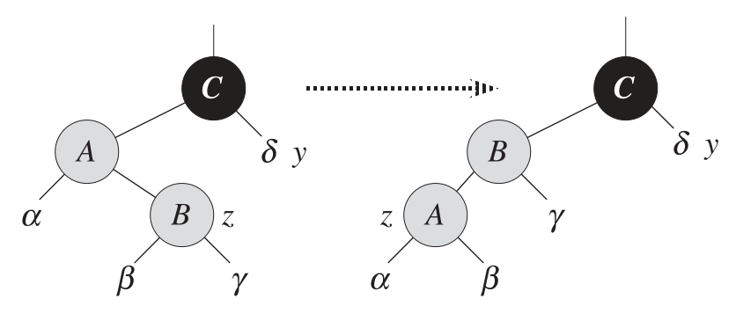

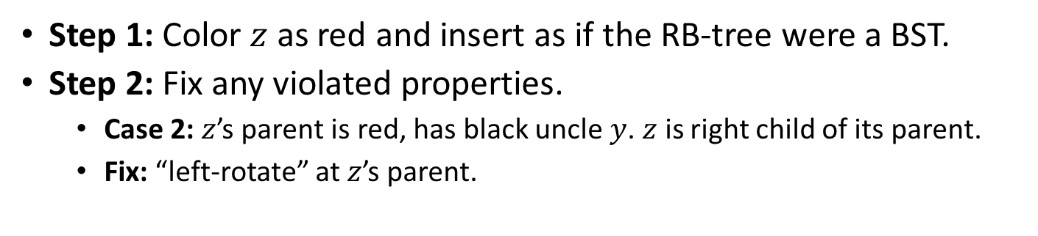
Insert node $z$ into an RB-Tree
Step 1: Color $z$ as red and insert as if the RB-tree were a BST.
Step 2: Fix any violated properties.
Case 2: $z$’s parent is red, has black uncle $y$. $z$ is right child of its parent.
Fix: “left-rotate” at $z$’s parent.
$$11$$
RB-Tree Properties:
Each node is red or black.
Root is black (easy fix).
Leaves are black.
No-red-edge property (fix).
Black-height property (maintain).
$$3$$
$$14$$
$$y$$
$$1$$
$$z$$
$$7$$
$$15$$
$$5$$
$$8$$
$$4$$

Slide 14


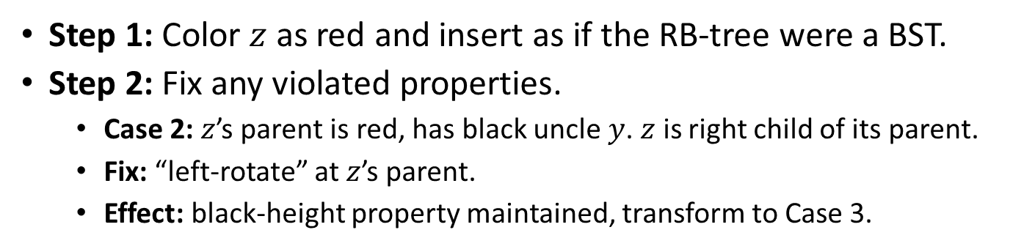





Insert node $z$ into an RB-Tree
Step 1: Color $z$ as red and insert as if the RB-tree were a BST.
Step 2: Fix any violated properties.
Case 2: $z$’s parent is red, has black uncle $y$. $z$ is right child of its parent.
Fix: “left-rotate” at $z$’s parent.
Effect: black-height property maintained, transform to Case 3.
$$11$$
RB-Tree Properties:
Each node is red or black.
Root is black (easy fix).
Leaves are black.
No-red-edge property (fix).
Black-height property (maintain).
$$7$$
$$14$$
$$y$$
$$z$$
$$3$$
$$8$$
$$15$$
$$1$$
$$5$$
$$4$$

Slide 15
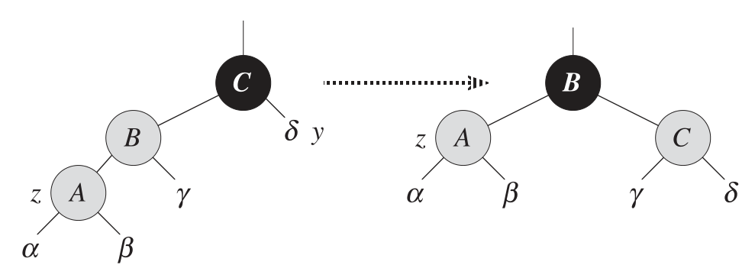
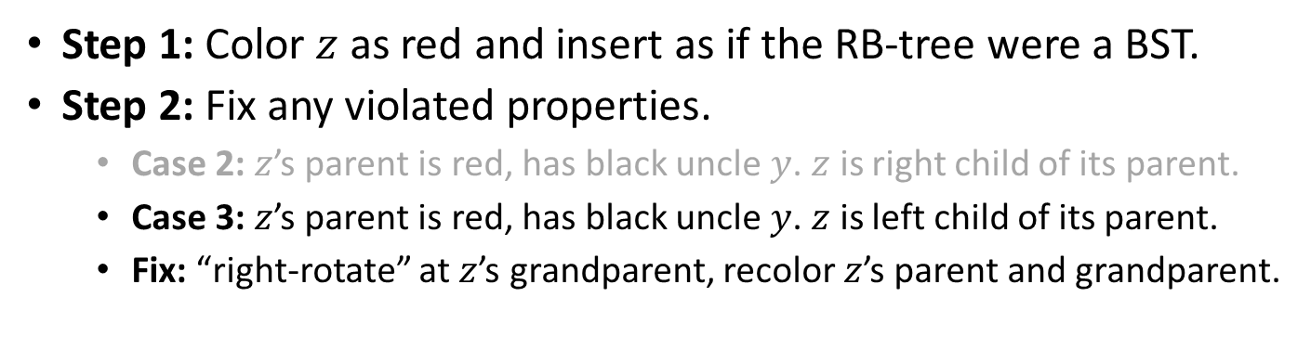
Insert node $z$ into an RB-Tree
Step 1: Color $z$ as red and insert as if the RB-tree were a BST.
Step 2: Fix any violated properties.
Case 2: $z$’s parent is red, has black uncle $y$. $z$ is right child of its parent.
Case 3: $z$’s parent is red, has black uncle $y$. $z$ is left child of its parent.
Fix: “right-rotate” at $z$’s grandparent, recolor $z$’s parent and grandparent.
$$11$$
RB-Tree Properties:
Each node is red or black.
Root is black (easy fix).
Leaves are black.
No-red-edge property (fix).
Black-height property (maintain).
$$7$$
$$14$$
$$y$$
$$z$$
$$3$$
$$8$$
$$15$$
$$1$$
$$5$$
$$4$$

Slide 16

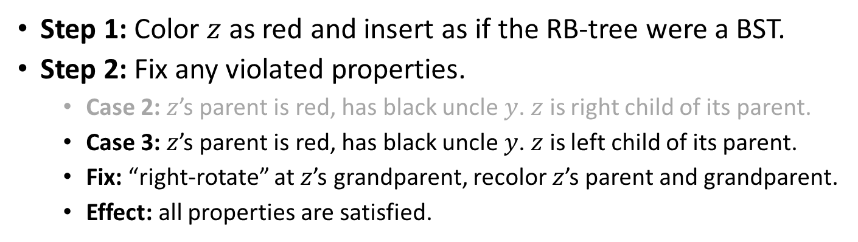




Insert node $z$ into an RB-Tree
Step 1: Color $z$ as red and insert as if the RB-tree were a BST.
Step 2: Fix any violated properties.
Case 2: $z$’s parent is red, has black uncle $y$. $z$ is right child of its parent.
Case 3: $z$’s parent is red, has black uncle $y$. $z$ is left child of its parent.
Fix: “right-rotate” at $z$’s grandparent, recolor $z$’s parent and grandparent.
Effect: all properties are satisfied.
We are done!
RB-Tree Properties:
Each node is red or black.
Root is black (easy fix).
Leaves are black.
No-red-edge property (fix).
Black-height property (maintain).
$$7$$
$$z$$
$$3$$
$$11$$
$$1$$
$$5$$
$$8$$
$$14$$
$$4$$
$$15$$

Slide 17





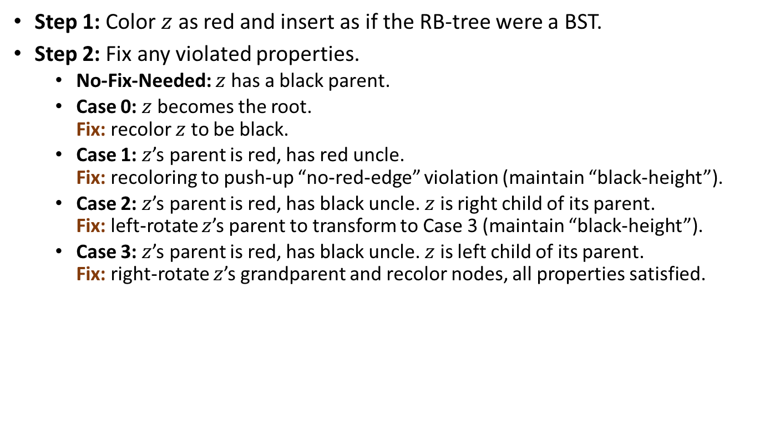


































Insert node $z$ into an RB-Tree
Step 1: Color $z$ as red and insert as if the RB-tree were a BST.
Step 2: Fix any violated properties.
No-Fix-Needed: $z$ has a black parent.
Case 0: $z$ becomes the root. Fix: recolor $z$ to be black.
Case 1: $z$’s parent is red, has red uncle. Fix: recoloring to push-up “no-red-edge” violation (maintain “black-height”).
Case 2: $z$’s parent is red, has black uncle. $z$ is right child of its parent. Fix: left-rotate $z$’s parent to transform to Case 3 (maintain “black-height”).
Case 3: $z$’s parent is red, has black uncle. $z$ is left child of its parent. Fix: right-rotate $z$’s grandparent and recolor nodes, all properties satisfied.
$$7$$
$$3$$
$$11$$
$$1$$
$$5$$
$$8$$
$$14$$
$$4$$
$$15$$
$$11$$
$$11$$
$$11$$
$$3$$
$$14$$
$$3$$
$$14$$
$$7$$
$$14$$
$$1$$
$$7$$
$$15$$
$$1$$
$$7$$
$$z$$
$$15$$
$$3$$
$$z$$
$$8$$
$$15$$
$$5$$
$$8$$
$$5$$
$$8$$
$$1$$
$$5$$
$$4$$
$$z$$
$$4$$
$$4$$

Slide 18
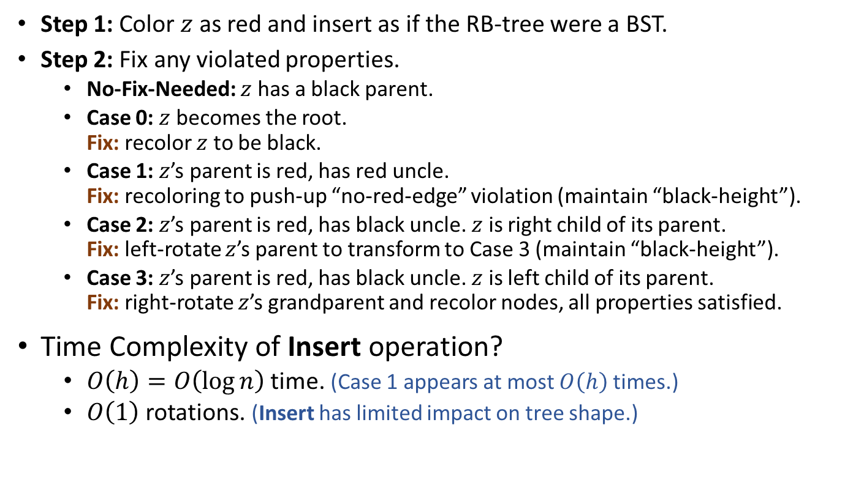
Insert node $z$ into an RB-Tree
Step 1: Color $z$ as red and insert as if the RB-tree were a BST.
Step 2: Fix any violated properties.
No-Fix-Needed: $z$ has a black parent.
Case 0: $z$ becomes the root. Fix: recolor $z$ to be black.
Case 1: $z$’s parent is red, has red uncle. Fix: recoloring to push-up “no-red-edge” violation (maintain “black-height”).
Case 2: $z$’s parent is red, has black uncle. $z$ is right child of its parent. Fix: left-rotate $z$’s parent to transform to Case 3 (maintain “black-height”).
Case 3: $z$’s parent is red, has black uncle. $z$ is left child of its parent. Fix: right-rotate $z$’s grandparent and recolor nodes, all properties satisfied.
Time Complexity of Insert operation?
$O\left(h\right)=O\left(\log{n}\right)$ time. (Case 1 appears at most $O\left(h\right)$ times.)
$O\left(1\right)$ rotations. (Insert has limited impact on tree shape.)

Slide 19

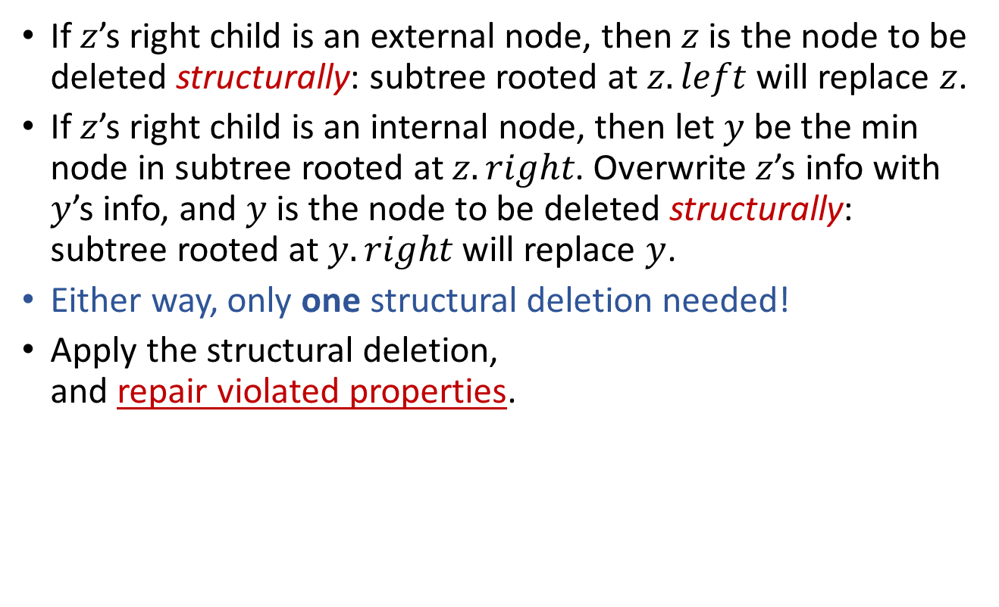







Remove node $z$ from an RB-Tree
If $z$’s right child is an external node, then $z$ is the node to be deleted structurally: subtree rooted at $z.left$ will replace $z$.
If $z$’s right child is an internal node, then let $y$ be the min node in subtree rooted at $z.right$. Overwrite $z$’s info with $y$’s info, and $y$ is the node to be deleted structurally: subtree rooted at $y.right$ will replace $y$.
Either way, only one structural deletion needed!
Apply the structural deletion, and repair violated properties.
$$z$$
Call the node to be deleted structurally $y$, and let $x$ be the node that will replace $y$.
$$y$$
$$y=$$
$$z$$
$$x$$
$$x$$

Slide 20
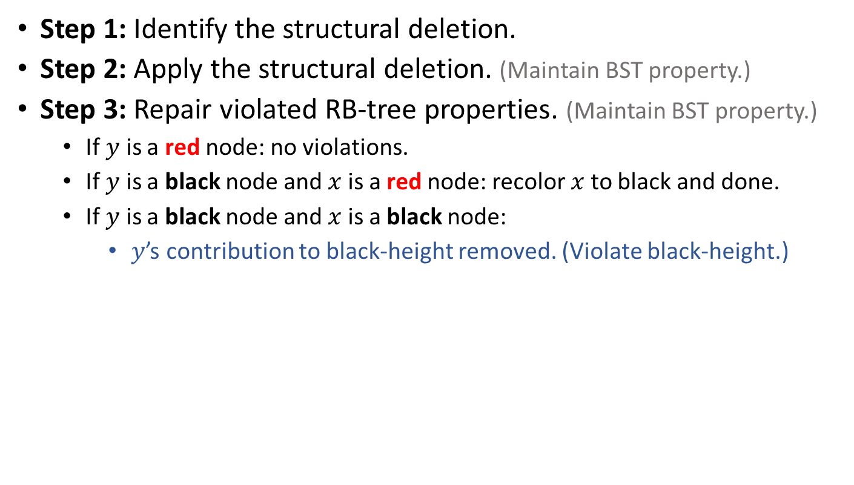
Remove node $z$ from an RB-Tree
Step 1: Identify the structural deletion.
Step 2: Apply the structural deletion. (Maintain BST property.)
Step 3: Repair violated RB-tree properties. (Maintain BST property.)
If $y$ is a red node: no violations.
If $y$ is a black node and $x$ is a red node: recolor $x$ to black and done.
If $y$ is a black node and $x$ is a black node:
$y$’s contribution to black-height removed. (Violate black-height.)
RB-Tree Properties:
Each node is red or black.
Root is black.
Leaves are black.
No-red-edge property.
Black-height property.
$$z$$
$$y$$
$$y=$$
$$z$$
$$x$$
$$x$$

Slide 21




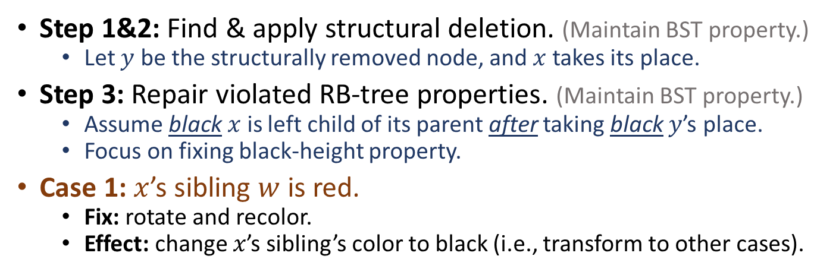






















Remove node $z$ from an RB-Tree
Step 1&2: Find & apply structural deletion. (Maintain BST property.)
Let $y$ be the structurally removed node, and $x$ takes its place.
Step 3: Repair violated RB-tree properties. (Maintain BST property.)
Assume black $x$ is left child of its parent after taking black $y$’s place.
Focus on fixing black-height property.
Case 1: $x$’s sibling $w$ is red.
Fix: rotate and recolor.
Effect: change $x$’s sibling’s color to black (i.e., transform to other cases).
$$B$$
BST and Black-height maintained.
$$D$$
$x$ (BB)
$$A$$
$$D$$
$$w$$
$$B$$
$$E$$
$$α$$
$$β$$
$$ε$$
$$ζ$$
$$C$$
$$E$$
$x$ (BB)
$$A$$
$$C$$
new $w$
$$γ$$
$$δ$$
$$ε$$
$$ζ$$
$$α$$
$$β$$
$$γ$$
$$δ$$

Slide 22




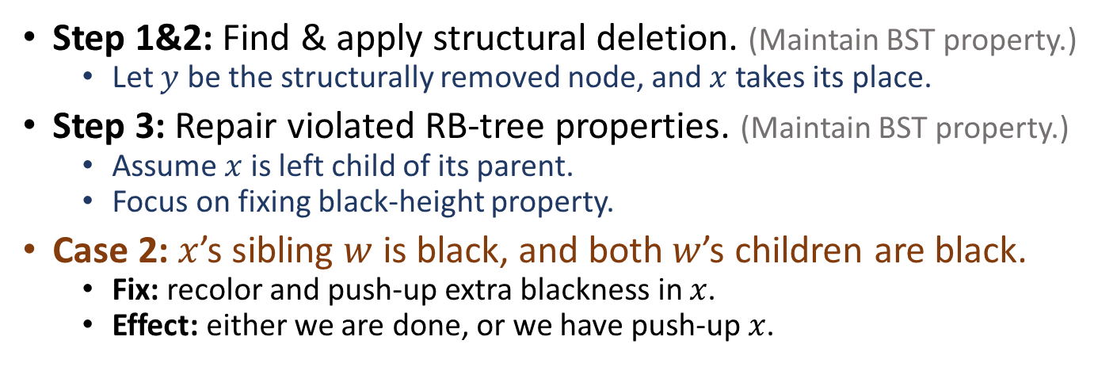






















Remove node $z$ from an RB-Tree
Step 1&2: Find & apply structural deletion. (Maintain BST property.)
Let $y$ be the structurally removed node, and $x$ takes its place.
Step 3: Repair violated RB-tree properties. (Maintain BST property.)
Assume $x$ is left child of its parent.
Focus on fixing black-height property.
Case 2: $x$’s sibling $w$ is black, and both $w$’s children are black.
Fix: recolor and push-up extra blackness in $x$.
Effect: either we are done, or we have push-up $x$.
$$B$$
(R or B)
$$B$$
new $x$ (BR or BB)
$x$ (BB)
$$A$$
$$D$$
$$w$$
$$A$$
$$D$$
$$w$$
$$α$$
$$β$$
$$α$$
$$β$$
$$C$$
$$E$$
$$C$$
$$E$$
$$γ$$
$$δ$$
$$ε$$
$$ζ$$
$$γ$$
$$δ$$
$$ε$$
$$ζ$$

Slide 23


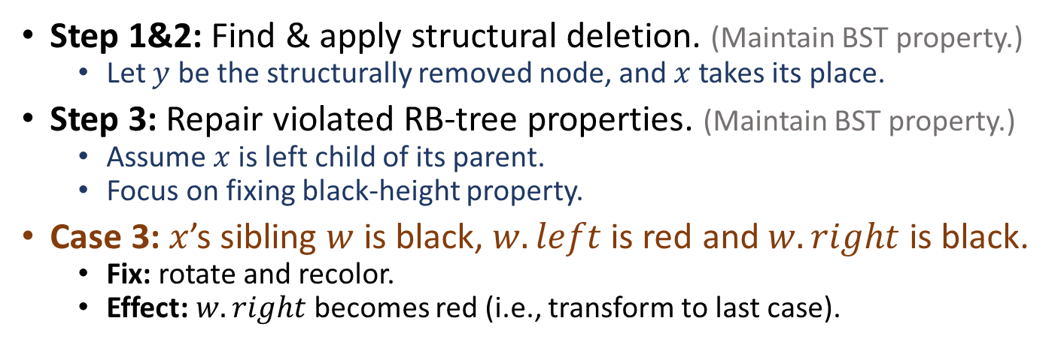












Remove node $z$ from an RB-Tree
Step 1&2: Find & apply structural deletion. (Maintain BST property.)
Let $y$ be the structurally removed node, and $x$ takes its place.
Step 3: Repair violated RB-tree properties. (Maintain BST property.)
Assume $x$ is left child of its parent.
Focus on fixing black-height property.
Case 3: $x$’s sibling $w$ is black, $w.left$ is red and $w.right$ is black.
Fix: rotate and recolor.
Effect: $w.right$ becomes red (i.e., transform to last case).
$$B$$
(R or B)
$$B$$
(R or B)
$x$ (BB)
$$A$$
$$C$$
new $w$
$x$ (BB)
$$A$$
$$D$$
$$w$$
$$α$$
$$β$$
$$γ$$
$$D$$
$$α$$
$$β$$
$$C$$
$$E$$
$$δ$$
$$E$$
$$γ$$
$$δ$$
$$ε$$
$$ζ$$
$$ε$$
$$ζ$$

Slide 24



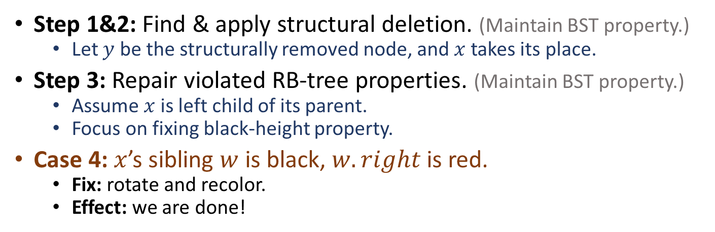











Remove node $z$ from an RB-Tree
Step 1&2: Find & apply structural deletion. (Maintain BST property.)
Let $y$ be the structurally removed node, and $x$ takes its place.
Step 3: Repair violated RB-tree properties. (Maintain BST property.)
Assume $x$ is left child of its parent.
Focus on fixing black-height property.
Case 4: $x$’s sibling $w$ is black, $w.right$ is red.
Fix: rotate and recolor.
Effect: we are done!
$$B$$
(R or B)
$$D$$
$x$ (BB)
$$A$$
$$D$$
$$w$$
$$B$$
$$E$$
$$α$$
$$β$$
$$ε$$
$$ζ$$
$$C$$
$$E$$
$$x$$
$$A$$
$$C$$
$$γ$$
$$δ$$
$$ε$$
$$ζ$$
$$α$$
$$β$$
$$γ$$
$$δ$$

Slide 25
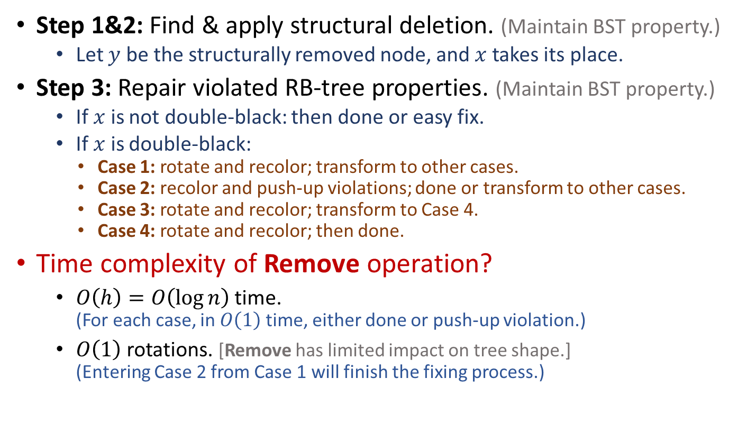


Remove node $z$ from an RB-Tree
Step 1&2: Find & apply structural deletion. (Maintain BST property.)
Let $y$ be the structurally removed node, and $x$ takes its place.
Step 3: Repair violated RB-tree properties. (Maintain BST property.)
If $x$ is not double-black: then done or easy fix.
If $x$ is double-black:
Case 1: rotate and recolor; transform to other cases.
Case 2: recolor and push-up violations; done or transform to other cases.
Case 3: rotate and recolor; transform to Case 4.
Case 4: rotate and recolor; then done.
Time complexity of Remove operation?
$O\left(h\right)=O\left(\log{n}\right)$ time. (For each case, in $O\left(1\right)$ time, either done or push-up violation.)
$O\left(1\right)$ rotations. [Remove has limited impact on tree shape.] (Entering Case 2 from Case 1 will finish the fixing process.)
$$O\left(h\right)=O(\log{n})$$
$$O\left(h\right)=O(\log{n})$$

Slide 26
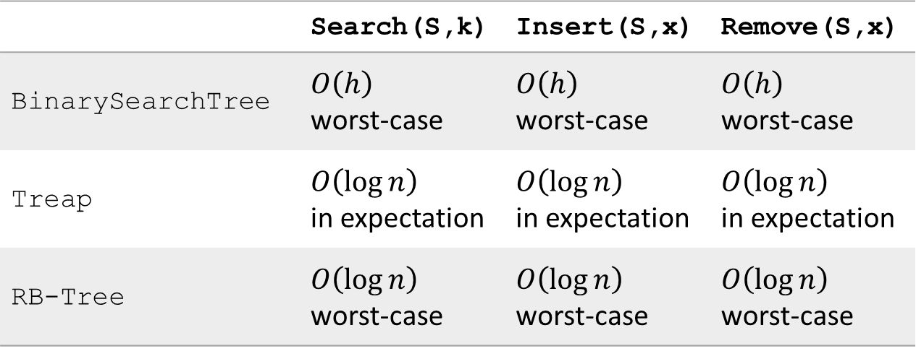
Efficient implementation of OSet
 | Search(S,k) | Insert(S,x) | Remove(S,x)
BinarySearchTree | $O\left(h\right)$ worst-case | $O\left(h\right)$ worst-case | $O\left(h\right)$ worst-case
Treap | $O\left(\log{n}\right)$ in expectation | $O\left(\log{n}\right)$ in expectation | $O\left(\log{n}\right)$ in expectation
RB-Tree | $O\left(\log{n}\right)$ worst-case | $O\left(\log{n}\right)$ worst-case | $O\left(\log{n}\right)$ worst-case
Efficiency versus Simplicity

Slide 27
“Balanced” Binary Search Trees
AVL tree (Adelson-Velsii & Landis, 1962)
B-tree (Bayer & McCreight, 1970)
Red-black tree (Bayer, 1972)
Splay tree (Sleator & Tarjan, 1985)
Treap (Seidel & Aragon, 1996)
Skip list (Pugh, 1989)
and so on …

Slide 28

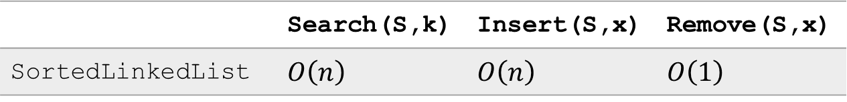
SkipList
 | Search(S,k) | Insert(S,x) | Remove(S,x)
SortedLinkedList | $O\left(n\right)$ | $O\left(n\right)$ | $O\left(1\right)$
Q: Why sorted linked-list is slow?
A: To reach an element, you have to move from current position to destination one element at a time.
A
C
E
H
A
B
C
D
E
F
G
H

Slide 29
SkipList
 | Search(S,k) | Insert(S,x) | Remove(S,x)
SortedLinkedList | $O\left(n\right)$ | $O\left(n\right)$ | $O\left(1\right)$
Q: Why sorted linked-list is slow?
A: To reach an element, you have to move from current position to destination one element at a time.
Let’s build an “expressway”!
Search cost is reduced by half!
Why stop at one layer of “expressway”?!
Example: search for 8.
-∞
4
6
11
22
∞
-∞
1
4
5
6
8
11
15
22
∞

Slide 30


SkipList
Search can be done in $O\left(\log{n}\right)$ time.
Space complexity $≈2n$
Build multiple “expressways”:
Reduce number of elements by half at each level.
This is just binary search: reduce search range by half at each level.
This is very efficient: spend $O\left(1\right)$ time at each level, and $O\left(\log{n}\right)$ levels in total.
Example One: search for 15.
Example Two: search for 14.
-∞
22
∞
-∞
6
22
∞
-∞
4
6
11
22
∞
-∞
1
4
5
6
8
11
15
22
∞

Slide 31
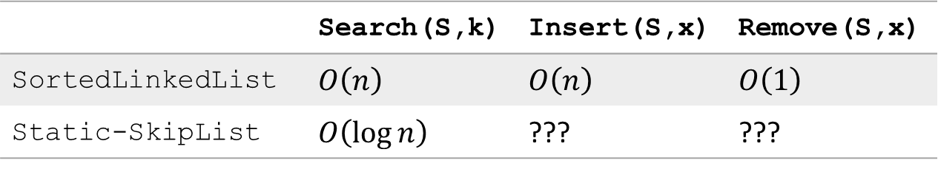
SkipList
 | Search(S,k) | Insert(S,x) | Remove(S,x)
SortedLinkedList | $O\left(n\right)$ | $O\left(n\right)$ | $O\left(1\right)$
Static-SkipList | $O\left(\log{n}\right)$ | ??? | ???
Efficient Search with limited space overhead.
But how to implement Insert and Remove?
-∞
22
∞
-∞
6
22
∞
-∞
4
6
11
22
∞
-∞
1
4
5
6
8
11
15
22
∞

Slide 32
The real SkipList
Insert(L,x):
level = 1, done = false
while (!done)
Insert x into level k list.
Flip a fair coin:
With probability 1/2: done = true
With probability 1/2: k = k+1
Example: insert 7.
Lvl:
4
-∞
22
∞
3
-∞
22
∞
2
-∞
4
11
22
∞
1
-∞
1
4
5
8
11
15
22
∞

Slide 33
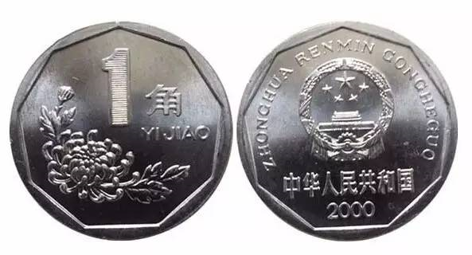
The real SkipList
Insert(L,x):
level = 1, done = false
while (!done)
Insert x into level k list.
Flip a fair coin:
With probability 1/2: done = true
With probability 1/2: k = k+1
Example: insert 7.
Lvl:
4
-∞
22
∞
3
-∞
22
∞
2
-∞
4
11
22
∞
1
-∞
1
4
5
7
8
11
15
22
∞

Slide 34
The real SkipList
Insert(L,x):
level = 1, done = false
while (!done)
Insert x into level k list.
Flip a fair coin:
With probability 1/2: done = true
With probability 1/2: k = k+1
Example: insert 7.
Lvl:
4
-∞
22
∞
3
-∞
22
∞
2
-∞
4
7
11
22
∞
1
-∞
1
4
5
7
8
11
15
22
∞

Slide 35
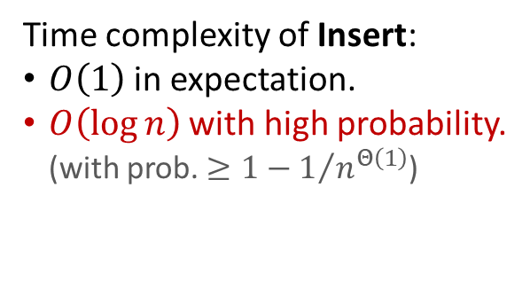

The real SkipList
Insert(L,x):
level = 1, done = false
while (!done)
Insert x into level k list.
Flip a fair coin:
With probability 1/2: done = true
With probability 1/2: k = k+1
Time complexity of Insert:
$O\left(1\right)$ in expectation.
$O\left(\log{n}\right)$ with high probability. (with prob. $≥1−1/{n^{Θ\left(1\right)}}$)
Max level of $n$-element SkipList is $O\left(\log{n}\right)$ with high probability.
Example: insert 7.
Lvl:
But search time is affected with such Insert!
(“Every level reduce # of elements by half”)
4
-∞
22
∞
3
-∞
7
22
∞
2
-∞
4
7
11
22
∞
1
-∞
1
4
5
7
8
11
15
22
∞

Slide 36

The real SkipList
Insert(L,x):
level = 1, done = false
while (!done)
Insert x into level k list.
Flip a fair coin:
With probability 1/2: done = true
With probability 1/2: k = k+1
Max level of $n$-element SkipList is $O\left(\log{n}\right)$ with high probability.
Example: search 81.
-∞
51
∞
-∞
51
57
∞
-∞
37
51
57
∞
-∞
10
37
51
57
∞
-∞
6
10
32
37
42
51
52
57
81
∞

Slide 37
The real SkipList
Insert(L,x):
level = 1, done = false
while (!done)
Insert x into level k list.
Flip a fair coin:
With probability 1/2: done = true
With probability 1/2: k = k+1
Max level of $n$-element SkipList is $O\left(\log{n}\right)$ with high probability.
-∞
[-∞,51)
51
[51, ∞)
∞
-∞
[-∞,51)
51
[51, 57)
57
[57, ∞)
∞
-∞
[-∞,37)
37
[37, 51)
51
[51, 57)
57
[57, ∞)
∞
-∞
[-∞,10)
10
[10, 37)
37
[37, 51)
51
[51, 57)
57
[57, ∞)
∞
-∞
6
10
32
37
42
51
52
57
81
∞

Slide 38
[-∞, ∞)
Example: search 81.
[-∞,51)
[51, ∞)
∞
[-∞,51)
[51, 57)
[57, ∞)
∞
[-∞,37)
[37, 51)
[51, 57)
[57, ∞)
∞
[-∞,10)
[10, 37)
[37, 51)
[51, 57)
[57, ∞)
∞
-∞
6
10
32
37
42
51
52
57
81
∞
-∞
[-∞,51)
51
[51, ∞)
∞
-∞
[-∞,51)
51
[51, 57)
57
[57, ∞)
∞
-∞
[-∞,37)
37
[37, 51)
51
[51, 57)
57
[57, ∞)
∞
-∞
[-∞,10)
10
[10, 37)
37
[37, 51)
51
[51, 57)
57
[57, ∞)
∞
-∞
6
10
32
37
42
51
52
57
81
∞

Slide 39
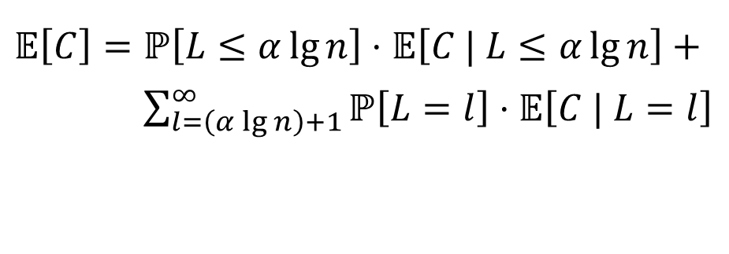
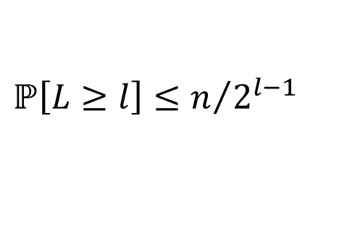
[-∞, ∞)
[-∞,51)
[51, ∞)
∞
[-∞,51)
[51, 57)
[57, ∞)
∞
[-∞,37)
[37, 51)
[51, 57)
[57, ∞)
∞
[-∞,10)
[10, 37)
[37, 51)
[51, 57)
[57, ∞)
∞
-∞
6
10
32
37
42
51
52
57
81
∞
Each node in the “search tree” has $O\left(1\right)$ children, in expectation.
Max level of $n$-element SkipList is $O\left(\log{n}\right)$ with high probability.
Let r.v. $L$ be the max level of a $n$-node SkipList, let $C$ denote the cost for search.
$$ℙ\left[L≥l\right]≤n/{2^{l−1}}$$
Some large constant.
$𝔼\left[C\right]=ℙ\left[L≤α\lg{n}\right]⋅𝔼\left[C | L≤α\lg{n}\right]+$
$𝔼\left[C\right]=\sum_{l=\left(α\lg{n}\right)+1}^{∞}{ℙ\left[L=l\right]⋅𝔼\left[C | L=l\right]}$

Slide 40
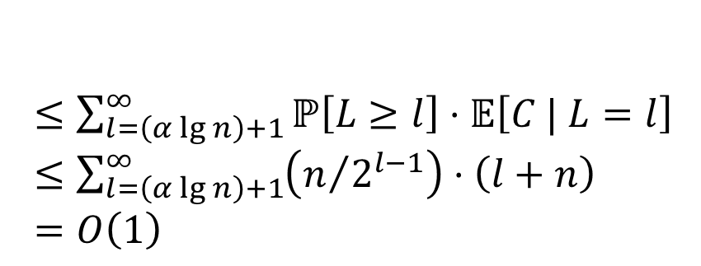


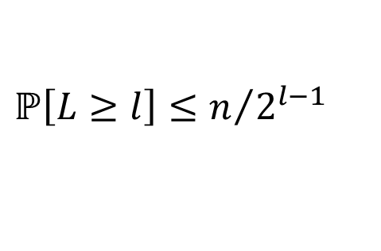
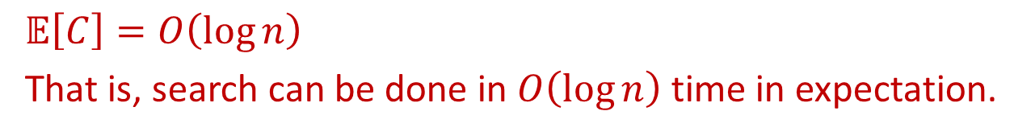
Each node in the “search tree” has $O\left(1\right)$ children, in expectation.
Max level of $n$-element SkipList is $O\left(\log{n}\right)$ with high probability.
Let r.v. $L$ be the max level of the skip list, let $C$ denote the cost for search.
$$ℙ\left[L≥l\right]≤n/{2^{l−1}}$$
$𝔼\left[C\right]=ℙ\left[L≤α\lg{n}\right]⋅𝔼\left[C | L≤α\lg{n}\right]+$
$𝔼\left[C\right]=\sum_{l=\left(α\lg{n}\right)+1}^{∞}{ℙ\left[L=l\right]⋅𝔼\left[C | L=l\right]}$
?
$$≤1⋅O\left(\lg{n}\right)=O\left(\lg{n}\right)$$
$≤\sum_{l=\left(α\lg{n}\right)+1}^{∞}{ℙ\left[L≥l\right]⋅𝔼\left[C | L=l\right]}$
$≤\sum_{l=\left(α\lg{n}\right)+1}^{∞}{\left(n/{2^{l−1}}\right)⋅\left(l+n\right)}$
$=O\left(1\right)$
$𝔼\left[C\right]=O\left(\log{n}\right)$
That is, search can be done in $O\left(\log{n}\right)$ time in expectation.

Slide 41
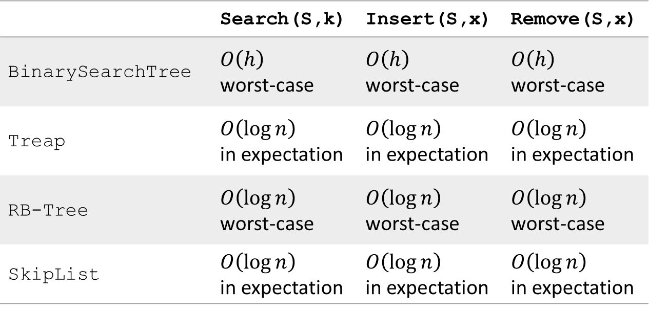
Efficient implementation of OSet
 | Search(S,k) | Insert(S,x) | Remove(S,x)
BinarySearchTree | $O\left(h\right)$ worst-case | $O\left(h\right)$ worst-case | $O\left(h\right)$ worst-case
Treap | $O\left(\log{n}\right)$ in expectation | $O\left(\log{n}\right)$ in expectation | $O\left(\log{n}\right)$ in expectation
RB-Tree | $O\left(\log{n}\right)$ worst-case | $O\left(\log{n}\right)$ worst-case | $O\left(\log{n}\right)$ worst-case
SkipList | $O\left(\log{n}\right)$ in expectation | $O\left(\log{n}\right)$ in expectation | $O\left(\log{n}\right)$ in expectation
Performance versus Simplicity

Slide 42
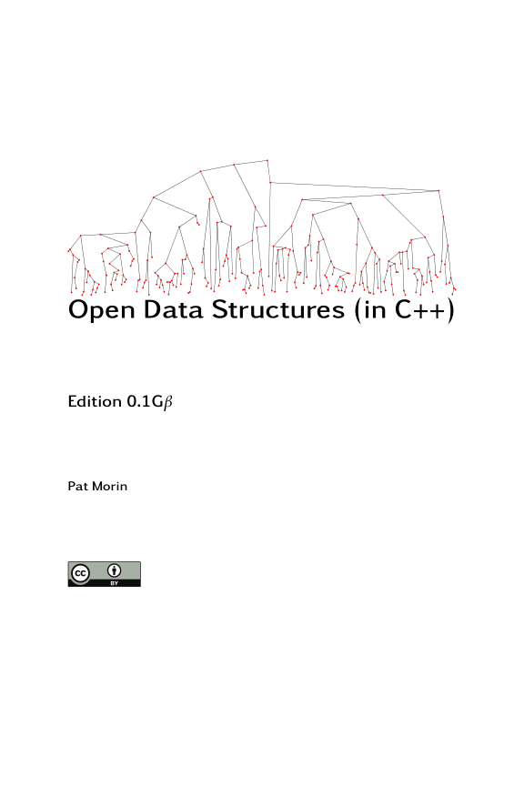
Reading
[CLRS] Ch.13
[Morin] Ch.4

