Slide 1
Recursive Functions
Prof. Charles W. Kann

Slide 2
Topics
Stacks
Program Stacks
AAPCS-ABI
Recursive Programming
  Recursive Multiply
  Recursive Summation
Problems
  Implement print input numbers backward
  Implement recursive fibonacci

Slide 3
Stacks
Stacks are a Last-In-First-Out data structure.
A stack is a essential part of a Turing machine that can process a context free grammar
  Church Turing Thesis: Any function can be computed can be computed recursively and computed on a Turing machine.
Stacks are essential parts of being able to do computation.
Stacks have two operations, and can be easily implemented using a simple array (or any indexed memory).
  Push – add an item to the end of an array, adjust the pointer
  Pop – remove the last item in the array, adjust the pointer

Slide 4
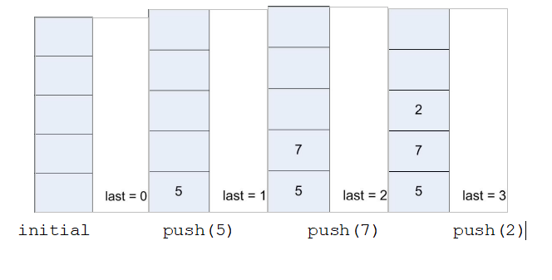
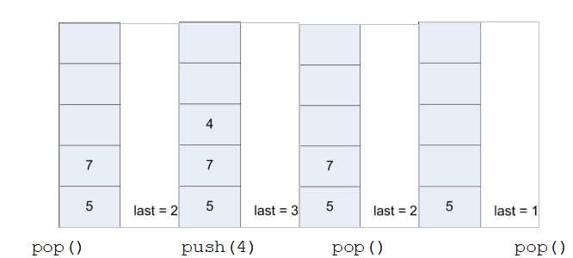
Stack example
push(5)
push(7)
push(2)
print(pop())
push(4)
print(pop())
print(pop())

Slide 5
Another stack example
Not all stacks have to insert a single item, or even the same items.
The following stack example pushes words of different sizes onto the stack.
There is a stack pointer to the current stack frame that contains the following data:
  The number of characters stored in the frame for each word
  The characters for the word, each stored as a separate item in the stack.
  Note that the stack grows downward (towards zero). There is no reason that a stack grows in particular direction so long as it follows the rules for a LIFO.

Slide 6
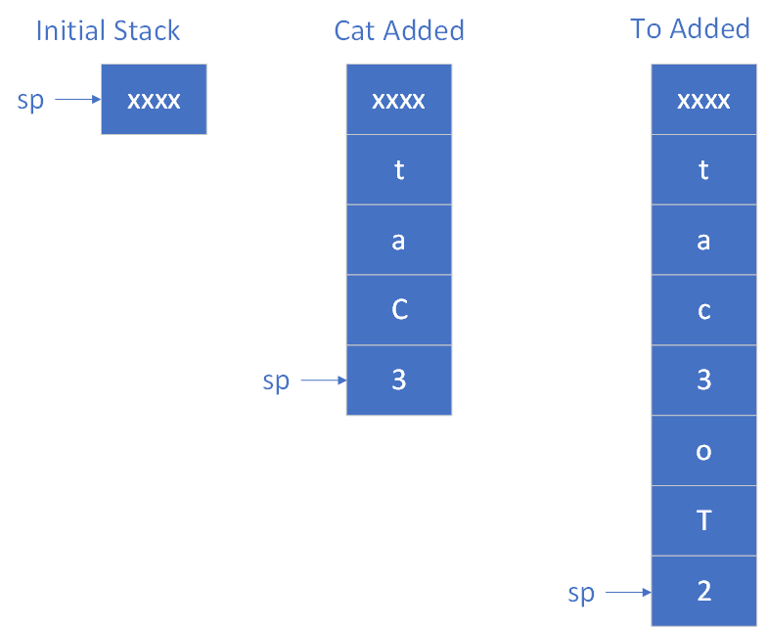
Example

Slide 7
Stack in F2C function
Remember theF2C function from Module 7.
  This program is on the next slide
  The program failed because the “bl __aeabi_idiv” function copied over the lr register.
  It was fixed by storing (pushing) the lr on the program stack when the program was entered, and then retrieving it from the program stack before returning.
  Why not just save the lr in some other register (like r10). Shouldn’t this work?
  No, because the callee function could also change r10.
  What then must be true of the stack

Slide 8
F2C program
# Push stack
sub sp, sp, #4
str lr, [sp, #0]
mov r1, #-32
add r0, r0, r1
mov r1, #5
mul r0, r0, r1
mov r1, #9
bl __aeabi_idiv
add r5, r5, r6
# Pop stack
ldr lr, [sp, #0]
add sp, sp, #4
mov pc, lr

Slide 9
What is the program stack
The program stack contains stack frames (sometimes called activation records) which are by convention owned and accessed (at least correctly) solely by the function execution.
It is a scratch space where a function execution keeps its data.
Note that there is not one stack frame per function. Each time a function is called, a stack frame is created. So there can be 1, 2, or many stack frames per function. This is what allows recursion.

Slide 10
Conventions in Assembly
Note that the only reason a stack works is that it is a convention that must be followed by all programs.
If any program chooses to ignore the conventions for a stack (e.g. to write on another programs stack, which I have seen done too often by inexperienced programmers) the whole scheme fails.
The conventions for the stack, register conventions, and all other parts of the ARM Application Binary Interface (ABI) are defined by AAPCS (Procedure Call Standard for the ARM Architecture) at https://developer.arm.com/documentation/ihi0042/f/
We will have other conventions (like a function must be a block) that we will discuss later.

Slide 11
How the stack is defined
The stack grows from higher memory to lower memory. This means that when entering the method a stack record is created by subtracting the size of the record (in bytes) from the sp, and on returning the sp is restored by adding the same amount to the sp.
Since the stack is growing downwards, the portion of this stack for this execution of a function is a positive offset from the sp.
All local variables are kept on a functions stack record.
There are conventions for which function (the caller or the callee) saves registers. There are on the next slide.

Slide 12
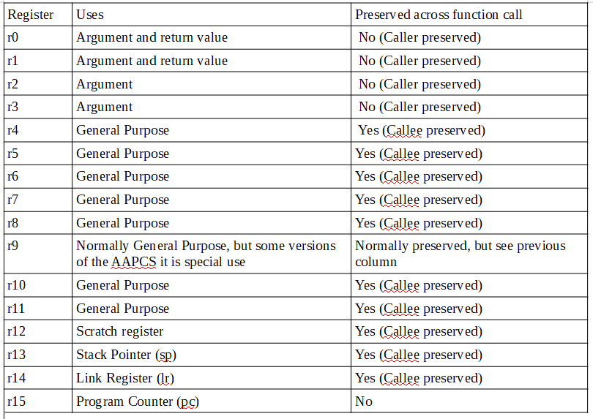
Register Conventions

Slide 13
Saving Registers
Registers only need to be saved if they are used.
  If a function uses a callee saved register, it must put the value of that register on the stack when the function is entered, and retrieve the value before returning.
  For caller saved registers, these do not have to be saved unless the caller needs them later in the execution.
  When copying multiple registers at the same time, use the STM and LDM commands. These commands do a block copy of the registers, and are more efficient.

Slide 14
Summation Example – Java Code
public class Summation {
public static void main(String[] args) {
System.out.println("Summation is " + summation(10));
}
public static int summation(int upto) {
if (upto == 0)
return 0;
return upto + summation(upto - 1);
}
}

Slide 15
Summation Example – Assembly Code, registers saved by Caller convention
# Note: Summation is NOT a global symbol!
# It is a static function
Summation:
# push stack. Save r0 (summation) in r10,
# so r10 has to be saved by callee convention
sub sp, sp, #8
str lr, [sp, #0]
str r10, [sp, #4]
mov r10, r0
# if r0 is 0, return 0
mov r4, #0
cmp r0, r4
beq return @ return 0 in r0
add r0, r0, #-1
bl Summation @ return value in r0
add r0, r10, r0 @ return summation in r0
b return @ not really needed
# pop stack and return
return:
ldr lr, [sp, #0]
ldr r10, [sp, #4]
add sp, sp, #8
mov pc, lr
#END Summation
.text
.global main
main:
# Save return to os on stack
sub sp, sp, #4
str lr, [sp, #0]
mov r0, #10
bl Summation
mov r1, r0
ldr r0, =output
bl printf
# Return to the OS
ldr lr, [sp, #0]
add sp, sp, #4
mov pc, lr
.data
output: .asciz "Summation is %d\n"
.text

Slide 16
Summation Example – Assembly Code, registers saved by Callee convention
.text
Summation:
# push stack. Save r0 (summation) on stack.
# since r0 will be used later, save it by caller convention
# r0 is not a preserved register.
sub sp, sp, #8
str lr, [sp, #0]
str r0, [sp, #4]
# if r0 is 0, return 0
mov r1, #0 @ use r1 since it is not a preserved register
cmp r0, r1
beq return @ return 0 in r0
add r0, r0, #-1
bl Summation @ return value in r0
ldr r4, [sp, #4] @ get the original value of r0 from r4
add r0, r4, r0 @ return summation in r0
b return @ not really needed
# pop stack and return
return:
ldr lr, [sp, #0]
ldr r10, [sp, #4]
add sp, sp, #8
mov pc, lr
#END Summation
.text
.global main
main:
# Save return to os on stack
sub sp, sp, #4
str lr, [sp, #0]
mov r0, #10
bl Summation
mov r1, r0
ldr r0, =output
bl printf
# Return to the OS
ldr lr, [sp, #0]
add sp, sp, #4
mov pc, lr
.data
output: .asciz "Summation is %d\n"

Slide 17
Recursive Multiply example – Java Code
public class Multiplication {
public static void main(String[] args) {
System.out.println(" 5 x 3 = " + multiply(5, 3));
}
public static int multiply(int multiplier , int multiplicand) {
if (multiplier == 1)
return multiplicand;
return multiplicand + multiply(multiplier-1, multiplicand);
}
}

Slide 18
Recursive Multiply example – Assembly Code
.text
.global main
main:
# Save return to os on stack
sub sp, sp, #4
str lr, [sp, #0]
mov r0, #4
mov r1, #5
bl Multiply
mov r1, r0
ldr r0, =output
bl printf
# Return to the OS
ldr lr, [sp, #0]
add sp, sp, #4
mov pc, lr
.data
output: .asciz "Multiplication result is %d\n"
.text
Multiply:
# push stack. Save r1 (multiplicand) is it has to be
# used later. So r1 has to be saved by caller convention
sub sp, sp, #8
str lr, [sp, #0]
str r1, [sp, #4]
# if r0 is 0, return 0
mov r4, #0
cmp r0, r4
beq return @ return 0 in r0
add r0, r0, #-1
bl Multiply @ return value in r0
ldr r1, [sp, #4] @ restore r1 in case it was changed
add r0, r1, r0 @ return product in r0
b return @ not really needed
# pop stack and return
return:
ldr lr, [sp, #0]
add sp, sp, #8
mov pc, lr
#END Multiply

