Slide 1
Basic Instructions In MIPS
Prof. Charles W. Kann

Slide 2
Overview of Class
mov, movw, and movt
What is a register and an Arithmetic Logic Unit (ALU)
What is an Instruction Set Architecture (ISA)?
How does a 3-Address Load/Store Architecture work?
Arithmetic
  Addition and Subtraction
  Multiplication
  Division
Boolean Operations
  Bitwise Operations
  Logical Operations
  Shift Operations

Slide 3
mov
ARM has 2 move commands
mov can be used to:
  Move (copy) the value from one register to another: mov r0, r1
  Move an 8 bit (1 byte) immediate into a register: mov r0, #0x12
  Note: if you try to move move than 8 bits, you will get the following error:
MovExample.s: Assembler messages:
MovExample.s:11: Error: invalid constant (4714) after fixup
make: *** [Makefile:22: MovExample] Error 1

Slide 4
movw and movt
Registers are 32 bits wide.
  What if you need to load a 32 bit immediate into a register?
  ARM has a movw (move wide) and movt (move top) commands that load 32 bits
    movw loads the lower half (16 bits) of the register with an immediate
    movt loads the upper half (16 bits) of the register with an immediate
However
  The movw and movt were not supported on the chip in my Pi zero.
  To move a 32 immediate value to a register, you need to do the following:
#movw r0, #0x1234
#movt r0, #0x5678
mov r0,#0x12000000
orr r0,r0,#0x00340000
orr r0,r0,#0x00005600
orr r0,r0,#0x00000078

Slide 5
Main components of a CPU
At a very high abstract level, a CPU can be thought of as having 3 major components:
  Memory that is part of the CPU. Memory that is part of a CPU is called a register. Memory that is not part of the CPU (even cache memory that is on the die) is called memory.
  An Arithmetic Logic Unit, or ALU. The ALU performs all calculations including arithmetic (add, sub, etc), as well as all bit operations such as AND, OR, shifting, etc.
  A Control Unit, which interprets the instruction and configures the CPU to run the instruction.
  The job of the CPU is to process instructions to the ALU and store the result

Slide 6
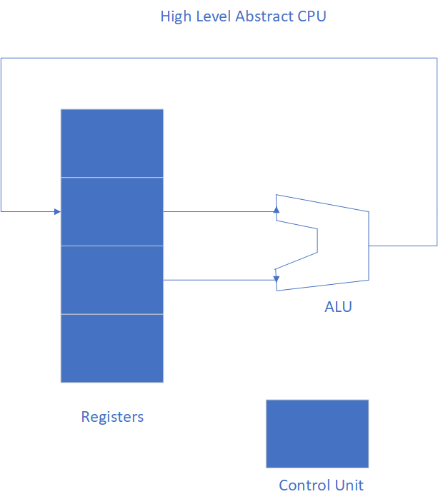
Abstract view of a CPU

Slide 7
Arithmetic Logic Unit
The Arithmetic Logic Unit
  Is a binary unit: it takes two inputs, processes them according to the instruction operation, and produces an output.
  The Control Unit selects the two inputs from register memory, and the register that is to save the value produced out of the ALU.
  The whole point of a CPU is the care and feeding of the ALU.

Slide 8
Why do we need an Instruction Set Architecture ( ISA)?
The number of registers is, on any CPU is by necessity and design, limited.
To have a real computer, there is a need to access external memory and access to other system resources.
The ISA is the definition of how values get from memory and external devices to registers so they can be used by the CPU.
The ISA uses the system bus to retrieve values from memory or other devices, so the next slide explains the system bus.

Slide 9
What is a system bus?
Memory values are passed to/from the CPU using the system bus.
The system bus is bi-directional
The instructions of the type ldr and str are used to access memory.
Other system resources, such as the console, disk drives, network cards, etc., are also accessed via the system bus but use interrupts with system calls. This was shown in Module 1.

Slide 10
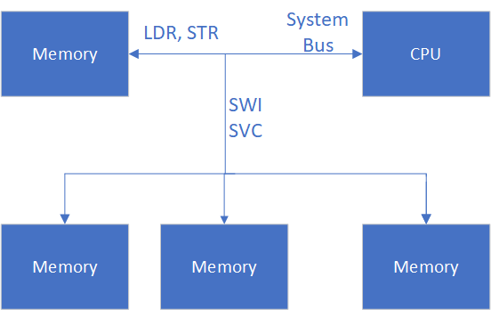
System bus

Slide 11
What is the ARM ISA?
ARM uses a 3 address load/store ISA.
The three address means all ALU operations specify 2 input registers and an output register, which are the three operands to the ALU, called addresses.
The load/store means that any value to the ALU must be retrieved via the system bus into a register before it can be used.

Slide 12
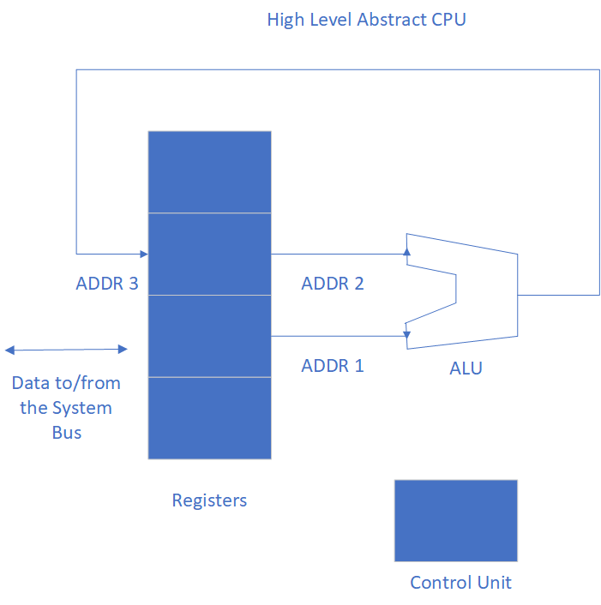
3 Address Load/Store Architecture

Slide 13
Arithmetic Instructions

Slide 14
Mov Instruction
Move can mov a value into a register, or a value between registers.
    MOV r0, #5
    MOV r0, r1

Slide 15
Addition and Subtraction
Adding/subtracting two registers and with an immediate value
  ArithmeticSubtract.s
Note 1: immediate value must be between -128..127 (8 bits)
Note 2: there is a form of the add that uses the ARM barrel shifter that will be covered in the chapter on arrays

Slide 16
Normal Multiplication
In most cases the multiplication will be a 32 bit value multiplied by a 32 bit number, with the result being a 32 bit value.
  mul R_{d}, R_{m}, R_{s} # R_{d} = R_{m}* R_{s}
Notes:
  Note there is no immediate multiply
  R_{d} cannot be the same as R_{m}
  R_{d} cannot be R15

Slide 17
Division
Division is not included in many chips, including the version of the ARM chip used in the Pi 0. The reason is division is expensive compared to other hardware, and can be done in assembly as cheaply as it can be done in hardware.
https://www.quora.com/Why-doesnt-ARM-contain-divide-instruction
There is a sdiv (signed division) and an udiv (unsigned division) operation in ARM assembly, but it may or may not be implemented in your chip (no Pi chips have them).
On the Raspberry Pi 0, the sdiv and udiv are not included.

Slide 18
How this class will implement division
Later in the class, we will write a slightly faster division algorithm.
For now, ARM provides a helper function for division, __aeabi_idiv. This function will be used to implement division.
For this function, r0 is the dividend, r1 is the divisor, and r0 is the quotient.
See Divide.s
Remember that integer division truncates the remainder.

Slide 19
Logical and Bitwise Instructions

Slide 20
Logical vs bitwise operations
Logical vs Bitwise Operators
  In high level languages (hll, like Java or C++) logical operators result in a true or false value. The operands are a single bit, and can short circuit. In Java and C++, they are operators like && or ||
  Bitwise operators are used to operate on all bits in operand values. Operands generally contain n bits (n > 1), and each bit from the first operand and the second operand are used to create a n bit resultresult. These operands cannot short circuit. In Java and C++ they are operators like &, |, ^, etc...
Logical Operators In Assembly
  Assembly does not have a concept that equates to a hll Logical operator. All Boolean operations are bitwise, but these operators are called Logical operators. Just realize the naming convention, and accept it. It is confusing, but it is what it is.

Slide 21
Bitwise and Logical operations in Assembly
In assembly
  All logical operators are bitwise, they work on each individual bit in the operand.
  Bitwise operators are used to accomplish what is called bitmasking. Bitmasking turns on or off specific bits.
  For example, the network device might turn on bit 4 of a 8 bit IO status word. By using AND on with word with binary 00010000 (or 0x10, with bit numbering being zero based), any bits in the IO status word except bit 4 are turned off.
  For example, if the IO status word contained 11011001, the result of the and is:
11011001
& 00010000
00010000 Only the 4th bit is left on.

Slide 22
Logical Operators in ARM
ARM has the following logical operators
  AND, ORR, EOR, and MOVN
  EOR is for an XOR operation, MOVN is used for a binary NOT operation
ARM has the following shift operations
  LSL – Logical Shift Left
  LSR – Logical Shift Right
  ASR – Arithmetic Shift Right
  ROR – Rotate Right
  Note that there is a RRX operation, but that instruction affects the CPSR will have to wait until the basic ARM machine code is covered.

Slide 23
Bitmask example: using AND and ORR
ASCII operation to convert upper case to lower case
Note that in ASCII, and upper case ‘A’ (0x41) and lower case ‘a’ (0x61) differ by one bit (0x20).
An upper case ‘A’ can be converted to a lower case ‘a’ by turning on that bit (and only that bit) as follows (this is faster and more correct than addition, for anyone who thought about that).
# Change upper case to lower case letter
mov r0, #0x40
orr r0, r0, #0x20
# examine value in r0, should be 0x60
# Change lower case to upper case letter
and r0, r0, #0xdf
# examine value in r0, should be 0x40

Slide 24
EOR (XOR) Instruction
The ARM eor instruction is a very useful instruction
  It can reduce the number of operations that are needed to implement a circuit.
  It can be used to store a reversible value
  It can be use to store two values at the same time
The following example shows how to store and retrieve values with an EOR
mov r0, #0x47
mov r1, #0xf4
EOR r2, r0, r1
# r2 now contains both r0 and r1!
# to show this retrieve r1 into r0
eor r0, r2, r0

Slide 25
Shift instructions
The following shift operations are available in ARM assembly:
  LSL – Logical shift left. Shifts all bits #n places to the left, inserting 0’s. Used for multiplication and to examine bits one at a time in a word (e.g. string processing).
  LSR – Logical shift right. Shifts all bits #n places to the right, inserting 0’s. Used to examine bits one at a time in a word (e.g. string processing).
  ASR – Arithmetic shift right. Shifts all bits #n places to the right, inserting the 2’s complement sign bit. Used to examine bits one at a time in a word.
  ROR – Rotate right. Shifts bits to the right, and as they shift out they are appended to the left of the word (e.g. string processing).
  See ShiftExamples.s for examples. The shifts can be viewed in gdb.

Slide 26
Flexible operand or Operand2

Slide 27
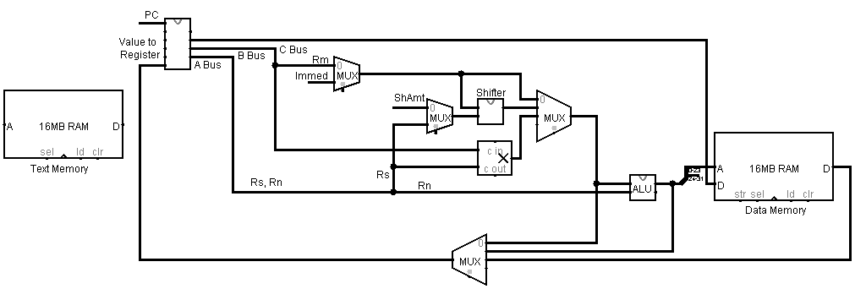
ARM CPU

Slide 28
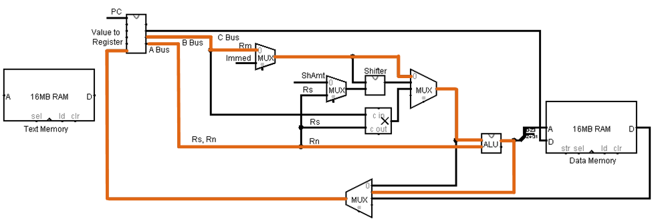
ADD Instruction: ADD r1, r2, r3

Slide 29
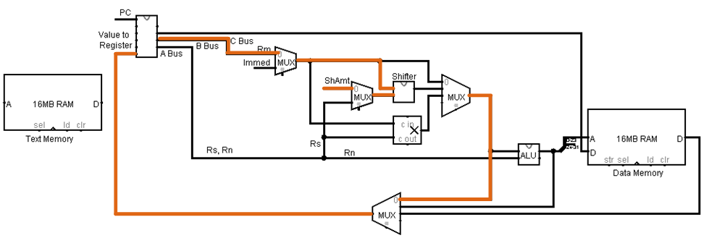
LSL Instruction: LSL r1, r2, #3

Slide 30
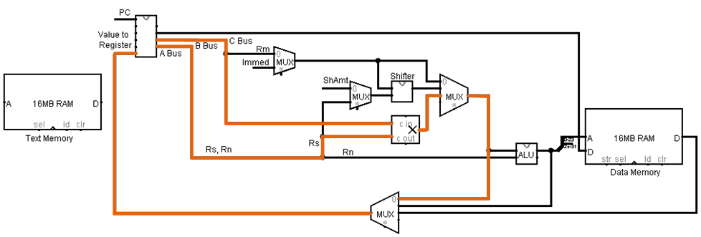
MUL Instruction

Slide 31
Flexible Operand or Operand2
Since the Barrel Shifter is and Multiplier are before the ALU, they can do operations before the operation in the ALU.
This means the second operand to the ALU can be a shifted or multiplied value.
This is called a Flexible Operand or Operand2

Slide 32
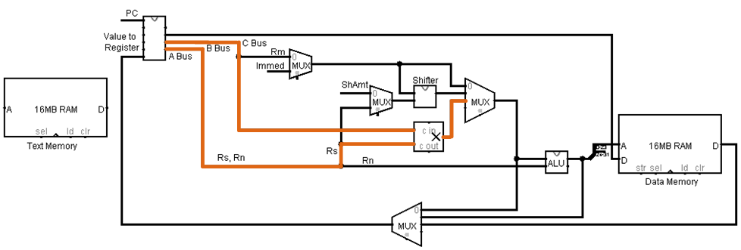
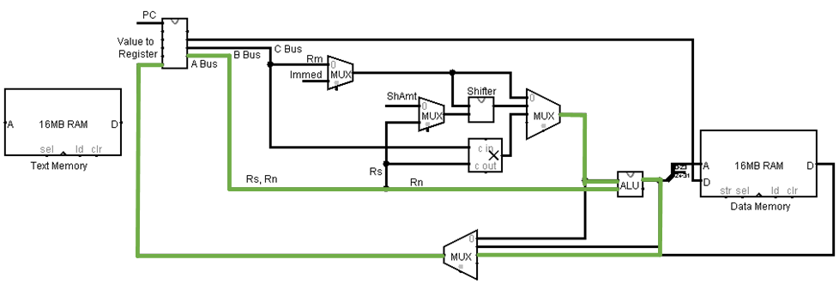
MULA Instruction: MLA r1, r2, r3, r4

Slide 33
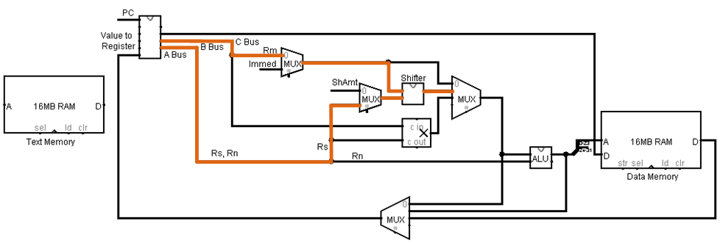
Operand2 Instruction: ADD r1, r2, r3, lsl #2

Slide 34
Operand2 syntax
Operand2 syntax
  <k> := even number less than 32
<m> := any 32 bits that contains all zeros except for one grouping
of less than 8 bits that can contain 1’s.
<n> := any number < 32
<immediate> := # <m> | # <m> , <k>
<ShAmt> := # <n> | # <n> , <k>
<ShValue> := <ShAmt | register>
<shiftOp> := <ShType> # <ShValue>
<ShType> := lsl | lsr | asr | ror | rrx
<register> := <Rm> | <Rm> , <shiftOp>
<operand2> := <immediate> | <register>

Slide 35
Operand2 and MOV for immediate
Operand2 can be used in a MOV instruction
  Does not use the ALU
  MOV r0, #m, k OR MOV r0, #m, r1
  e.g. MOV r0, #1, 24 // Value is 258
  Values like MOV r0, #65530 must be “fixed-up”.
  If can’t be “fixed-up”, error message in assembler.
  8 bit representation is rotated right. In this case, by 24 bits
  Rotation can be up to 32 bits, but the rotation value is only 4 bits. Hence k must be even.

Slide 36
Operand2 and MOV for Register
Operand2 can be used in a MOV instruction
  Does not use the ALU
  MOV r0, Operand2
  Can use any shift
    MOV r0, r1, lsl #3 or MOV r0, r1, lsl r2 // Same as an LSL command

Slide 37
Most instructions can use Operand2
Add, Sub, Shift, etc. can use Operand2.
Mul cannot (why?)
ALU is now included
Add r0, r1, operand2
  ADD r0, r1, r2, lsl #3 OR ADD r0, r1, r2, lsl r3

Slide 38
Other Multiplication instructions
ARM provides other multiplication instructions
  Shown in program OtherMulitiply.s
  mla – multiply and add to accumulator, which is self explanator
    mla r5, r1, r2, r3 @ r5 ← r1 * r2 + r3
  Smull – multiply with overflow, which requires more explanation on following slides
    smull r6, r7, r1, r2 @ r6 and r7 get the lo and hi part of multiplying r1 and r2

Slide 39
Multiplication with overflow
Remember 9*9 = 81 (two one digit number multiplied can be 2 digits)
Remember 99 * 99 = 9801 (two two digit number multiplied can be 4 digits)
So, two 32 bit numbers multiplied together can result in a 64 bit number.
ARM has instructions to allow access to the upper 32 bits:
  UMULL, UMLAL - Unsigned Multiply and Multiply with Accumulate
  SMULL, SMLAL – Signed Multiply and Multiply with Accumulate
  Note: The main reason to use these is this class is to check for multiply overflow.
  SMULL R_{dLo}, R_{dHi}, R_{m}, R_{s}
  Note that the answer is in R_{dLo}, and any overflow is in R_{dHi}. Suggest an algorithm to check for overflow (you do not have to implement it now, you will implement it later in the semester.)

