Slide 1
Vue 3 • Node.js / Express • MySQL • Docker / Podman
BLOOD
DONATION
CAMP SYSTEM
A production-style system for managing blood donors, donation camps, camp finances and multi-channel (WhatsApp/SMS) donor communication — built as a containerised SPA + REST API + relational database.
Full-Stack Web Platform
Presented by: ____________________________
Stack: Vue 3 SPA · Node/Express API · MariaDB · Podman/Docker
Status: Audited, fixed and containerised — 2026

Slide 2
1. Project Overview
A digital platform to organise blood donation camps end-to-end.
▪ Manages the full lifecycle of a blood donation drive: donors, camps, on-site registration, finances and outreach.
▪ A Vue 3 single-page app talks to a Node.js/Express REST API, backed by a MySQL/MariaDB relational database.
▪ Donor and camp records are normalised, indexed and searchable — built to hold 800+ real donor records.
▪ Multi-channel outreach: bulk WhatsApp (Meta Cloud API) and SMS (Notify.lk / Twilio), in English and Sinhala.
▪ Every write path (auth, CRUD, messaging, imports/exports) is authenticated and input-validated end to end.
▪ Ships fully containerised — one command brings up the SPA, API and database together.
DotLife | Vue 3 + Node.js + MySQL | Project Presentation
2

Slide 3
2. Problem Statement
What organising a blood camp on paper and spreadsheets looks like.
▪ Donor registers are kept as paper books or scattered spreadsheets, organised by village or camp.
▪ Finding donors of a specific blood group who are due to donate again takes manual cross-checking.
▪ Announcing a camp means calling or messaging donors one by one — slow and easy to under- or over-send.
▪ Camp income (cash and in-kind donations) and expenses are tracked informally, if at all.
▪ No shared, auditable record of who attended a camp, who actually donated, and who was contacted when.
▪ Emergency blood requests have no fast way to reach the right blood group at scale.
DotLife | Vue 3 + Node.js + MySQL | Project Presentation
3

Slide 4
3. Objectives
What the system sets out to achieve.
▪ Give organisers one system for donors, camps, on-site registration, budgets and messaging.
▪ Digitise the paper camp register while preserving its logic: T.P. (mobile) number as the unique identifier.
▪ Make blood-group and eligibility (4-month) filtering instant instead of manual.
▪ Support bulk, chunked WhatsApp/SMS campaigns that survive timeouts and never double-send.
▪ Track camp finances — cash donations, in-kind goods and expenses — without mixing the two.
▪ Package the whole stack so it can be built and run identically anywhere with one Docker/Podman command.
DotLife | Vue 3 + Node.js + MySQL | Project Presentation
4

Slide 5
4. Technology Stack
The concrete stack behind the platform.
Frontend
Backend API
Vue 3 (Composition API) · Vite · Vue Router 4 · Pinia · Bootstrap 5 · Chart.js · Axios
Node.js 20 · Express · JWT (httpOnly cookies) · bcrypt · mysql2/promise · ExcelJS
Database
Infrastructure
MySQL / MariaDB 10.11 · 12 tables · foreign keys · indexes · migration ledger
Docker & Podman (OCI) · Compose · Nginx (SPA + reverse proxy) · Railway-ready
DotLife | Vue 3 + Node.js + MySQL | Project Presentation
5

Slide 6
5. Main Features
Core modules available to an administrator.
▪ Donor Management — CRUD, Excel import/export, blood-group and eligibility filtering, duplicate detection.
▪ Blood Camps — schedule camps, track status (Upcoming / Completed / Cancelled), planned budget per camp.
▪ Camp Register — digital attendance book by T.P. number: known donor, walk-in, or already-registered.
▪ Budget & Donations — cash and in-kind contributions tracked separately from spend, with a live balance.
▪ Staff — organising-committee directory, reachable through the same messaging pipeline as donors.
▪ Messaging — bulk WhatsApp (approved templates) and SMS, chunked sending, campaign de-duplication.
▪ Templates — reusable message bodies with Meta template mapping, English and Sinhala.
▪ Emergency Alerts — one-click blood-group targeted request to every matching active donor.
▪ Reports — date-filtered analytics with Excel export; Settings — app, messaging and account configuration.
DotLife | Vue 3 + Node.js + MySQL | Project Presentation
6

Slide 7
6. System Architecture
How a request travels through the stack.
1
2
3
4
5
Browser
(Vue 3 SPA)
Nginx
(static + proxy)
Express
REST API
MariaDB
(data)
WhatsApp / SMS
(Meta, Notify.lk)
Auth via JWT in an httpOnly cookie • All queries parameterised • CORS locked to the frontend origin
Three containers, one Compose file: frontend (Vue build served by Nginx, which also reverse-proxies /api to the backend), backend (Node/Express) and db (MariaDB with a health-checked startup). Runs identically under Docker or Podman.
DotLife | Vue 3 + Node.js + MySQL | Project Presentation
7

Slide 8
7. Database Design
Core MySQL/MariaDB tables (of 12 total).
Table
Key Fields
Purpose
donors
id, donor_name, mobile (unique), blood_group, status, last_donation_date
The donor roll — mobile is the durable identity
blood_camps
id, title, camp_date, location, status, budget_amount
Scheduled camps and their planned budget
camp_registrations
id, camp_id, donor_id, serial_no, status
The digital attendance register per camp
camp_contributions /
camp_expenses
camp_id, category, amount, status
Money and goods in vs. money spent, kept apart
message_logs
donor_id / staff_id, campaign_id, status, sent_at
Full audit trail of every WhatsApp/SMS sent
admins, staff,
login_attempts
email/password, name/mobile, ip_address
Accounts, committee members, brute-force throttling
DotLife | Vue 3 + Node.js + MySQL | Project Presentation
8

Slide 9
8. Security & Reliability
Hardening applied on top of the base CRUD app.
▪ Authentication — JWT in an httpOnly cookie (XSS-resistant), bcrypt-hashed passwords, session-aware CORS.
▪ Brute-force throttling — login_attempts table caps failures per email and per IP within a rolling window.
▪ SQL injection — every query goes through mysql2's parameterised placeholders; no string concatenation.
▪ Account changes — changing name, email or password requires re-entering the current password.
▪ Fail closed — a global error handler returns a generic message instead of leaking stack traces to clients.
▪ Data integrity — foreign keys with explicit ON DELETE rules; a schema_migrations ledger tracks what ran.
▪ Excel import/export — size-capped uploads, mobile-number normalisation, garbled-CSV detection.
DotLife | Vue 3 + Node.js + MySQL | Project Presentation
9

Slide 10
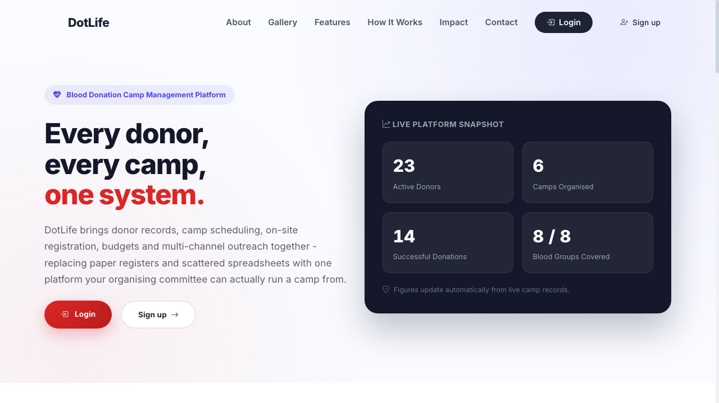
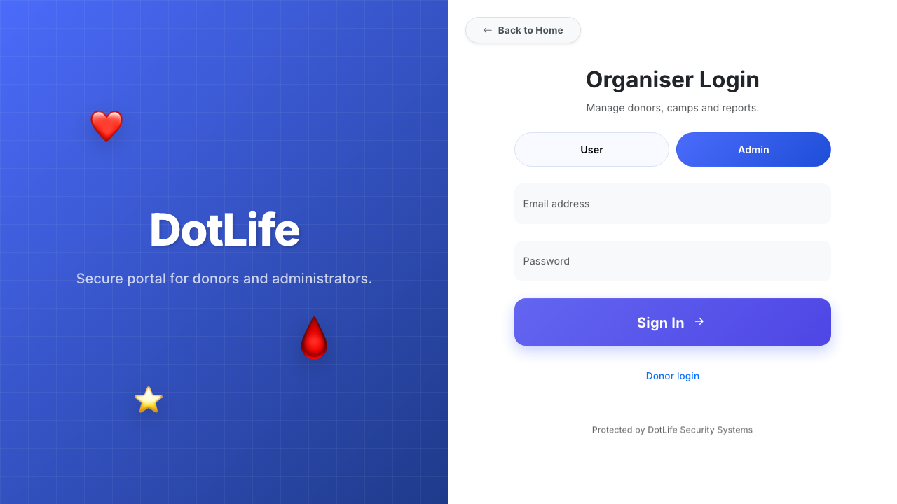
9. Application Screens
Key screens in the admin console.
SCREENSHOT
SCREENSHOT
SCREENSHOT
Dashboard
Donor Management
Camp Register
SCREENSHOT
SCREENSHOT
SCREENSHOT
Budget & Donations
Messaging & Templates
Reports
DotLife | Vue 3 + Node.js + MySQL | Project Presentation
10

Slide 11
10. Testing & Verification
How the fixed system was verified before this presentation.
▪ Full source audit across the Vue 3 frontend, Express API and MySQL schema — request/response contracts, SQL correctness and router paths checked file by file.
▪ Built and started the whole stack with Podman Compose: database, backend and frontend containers, all reporting healthy.
▪ Live endpoint checks after fixes: login and session flow, donor CRUD and search, camp finance summary and category totals, camp-register lookup, and Excel report export.
▪ Data-integrity check: fresh-install seed data (donors, camps, templates, message logs) loads without foreign-key errors.
▪ Regression check: values written through the fixed endpoints (e.g. new contribution categories) were re-read back correctly, then the test rows were removed — the database ships clean.
DotLife | Vue 3 + Node.js + MySQL | Project Presentation
11

Slide 12
11. Deployment
From a laptop to a container host in one command.
▪ podman compose up --build — builds and starts frontend, backend and database together.
▪ OCI-compliant images: identical behaviour under Podman and Docker.
▪ MariaDB seeds itself from /database on first boot; a health check gates the backend start.
▪ Nginx serves the built SPA and reverse-proxies /api to the Node backend inside the same network.
▪ A production Compose overlay swaps in a leaner backend build stage and disables debug output.
▪ Deployable to Railway.app as three services (frontend, backend, MySQL plugin) via the same Dockerfiles.
docker-compose.yml
services:
db (MariaDB 10.11)
backend (Node 20 / Express)
frontend (Nginx + Vue build)
ports:
3000 → frontend
8081 → backend API
3306 → database
DotLife | Vue 3 + Node.js + MySQL | Project Presentation
12

Slide 13
12. Benefits & Future Scope
Impact today, and what's still ahead.
▪ One system replaces paper registers, spreadsheets and ad-hoc phone calls for running a camp.
▪ Chunked, deduplicated messaging safely reaches hundreds of donors without double-sending.
▪ Clear separation of cash vs. in-kind donations gives organisers an honest, auditable budget picture.
Outstanding / Roadmap
▪ Get the three WhatsApp templates (camp notice, emergency, general) approved in WhatsApp Manager.
▪ Register the organisation's own WhatsApp number and an 11-character approved SMS sender ID.
▪ Finish transcribing the remaining paper register pages (~19) into the donor database.
▪ Admin dashboard widgets for donor-retention trends and per-camp turnout over time.
DotLife | Vue 3 + Node.js + MySQL | Project Presentation
13

Slide 14
Thank You
Questions & Answers
DotLife
Vue 3 • Node.js / Express • MySQL • Docker / Podman
“A small contribution can save a life.”

