Slide 1
Iterator

Slide 2
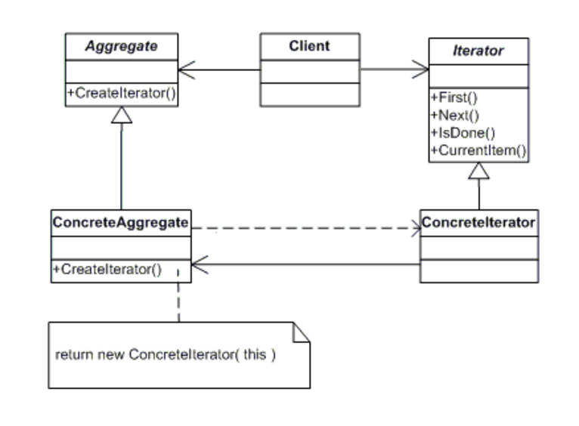
Class diagram

Slide 3
Participants
Iterator
defines an interface for accessing and traversing elements.
ConcreteIterator (Iterator)
implements the Iterator interface.
keeps track of the current position in the traversal of the aggregate.
Aggregate
defines an interface for creating an Iterator object (Collection)
ConcreteAggregate
implements the Iterator creation interface to return an instance of the ConcreteIterator

Slide 4
Frequency of Use:
High
Advantage and Application:
Iterate over any kind of collection.
Access contents of a collection without exposing its internal structure.

Slide 5
Implementation

Slide 6
Factory

Slide 7
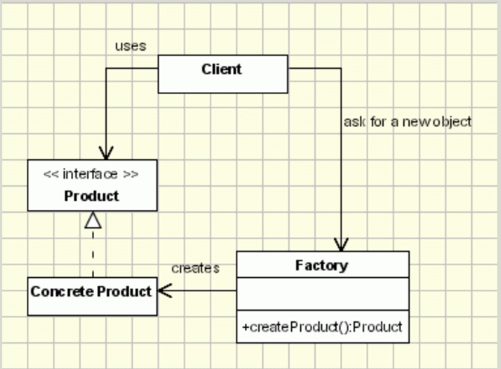
Class diagram

Slide 8
Participants
Product
defines the interface of objects the factory method creates
ConcreteProduct
implements the Product interface
Factory
declares the factory method, which returns an object of type Product.

Slide 9
Frequency of Use:
High
Advantage And Application:
Creates objects without exposing the instantiation logic to the client.

Slide 10
Implementation

Slide 11
Proxy

Slide 12
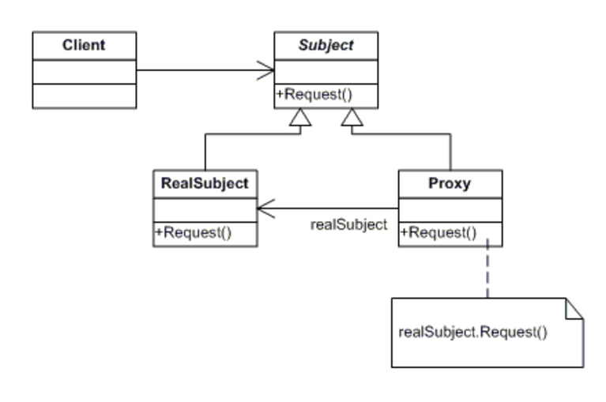
Class diagram

Slide 13
Participants
Proxy
Maintains a reference that allows the Proxy to access the RealSubject.
Provides an interface identical to Subject's so that a proxy can be substituted for the real subject.
Controls access to the real subject and may be responsible for creating and deleting it.
other responsibility depend on the kind of proxy:
remote proxies are responsible for encoding a request and its arguments and for sending the encoded request to the real subject in a different address space.
protection proxies check that the caller has the access permissions required to perform a request.
Subject
defines the common interface for RealSubject and Proxy so that a Proxy can be used anywhere a RealSubject is expected.
RealSubject
defines the real object that the proxy represents.

Slide 14
Frequency of Use:
Medium High
Advantage & Application:
Virtual Proxies: delaying the creation and initialization of expensive objects until needed, where the objects are created on deman.
Remote Proxies: remote proxies are responsible for encoding a request and its arguments and for sending the encoded request to the real subject in a different address space.
Protection Proxies: check that the caller has the access permissions required to perform a request.
Smart Proxy – A smart proxy provides additional layer of security by interposing specific actions when the object is accessed. An example can be to check if the real object is locked before it is accessed to ensure that no other object can change it.

Slide 15
Implementation

