Slide 1


Forecasting Box Office Success of Movies:
An Update and a DSS Perspective
Ramesh Sharda and Dursun Delen
Institute for Research in Information Systems
Department of Management Science and Information Systems
William S. Spears School of Business
Oklahoma State University
(Assistance from Michael Henry on recent data collection and trials; Ben Johnson and Xin Cao on MFG implementation)

Slide 2
Forecasting Box-Office Receipts:
A Tough Problem!
“… No one can tell you how a movie is going to do in the marketplace… not until the film opens in darkened theatre and sparks fly up between the screen and the audience”
Mr. Jack Valenti
President and CEO
of the Motion Picture Association of America

Slide 3
Introduction
Pirates of the Caribbean
“When production for the film was first announced, movie fans and critics were skeptical of its chances of success”
– www.wikipedia.com
  3rd highest grossing movie in 2003
  22nd highest grossing movie of all time
  Sequel was the 6th highest grossing movie of all time
  -www.the-movie-times.com

Slide 4


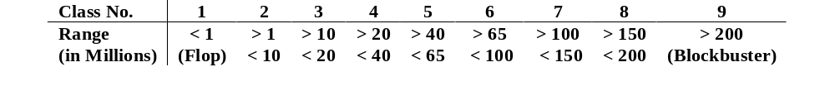
Our Approach – Movie Forecast Guru
DATA –Movies released between 1998-2005
Movie Decision Parameters:
  Intensity of competition rating
  MPAA Rating
  Star power
  Genre
  Technical Effects
  Sequel ?
  Estimated screens at opening
  …
Output: Box office gross receipts (flop → blockbuster)

Slide 5
Method: Neural Networks and others
Output
  Box office receipts: 9 categories
  Flop (category 1)
  Blockbuster (category 9)
Prediction Results
  Bingo
  1-Away

Slide 6
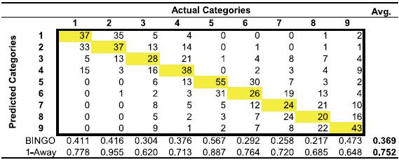
Updates of Previous Results
Original data from 1998 to 2002
834 Movies Tested

Slide 7
New Experiments
Method
Collect Data from 2003 to 2005
Run test on data from 2003 to 2005
Compare with previous results from 1998 to 2002

Slide 8
Experiment One
Data
Collect and test 475 movies
  Independent variables: www.imdb.com
  Dependent variables: www.the-movie-times.com

Slide 9
Experiment One
1998 to 2002 Bingo: 39.6% 1-Away: 75.2% | 2003 to 2005 Bingo: 54.1% 1-Away: 74.6%
*1998 to 2002 results from Sharda and Delen

Slide 10
Experiment Two
Method
Combine data from 1998 to 2005
Test data from 1998 to 2005
Compare with previous tests results

Slide 11
Experiment Two
Data
Test included 1,323 movies
1998 to 2002 included 848 movies
2003 to 2005 included 475 movies

Slide 12
Experiment Two
1998 to 2002 Bingo: 54.5% 1-Away: 80.7% | 2003 to 2005 Bingo: 54.1% 1-Away: 74.6% | 1998 to 2005 Bingo: 49.12% 1-Away: 81.60%
*current 1998 to 2002 results

Slide 13
What about predictions in 2006?
Movie | Actual | Prediction
Pirates of Caribbean 2 The Break Up Inside Man V for Vendetta Underworld 2 BloodRayne | Class 9 Class 7 Class 6 Class 6 Class 5 Class 2 Class 1 | Class 9 Class 7 Class 6 Class 6 Class 4 Class 4 Class 2

Slide 14
Results So far…
The more data available to train and test model, the higher the prediction rate.
Re-evaluating the data to ensure consistency and accuracy improved the prediction rate.
Neural networks can handle complex problems in forecasting in difficult business situations.

Slide 15
Web-Based DSS
Information fusion (multiple method forecasting)
Use of models not owned by the developer
Sensitivity Analysis

Slide 16
Web-Based DSS
Collaboration among stakeholders
Platform independence
Forecasting models change frequently
  Versioning
Web services a good method for updates
Web-based DSS!

Slide 17
DSS: Movie Forecast Guru
Forecast Methods:
  Neural Networks
  Decision Tree (CART & C5)
  Logistic Regression
  Discriminant Analysis
  Information Fusion
.Net server

Slide 18
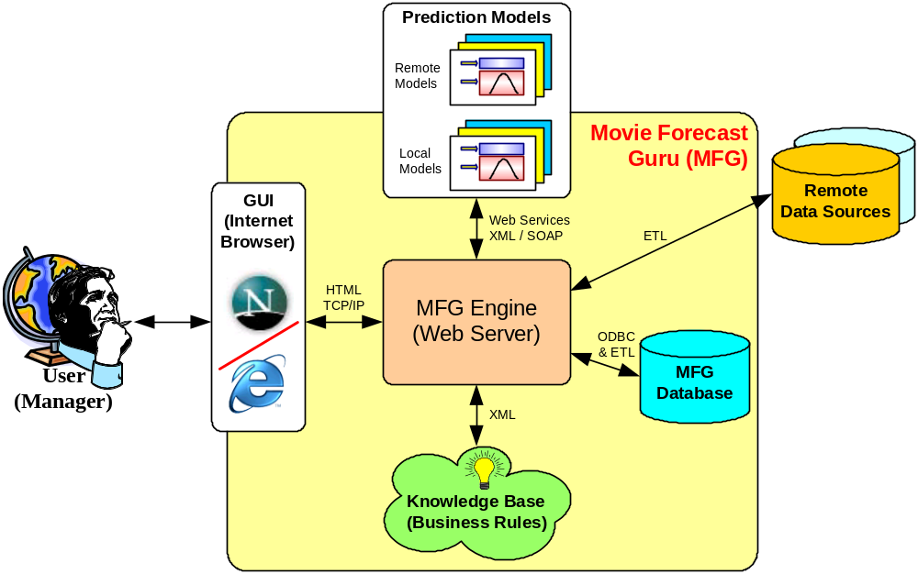

Conceptual Software Architecture
Demonstration

Slide 19
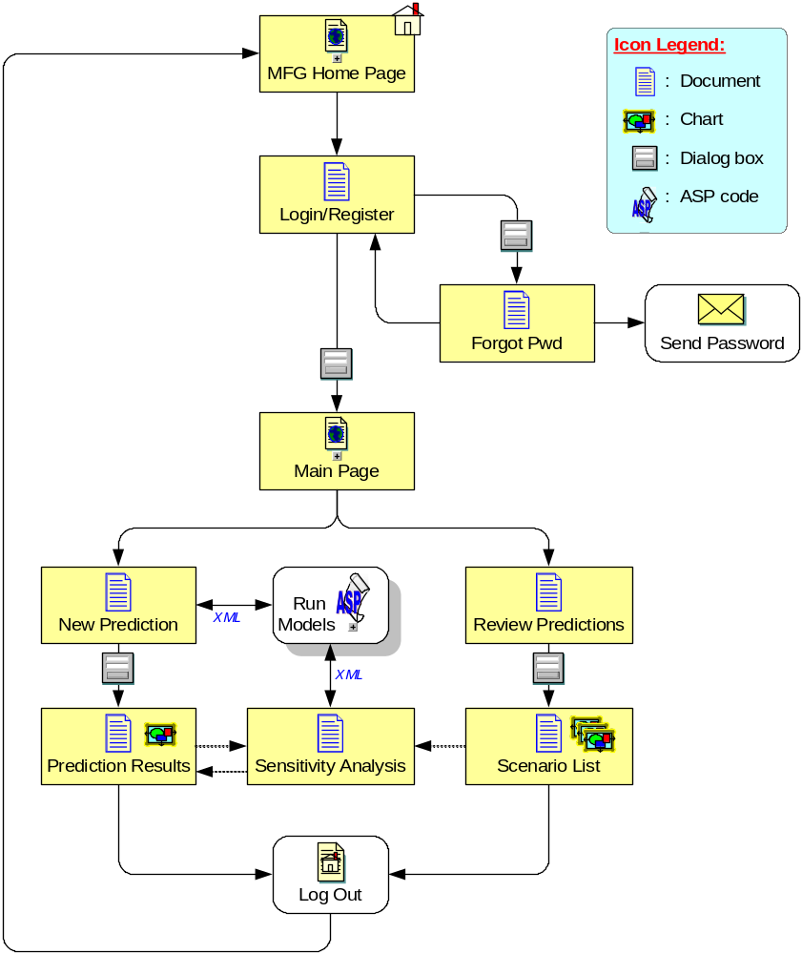
User Interaction with MFG

Slide 20
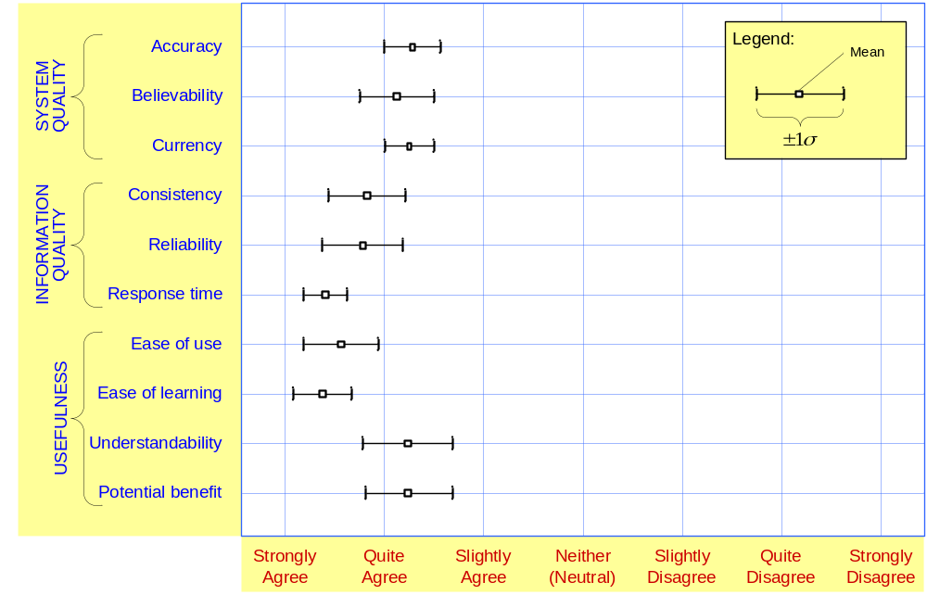
Preliminary Assessment

Slide 21
Conclusions
Interesting problem for DSS Implementation
Marketing challenge remains!
Many other similar problems in forecasting
Web-DSS framework

