Slide 1
Decision tree

Slide 2
What is a decision tree?
A decision tree is a classification and prediction tool having a tree like structure, where each internal node denotes a test on an attribute, each branch represents an outcome of the test, and each leaf node (terminal node) holds a class label.
Root Node: The factor of ‘temperature’ is considered as the root in this case.
Internal Node: The nodes with one incoming edge and 2 or more outgoing edges.
Leaf Node: This is the terminal node with no out-going edge.

Slide 3

Solution steps
info(D) DATA SET = - (P+ log₂ p₊ + p- log$2$ p₋)
info(attributes )
Gain = info(D) – info(attributes)
choice Higher Gain

Slide 4
No | Outlook | Temperature | Humidity | Windy | Play
1 | Sunny | hot | High | False | No
2 | Sunny | hot | High | True | No
3 | Overcast | hot | High | False | Yes
4 | Rainy | mild | High | False | Yes
5 | Rainy | Cool | Normal | False | Yes
6 | Rainy | Cool | Normal | True | No
7 | Overcast | Cool | Normal | True | Yes
8 | Sunny | Mild | High | False | No
9 | Sunny | Cool | Normal | False | Yes
10 | Rainy | Mild | Normal | False | Yes
11 | Sunny | Mild | Normal | True | Yes
12 | Overcast | Mild | High | True | Yes
13 | Overcast | Hot | Normal | False | Yes
14 | Rainy | Mild | High | True | no
Example: we have this dataset Create decision tree

Slide 5
As the first step, we have to find the parent node for our decision tree. For that follow the steps:
Info(D)= -[(9/14) log₂(9/14) + (5/14)log₂(5/14)] = 0.94
Here total there are 14 yes/no. Out of which 9 yes and 5 no.
From the above data for outlook we can arrive at following table easily
 |  | play
 |  | Yes | No | Total
 | sunny | 3 | 2 | 5
Outlook | Overcast | 4 | 0 | 4
 | rainy | 2 | 3 | 5
 |  |  |  | 14

Slide 6
Now we have to calculate average weighted entropy. ie, we have found the total of weights of each feature multiplied by probabilities.
info(outlook) =(5/14)*E(3,2) + (4/14)*E(4,0) + (5/14)*E(2,3)
=(5/14)(-(3/5) log₂(3/5)-(2/5) log₂(2/5))
+(4/14)(-(4/4) log₂ (4/4)-(0/4) log₂ (0/4))
+ (5/14)(-(2/5) log₂(2/5)-(3/5) log₂(3/5)) = 0.693
Next step is to find the information gain. It is difference between parent entropy and average weighted entropy we found above.
Gain(outlook) = info(D) – info(outlook) = 0.94 - 0.693 = 0.247

Slide 7
 |  | play
 |  | Yes | No | Total
 | hot | 2 | 2 | 4
Temperature | mild | 4 | 2 | 6
 | cool | 3 | 1 | 4
 |  |  |  | 14
info(Temp) = (4/14)*E(2,2) + (6/14)*E(4,2) + (4/14)*E(3,1)
= (4/14)(-(2/4) log₂(2/4)-(2/4) log₂(2/4))
+ (6/14) (-(4/6) log₂(4/6)-(2/6) log₂(2/6))
+ (4/14)(-(3/4) log₂(3/4)-(1/4) log₂(1/4))
= 0.911
Gain(Temp) = info(D) – info(Temp) = 0.94 - 0.911 = 0.029

Slide 8
 |  | play
 |  | Yes | No | Total
Humidity | high | 3 | 4 | 7
 | Normal | 6 | 1 | 7
 |  |  |  | 14
info(Humidity) = (7/14)*E(3,4) + (7/14)*E(6,1)
= (7/14)(-(3/7) log₂(3/7)-(4/7) log₂(4/7))
+ (7/14)(-(6/7) log₂(6/7)-(1/7) log₂(1/7 ))
= 0.788
Gain(Humidity) = info(D) – info(Humidity) = 0.94 - 0.788 = 0.152

Slide 9
 |  | play
 |  | Yes | No | Total
Windy | True | 3 | 3 | 6
 | False | 6 | 2 | 8
 |  |  |  | 14
info(Humidity) = (6/14)*E(3,3) + (8/14)*E(6,2)
= (6/14)(-(3/6) log₂(3/6)-(3/6) log₂(3/6))
+ (8/14)(-(6/8) log₂(6/8)-(2/8) log₂(2/8 ))
= 0.8932
Gain(Humidity) = info(D) – info(Humidity) = 0.94 - 0.8932 = 0.048

Slide 10
Now select the feature having largest entropy gain. Here it is Outlook. So it forms first node(root node) of our decision tree.
Outlook
 |  | play
 |  | Yes | No | Total
 | sunny | 3 | 2 | 5
Outlook | Overcast | 4 | 0 | 4
 | rainy | 2 | 3 | 5
 |  |  |  | 14
Sunny
Overcast
Rain
Yes
For outlook from the above table, we can say that play will occur if outlook is Overcast

Slide 11
Next step is to find the next node in our decision tree. Now we will find one under sunny.
We have to determine which of the following Temperature ,Humidity or Wind has higher information gain.
Outlook | Temperature | Humidity | Wind | Play
Sunny | Hot | High | False | No
Sunny | Hot | High | True | No
Sunny | Mild | High | False | No
Sunny | Cool | Normal | False | Yes
Sunny | Mild | Normal | True | Yes
Calculate parent entropy E(sunny)
info(sunny) = (-(3/5) log₂(3/5)-(2/5) log₂(2/5)) = 0.971.
Here total there are 5 yes/no. Out of which 2 yes and 3 no.
Now Calculate information gain of Temperature. IG(sunny, Temperature)

Slide 12
Now Calculate information gain of Temperature. Gain(sunny, Temperature)
 |  | play
 |  | Yes | No | Total
 | hot | 0 | 2 | 2
Temperature | mild | 1 | 1 | 2
 | cool | 1 | 0 | 1
 |  |  |  | 5
info(Temp) = (2/5)*E(0,2) + (2/5)*E(1,1) + (1/5)*E(1,0)
= (2/5)(-(0/5) log₂(0/5)-(2/5) log₂(2/5))
+ (2/5) (-(1/5) log₂(1/5)-(1/5) log₂(1/5))
+ (1/5)(-(1/5) log₂(1/5)-(0/5) log₂(0/5))
= 0.4
Gain(sunny, Temperature) = 0.971–0.4 =0.571

Slide 13
Now Calculate information gain of Temperature. Gain(sunny, Humidity)
 |  | play
 |  | Yes | No | Total
 | High | 0 | 3 | 3
Humidity | Normal | 2 | 0 | 2
 |  |  |  | 5
info(Humidity) = (3/5)*E(0,3) + (2/5)*E(2,0)
= (3/5)(-(0/5) log₂(0/5)-(3/5) log₂(3/5))
+ (2/5) (-(2/5) log₂(2/5)-(0/5) log₂(0/5))
= 0
Gain(sunny, Humidity) = 0.971–0 =0.971

Slide 14
Now Calculate information gain of Temperature. Gain(sunny, Windy)
 |  | play
 |  | Yes | No | Total
 | True | 1 | 1 | 2
Windy | False | 1 | 2 | 3
 |  |  |  | 5
info(Windy) = (2/5)*E(1,1) + (3/5)*E(1,2)
= (2/5)(-(1/5) log₂(1/5)-(1/5) log₂(1/5))
+ (3/5) (-(1/5) log₂(1/5)-(2/5) log₂(2/5))
= 0.967
Gain(sunny, Windy) = 0.971–0.967 =0.001

Slide 15
Here Gain(sunny, Humidity) is the largest value. So Humidity is the node which comes under sunny
 |  | Play
 |  | Yes | No
Humidity | High | 0 | 3
 | Normal | 2 | 0
For humidity from the above table, we can say that play will occur if humidity is normal and will not occur if it is high. Similarly, find the nodes under rainy.

Slide 16
Outlook
Sunny
Overcast
Rainy
Humidity
Yes
Normal
high
Yes
No

Slide 17
Next step is to find the next node in our decision tree. Now we will find one under Rainy.
We have to determine which of the following Temperature or Wind has higher information gain.
Outlook | Temperature | Wind | Play
Rainy | mild | False | Yes
Rainy | Cool | False | Yes
Rainy | Cool | True | No
Rainy | Mild | False | Yes
Rainy | Mild | True | No
Calculate parent entropy E(Rainy)
info(Rainy) = (-(3/5) log₂(3/5)-(2/5) log₂(2/5)) = 0.971.
Here total there are 5 yes/no. Out of which 3 yes and 2 no.
Now Calculate information gain of Temperature. IG(Rainy, Temperature)

Slide 18
Now Calculate information gain of Temperature. Gain(Rainy, Temperature)
 |  | play
 |  | Yes | No | Total
 | hot | 0 | 0 | 0
Temperature | mild | 2 | 1 | 3
 | cool | 1 | 1 | 2
 |  |  |  | 5
info(Temp) = (0/5)*E(0,0) + (3/5)*E(2,1) + (2/5)*E(1,1)
= (0/5)(-(0/5) log₂(0/5)-(0/5) log₂(0/5))
+ (3/5) (-(2/5) log₂(2/5)-(1/5) log₂(1/5))
+ (2/5)(-(1/5) log₂(1/5)-(1/5) log₂(1/5))
= 0.967
Gain(Rainy, Temperature) = 0.971–0.967 =0.004

Slide 19
Now Calculate information gain of Temperature. Gain(Rainy, Wind)
 |  | play
 |  | Yes | No | Total
Windy | True | 0 | 2 | 2
 | False | 3 | 0 | 3
 |  |  |  | 5
info(Wind) = (2/5)*E(0,2) + (3/5)*E(3,0)
=(2/5) (-(0/5) log₂(0/5)-(2/5) log₂(2/5))
+ (3/5)(-(3/5) log₂(3/5)-(0/5) log₂(0/5))
= 0
Gain(Rainy, Wind) = 0.971–0 =0.971

Slide 20
Here Gain(Rainy, Wind) is the largest value. So Windy is the node which comes under Rainy
 |  | play
 |  | Yes | No | Total
Windy | True | 0 | 2 | 2
 | False | 3 | 0 | 3
 |  |  |  | 5
For Windy from the above table, we can say that play will occur if windy is false and will not occur if it is true.

Slide 21
Outlook
Sunny
Overcast
Rainy
Humidity
Yes
Windy
Normal
high
False
True
Yes
No
Yes
No

Slide 22
Key-Nearest Neighbor

Slide 23
step by step on how to compute K-nearest neighbors KNN algorithm:
Determine parameter k = number of nearest neighbors
Calculate the distance between the query-instance and all the training samples
Sort the distance and determine nearest neighbors based on the K-th minimum distance
Gather the category of the nearest neighbors
Use simple majority of the category of nearest neighbors as the prediction value of the query instance

Slide 24
Apply the Key-Nearest Neighbor ( KNN ) Algorithm to classify the last record in the table, Suppose that K = 4.
ID | Blood Pressure | Age | Weight | Heart Attack
1 | High | 40 | 70 | No
2 | Normal | 30 | 65 | No
3 | High | 45 | 80 | Yes
4 | Low | 60 | 68 | No
5 | Normal | 50 | 110 | Yes
6 | Normal | 55 | 74 | ??

Slide 25
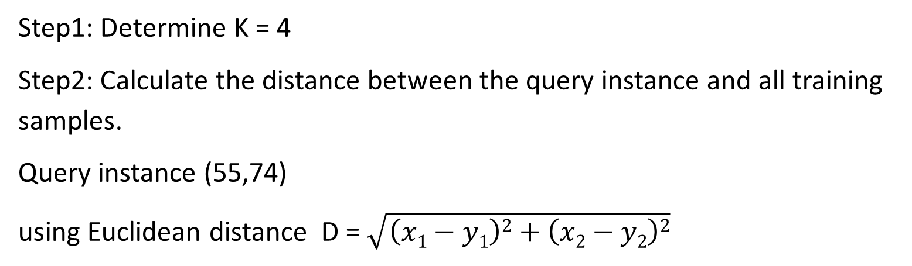
Answer
Step1: Determine K = 4
Step2: Calculate the distance between the query instance and all training samples.
Query instance (55,74)
using Euclidean distance D = $\sqrt{\left(x1−y1\right)2+\left(x2−y2\right)2}$

Slide 26
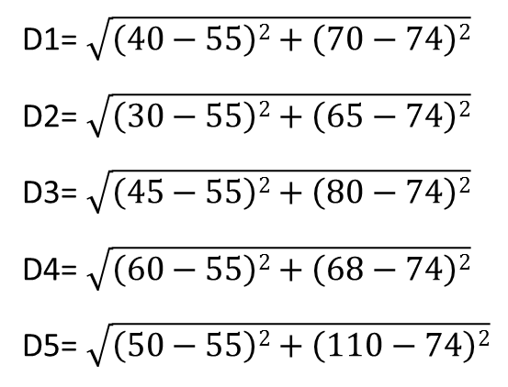
Query instance (55,74)
ID | Blood Pressure | Age | Weight | Heart Attack | D
1 | High | 40 | 70 | No | 15.5
2 | Normal | 30 | 65 | No | 26.6
3 | High | 45 | 80 | Yes | 11.7
4 | Low | 60 | 68 | No | 7.8
5 | Normal | 50 | 110 | Yes | 36.3
6 | Normal | 55 | 74 | ??
D1= $\sqrt{\left(40−55\right)2+\left(70−74\right)2}$
D2= $\sqrt{\left(30−55\right)2+\left(65−74\right)2}$
D3= $\sqrt{\left(45−55\right)2+\left(80−74\right)2}$
D4= $\sqrt{\left(60−55\right)2+\left(68−74\right)2}$
D5= $\sqrt{\left(50−55\right)2+\left(110−74\right)2}$

Slide 27
Step3: Sort the distance
ID | Blood Pressure | Age | Weight | Heart Attack | D | Sort D
1 | High | 40 | 70 | No | 15.5 | 3
2 | Normal | 30 | 65 | No | 26.6 | 4
3 | High | 45 | 80 | Yes | 11.7 | 2
4 | Low | 60 | 68 | No | 7.8 | 1
5 | Normal | 50 | 110 | Yes | 36.3 | 5
6 | Normal | 55 | 74 | ??

Slide 28
Step4: Gather the category of the nearest neighbors=4
Notice in the 5 rows is not included because the rank of this data is more than 4=k
ID | Blood Pressure | Age | Weight | Heart Attack | D | Sort D
1 | High | 40 | 70 | No | 15.5 | 3
2 | Normal | 30 | 65 | No | 26.6 | 4
3 | High | 45 | 80 | Yes | 11.7 | 2
4 | Low | 60 | 68 | No | 7.8 | 1
5 | Normal | 50 | 110 | - | 36.3 | 5
6 | Normal | 55 | 74 | ??
Step5: Predict the value of the query instance
We have 3 No and 1 yes, then the instance is No labeled

