Slide 1
Advanced Encryption Standard AES

Slide 2
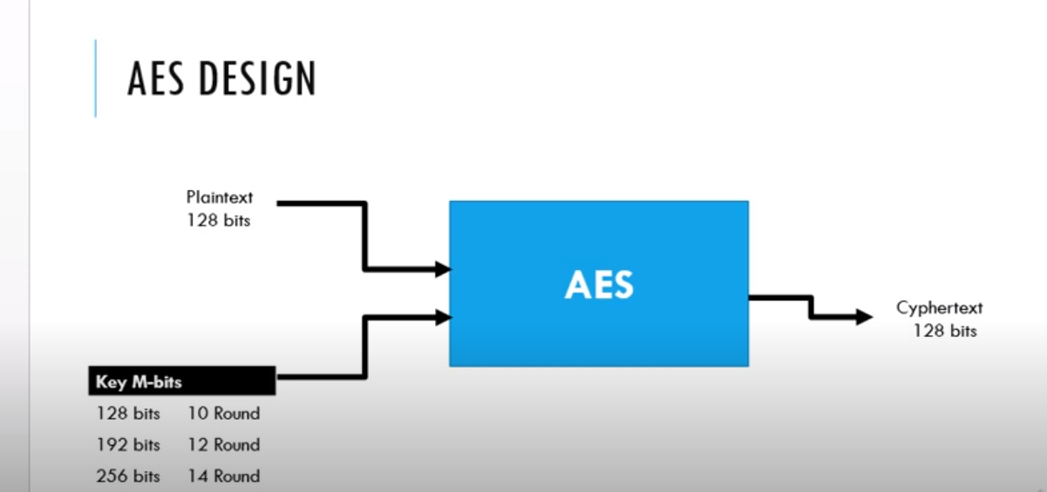

Slide 3
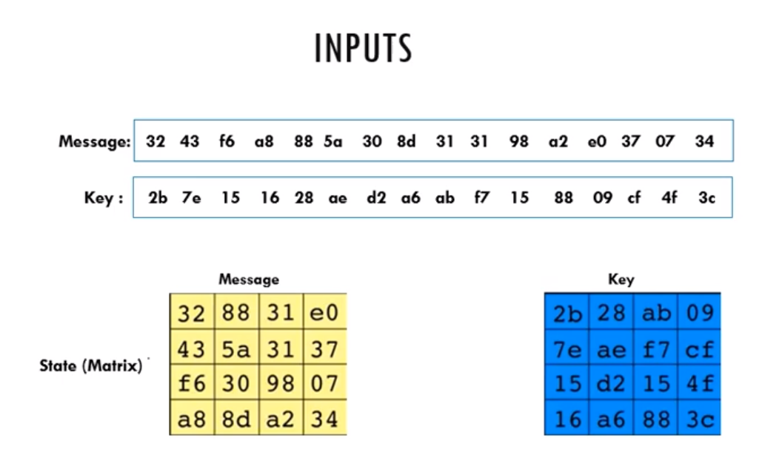

Slide 4
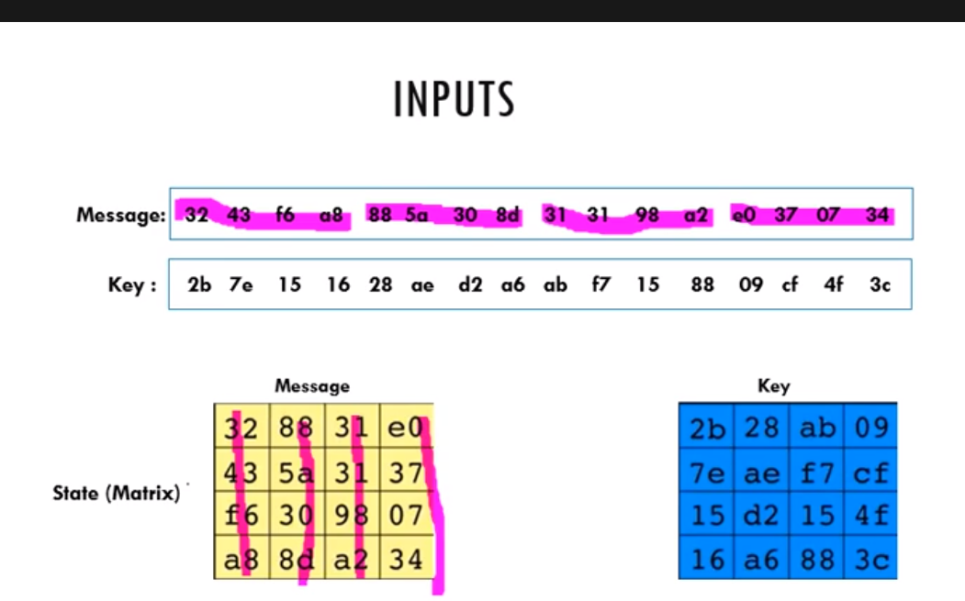

Slide 5
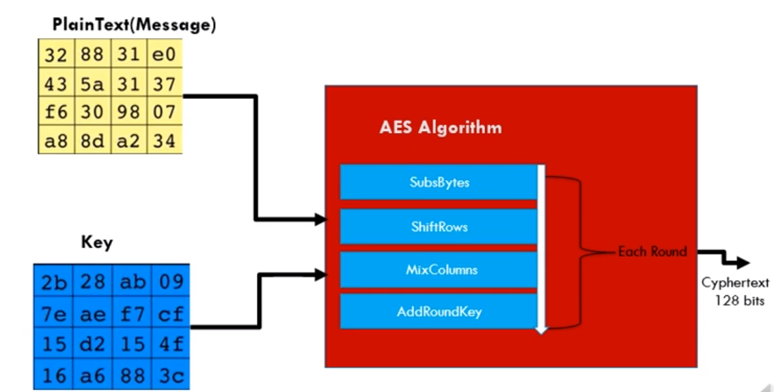

Slide 6
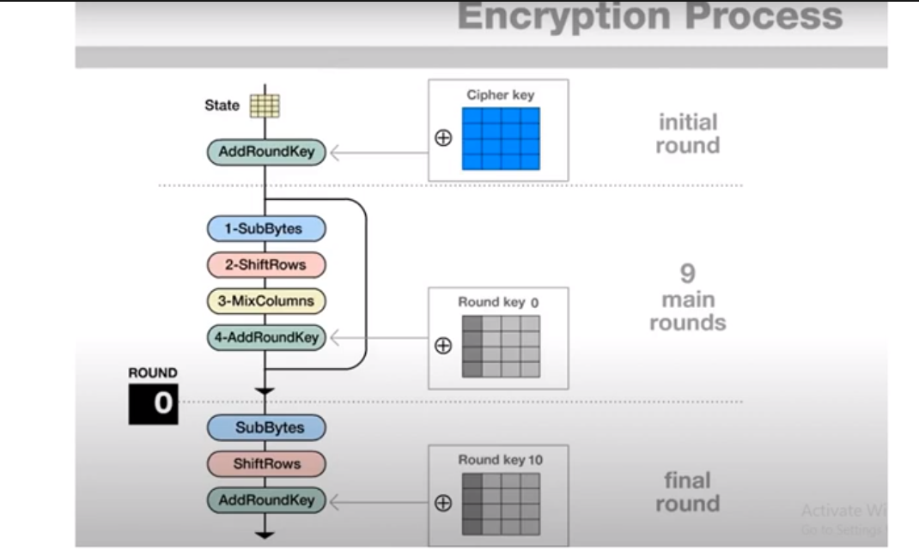

Slide 7
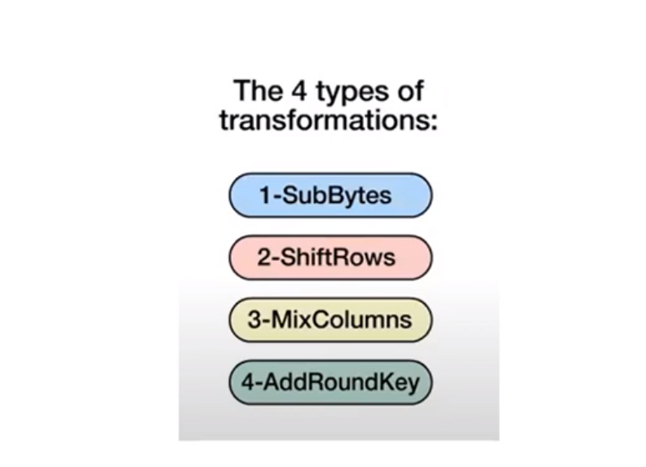

Slide 8
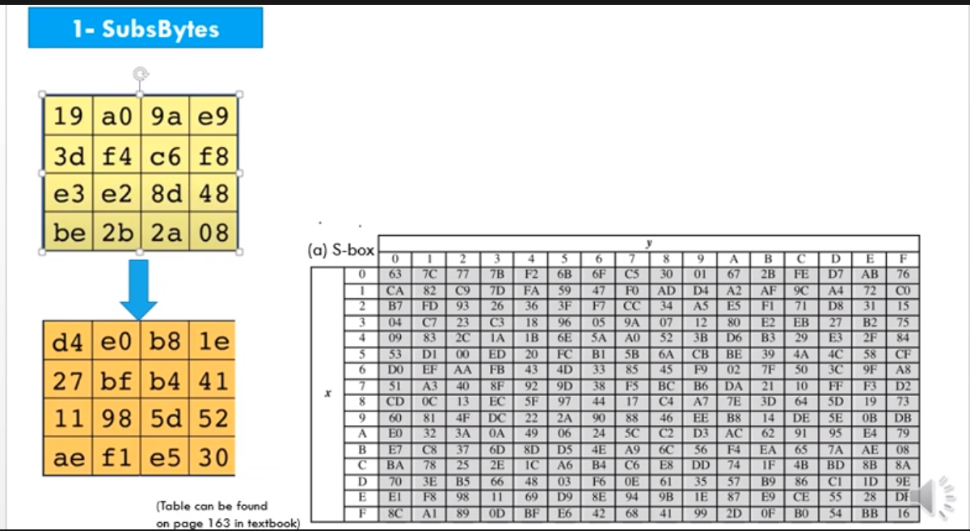

Slide 9
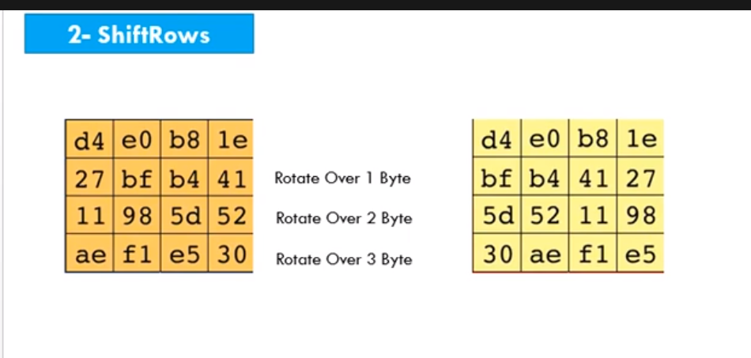

Slide 10
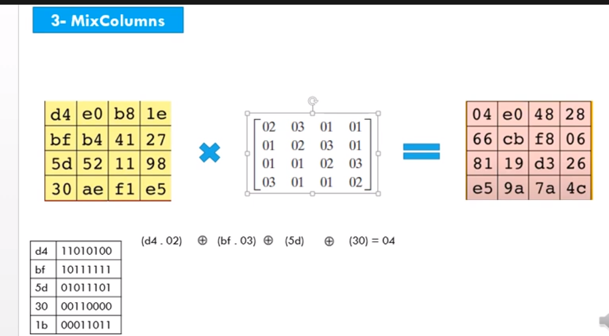

Slide 11
63
01
1- the same number
01100011
01100011
63
02
1- shift (0) to the right
01100011
11000110

Slide 12
F2
02
1- delete (1) from left
2- add (0) to the right
3- XOR 1B
11110010
11100100
+
1B
00011011
11111111
F2
03
F2
02
F2
01
+

Slide 13
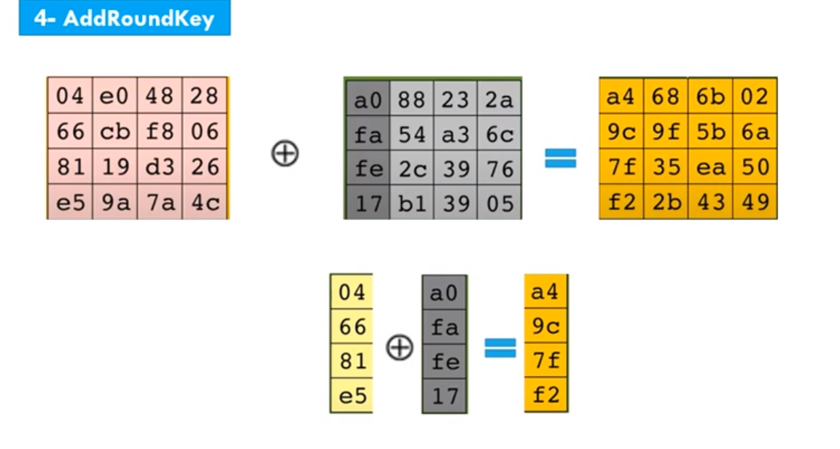
00000100
0 4
10100000
a 0
10100100
a 4

Slide 15
Algorithms
Caesar
Playfair
Polyalphabetic
Monoalphabetic
Vernam
Rail fence
Vigenere
DES
AES

