Slide 1
S-DES simplified – Data encryption Standard

Slide 2
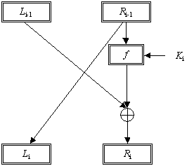
Plain text (L R 12bits) key(8 bits)

Slide 3
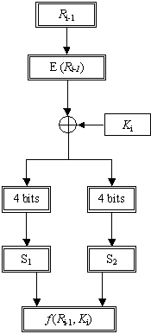

Slide 4

Expand

Slide 5
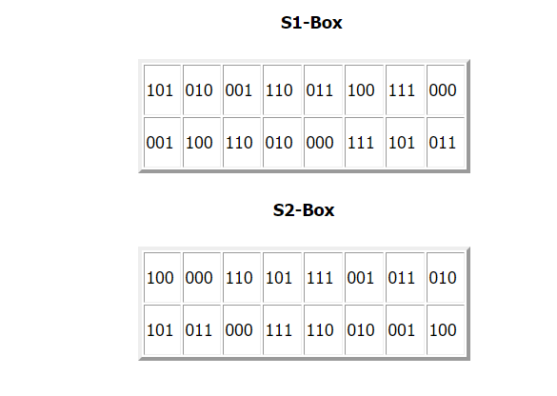
(S -box)

Slide 6
Example
Round 1 (i = 0)
L₀= 100010 and R₀= 110101; K₁ = 11100011.
E(R₀) = 11101001.
E(R₀) XOR K₁ = 11101001 XOR 11100011 = 00001010.
S1(0000) = 101, S2(1010) = 000,
f(R₀,K₁) = 101000
f(R₀,K₁) XOR L₀ = 101000 XOR 100010 = 001010.
Now using the formulas L_{i} = R_{i-1} and
R_{i} = L_{i-1} XOR f (R_{i-1}, K_{i})
we get L₁ = 110101 and R₁ = 001010.

Slide 7
Round 2 (i = 1)
L₁ = 110101 and R₁ = 001010; K₂ = 11000111.
E(R₁) = 00010110.
E(R₁) XOR K₁ = 00010110 XOR 11000111= 11010001.
S1(1101) = 111; S2(0001) = 000;
f(R₁,K₂) = 111000
f(R₁,K₂) XOR L₁ = 111000 XOR 110101 = 001101.
Now using the formulas L_{i} = R_{i-1} and
R_{i} = L_{i-1} XOR f (R_{i-1}, K_{i})
we get L₂ = 001010 and R₂ = 001101.
So encrypted message, R₂ L₂ = 001101001010

