Slide 1
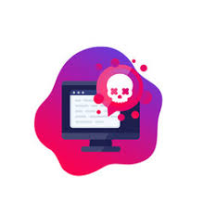
Ransomware
Ransomware
Definition, Danger & Prevention

Slide 2

Malware ?
Some Malware Type
What is Ransomware ?
Common Ransomware Attack Vectors
Ransomware Lifecycle (Simple lab)
Top Ransomware
Prevention

Slide 3
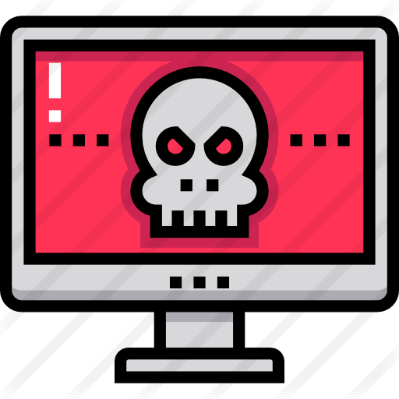
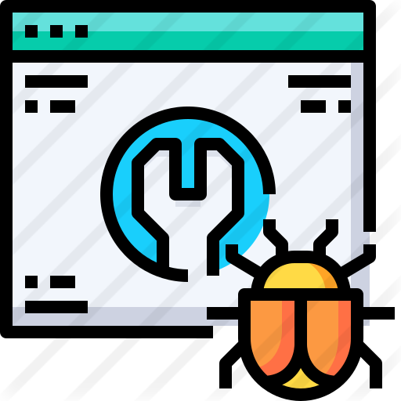
Malware ?
The term malware is a contraction of malicious software.
To make it simple,Malware is any piece of software that is designed with the intent to damage, disrupt or gain unauthorised access to people device and inflict harm to data and/or people in multiple ways.

Slide 4
Some Malware Types
Virus: destroy system and slow down the performance.
Worms: make copies of itself over and over — depleting system resources, such as hard drive space or bandwidth, by overloading a shared network.
Spyware: Collects information and sends it to the hacker.
Trojans: creating Back-doors that give other malware variants easy access.
Bots & Botnets: control victim computer and use it in spam and phishing messages,... etc
Ransomware

Slide 5
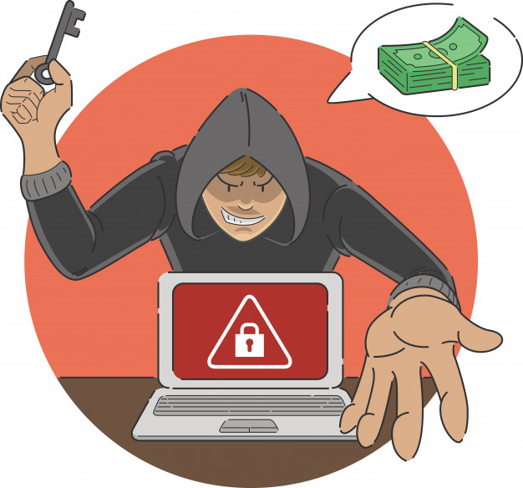
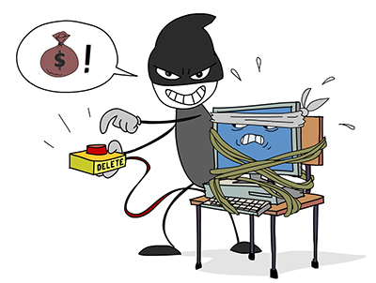
what is Ransomware
Ransomware is a type of malware that is designed to block user access from own system until a ransom fee is paid to ransomware creator.

Slide 6
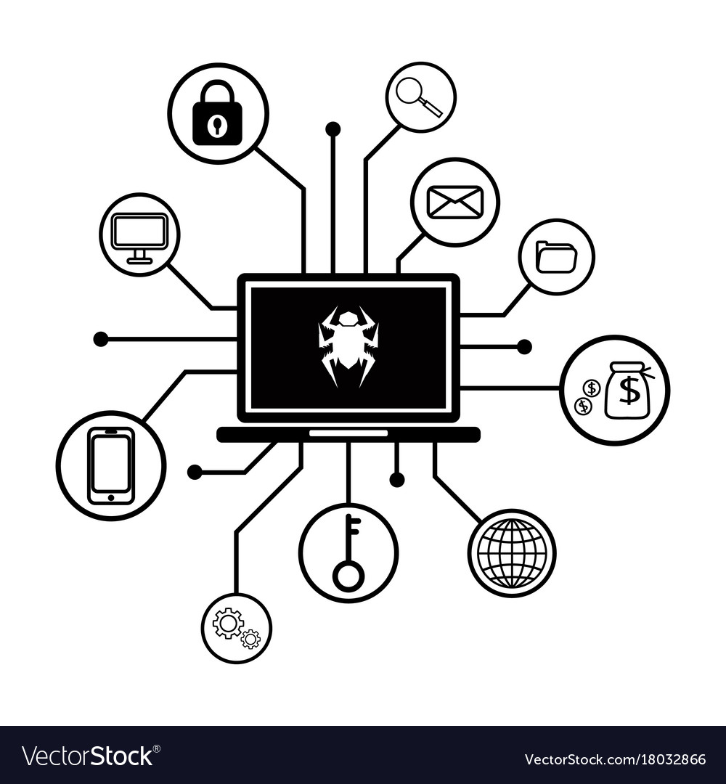
Common Ransomware Attack Vectors
Exploiting unsecured RDP ports (Remote Desktop Protocol)
Brute forcing or dictionary attacks of weak passwords
Sending phishing emails with malicious links or attachments
Utilizing exploit kits to target known operating system vulnerabilities
Gaining unauthorized access via out of date, unpatched software, servers, or firewalls

Slide 7
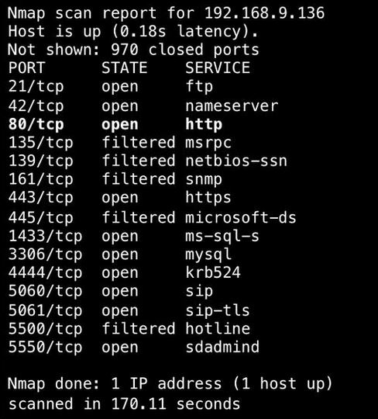
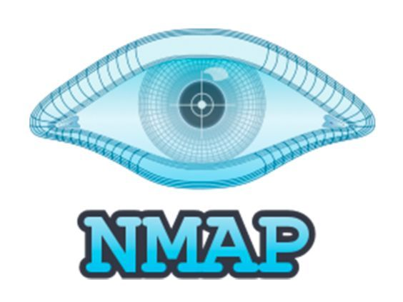
Unsecured RDP ports
has been known since 2016 as a way to attack some computers and networks
hackers have developed methods of identifying and exploiting vulnerable RDP sessions via the Internet to steal identities, login credentials and install and launch ransomware attacks.

Slide 8
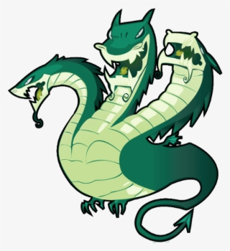

Brute Forcing || Dictionary Attacks
is a cryptographic hack that relies on guessing possible combinations of a targeted password until the correct password is discovered.

Slide 9
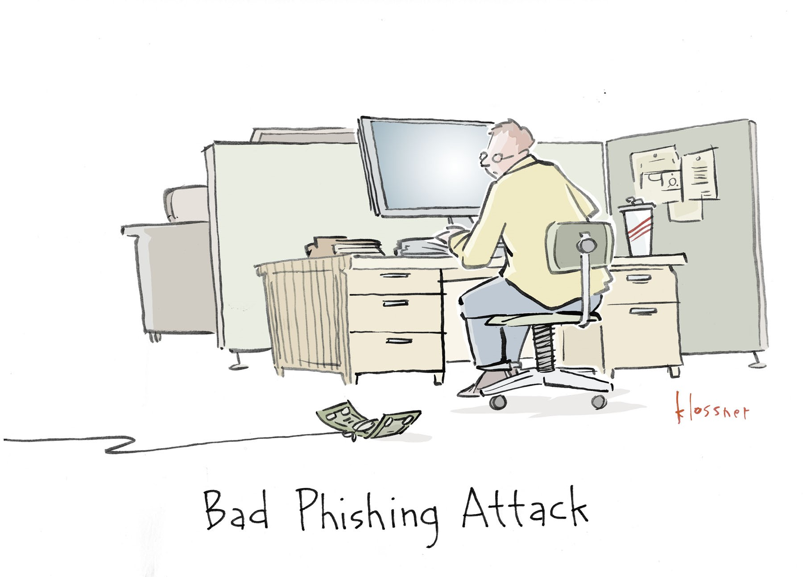
Phishing Attack
type of social engineering attack use to trick users into doing 'the wrong thing', such as clicking a bad link that will download malware, or direct them to a dodgy(unsafe) website.

Slide 10
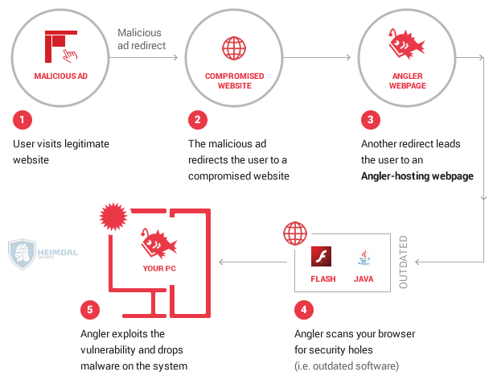
exploit kits
automatically and silently exploit vulnerabilities on victims’ machines while browsing the web.

Slide 11


Unauthorized access
Out of date application ,serves , or even browser can lead to unauthorized access or install Malware into user device

Slide 12
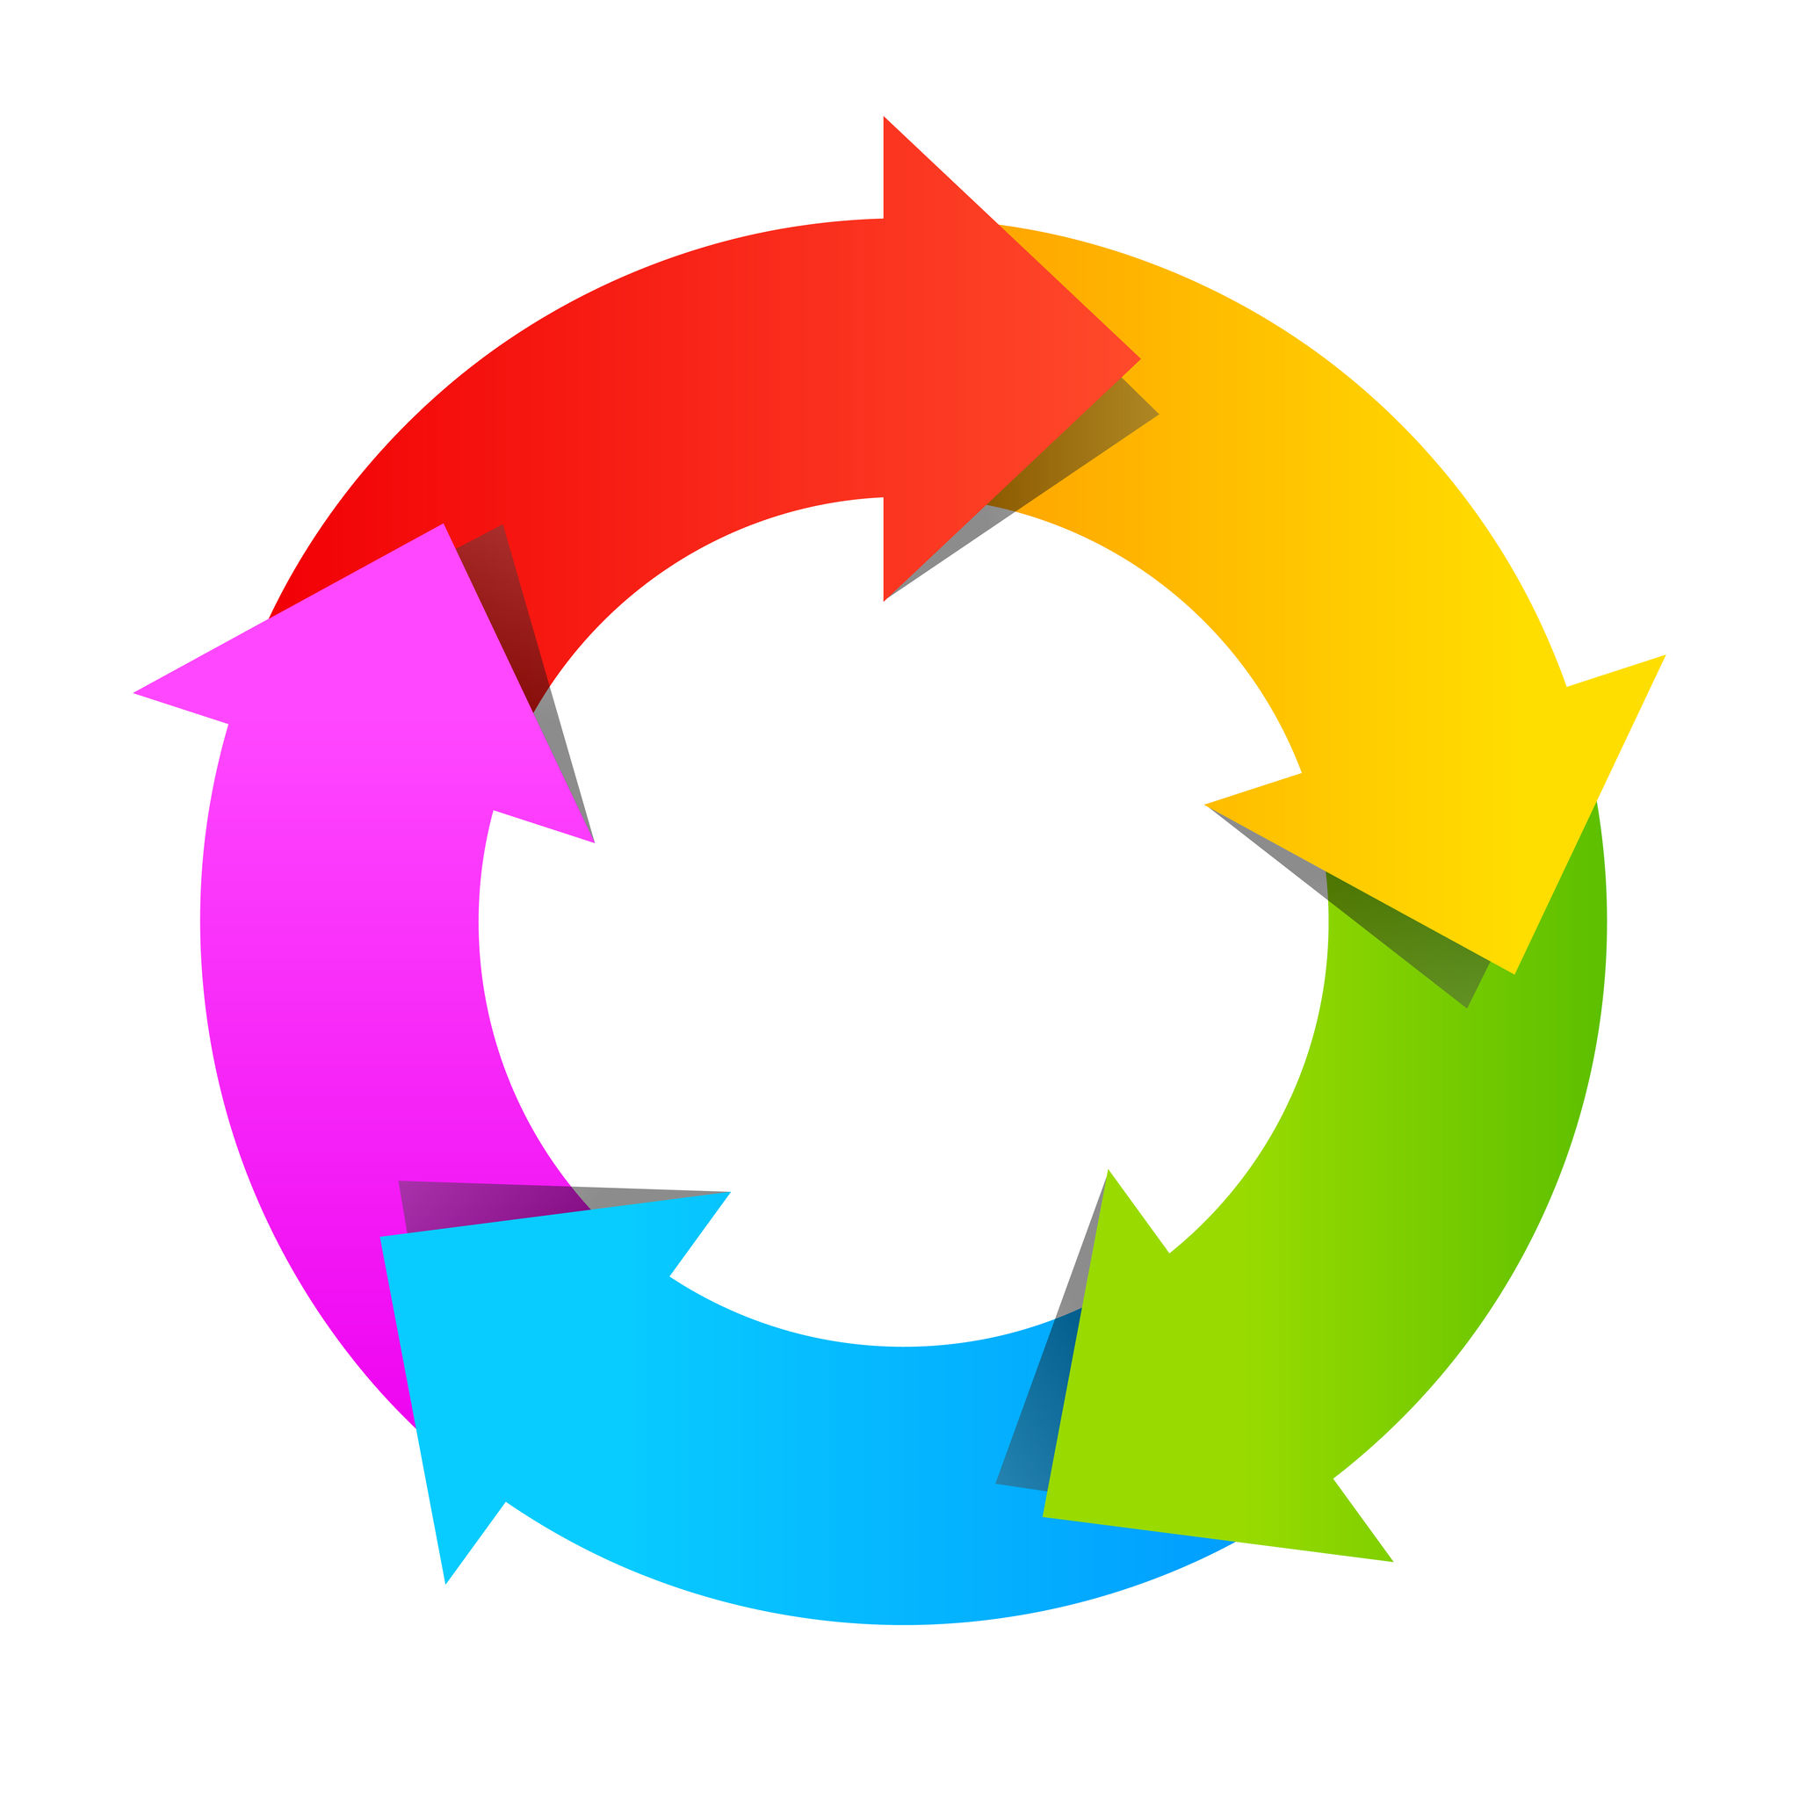
Ransomware Lifecycle
Distribution Campaign
Infection/Infiltration
Staging
Scanning (covert reconnaissance)
Encryption
Ransom Demand

Slide 13

Distribution Campaign
attackers use techniques like social engineering and weaponized websites to trick or force users to download a dropper which kicks off the infection

Slide 14
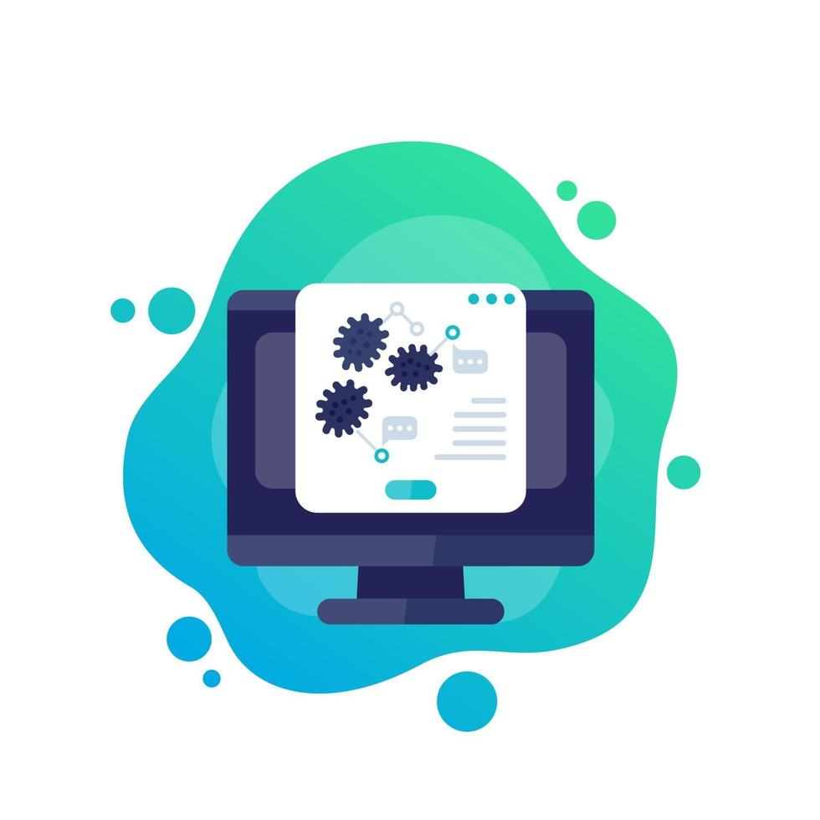
Infection
file downloaded and code execution begins.
At this point your system has been infected with ransomware.
none of your files are encrypted yet.
It's important to note that at this point:
all your automated detection controls have failed. all traffic are allowed .
Malware check if it not in Sandbox Environment before start any action in this step

Slide 15
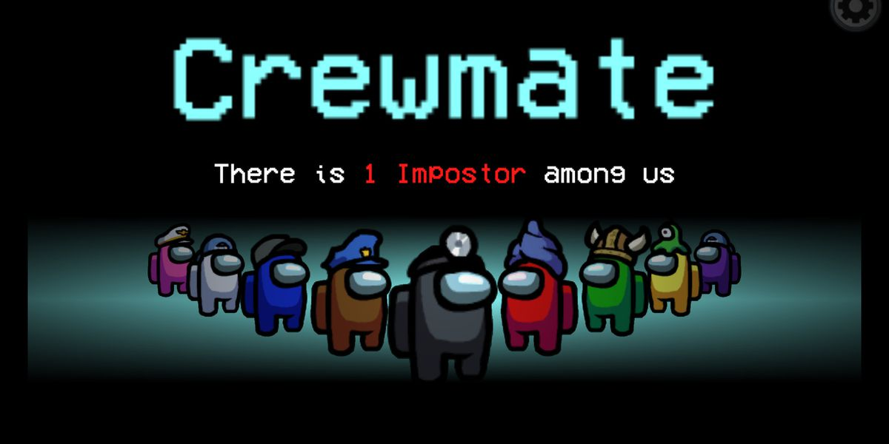
Staging
the ransomware sets up, embeds itself in a system, and establishes persistency to exist beyond a reboot
The attacker now “owns” the system.

Slide 16

Scanning (covert reconnaissance)
Look, learn, and remain on the network. Get an understanding of how the network works, its vulnerabilities, and where the sensitive data is that will be worth a ransom
ransomware searches for content to encrypt, both on the local computer and the network acces-sible resources

Slide 17
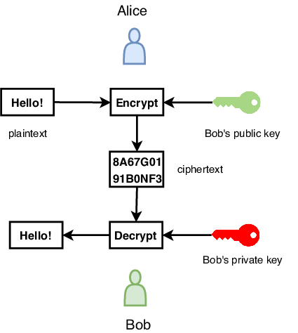
Encryption
The discovered files are encrypted
data on network file shares are copied down and encrypted locally, Then the encrypted files must be uploaded and the original files deleted.

Slide 18
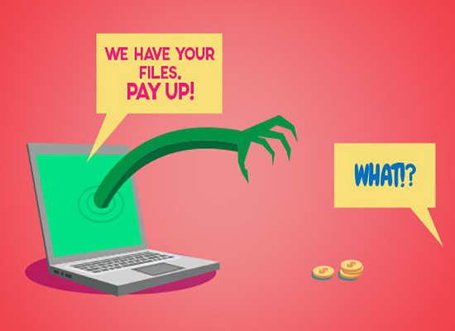
Ransom Demand
A ransom note is generated, shown to the victim, and the hacker waits to collect on the ransom

Slide 19
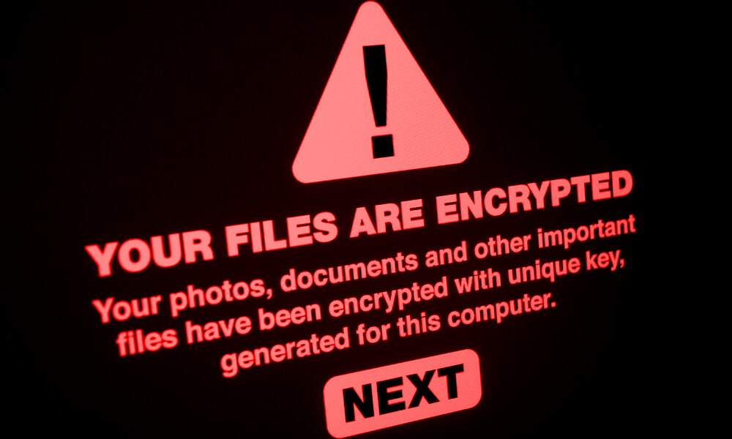
Top Ransomware attack 2020
ISS World
Estimated cost: $74 million
recovery costs: between $22.5 million and $45 million
Cognizant
Estimated cost: $50 million
recovery costs: $70 million
Sopra Steria
Estimated cost: $50 million
recovery costs: $40 million and $50 million.

Slide 20

Prevention
Keep current data backups
Scan emails for malware
Not download files from unsafe site
Check firewalls and endpoint protections
Keep your OS, applications & serves up-to-date

