Slide 2
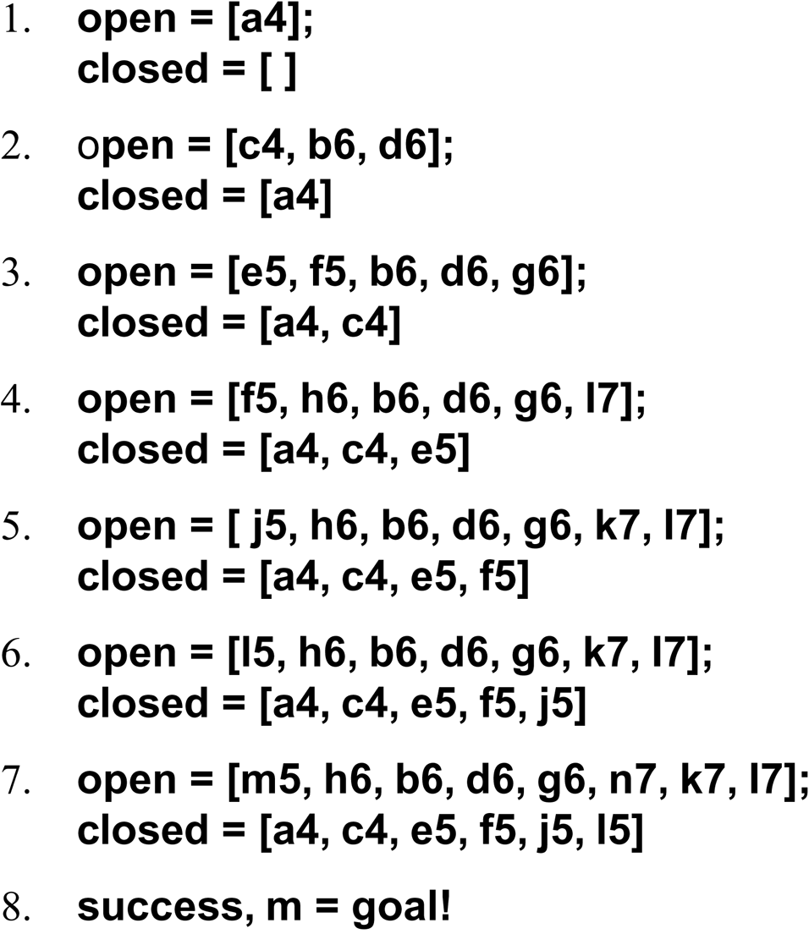
The successive stages of open and closed that generate this graph are:

Slide 3
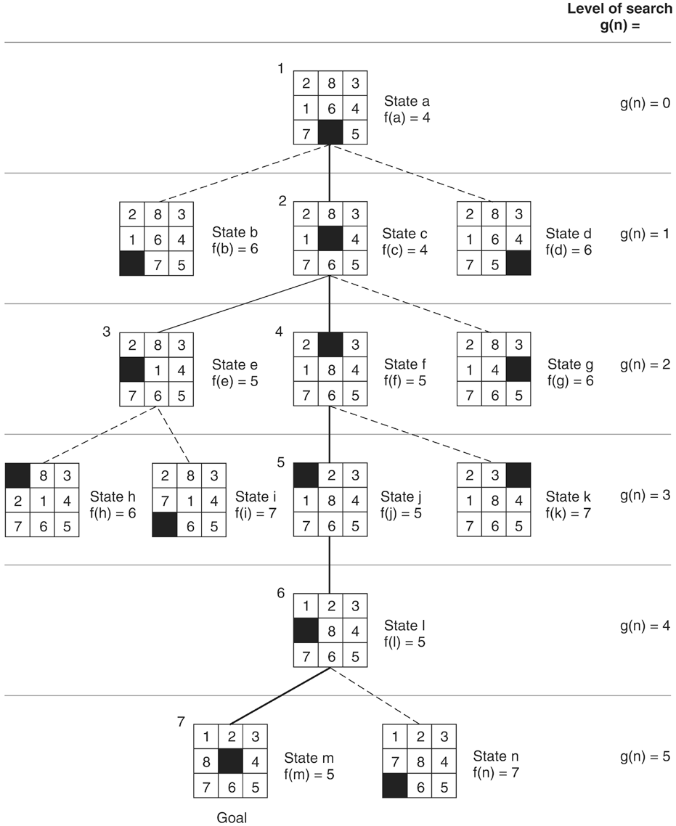
Figure 4.10: State space generated in heuristic search of the 8-puzzle graph.

Slide 4
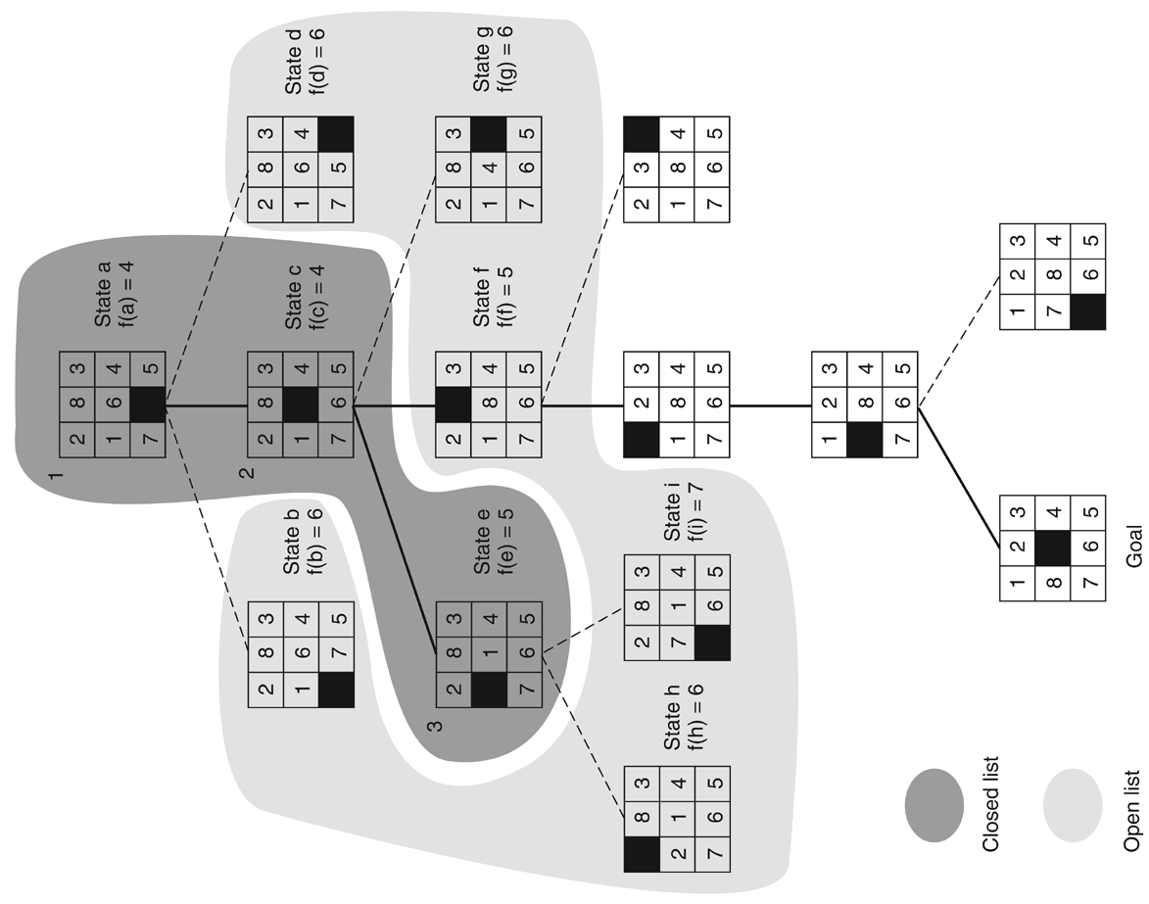
Figure 4.11: open and closed as they appear after the third iteration of heuristic search.

Slide 5
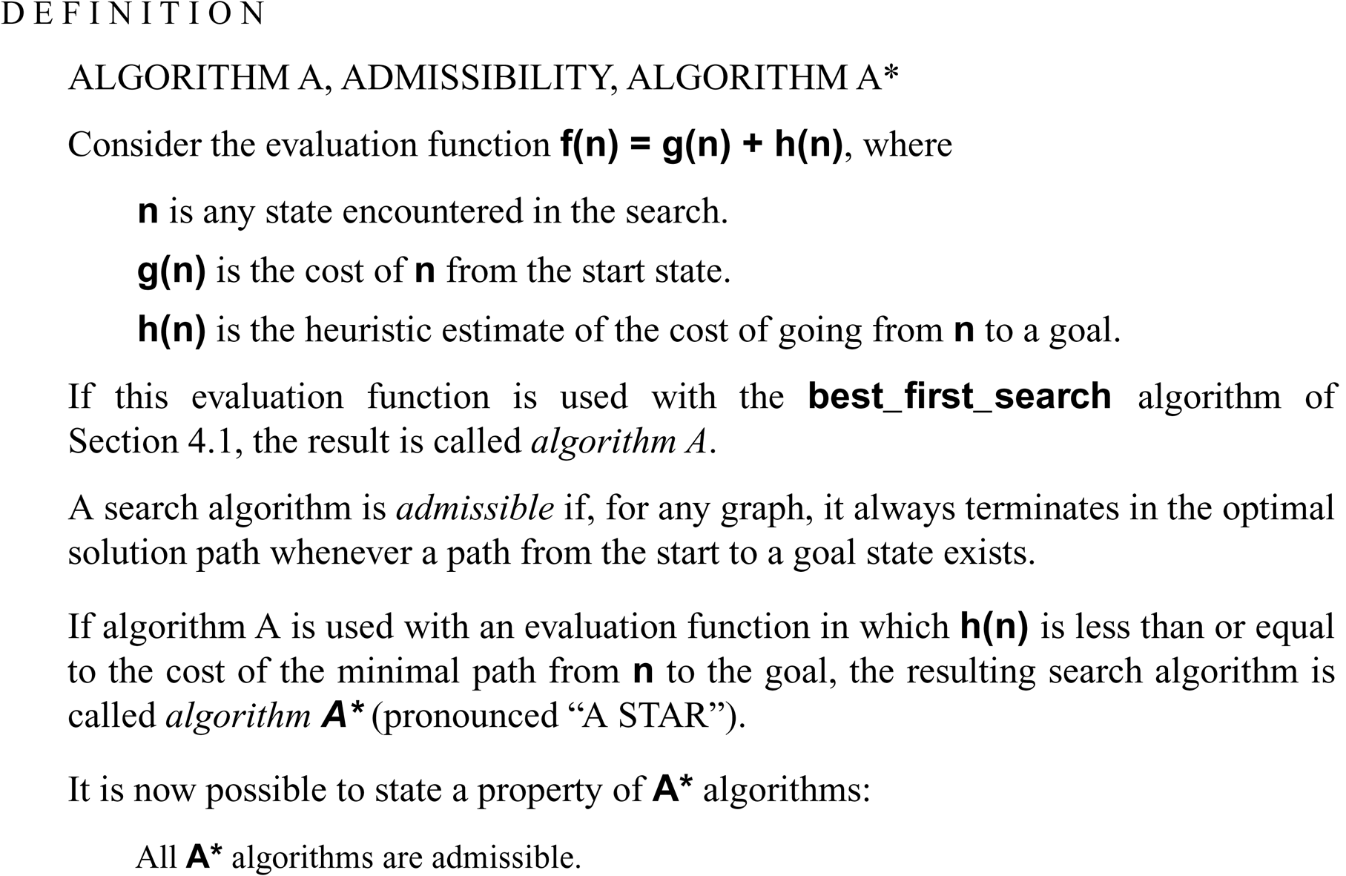

Slide 6
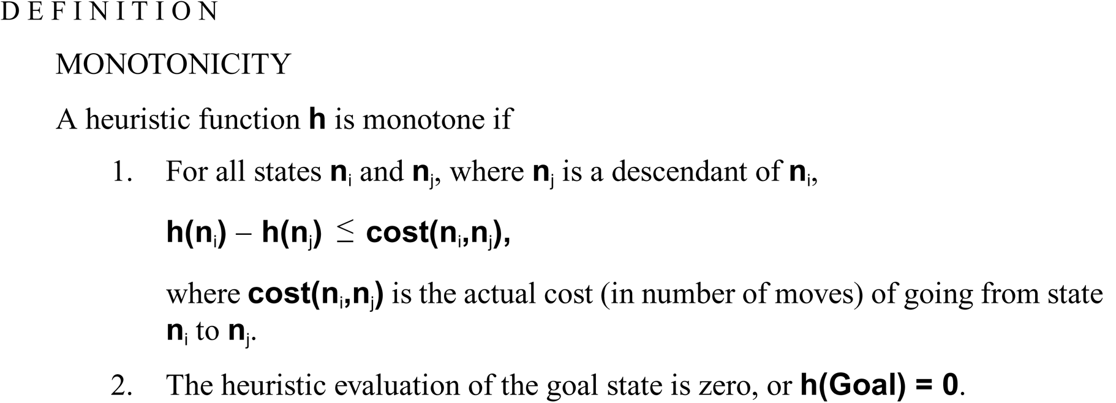

Slide 7
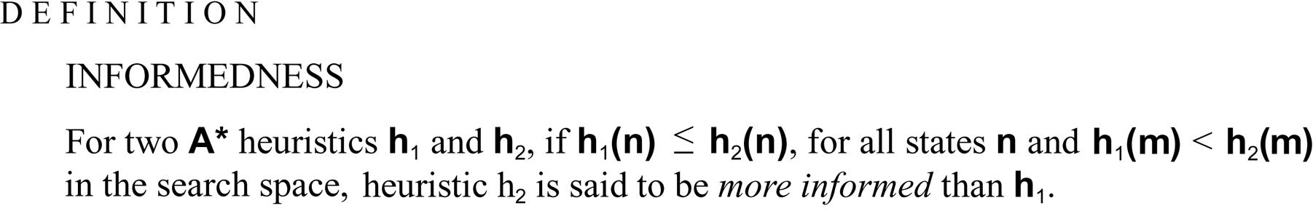

Slide 8
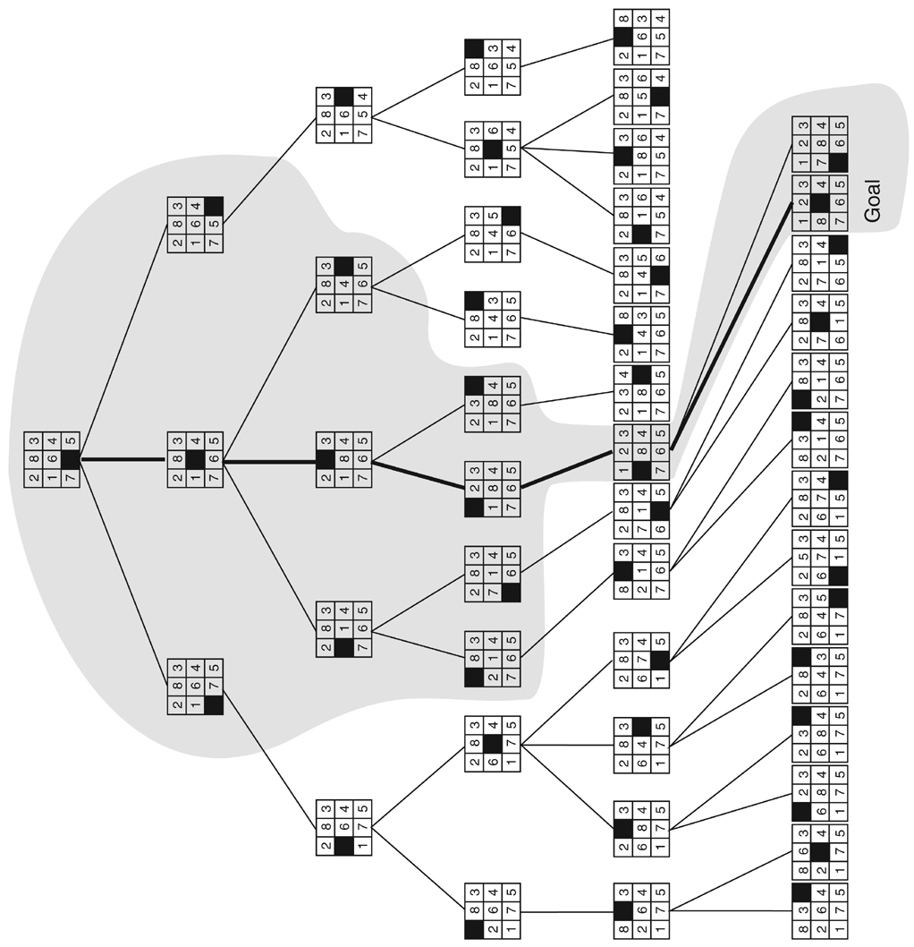
Figure 4.12: Comparison of state space searched using heuristic search with space searched by breadth-first search. The portion of the graph searched heuristically is shaded. The optimal solution path is in bold. Heuristic used is f(n) = g(n) + h(n) where h(n) is tiles out of place.

Slide 9
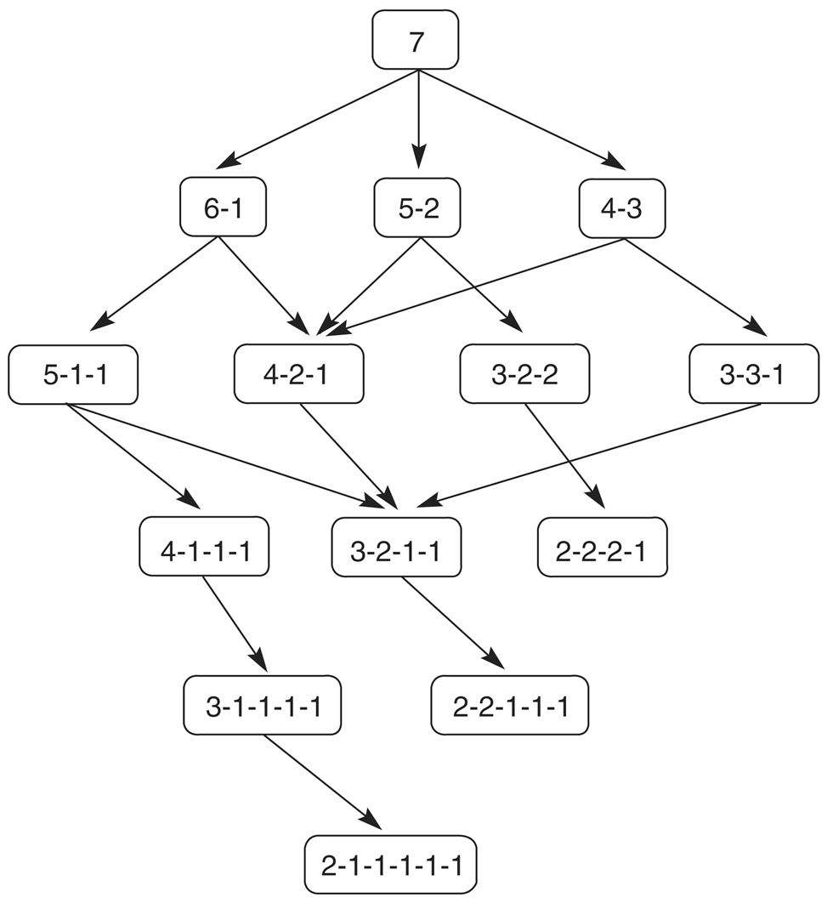
Figure 4.13: State space for a variant of nim. Each state partitions the seven matches into one or more piles.

Slide 10
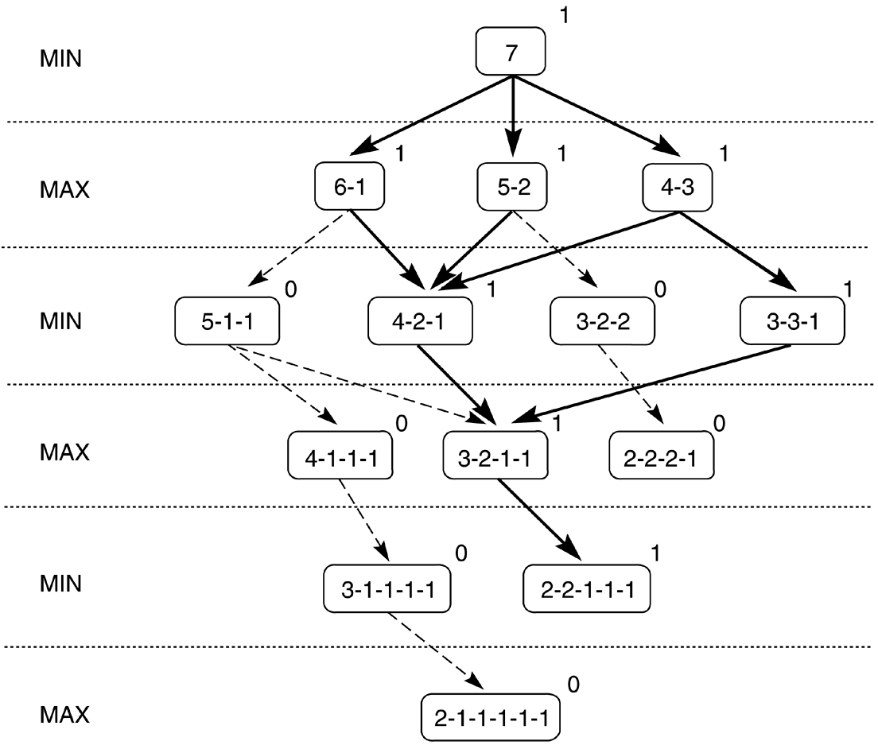
Figure 4.14: Exhaustive minimax for the game of nim. Bold lines indicate forced win for MAX. Each node is marked with its derived value (0 or 1) under minimax.

Slide 11
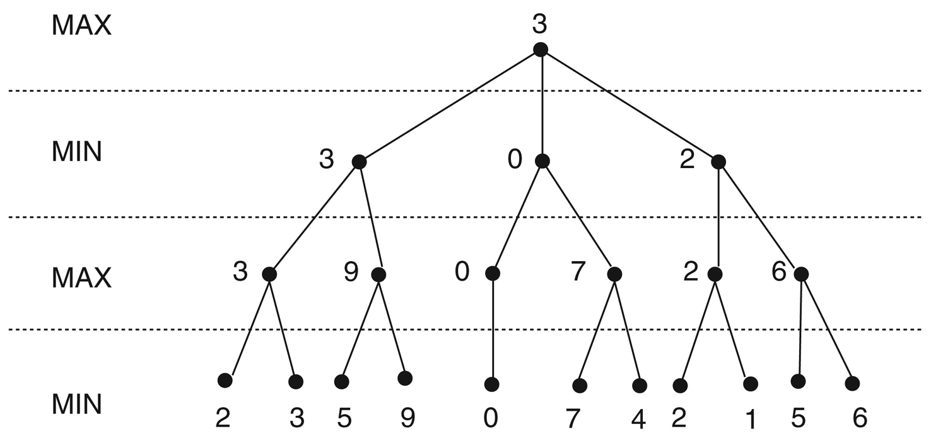
Figure 4.15: Minimax to a hypothetical state space. Leaf states show heuristic values; internal states show backed-up values.

Slide 12
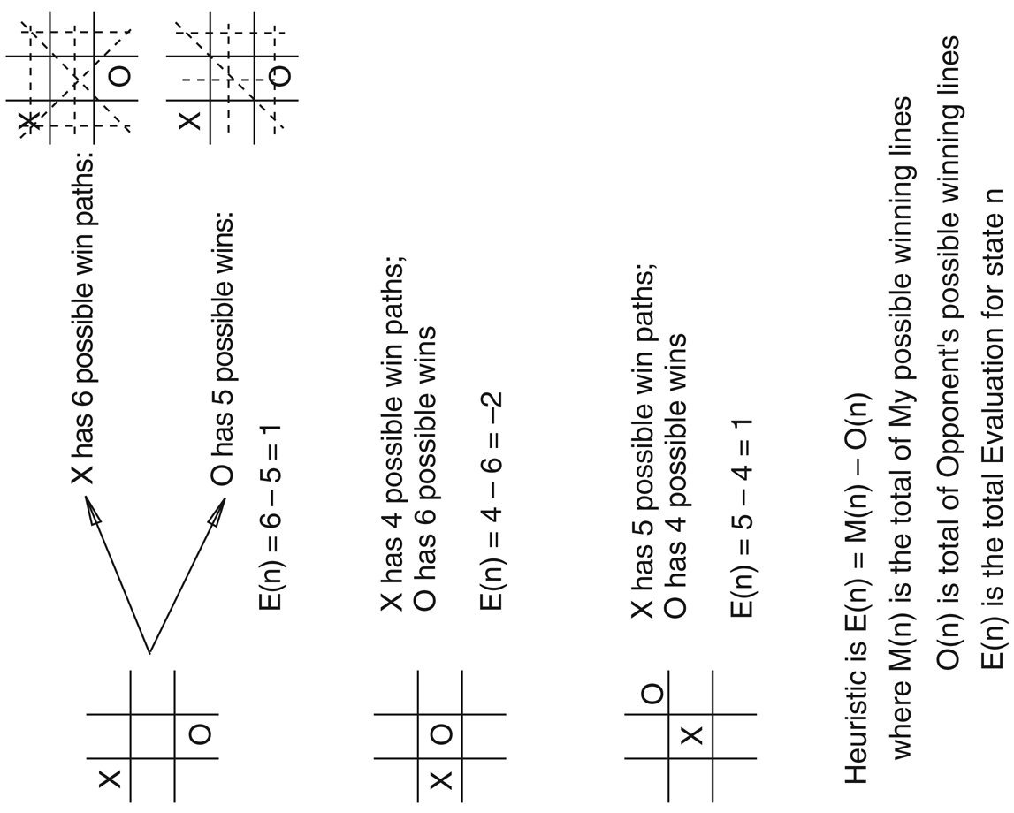
Figure 4.16: Heuristic measuring conflict applied to states of tic-tac-toe.

