Slide 1

Dr. Mohamed Ghetas

Slide 2

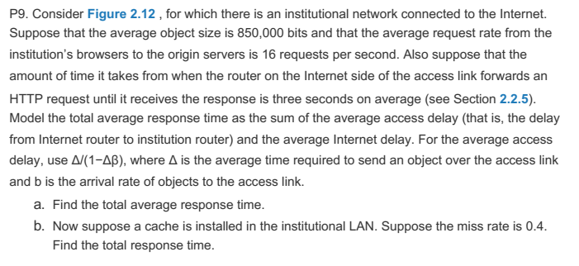
©1992-2012 by Pearson Education, Inc. All Rights Reserved.

Slide 3
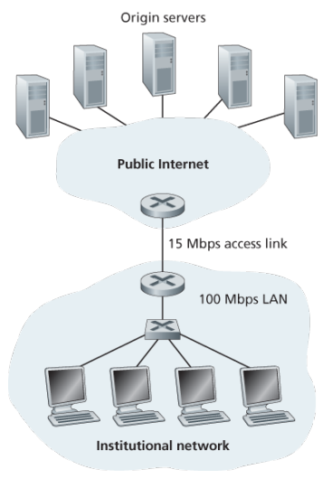

Slide 4
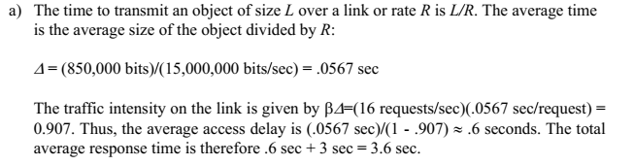
©1992-2012 by Pearson Education, Inc. All Rights Reserved.

Slide 5
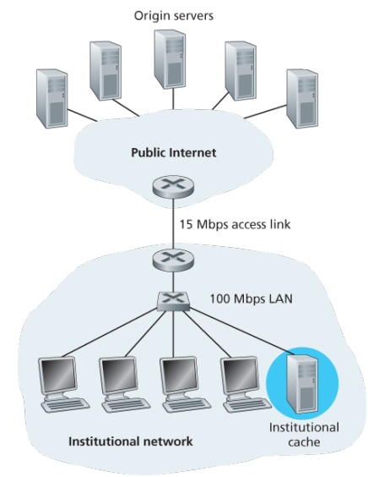

Slide 6
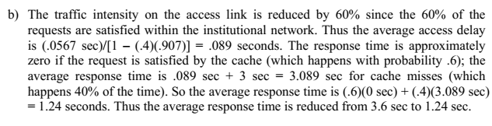
©1992-2012 by Pearson Education, Inc. All Rights Reserved.

Slide 7

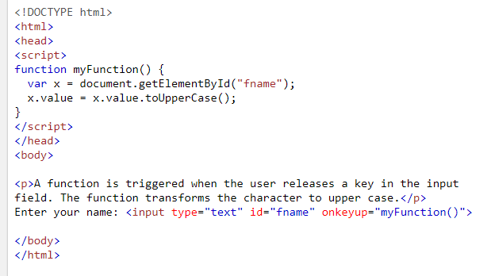
Write a function that is triggered when the user releases a key in the input field. The function transforms the character to upper case.

Slide 8

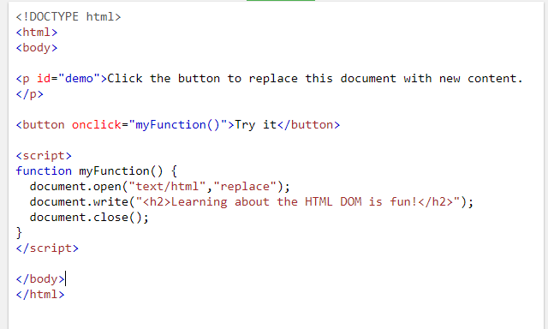
Write JavaScript code to replace the content of webpage when the button clicked.

Slide 9
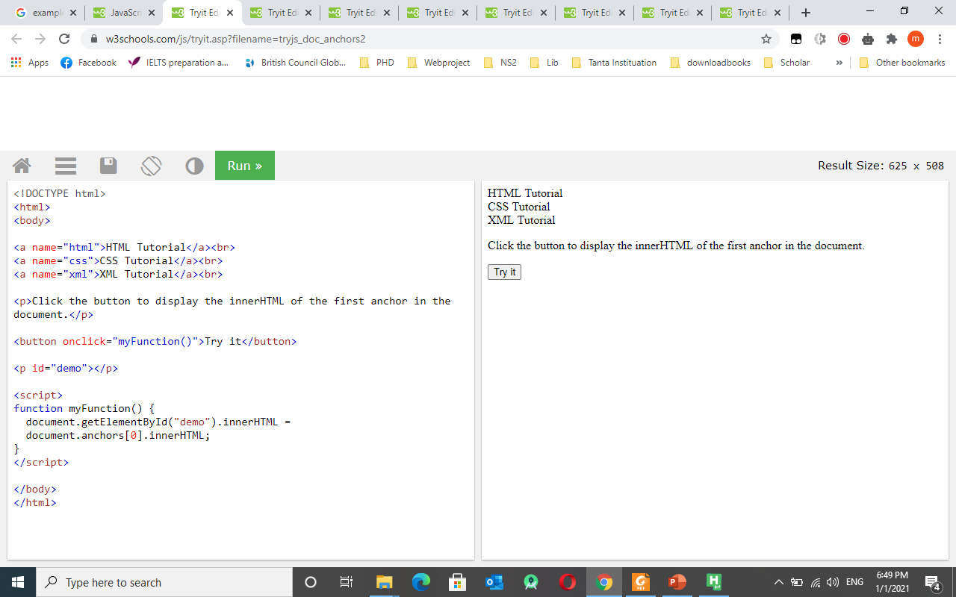
Write JavaScript to find the InnerHTML for the first anchor in HTML

Slide 10

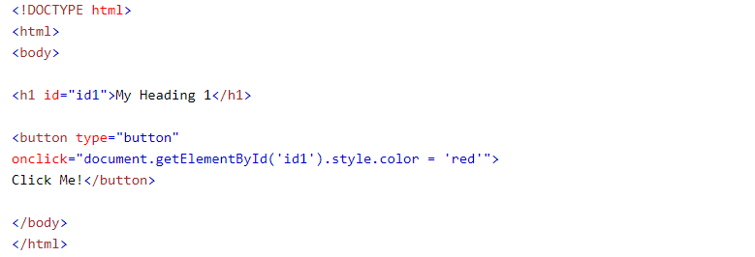
This example changes the style of the HTML element with id="id1", when the user clicks a button:
©1992-2012 by Pearson Education, Inc. All Rights Reserved.

Slide 11

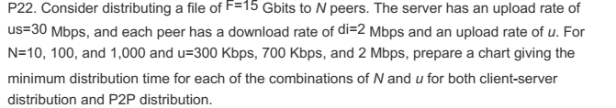
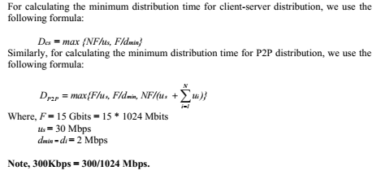

Slide 12
