Slide 1
Quality Management

Slide 2
Software quality management
Concerned with ensuring that the required level of quality is achieved in a software product.
Three principal concerns:
  At the organizational level, quality management is concerned with establishing a framework of organizational processes and standards that will lead to high-quality software.
  At the project level, quality management involves
  Establishing a quality plan for a project. The quality plan should set out the quality goals for the project and define what processes and standards are to be used.
  Application of specific quality processes and checking that these planned processes have been followed.

Slide 3
Quality management activities
Quality management provides an independent check on the software development process.
The quality management process checks the project deliverables to ensure that they are consistent with organizational standards and goals
The quality team should be independent from the development team so that they can take an objective view of the software.
This allows them to report on software quality without being influenced by software development issues.

Slide 4
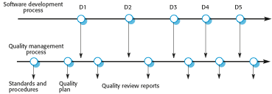
Quality management and software development

Slide 5
Quality planning
A quality plan sets out the desired product qualities and how these are assessed and defines the most significant quality attributes.
The quality plan should define the quality assessment process.
It should set out which organisational standards should be applied and, where necessary, define new standards to be used.

Slide 6
Quality plans
Quality plan structure
  Product introduction;
  Product plans;
  Process descriptions;
  Quality goals;
  Risks and risk management.
Quality plans should be short, succinct documents
  If they are too long, no-one will read them.

Slide 7
Scope of quality management
Quality management is particularly important for large, complex systems. The quality documentation is a record of progress and supports continuity of development as the development team changes.
For smaller systems, quality management needs less documentation and should focus on establishing a quality culture.

Slide 8
Software quality
Quality, simplistically, means that a product should meet its specification.
This is problematical for software systems
  There is a tension between customer quality requirements (efficiency, reliability, etc.) and developer quality requirements (maintainability, reusability, etc.);
  Some quality requirements are difficult to specify in an unambiguous way;
  Software specifications are usually incomplete and often inconsistent.
The focus may be ‘fitness for purpose’ rather than specification conformance.

Slide 9
Software fitness for purpose
Have programming and documentation standards been followed in the development process?
Has the software been properly tested?
Is the software sufficiently dependable to be put into use?
Is the performance of the software acceptable for normal use?
Is the software usable?
Is the software well-structured and understandable?

Slide 10
Software quality attributes
Safety | Understandability | Portability
Security | Testability | Usability
Reliability | Adaptability | Reusability
Resilience | Modularity | Efficiency
Robustness | Complexity | Learnability
Resilience:
the quality of being able to return quickly to a previous good condition after problems:

Slide 11
Quality conflicts
It is not possible for any system to be optimized for all of these attributes – for example, improving robustness may lead to loss of performance.
The quality plan should therefore define the most important quality attributes for the software that is being developed.
The plan should also include a definition of the quality assessment process, an agreed way of assessing whether some quality, such as maintainability or robustness, is present in the product.

Slide 12
Process and product quality
The quality of a developed product is influenced by the quality of the production process.
This is important in software development as some product quality attributes are hard to assess.
However, there is a very complex and poorly understood relationship between software processes and product quality.
  The application of individual skills and experience is particularly important in software development;
  External factors such as the novelty of an application or the need for an accelerated development schedule may impair product quality.

Slide 13
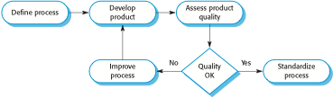
Process-based quality

Slide 14
Software standards
Standards define the required attributes of a product or process. They play an important role in quality management.
Standards may be international, national, organizational or project standards.
Product standards define characteristics that all software components should exhibit
e.g. a common programming style.
Process standards define how the software process should be enacted.

Slide 15
Importance of standards
Encapsulation of best practice- avoids repetition of past mistakes.
They are a framework for defining what quality means in a particular setting i.e. that organization’s view of quality.
They provide continuity - new staff can understand the organisation by understanding the standards that are used.

Slide 16
Product and process standards
Product standards | Process standards
Design review form | Design review conduct
Requirements document structure | Submission of new code for system building
Method header format | Version release process
Java programming style | Project plan approval process
Project plan format | Change control process
Change request form | Test recording process

Slide 17
Problems with standards
They may not be seen as relevant and up-to-date by software engineers.
They often involve too much bureaucratic form filling.
If they are unsupported by software tools, tedious form filling work is often involved to maintain the documentation associated with the standards.

Slide 18
Standards development
Involve practitioners in development. Engineers should understand the rationale underlying a standard.
Review standards and their usage regularly.
Standards can quickly become outdated and this reduces their credibility amongst practitioners.
Detailed standards should have specialized tool support. Excessive clerical work is the most
significant complaint against standards.
  Web-based forms are not good enough.

Slide 19
ISO 9001 standards framework
An international set of standards that can be used as a basis for developing quality management systems.
ISO 9001, the most general of these standards, applies to organizations that design, develop and maintain products, including software.
The ISO 9001 standard is a framework for developing software standards.
  It sets out general quality principles, describes quality processes in general and lays out the organizational standards and procedures that should be defined. These should be documented in an organizational quality manual.

Slide 20
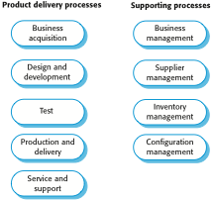
ISO 9001 core processes

Slide 21
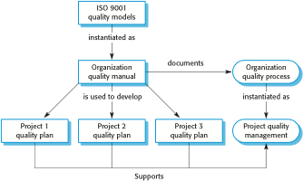
ISO 9001 and quality management

Slide 22
ISO 9001 certification
Quality standards and procedures should be documented in an organisational quality manual.
An external body may certify that an organisation’s quality manual conforms to ISO 9000 standards.
Some customers require suppliers to be ISO 9000 certified although the need for flexibility here is increasingly recognised.

Slide 24
Reviews and inspections
A group examines part or all of a process or system and its documentation to find potential problems.
Software or documents may be 'signed off' at a review which signifies that progress to the next development stage has been approved by management.
There are different types of review with different objectives
  Inspections for defect removal (product);
  Reviews for progress assessment (product and process);
  Quality reviews (product and standards).

Slide 25
Quality reviews
A group of people carefully examine part or all of a software system and its associated documentation.
Code, designs, specifications, test plans, standards, etc. can all be reviewed.
Software or documents may be 'signed off' at a review which signifies that progress to the next development stage has been approved by management.

Slide 26

The software review process

Slide 27
Reviews and agile methods
The review process in agile software development is usually informal.
  In Scrum, for example, there is a review meeting after each iteration of the software has been completed (a sprint review), where quality issues and problems may be discussed.
In extreme programming, pair programming ensures that code is constantly being examined and reviewed by another team member.
XP relies on individuals taking the initiative to improve and refactor code. Agile approaches are not usually standards-driven, so issues of standards compliance are not usually considered.

Slide 28
Program inspections
These are peer reviews where engineers examine the source of a system with the aim of discovering anomalies and defects.
Inspections do not require execution of a system so may be used before implementation.
They may be applied to any representation of the system (requirements, design, configuration data, test data, etc.).
They have been shown to be an effective technique for discovering program errors.

Slide 29
Inspection checklists
Checklist of common errors should be used to drive the inspection.
Error checklists are programming language dependent and reflect the characteristic errors that are likely to arise in the language.
In general, the 'weaker' the type checking, the larger the checklist.
Examples: Initialisation, Constant naming, loop termination, array bounds, etc.

Slide 30
An inspection checklist (a)
Fault class | Inspection check
Data faults | Are all program variables initialized before their values are used? Have all constants been named? Should the upper bound of arrays be equal to the size of the array or Size -1? If character strings are used, is a delimiter explicitly assigned? Is there any possibility of buffer overflow?
Control faults | For each conditional statement, is the condition correct? Is each loop certain to terminate? Are compound statements correctly bracketed? In case statements, are all possible cases accounted for? If a break is required after each case in case statements, has it been included?
Input/output faults | Are all input variables used? Are all output variables assigned a value before they are output? Can unexpected inputs cause corruption?

Slide 31
An inspection checklist (b)
Fault class | Inspection check
Interface faults | Do all function and method calls have the correct number of parameters? Do formal and actual parameter types match? Are the parameters in the right order? If components access shared memory, do they have the same model of the shared memory structure?
Storage management faults | If a linked structure is modified, have all links been correctly reassigned? If dynamic storage is used, has space been allocated correctly? Is space explicitly deallocated after it is no longer required?
Exception management faults | Have all possible error conditions been taken into account?

Slide 32
Agile methods and inspections
Agile processes rarely use formal inspection or peer review processes.
Rather, they rely on team members cooperating to check each other’s code, and informal guidelines, such as ‘check before check-in’, which suggest that programmers should check their own code.
Extreme programming practitioners argue that pair programming is an effective substitute for inspection as this is, in effect, a continual inspection process.
Two people look at every line of code and check it before it is accepted.

Slide 33
Software measurement and metrics
Software measurement is concerned with deriving a numeric value for an attribute of a software product or process.
This allows for objective comparisons between techniques and processes.
Although some companies have introduced measurement programmes, most organisations still don’t make systematic use of software measurement.
There are few established standards in this area.

Slide 34
Software metric
Any type of measurement which relates to a software system, process or related documentation
  Lines of code in a program, the Fog index, number of person-days required to develop a component.
Allow the software and the software process to
be quantified.
May be used to predict product attributes or to control the software process.
Product metrics can be used for general predictions or to identify anomalous components.

Slide 35
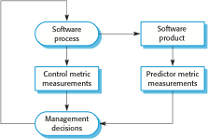
Predictor and control measurements

Slide 36
Use of measurements
To assign a value to system quality attributes
  By measuring the characteristics of system components, such as their cyclomatic complexity, and then aggregating these measurements, you can assess system quality attributes, such as maintainability.
To identify the system components whose quality is sub-standard
  Measurements can identify individual components with characteristics that deviate from the norm. For example, you can measure components to discover those with the highest complexity. These are most likely to contain bugs because the complexity makes them harder to understand.

Slide 37
Metrics assumptions
A software property can be measured.
The relationship exists between what we can
measure and what we want to know. We can only measure internal attributes but are often more interested in external software attributes.
This relationship has been formalised and
validated.
It may be difficult to relate what can be measured to desirable external quality attributes.

Slide 38
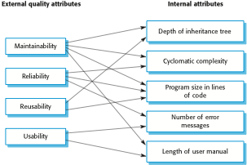
Relationships between internal and external software

Slide 39
Problems with measurement in industry
It is impossible to quantify the return on investment of introducing an organizational metrics program.
There are no standards for software metrics or standardized processes for measurement and analysis.
In many companies, software processes are not standardized and are poorly defined and controlled.
Most work on software measurement has focused on code-based metrics and plan-driven development processes. However, more and more software is now developed by configuring ERP systems or COTS.
Introducing measurement adds additional overhead to processes.

Slide 40
Product metrics
A quality metric should be a predictor of product quality.
Classes of product metric
  Dynamic metrics which are collected by measurements made of a program in execution;
  Static metrics which are collected by measurements made of the system representations;
  Dynamic metrics help assess efficiency and reliability
  Static metrics help assess complexity, understandability and maintainability.

Slide 41
Dynamic and static metrics
Dynamic metrics are closely related to software quality attributes
  It is relatively easy to measure the response time of a system (performance attribute) or the number of failures (reliability attribute).
Static metrics have an indirect relationship with quality attributes
  You need to try and derive a relationship between these metrics and properties such as complexity, understandability and maintainability.

Slide 42
Static software product metrics
Software metric | Description
Fan-in/Fan-out | Fan-in is a measure of the number of functions or methods that call another function or method (say X). Fan-out is the number of functions that are called by function X. A high value for fan-in means that X is tightly coupled to the rest of the design and changes to X will have extensive knock-on effects. A high value for fan-out suggests that the overall complexity of X may be high because of the complexity of the control logic needed to coordinate the called components.
Length of code | This is a measure of the size of a program. Generally, the larger the size of the code of a component, the more complex and error-prone that component is likely to be. Length of code has been shown to be one of the most reliable metrics for predicting error-proneness in components.

Slide 43
Static software product metrics
Software metric | Description
Cyclomatic complexity | This is a measure of the control complexity of a program. This control complexity may be related to program understandability. I discuss cyclomatic complexity in Chapter 8.
Length of identifiers | This is a measure of the average length of identifiers (names for variables, classes, methods, etc.) in a program. The longer the identifiers, the more likely they are to be meaningful and hence the more understandable the program.
Depth of conditional nesting | This is a measure of the depth of nesting of if-statements in a program. Deeply nested if-statements are hard to understand and potentially error-prone.
Fog index | This is a measure of the average length of words and sentences in documents. The higher the value of a document’s Fog index, the more difficult the document is to understand.

Slide 44
The CK object-oriented metrics suite
Object-oriented metric | Description
Weighted methods per class (WMC) | This is the number of methods in each class, weighted by the complexity of each method. Therefore, a simple method may have a complexity of 1, and a large and complex method a much higher value. The larger the value for this metric, the more complex the object class. Complex objects are more likely to be difficult to understand. They may not be logically cohesive, so cannot be reused effectively as superclasses in an inheritance tree.
Depth of inheritance tree (DIT) | This represents the number of discrete levels in the inheritance tree where subclasses inherit attributes and operations (methods) from superclasses. The deeper the inheritance tree, the more complex the design. Many object classes may have to be understood to understand the object classes at the leaves of the tree.
Number of children (NOC) | This is a measure of the number of immediate subclasses in a class. It measures the breadth of a class hierarchy, whereas DIT measures its depth. A high value for NOC may indicate greater reuse. It may mean that more effort should be made in validating base classes because of the number of subclasses that depend on them.

Slide 45
The CK object-oriented metrics suite
Object-oriented metric | Description
Coupling between object classes (CBO) | Classes are coupled when methods in one class use methods or instance variables defined in a different class. CBO is a measure of how much coupling exists. A high value for CBO means that classes are highly dependent, and therefore it is more likely that changing one class will affect other classes in the program.
Response for a class (RFC) | RFC is a measure of the number of methods that could potentially be executed in response to a message received by an object of that class. Again, RFC is related to complexity. The higher the value for RFC, the more complex a class and hence the more likely it is that it will include errors.
Lack of cohesion in methods (LCOM) | LCOM is calculated by considering pairs of methods in a class. LCOM is the difference between the number of method pairs without shared attributes and the number of method pairs with shared attributes. The value of this metric has been widely debated and it exists in several variations. It is not clear if it really adds any additional, useful information over and above that provided by other metrics.

Slide 46
Software component analysis
System component can be analyzed separately using a range of metrics.
The values of these metrics may then compared for different components and, perhaps, with historical measurement data collected on previous projects.
Anomalous measurements, which deviate significantly from the norm, may imply that there are problems with the quality of these components.

Slide 47
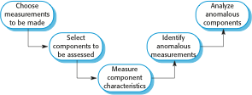
The process of product measurement

Slide 48
Measurement surprises
Reducing the number of faults in a program leads to an increased number of help desk calls
  The program is now thought of as more reliable and so has a wider more diverse market. The percentage of users who call the help desk may have decreased but the total may increase;
  A more reliable system is used in a different way from a system where users work around the faults. This leads to more help desk calls.

Slide 50
Software Quality
Different people understand different meanings of quality like:
conformance to requirements
fitness for the purpose
level of satisfaction

Slide 51
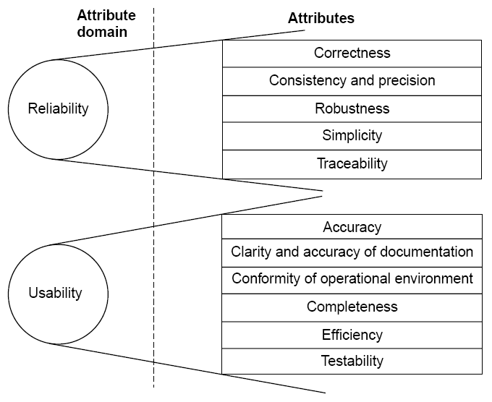

Slide 52
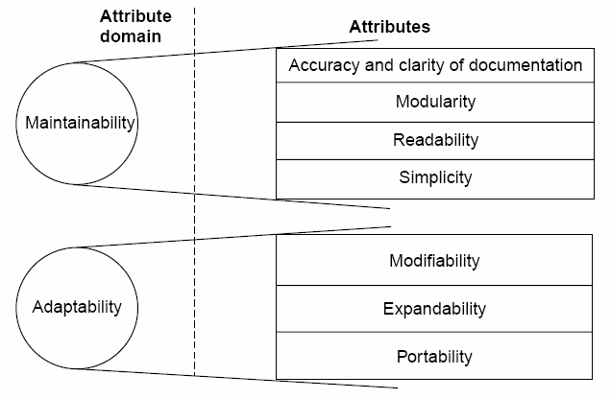
Fig 7.8: Software quality attributes

Slide 53
1 | Reliability | The extent to which a software performs its intended functions without failure.
2 | Correctness | The extent to which a software meets its specifications.
3 | Consistency & precision | The extent to which a software is consistent and give results with precision.
4 | Robustness | The extent to which a software tolerates the unexpected problems.
5 | Simplicity | The extent to which a software is simple in its operations.
6 | Traceability | The extent to which an error is traceable in order to fix it.
7 | Usability | The extent of effort required to learn, operate and understand the functions of the software

Slide 54
8 | Accuracy | Meeting specifications with precision.
9 | Clarity & Accuracy of documentation | The extent to which documents are clearly & accurately written.
10 | Conformity of operational environment | The extent to which a software is in conformity of operational environment.
11 | Completeness | The extent to which a software has specified functions.
12 | Efficiency | The amount of computing resources and code required by software to perform a function.
13 | Testability | The effort required to test a software to ensure that it performs its intended functions.
14 | Maintainability | The effort required to locate and fix an error during maintenance phase.

Slide 55
15 | Modularity | It is the extent of ease to implement, test, debug and maintain the software.
16 | Readability | The extent to which a software is readable in order to understand.
17 | Adaptability | The extent to which a software is adaptable to new platforms & technologies.
18 | Modifiability | The effort required to modify a software during maintenance phase.
19 | Expandability | The extent to which a software is expandable without undesirable side effects.
20 | Portability | The effort required to transfer a program from one platform to another platform.
Table 7.4: Software quality attributes

Slide 56
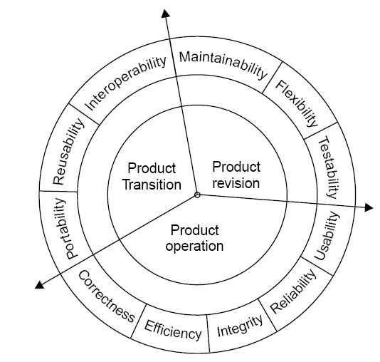
McCall Software Quality Model
Fig 7.9: Software quality factors

Slide 57
i. Product Operation
Factors which are related combined. The factors are:
to the operation
of a product are
Correctness
Efficiency
Integrity
Reliability
Usability
These five factors are related to operational performance, convenience, ease of usage and its correctness. These factors play a very significant role in building customer’s satisfaction.
31

Slide 58
ii. Product Revision
The factors which are required combined and are given below:
for testing
& maintenance are
Maintainability
Flexibility
Testability
These factors pertain to the testing & maintainability of software. They give us idea about ease of maintenance, flexibility and testing effort. Hence, they are combined under the umbrella of product revision.
32

Slide 59
Product Transition
We may have to transfer a product from one platform to an other platform or from one technology to another technology. The factors related to such a transfer are combined and given below:
  Portability
  Reusability
  Interoperability
33

Slide 60
Most of the quality factors are explained in table 7.4. The remaining factors are given in table 7.5.
Sr.No. | Quality Factors | Purpose
1 | Integrity | The extent to which access to software or data by the unauthorized persons can be controlled.
2 | Flexibility | The effort required to modify an operational program.
3 | Reusability | The extent to which a program can be reused in other applications.
4 | Interoperability | The effort required to couple one system with another.
34
Table 7.5: Remaining quality factors (other are in table 7.4)

Slide 61
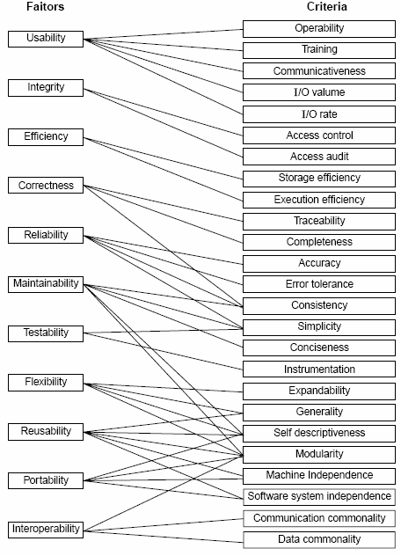
Quality criteria
Fig 7.10: McCall’s quality model

Slide 62
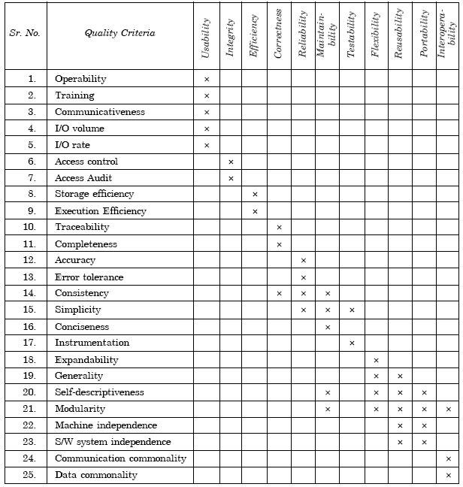
Table 7.5(a): Relation between quality factors and quality criteria

Slide 63
1 | Operability | The ease of operation of the software.
2 | Training | The ease with which new users can use the system.
3 | Communicativeness | The ease with which inputs and outputs can be assimilated.
4 | I/O volume | It is related to the I/O volume.
5 | I/O rate | It is the indication of I/O rate.
6 | Access control | The provisions for control and protection of the software and data.
7 | Access audit | The ease with which software and data can be checked for compliance with standards or other requirements.
8 | Storage efficiency | The run time storage requirements of the software.
9 | Execution efficiency | The run-time efficiency of the software.

Slide 64
10 | Traceability | The ability to link software components to requirements.
11 | Completeness | The degree to which a full implementation of the required functionality has been achieved.
12 | Accuracy | The precision of computations and output.
13 | Error tolerance | The degree to which continuity of operation is ensured under adverse conditions.
14 | Consistency | The use of uniform design and implementation techniques and notations throughout a project.
15 | Simplicity | The ease with which the software can be understood.
16 | Conciseness | The compactness of the source code, in terms of lines of code.
17 | Instrumentation | The degree to which the software provides for measurements of its use or identification of errors.

Slide 65
18 | Expandability | The degree to which storage requirements or software functions can be expanded.
19 | Generability | The breadth of the potential application of software components.
20 | Self- descriptiveness | The degree to which the documents are self explanatory.
21 | Modularity | The provision of highly independent modules.
22 | Machine independence | The degree to which software is dependent on its associated hardware.
23 | Software system independence | The degree to which software is independent of its environment.
24 | Communication commonality | The degree to which standard protocols and interfaces are used.
25 | Data commonality | The use of standard data representations.
Table 7.5 (b): Software quality criteria

Slide 66
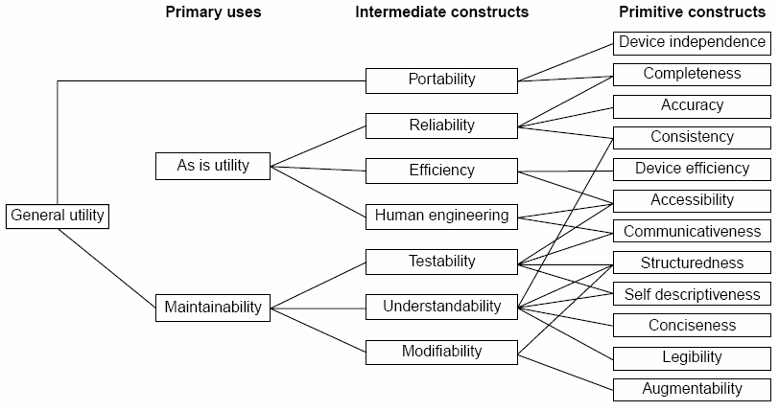
Boehm Software Quality Model
40
Fig.7.11: The Boehm software quality model

Slide 67
ISO 9126
Functionality
Reliability
Usability
Efficiency
Maintainability
Portability

Slide 68
Characteristic/ Attribute | Short Description of the Characteristics and the concerns Addressed by Attributes
Functionality | Characteristics relating to achievement of the basic purpose for which the software is being engineered
Suitability | The presence and appropriateness of a set of functions for specified tasks
Accuracy | The provision of right or agreed results or effects
Interoperability | Software’s ability to interact with specified systems
Security | Ability to prevent unauthorized access, whether accidental or deliberate, to program and data.
Reliability | Characteristics relating to capability of software to maintain its level of performance under stated conditions for a stated period of time
Maturity | Attributes of software that bear on the frequency of failure by faults in the software

Slide 69
Fault tolerance | Ability to maintain a specified level of performance in cases of software faults or unexpected inputs
Recoverability | Capability and effort needed to reestablish level of performance and recover affected data after possible failure.
Usability | Characteristics relating to the effort needed for use, and on the individual assessment of such use, by a stated implied set of users.
Understandability | The effort required for a user to recognize the logical concept and its applicability.
Learnability | The effort required for a user to learn its application, operation, input and output.
Operability | The ease of operation and control by users.
Efficiency | Characteristic related to the relationship between the level of performance of the software and the amount of resources used, under stated conditions.

Slide 70
Time behavior | The speed of response and processing times and throughout rates in performing its function.
Resource behavior | The amount of resources used and the duration of such use in performing its function.
Maintainability | Characteristics related to the effort needed to make modifications, including corrections, improvements or adaptation of software to changes in environment, requirements and functions specifications.
Analyzability | The effort needed for diagnosis of deficiencies or causes of failures, or for identification of parts to be modified.
Changeability | The effort needed for modification, fault removal or for environmental change.
Stability | The risk of unexpected effect of modifications.
Testability | The effort needed for validating the modified software.

Slide 71
Portability | Characteristics related to the ability to transfer the software from one organization or hardware or software environment to another.
Adaptability | The opportunity for its adaptation to different specified environments.
Installability | The effort needed to install the software in a specified environment.
Conformance | The extent to which it adheres to standards or conventions relating to portability.
Replaceability | The opportunity and effort of using it in the place of other software in a particular environment.
Table 7.6: Software quality characteristics and attributes – The ISO 9126 view

Slide 72
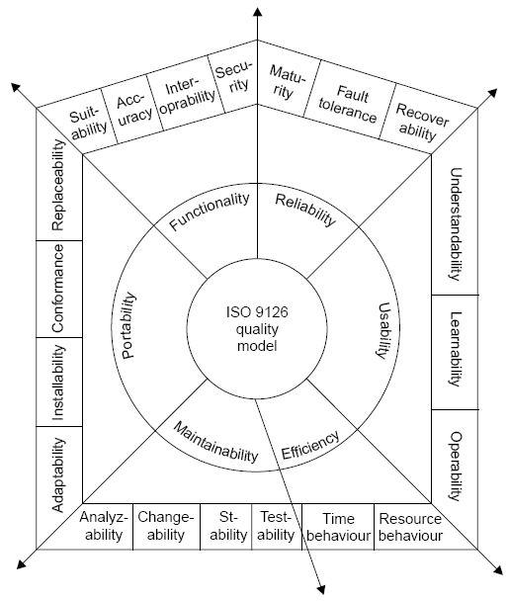
Fig.7.12: ISO 9126 quality model

