Slide 1
Assume that we first observe evidence E₃. The expert system computes the posterior probabilities for all hypotheses as

Slide 2
Thus,

Slide 3
Suppose now that we observe evidence E₁. The posterior probabilities are calculated as
Hence,
Hypothesis H₂ has now become the most likely one.

Slide 4
Apply the depth first search algorithm on the following graph, where the start state is (A) and the desired goal state is (G)
A
B
C
D
E
F
G
H
I
J

Slide 5
A
Iteration | X | Open | Closed
0
-
[A]
[]
1
A
[BCD]
[A]
B
C
D
2
B
[EFCD]
[BA]
3
E
[HIFCD]
[EBA]
4
H
[IFCD]
[HEBA]
E
F
G
5
I
[FCD]
[IHEBA]
6
F
[JCD]
[FIHEBA]
7
J
[CD]
[JFIHEBA]
H
I
J
8
C
[GD]
[CJFIHEBA]
9
G
G is the goal

Slide 6
Apply the Breadth first search algorithm on the following graph, where the start state is (A) and the desired goal state is (G)
A
B
C
D
E
F
G
H
I
J

Slide 7
A
Iteration | X | Open | Closed
0
-
[A]
[]
1
A
[BCD]
[A]
B
C
D
2
B
[CDEF]
[BA]
3
C
[DEFG]
[CBA]
4
D
[EFG]
[DCBA]
E
F
G
5
E
[FGHI]
[EDCBA]
6
F
[GHIJ]
[FEDCBA]
7
G
G is the goal
H
I
J

Slide 8
Apply the BackTrack search algorithm on the following graph, where the start state is (A) and the desired goal state is (G)
A
B
C
D
E
F
G
H
I
J

Slide 9
الالجوزيم هنا ليه طريقين
أولا: ان Node ليها children فكدا هيضيفها في SL ويضيف ال children بتوعها في NSL وال DE زي ما هي هسيبها
ثانيا: ان Node دي ملهاش children فكدا هيكرر مجموعه من الخطوات تحت شرط ان CS تساوي اول عنصر ف SL فكدا هضيف ال node دي في DE وهحذف اول عنصر في SL و NSL وهاخد اول عنصر ف NSL وأحطه في CS

Slide 10
Iteration | CS | SL | NSL | DE
0
A
[A]
[A]
[]
A
1
B
[BA]
[BCDA]
[]
2
E
[EBA]
[EFBCDA]
[]
3
H
[HEBA]
[HIEFBCDA]
[]
I
[EBA]
[IEFBCDA]
[H]
B
C
D
4
I
[IEBA]
[IEFBCDA]
[H]
E
[EBA]
[EFBCDA]
[IH]
F
[BA]
[FBCDA]
[EIH]
E
F
G
5
F
[FBA]
[FBCDA]
[EIH]
6
J
[JFBA]
[JFBCDA]
[EIH]
F
[FBA]
[FBCDA]
[JEIH]
[FJEIH]
H
I
J
B
[BA]
[BCDA]
C
[A]
[CDA]
[BJEIH]
7
C
[CA]
[CDA]
[BJEIH]
8
G
[GCA]
[GCDA]
[BJEIH]
9
G is the goal, path = GCA
Notes:
Sl دي هي state liste بخزن فيها كل state اللي بمر بيها
NSL بخزن فيها ال children بتاع النود الفرق بينه وبين open ان مش بشيل العنصر هنا
DE بحط فيها العناصر اللي مش ليها childe او بمر عليها اكتر من مره

Slide 11
Forward chaining

Slide 12
Backward chaining

Slide 13
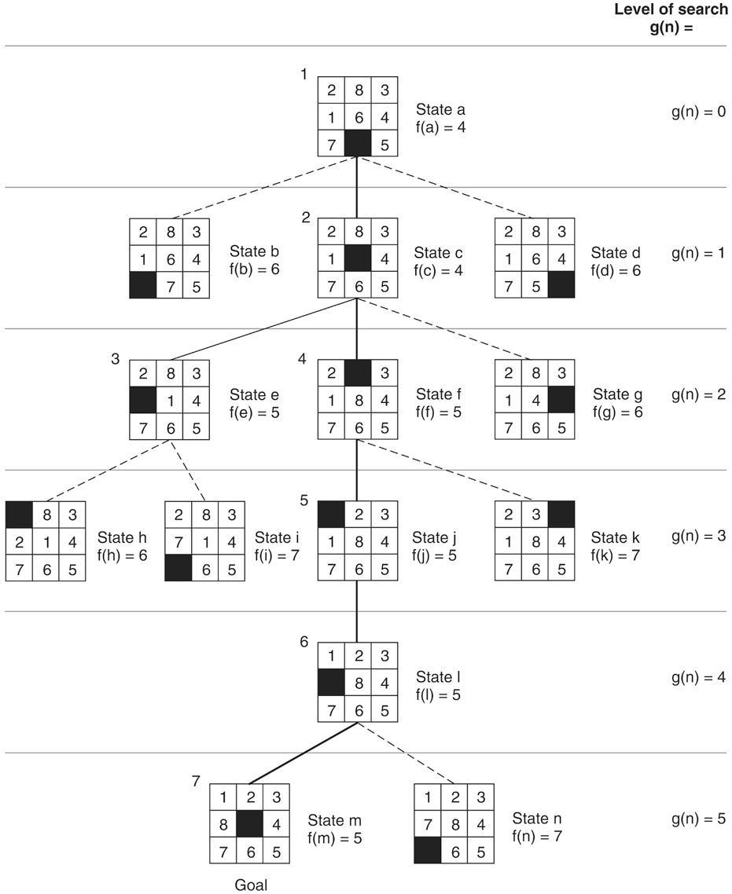

Slide 14
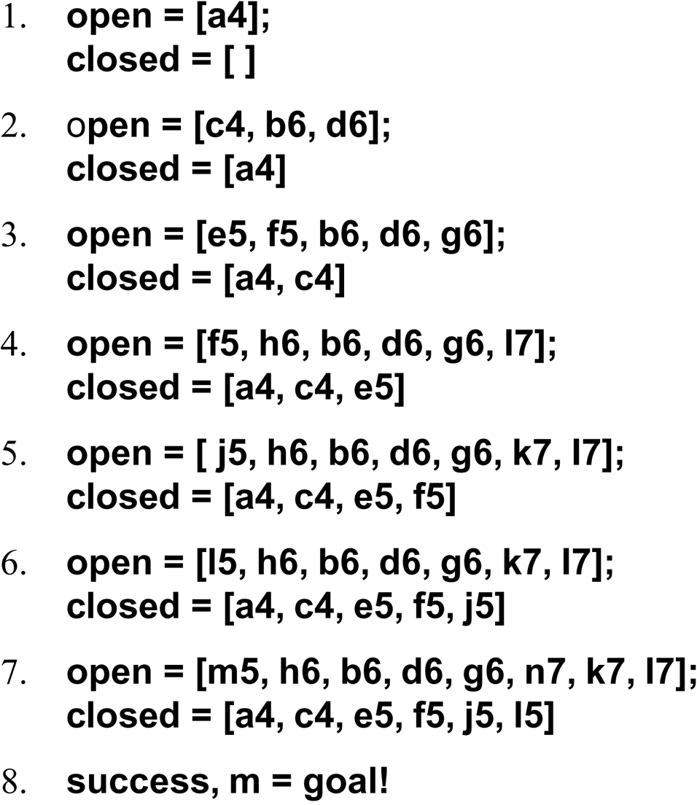
The successive stages of open and closed that generate this graph are:

Slide 15
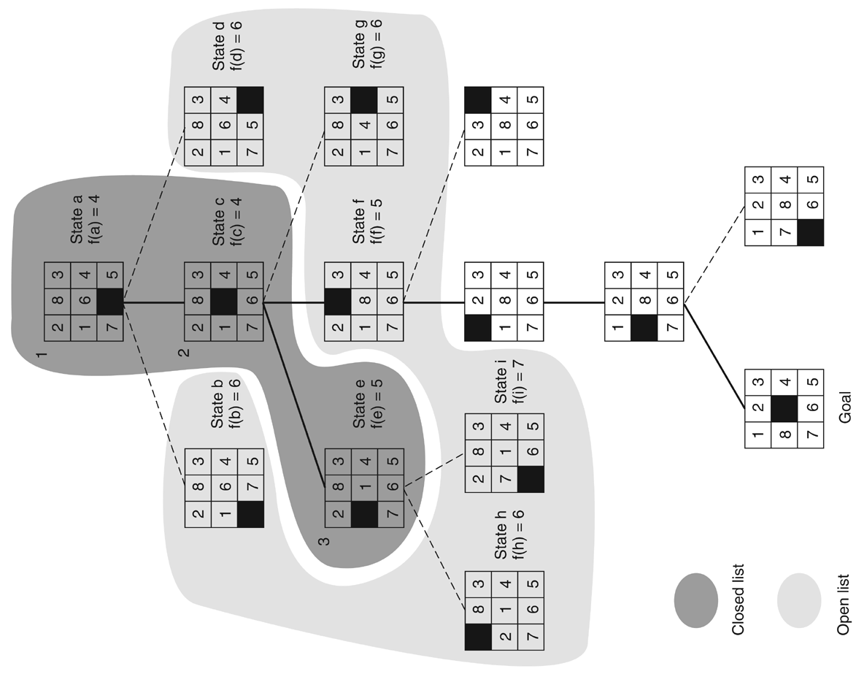
Figure 4.11: open and closed as they appear after the third iteration of heuristic search.

Slide 16
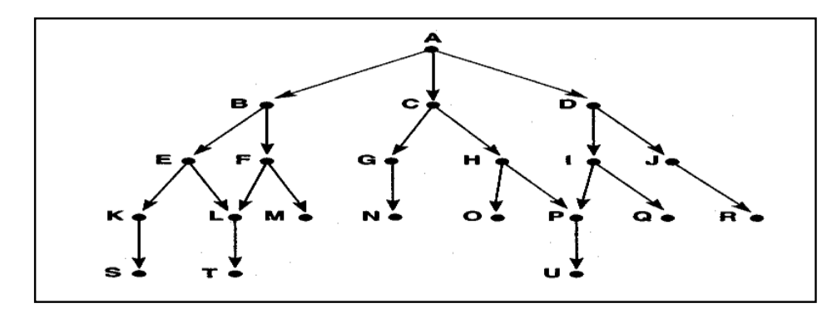

Slide 17
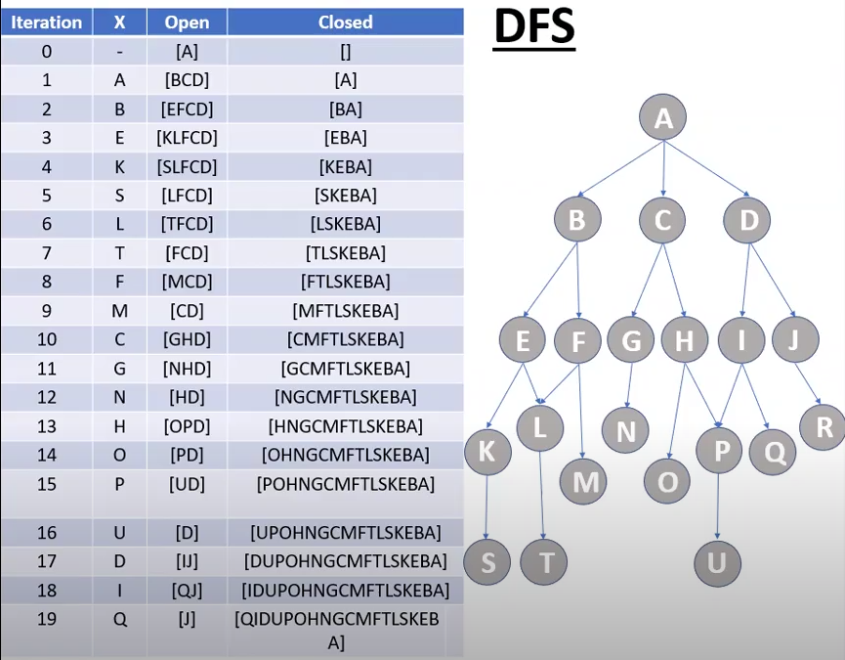

Slide 18
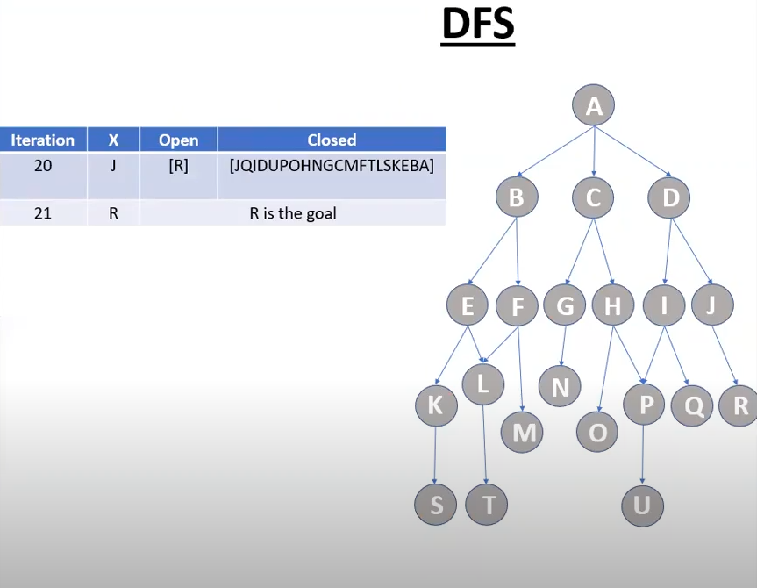

Slide 19
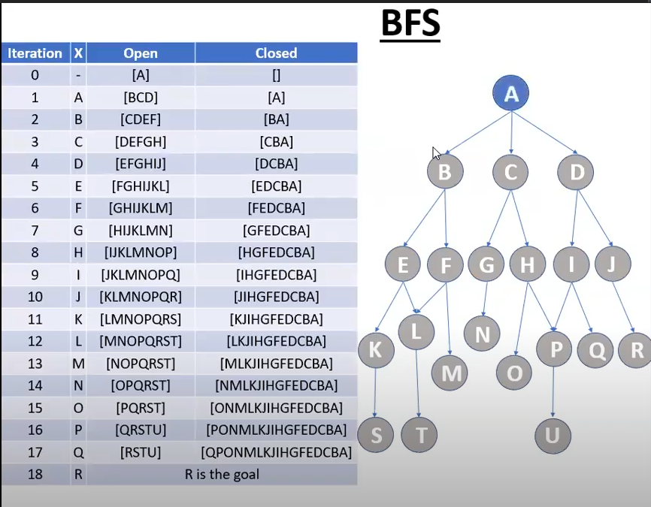

Slide 20
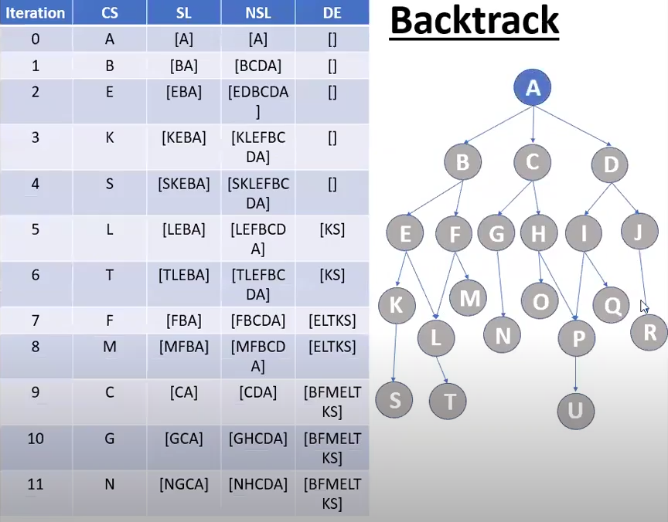

Slide 21
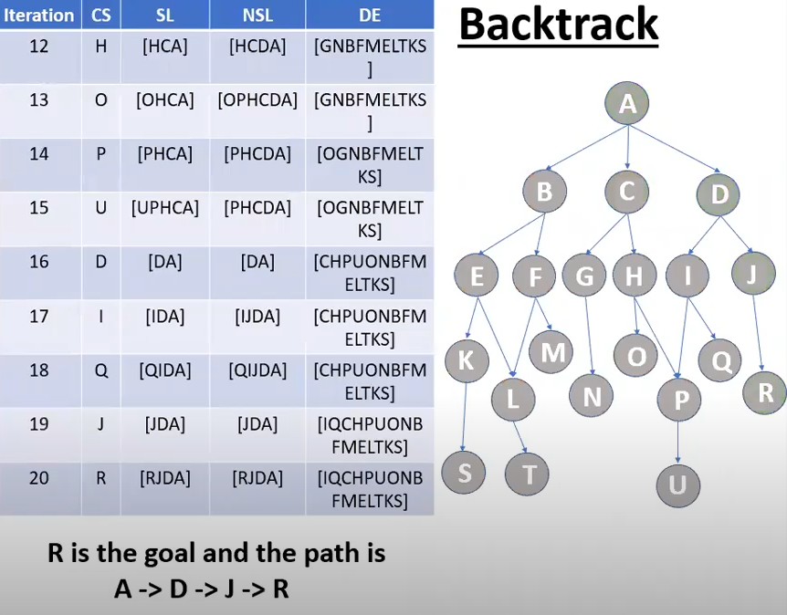

Slide 22
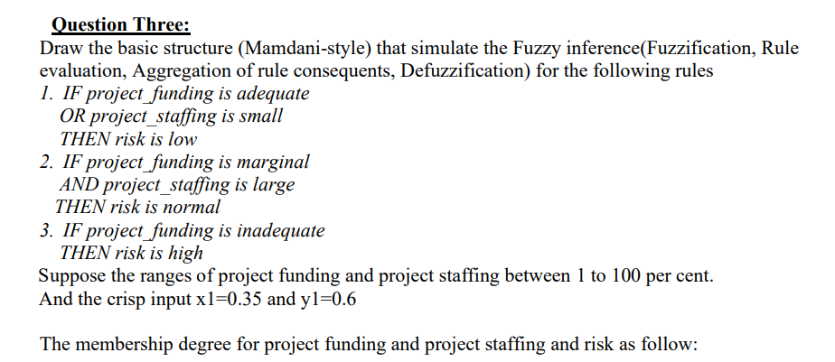

Slide 23
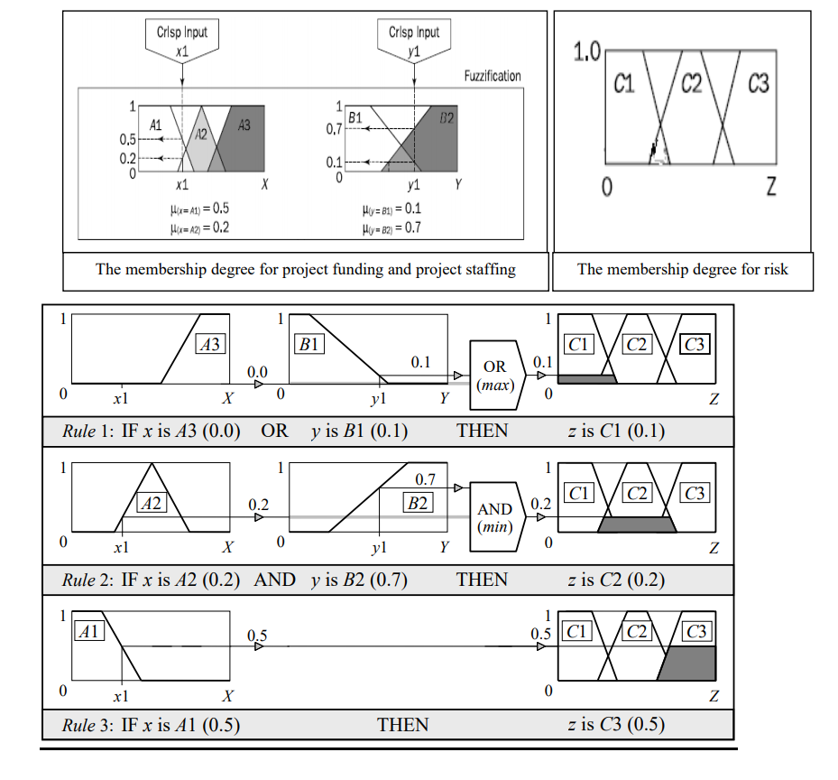

Slide 24
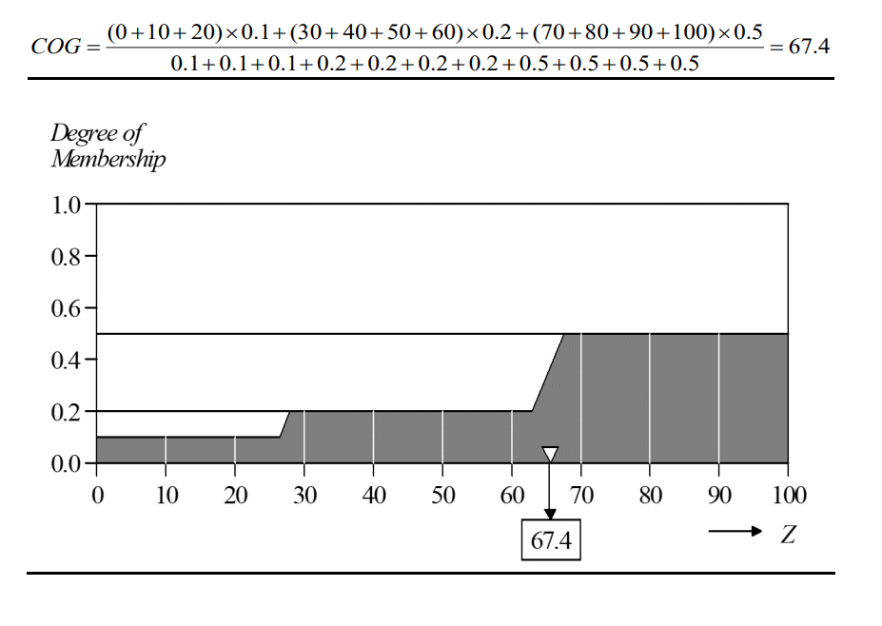

Slide 25
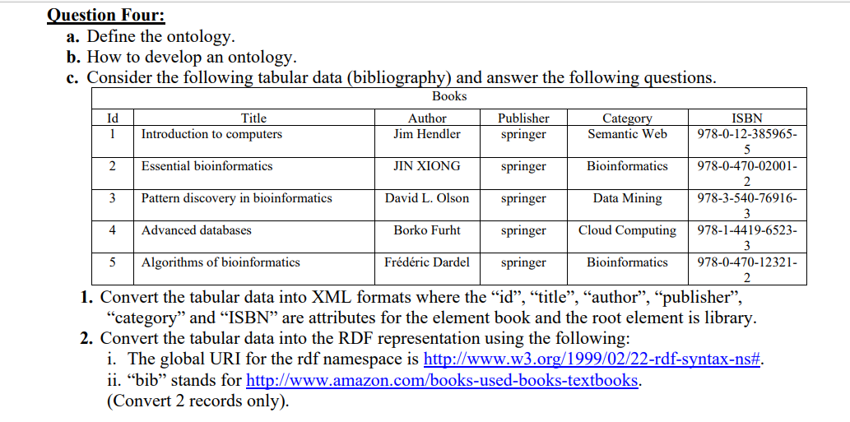

Slide 26
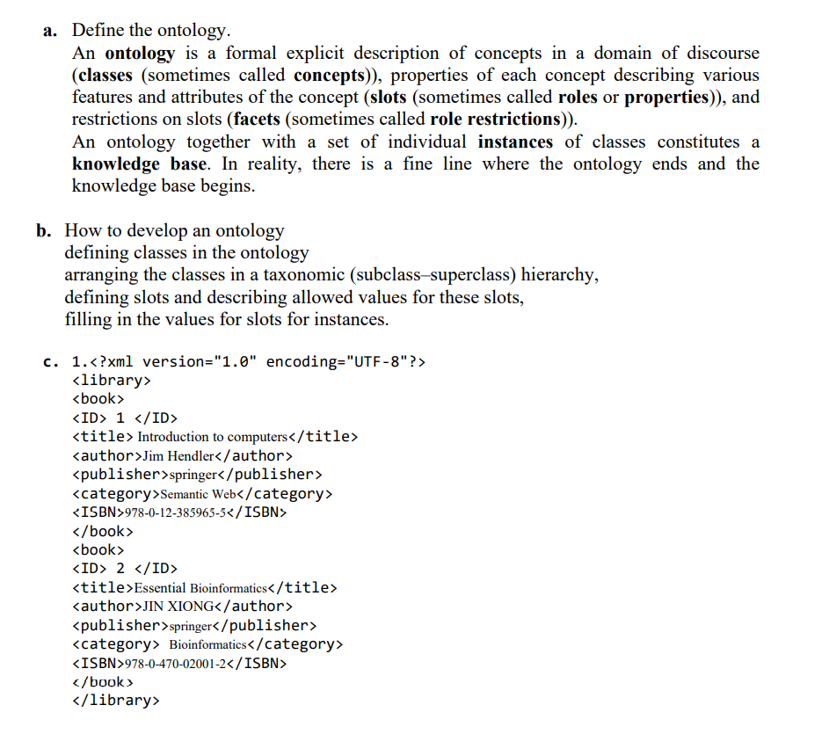

Slide 27
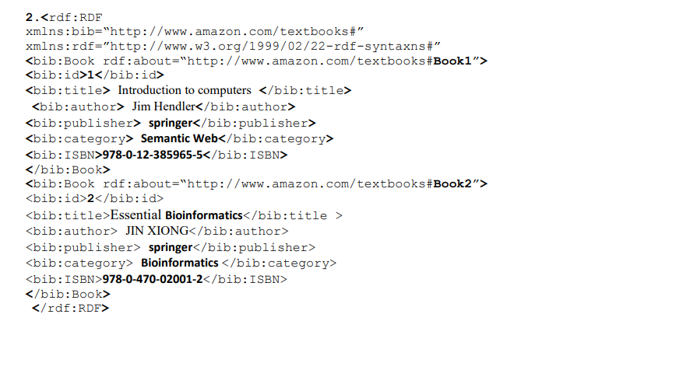

Slide 28
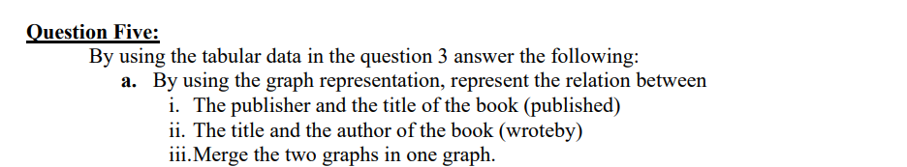
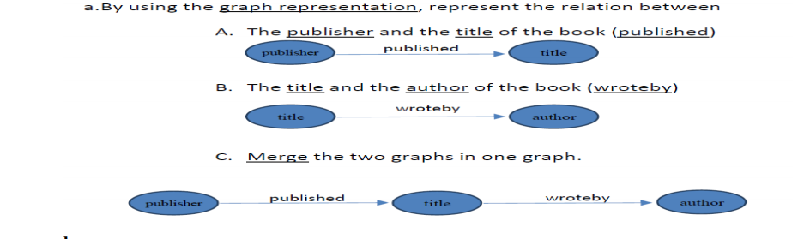

Slide 29
