Slide 1
Decision Support and Business Intelligence Systems
Chapter 1:
Decision Support Systems and Business Intelligence

Slide 2
Learning Objectives
Understand today's turbulent business environment and describe how organizations survive and even excel in such an environment (solving problems and exploiting opportunities)
Understand the need for computerized support of managerial decision making
Understand an early framework for managerial decision making
Learn the conceptual foundations of the decision support systems (DSS)

Slide 3
Learning Objectives – cont.
Describe the business intelligence (BI) methodology and concepts and relate them to DSS
Describe the concept of work systems and its relationship to decision support
List the major tools of computerized decision support
Understand the major issues in implementing computerized support systems

Slide 4
Chapter 1
Management Support Systems:
An Overview
Turban, Aronson, and Liang Decision Support Systems and Intelligent Systems, Seventh Edition
© 2005 Prentice Hall, Decision Support Systems and Intelligent Systems, 7th Edition, Turban, Aronson, and Liang
1-<number>

Slide 5
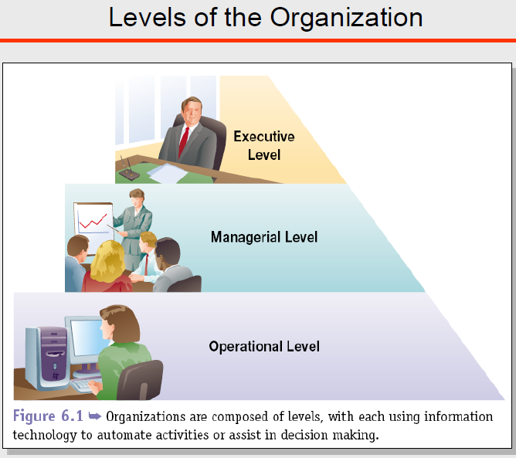
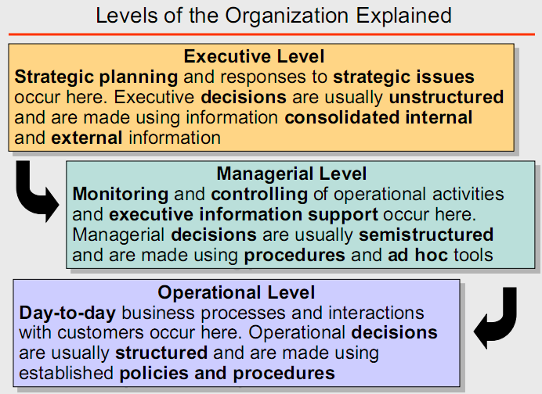
1-<number>

Slide 6
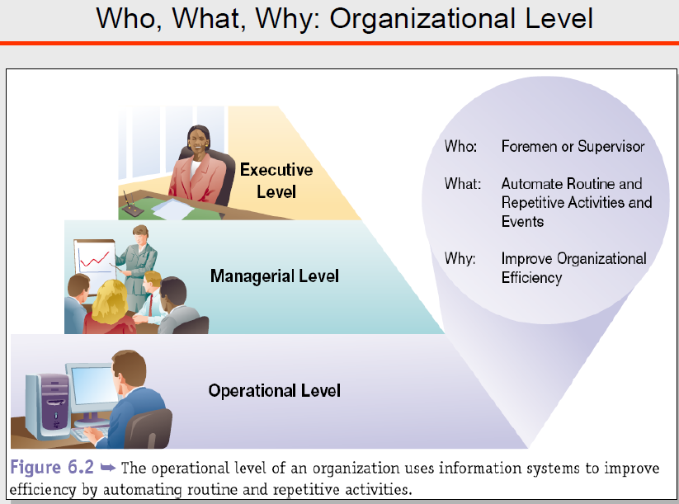
TPSs are special class of information systems designed to process business events and transactions. Contoh : Payroll System
TPS : Payroll System

Slide 7
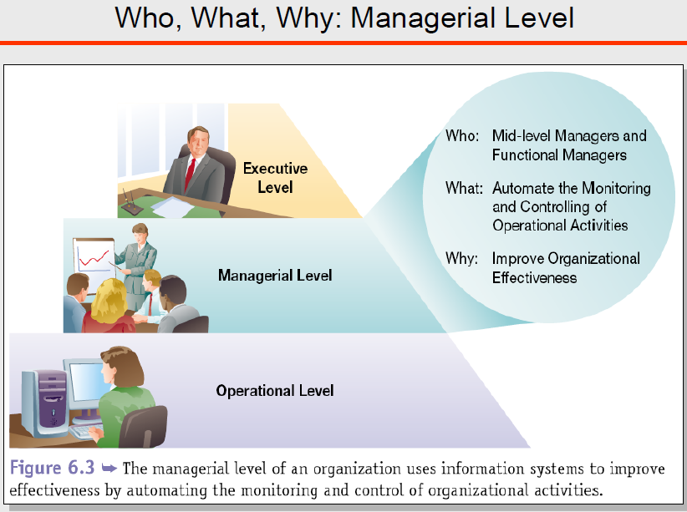
MISs are used by managerial employees to support recurring decision making in managing a function or the entire business
MIS

Slide 8
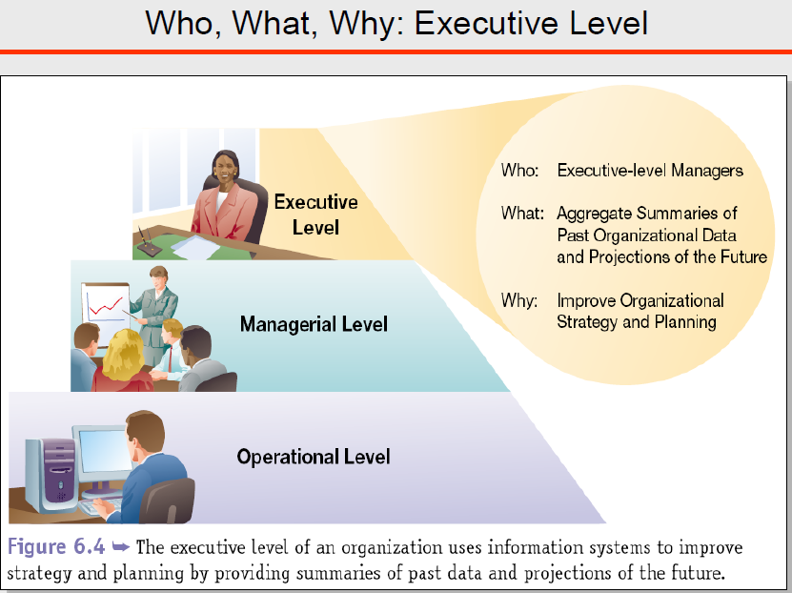
EISs (=Executive Support Systems/ESS) are special purpose IS to support executive decision-making.
EIS

Slide 9
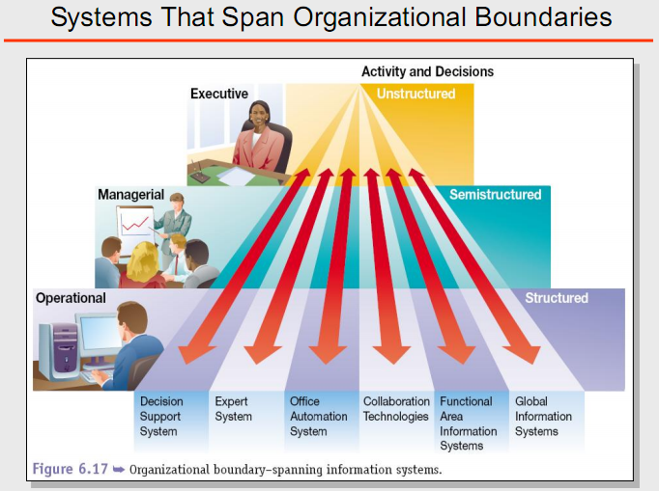


Slide 10
Opening Vignette:
“Norfolk Southern Uses BI for Decision Support to Reach Success”
Company background
Problem
Proposed solution
Results
Answer and discuss the case questions
Notes:
Vignette:مقاله
Norfolk Southern has always used a variety of sophisticated systems to run its business.
Becoming a scheduled railroad, however. requin:-d new systems that would first use statistical
nxxlels to determine the best routes and connections to optimize railroad performance, and then
apply the nxxlels to create the plan that would actually run the railroad operations. These new
systems wen:- called TOP, shon for Thoroughbred Operating Plan: TOP was deployn:l in 2002
Today, the Norfolk Southern dam warehouse has grown to a 6-terabyte system that manages
an extensive amount of infonnation about the company's vast network of railroads and shipping
se!Vices. Norfolk Southern uses the data warehouse to analyze trends. develop forecasting
schedules, archive records, and facilitate customer self-service. The dam warehouse provides
information to over 3.000 employees and over 14,000 external customers and stakeholders.
Norl'olk Southern was the first railroad to offer self-se!Vice business intelligence. and its
innovation is sening an example that OI:her railroads have followed. The company was also one
of the first railroads to provide a large variety of historical dam to external customers.

Slide 11
Changing Business Environment
Companies are moving aggressively to computerized support of their operations => Business Intelligence
Business Pressures–Responses–Support Model
  Business pressures result of today's competitive business climate
  Responses to counter the pressures
  Support to better facilitate the process

Slide 12
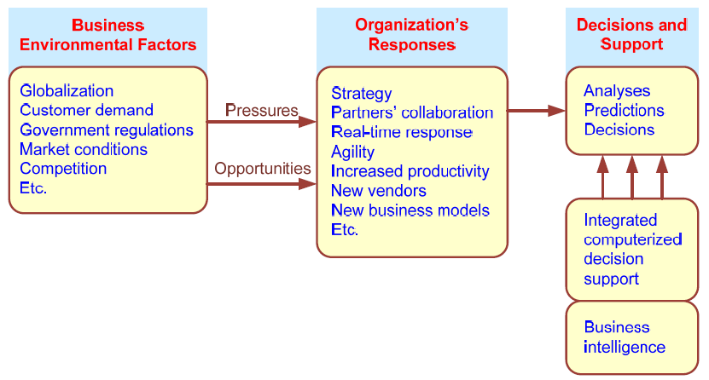
Business Pressures–Responses–Support Model

Slide 13
The Business Environment
The environment in which organizations operate today is becoming more and more complex, creating:
  opportunities, and
  problems
  Example: globalization
Business environment factors:
  markets, consumer demands, technology, and societal…

Slide 14
Business Environment Factors
FACTOR DESCRIPTION
Markets Strong competition
Expanding global markets
Blooming electronic markets on the Internet
Innovative marketing methods
Opportunities for outsourcing with IT support
Need for real-time, on-demand transactions
Consumer Desire for customization
demand Desire for quality, diversity of products, and speed of delivery
Customers getting powerful and less loyal
Technology More innovations, new products, and new services
Increasing obsolescence rate
  Increasing information overload
Social networking, Web 2.0 and beyond
Societal Growing government regulations and deregulation
Workforce more diversified, older, and composed of more women Prime concerns of homeland security and terrorist attacks
Necessity of Sarbanes-Oxley Act and other reporting-related legislation Increasing social responsibility of companies
Greater emphasis on sustainability
Notes:
Necessity of Sarbanes-Oxley Act and other reporting-related legislationقوانين الابلاغ

Slide 15
Organizational Responses
Be Reactive, Anticipative, Adaptive, and Proactive
Managers may take actions, such as
  Employ strategic planning
  Use new and innovative business models
  Restructure business processes
  Participate in business alliances
  Improve corporate information systems
  Improve partnership relationships
  Encourage innovation and creativity …cont…>
Notes:
Be Reactive, Anticipative, Adaptive, and Proactive
يكون رد الفعل، التوقعي، التكيف، والاستباقية
Participate in business alliances
تحالفات مؤسسية

Slide 16
Managers actions, continued
  Improve customer service and relationships
  Move to electronic commerce (e-commerce)
  Move to make-to-order production and on-demand manufacturing and services
  Use new IT to improve communication, data access (discovery of information), and collaboration
  Respond quickly to competitors' actions (e.g., in pricing, promotions, new products and services)
  Automate many tasks of white-collar employees
  Automate certain decision processes
  Improve decision making by employing analytics

Slide 17
Closing the Strategy Gap
One of the major objectives of computerized decision support is to facilitate closing the gap between the current performance of an organization and its desired performance, as expressed in its mission, objectives, and goals, and the strategy to achieve them

Slide 18
Managerial Decision Making
Management is a process by which organizational goals are achieved by using resources
  Inputs: resources
  Output: attainment of goals
  Measure of success: outputs / inputs
Management ≅ Decision Making
Decision making: selecting the best solution from two or more alternatives

Slide 19
Mintzberg's 10 Managerial Roles
Interpersonal
1. Figurehead
2. Leader
3. Liaison
Informational
4. Monitor
5. Disseminator
6. Spokesperson
Decisional
7. Entrepreneur
8. Disturbance handler
9. Resource allocator
10. Negotiator

Slide 20
Decision Making Process
Managers usually make decisions by following a four-step process (a.k.a. the scientific approach)
  Define the problem (or opportunity)
  Construct a model that describes the real-world problem
  Identify possible solutions to the modeled problem and evaluate the solutions
  Compare, choose, and recommend a potential solution to the problem

Slide 21
Decision making is difficult, because
Technology, information systems, advanced search engines, and globalization result in more and more alternatives from which to choose
Government regulations and the need for compliance, political instability and terrorism, competition, and changing consumer demands produce more uncertainty, making it more difficult to predict consequences and the future
Other factors are the need to make rapid decisions, the frequent and unpredictable changes that make trial-and-error learning difficult, and the potential costs of making mistakes

Slide 22
Why Use Computerized DSS
Computerized DSS can facilitate decision via:
  Speedy computations
  Improved communication and collaboration
  Increased productivity of group members
  Improved data management
  Overcoming cognitive limits
  Quality support; agility support
  Using Web; anywhere, anytime support

Slide 23
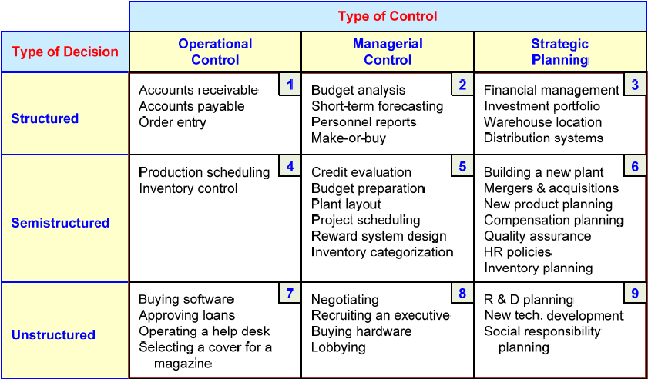
A Decision Support Framework
(by Gory and Scott-Morten, 1971)

Slide 24
A Decision Support Framework – cont.
Degree of Structuredness (Simon, 1977)
  Decision are classified as
    Highly structured (a.k.a. programmed)
    Semi-structured
    Highly unstructured (i.e., non-programmed)
Types of Control (Anthony, 1965)
  Strategic planning (top-level, long-range)
  Management control (tactical planning)
  Operational control

Slide 25
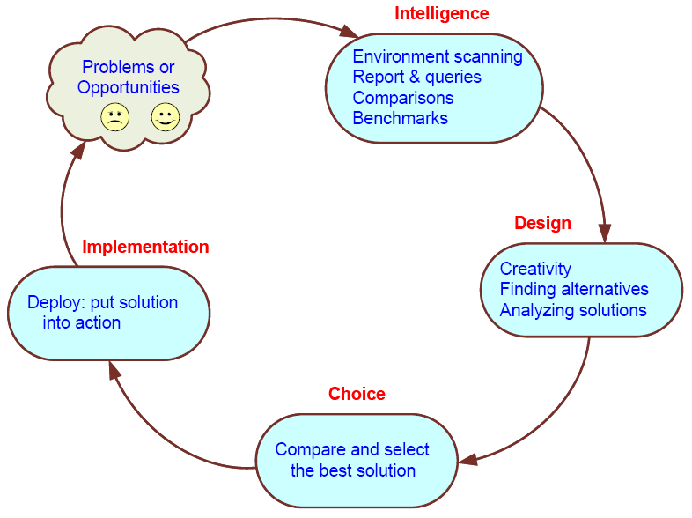
Simon’s Decision-Making Process

Slide 26
Computer Support for Structured Decisions
Structured problems: encountered repeatedly, have a high level of structure
It is possible to abstract, analyze, and classify them into specific categories
  e.g., make-or-buy decisions, capital budgeting, resource allocation, distribution, procurement, and inventory control
For each category a solution approach is developed => Management Science

Slide 27
Management Science Approach
Also referred to as Operation Research
In solving problems, managers should follow the five-step MS approach
  Define the problem
  Classify the problem into a standard category (*)
  Construct a model that describes the real-world problem
  Identify possible solutions to the modeled problem and evaluate the solutions
  Compare, choose, and recommend a potential solution to the problem

Slide 28
Automated Decision Making
A relatively new approach to supporting decision making
Applies to highly structures decisions
Automated decision systems (ADS)
(or decision automation systems)
An ADS is a rule-based system that provides a solution to a repetitive managerial problem in a specific area
  e.g., simple-loan approval system

Slide 29
Automated Decision Making
ADS initially appeared in the airline industry called revenue (or yield) management (or revenue optimization) systems
  dynamically price tickets based on actual demand
Today, many service industries use similar pricing models
ADS are driven by business rules!

Slide 30
Computer Support for
Unstructured Decisions
Unstructured problems can be only partially supported by standard computerized quantitative methods
They often require customized solutions
They benefit from data and information
Intuition and judgment may play a role
Computerized communication and collaboration technologies along with knowledge management is often used

Slide 31
Computer Support for
Semi-structured Problems
Solving semi-structured problems may involve a combination of standard solution procedures and human judgment
MS handles the structured parts while DSS deals with the unstructured parts
With proper data and information, a range of alternative solutions, along with their potential impacts

Slide 32
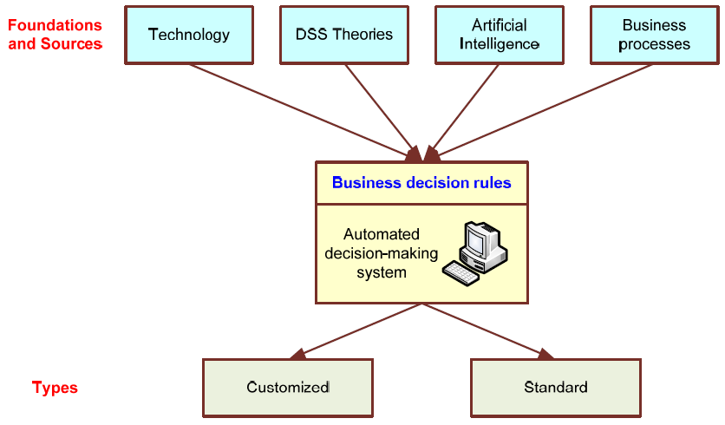
Automated Decision-Making Framework

Slide 33
Concept of Decision Support Systems
Classical Definitions of DSS
Interactive computer-based systems, which help decision makers utilize data and models to solve unstructured problems" - Gorry and Scott-Morton, 1971
Decision support systems couple the intellectual resources of individuals with the capabilities of the computer to improve the quality of decisions. It is a computer-based support system for management decision makers who deal with semistructured problems - Keen and Scott-Morton, 1978

Slide 34
DSS as an Umbrella Term
The term DSS can be used as an umbrella term to describe any computerized system that supports decision making in an organization
  E.g., an organization wide knowledge management system; a decision support system specific to an organizational function (marketing, finance, accounting, manufacturing, planning, SCM, etc.)

Slide 35
DSS as a Specific Application
In a narrow sense DSS refers to a process for building customized applications for unstructured or semi-structured problems
Components of the DSS Architecture
  Data, Model, Knowledge/Intelligence, User, Interface (API and/or user interface)
  DSS often is created by putting together loosely coupled instances of these components

Slide 36
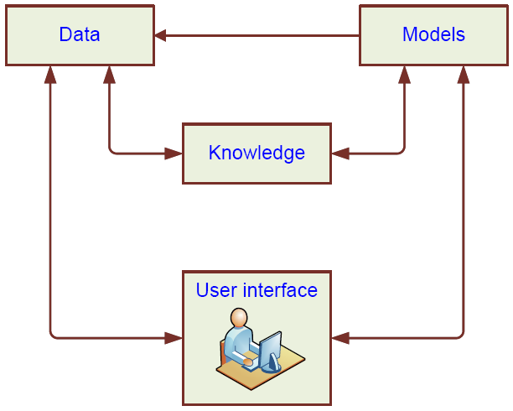
High-Level Architecture of a DSS

Slide 37
Types of DSS
Evolution of DSS into Business Intelligence
  Use of DSS moved from specialist to managers, and then whomever, whenever, wherever
  Enabling tools like OLAP, data warehousing, data mining, intelligent systems, delivered via Web technology have collectively led to the term “business intelligence” (BI) and “business analytics”
Notes:
OLAP (Online Analytical Processing) is the technology behind many Business Intelligence (BI) applications. OLAP is a powerful technology for data discovery, including capabilities for limitless report viewing, complex analytical calculations, and predictive “what if” scenario (budget, forecast) planning.

Slide 38
Business Intelligence (BI)
BI is an umbrella term that combines architectures, tools, databases, analytical tools, applications, and methodologies
Like DSS, BI a content-free expression, so it means different things to different people
BI's major objective is to enable easy access to data (and models) to provide business managers with the ability to conduct analysis
BI helps transform data, to information (and knowledge), to decisions and finally to action

Slide 39
A Brief History of BI
The term BI was coined by the Gartner Group in the mid-1990s
However, the concept is much older
  1970s - MIS reporting - static/periodic reports
  1980s - Executive Information Systems (EIS)
  1990s - OLAP, dynamic, multidimensional, ad-hoc reporting -> coining of the term “BI”
  2005+ Inclusion of AI and Data/Text Mining capabilities; Web-based Portals/Dashboards
  2010s - yet to be seen

Slide 40
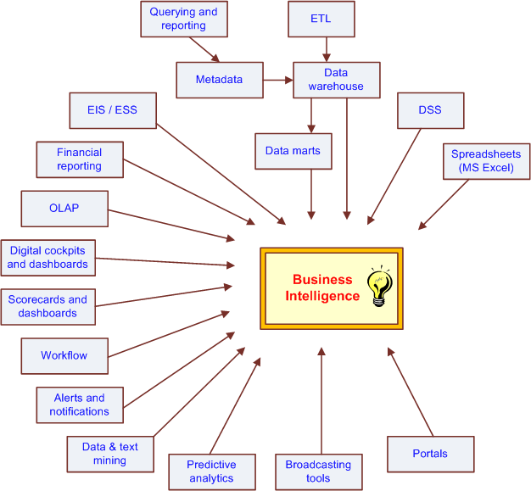
The Evolution of BI Capabilities

Slide 41
The Architecture of BI
A BI system has four major components
  a data warehouse, with its source data
  business analytics, a collection of tools for manipulating, mining, and analyzing the data in the data warehouse;
  business performance management (BPM) for monitoring and analyzing performance
  a user interface (e.g., dashboard)
Notes:
Business analytics: histrorical and draw future trends
National Australia Bank uses dut.1 mining to aid its predictive marketing. The tools ure used 10 extract and analyze data stored in the bank's Orade database. Specific applications focus on assessing how competltors' initiath-es are :Iffectlng the ba nk's bouom line.
The data mining tools are used to generate market analysis models from historical d ata. The bank considers initiatives to be crucial 10 maintaining an edge in the increasingly compctiti\'e financial services marketplace.

Slide 42
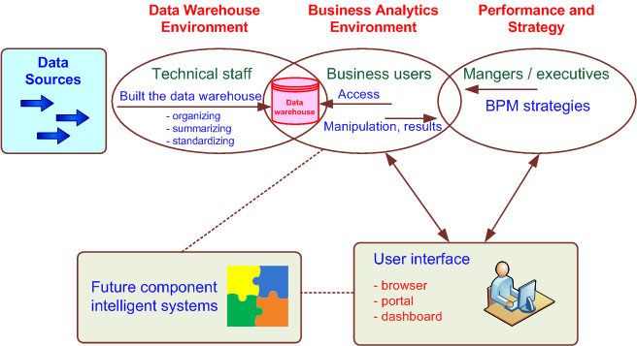
A High-Level Architecture of BI
Notes:
Performance and strategy :interface to assess models of analytics

Slide 43
Components in a BI Architecture
The data warehouse is a large repository of well-organized historical data
Business analytics are the tools that allow transformation of data into information and knowledge
Business performance management (BPM) allows monitoring, measuring, and comparing key performance indicators
User interface (e.g., dashboards) allows access and easy manipulation of other BI components

Slide 44
Styles of BI
MicroStrategy, Corp. distinguishes five styles of BI and offers tools for each
  report delivery and alerting
  enterprise reporting (using dashboards and scorecards)
  cube analysis (also known as slice-and-dice analysis)
  ad-hoc queries
  statistics and data mining

Slide 45
The Benefits of BI
The ability to provide accurate information when needed, including a real-time view of the corporate performance and its parts
A survey by Thompson (2004)
  Faster, more accurate reporting (81%)
  Improved decision making (78%)
  Improved customer service (56%)
  Increased revenue (49%)
See Table 1.3 for a list of BI analytic applications, the business questions they answer and the business value they bring

Slide 46
The DSS–BI Connection
First, their architectures are very similar because BI evolved from DSS
Second, DSS directly support specific decision making, while BI provides accurate and timely information, and indirectly support decision making
Third, BI has an executive and strategy orientation, especially in its BPM and dashboard components, while DSS, in contrast, is oriented toward analysts

Slide 47
The DSS–BI Connection – cont.
Fourth, most BI systems are constructed with commercially available tools and components, while DSS is often built from scratch
Fifth, DSS methodologies and even some tools were developed mostly in the academic world, while BI methodologies and tools were developed mostly by software companies
Sixth, many of the tools that BI uses are also considered DSS tools (e.g., data mining and predictive analysis are core tools in both)

Slide 48
The DSS–BI Connection – cont.
Although some people equate DSS with BI, these systems are not, at present, the same
  some people believe that DSS is a part of BI—one of its analytical tools
  others think that BI is a special case of DSS that deals mostly with reporting, communication, and collaboration (a form of data-oriented DSS)
  BI is a result of a continuous revolution and, as such, DSS is one of BI's original elements
  In this book, we separate DSS from BI
MSS = BI and/or DSS

Slide 49
A Work System View of Decision Support (Alter, 2004)
drop the word “systems” from DSS
focus on “decision support”
“use of any plausible computerized or noncomputerized means for improving decision making in a particular repetitive or nonrepetitive business situation in a particular organization”
Work system: a system in which human participants and/or machines perform a business process, using information, technology, and other resources, to produce products and/or services for internal or external customers

Slide 50
Elements of a Work System
Business process. Variations in the process rationale, sequence of steps, or methods used for performing particular steps
Participants. Better training, better skills, higher levels of commitment, or better real-time or delayed feedback
Information. Better information quality, information availability, or information presentation
Technology. Better data storage and retrieval, models, algorithms, statistical or graphical capabilities, or computer interaction
-->

Slide 51
Elements of a Work System – cont.
Product and services. Better ways to evaluate potential decisions
Customers. Better ways to involve customers in the decision process and to obtain greater clarity about their needs
Infrastructure. More effective use of shared infrastructure, which might lead to improvements
Environment. Better methods for incorporating concerns from the surrounding environment
Strategy. A fundamentally different operational strategy for the work system

Slide 52
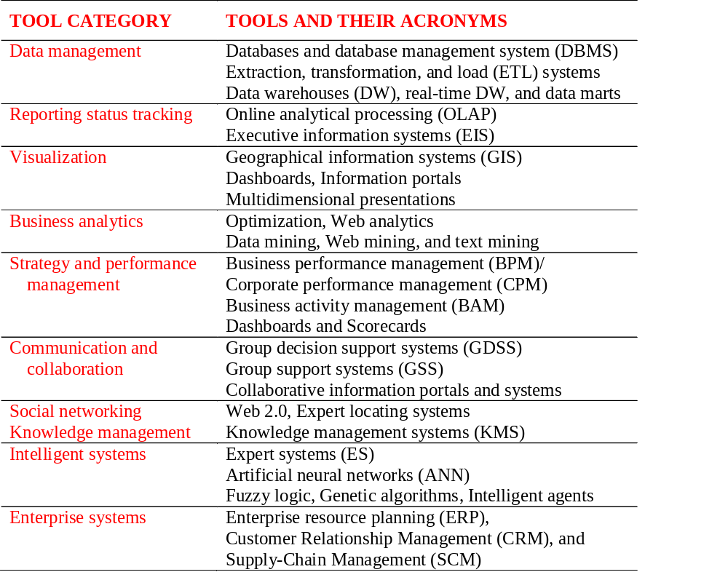
Major Tool Categories for MSS
Source: Table 1.4

Slide 53
Hybrid (Integrated) Support Systems
The objective of computerized decision support, regardless of its name or nature, is to assist management in solving managerial or organizational problems (and assess opportunities and strategies) faster and better than possible without computers
Every type of tool has certain capabilities and limitations. By integrating several tools, we can improve decision support because one tool can provide advantages where another is weak
The trend is therefore towards developing
hybrid (integrated) support system

Slide 54
Hybrid (Integrated) Support Systems
Type of integration
  Use each tool independently to solve different aspects of the problem
  Use several loosely integrated tools. This mainly involves transferring data from one tool to another for further processing
  Use several tightly integrated tools. From the user's standpoint, the tool appears as a unified system
In addition to performing different tasks in the problem-solving process, tools can support each other

Slide 55
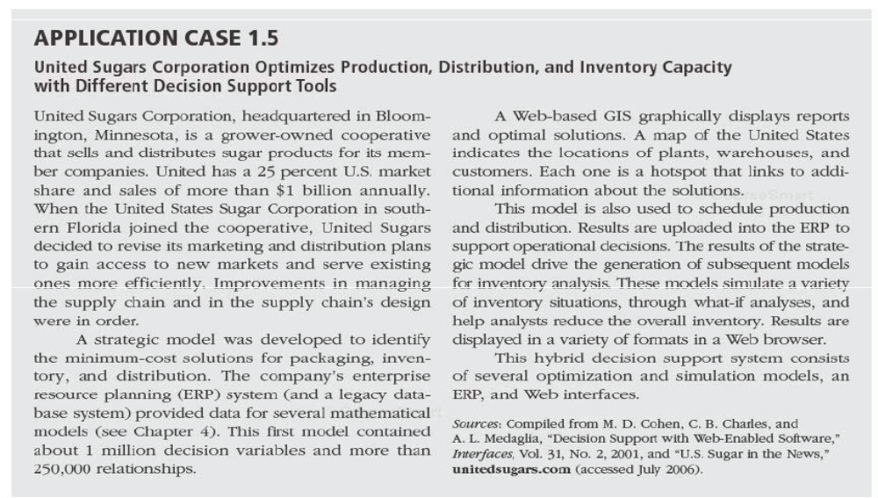
Case on IDSS

Slide 56
Harrah’s Makes a Great Bet Vignette
Data Warehouse
Data Mining
Business Intelligence
Transaction Processing System
Customer Relationship Management
Decision Support System
© 2005 Prentice Hall, Decision Support Systems and Intelligent Systems, 7th Edition, Turban, Aronson, and Liang
1-<number>
Notes:
Gaming is highly competitive and profitable. Many people want to gamble, and every casino wants to attract their business. In the early 1990s, gambling on riverboats and Native American reservations was legalized. Major operators moved into these new markets. Between 1990 and 1997, Harrah's tripled its number of casinos. As the new markets grew more competitive, the business reached the point of diminishing returns. Harrah's early arrival was often usurped by newer, grander, more extravagant casinos nearby. Each Harrah's casino operated and marketed itself independently from the others. The managers of each property felt that they owned certain customers, and customers were treated differently at other Harrah's properties.
Customer service had not changed much since the 1970s. Casino managers had long recognized the importance of building relationships with their most profitable clientele. They reserved star treatment for the high-rollers, but only gave an occasional free drink to the folks playing machines. However, by the end of the 1980s, slot machines surpassed table games as the major casinos' largest source of income. In 1997, executives at Harrah's recognized that devising a means to keep their 25 million slot players loyal to Harrah's was the key to profitability.

Slide 57
End of the Chapter
Questions / Comments…
Notes:
Students should present vodafone case study p.53 next lect

Slide 58

All rights reserved. No part of this publication may be reproduced, stored in a retrieval system, or transmitted, in any form or by any means, electronic, mechanical, photocopying, recording, or otherwise, without the prior written permission of the publisher. Printed in the United States of America.
Copyright © 2011 Pearson Education, Inc.
Publishing as Prentice Hall

