Slide 1


1

Slide 2
Alpha, Beta and Acceptance Testing
The term Acceptance Testing is used when the software is developed for a specific customer. A series of tests are conducted to enable the customer to validate all requirements. These tests are conducted by the end user / customer.
The terms alpha and beta testing are used when the software is developed as a product for anonymous customers.
Alpha Tests are conducted at the developer’s site by some potential customers. These tests are conducted in a controlled environment. Alpha testing may be started when formal testing process is near completion.
Beta Tests are conducted by the customers / end users at their sites. Unlike alpha testing, developer is not present here. Beta testing is conducted in a real environment that cannot be controlled by the developer.
12

Slide 3
Software Testing
Functional Testing
Input domain
Output domain
Input test data
Output test data
System under test
Fig. 3: Black box testing
13

Slide 4
Software Testing
Boundary Value Analysis
Consider a program with two input variables x and y. These input variables have specified boundaries as:
a ≤ x ≤ b
c ≤ y ≤ d
Input domain
d
y
c
a
b
x
Fig.4: Input domain for program having two input variables
14

Slide 5
Software Testing
The boundary value analysis test cases for our program with two inputs variables (x and y) that may have any value from 100 to 300 are: (200,100), (200,101), (200,200), (200,299), (200,300), (100,200), (101,200), (299,200) and
(300,200). This input domain is shown in Fig. 8.5. Each dot represent a test case and inner rectangle is the domain of legitimate inputs. Thus, for a program of n variables, boundary value analysis yield 4n + 1 test cases.
Input domain
400
300
y 200
100
0 100 400
200 300
x
Fig. 5: Input domain of two variables x and y with boundaries [100,300] each
15

Slide 6
Software Testing
Example 8.1
Consider a program for the determination of the nature of roots of a quadratic equation. Its input is a triple of positive integers (say a,b,c) and values may be from interval [0,100]. The program output may have one of the following words.
[Not a quadratic equation; Real roots; Imaginary roots; Equal roots]
Design the boundary value test cases.
16

Slide 7
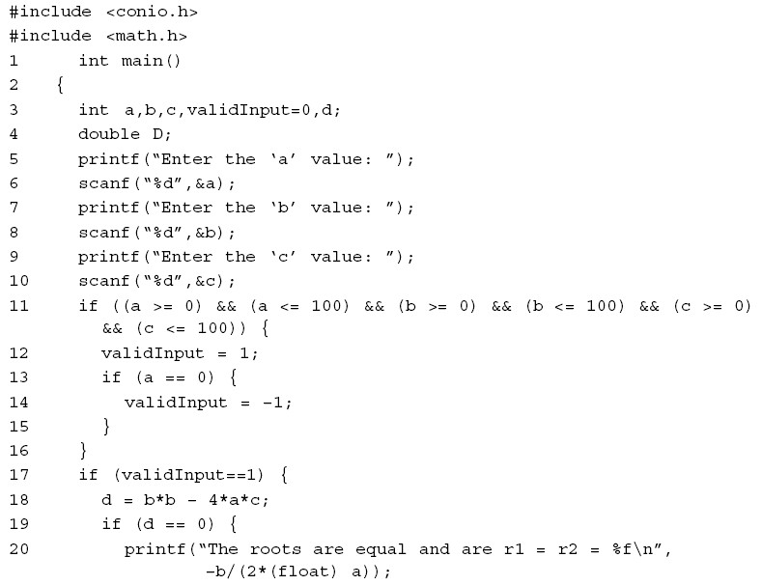
Software Testing

Slide 8
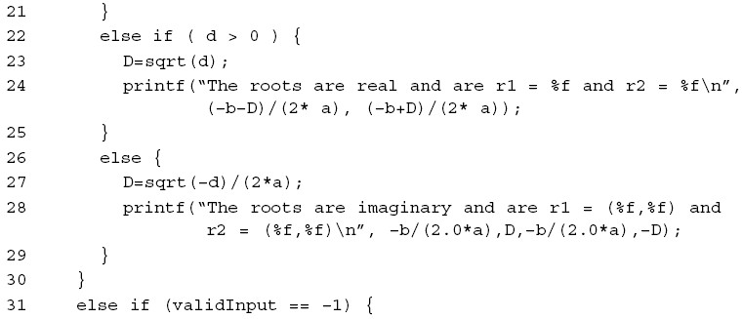
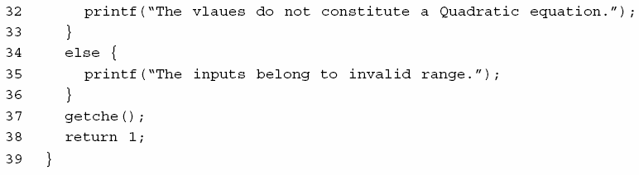
Software Testing
Fig. 19: Code of quadratic equation problem

Slide 9
Software Testing
Solution
Quadratic equation will be of type:
ax²+bx+c=0
Roots are real if (b²-4ac)>0
Roots are imaginary if (b²-4ac)<0
Roots are equal if (b²-4ac)=0
Equation is not quadratic if a=0
17

Slide 10
Software Testing
The boundary value test cases are :
Test Case | a | b | c | Expected output
1 | 0 | 50 | 50 | Not Quadratic
2 | 1 | 50 | 50 | Real Roots
3 | 50 | 50 | 50 | Imaginary Roots
4 | 99 | 50 | 50 | Imaginary Roots
5 | 100 | 50 | 50 | Imaginary Roots
6 | 50 | 0 | 50 | Imaginary Roots
7 | 50 | 1 | 50 | Imaginary Roots
8 | 50 | 99 | 50 | Imaginary Roots
9 | 50 | 100 | 50 | Equal Roots
10 | 50 | 50 | 0 | Real Roots
11 | 50 | 50 | 1 | Real Roots
12 | 50 | 50 | 99 | Imaginary Roots
13 | 50 | 50 | 100 | Imaginary Roots

Slide 11
Software Testing
Example 8.2
Consider a program for determining the Previous date. Its input is a triple of day, month and year with the values in the range
1 ≤ month ≤ 12
1 ≤ day ≤ 31
1900 ≤ year ≤ 2025
The possible outputs would be Previous date or invalid input date. Design the boundary value test cases.
19

Slide 12
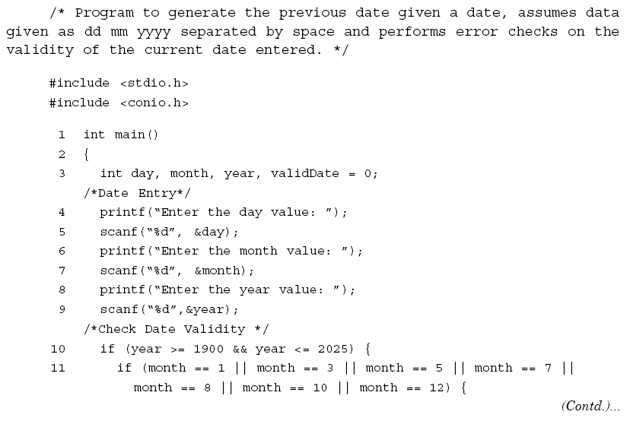
Software Testing

Slide 13
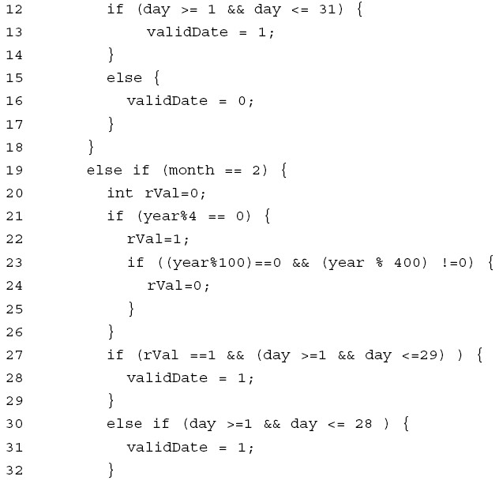
Software Testing

Slide 14
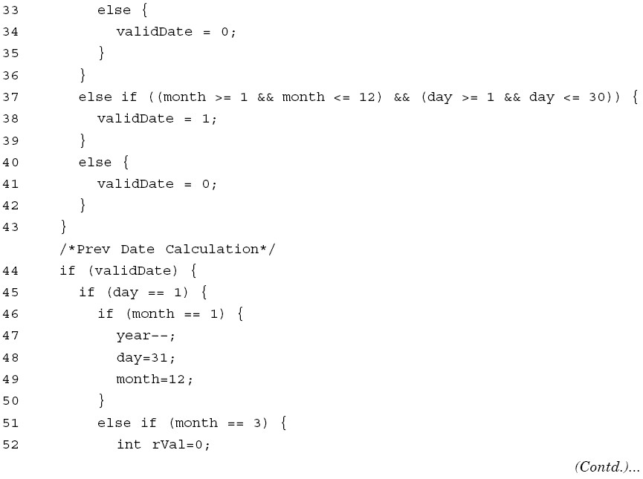
Software Testing

Slide 15
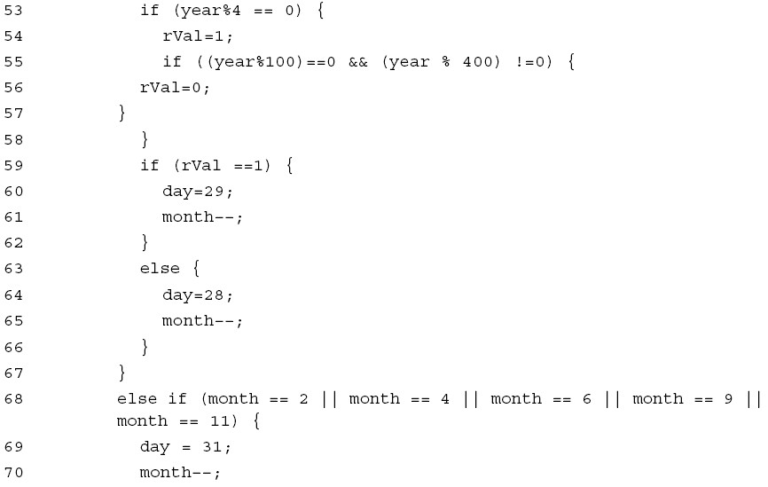
Software Testing
109

Slide 16
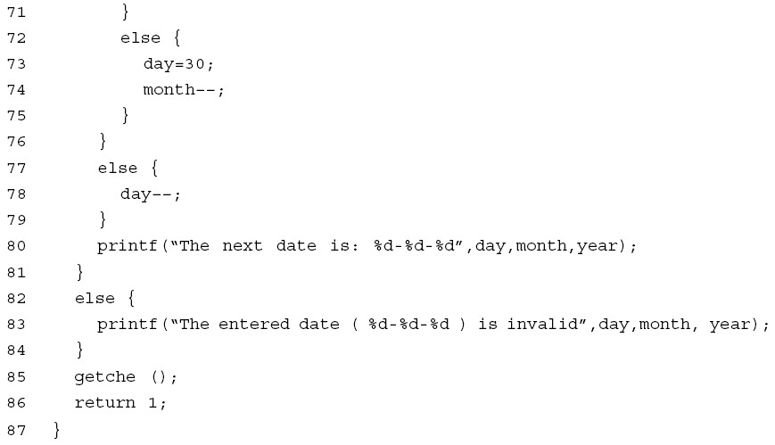
Software Testing
Fig. 15: Program for previous date problem

Slide 17
Software Testing
Solution
The Previous date program takes a date as input and checks it for validity. If valid, it returns the previous date as its output.
With single fault assumption theory, 4n+1 test cases can be designed and which are equal to 13.
20

Slide 18
Software Testing
The boundary value test cases are:
Test Case | Month | Day | Year | Expected output
1 | 6 | 15 | 1900 | 14 June, 1900
2 | 6 | 15 | 1901 | 14 June, 1901
3 | 6 | 15 | 1962 | 14 June, 1962
4 | 6 | 15 | 2024 | 14 June, 2024
5 | 6 | 15 | 2025 | 14 June, 2025
6 | 6 | 1 | 1962 | 31 May, 1962
7 | 6 | 2 | 1962 | 1 June, 1962
8 | 6 | 30 | 1962 | 29 June, 1962
9 | 6 | 31 | 1962 | Invalid date
10 | 1 | 15 | 1962 | 14 January, 1962
11 | 2 | 15 | 1962 | 14 February, 1962
12 | 11 | 15 | 1962 | 14 November, 1962
13 | 12 | 15 | 1962 | 14 December, 1962

Slide 19
Software Testing
Example 8.3
Consider a simple program to classify a triangle. Its inputs is a triple of positive integers (say x, y, z) and the data type for input parameters ensures that these will be integers greater than 0 and less than or equal to 100.
The program output may be one of the following words:
[Scalene; Isosceles; Equilateral; Not a triangle]
Design the boundary value test cases.
22

Slide 20
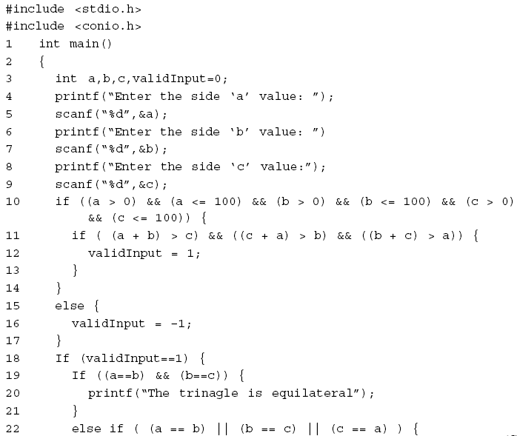
Software Testing

Slide 21
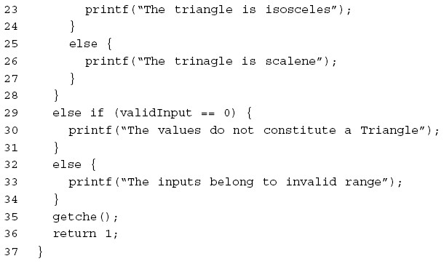
Software Testing
Fig. 20 : Code of triangle classification problem

Slide 22
Software Testing
Solution
The boundary value test cases are shown below:
Test case | x | y | z | Expected Output
1 | 50 | 50 | 1 | Isosceles
2 | 50 | 50 | 2 | Isosceles
3 | 50 | 50 | 50 | Equilateral
4 | 50 | 50 | 99 | Isosceles
5 | 50 | 50 | 100 | Not a triangle
6 | 50 | 1 | 50 | Isosceles
7 | 50 | 2 | 50 | Isosceles
8 | 50 | 99 | 50 | Isosceles
9 | 50 | 100 | 50 | Not a triangle
10 | 1 | 50 | 50 | Isosceles
11 | 2 | 50 | 50 | Isosceles
12 | 99 | 50 | 50 | Isosceles
13 | 100 | 50 | 50 | Not a triangle

Slide 23
Software Testing
Robustness testing
It is nothing but the extension of boundary value analysis. Here, we would like to see, what happens when the extreme values are exceeded with a value slightly greater than the maximum, and a value slightly less than minimum. It means, we want to go outside the legitimate boundary of input domain.
This extended form of boundary value analysis is called robustness testing and shown in Fig. 6
There are four additional test cases which are outside the legitimate input domain. Hence total test cases in robustness testing are 6n+1, where n is the number of input variables. So, 13 test cases are:
(200,99), (200,100), (200,101), (200,200), (200,299), (200,300)
(200,301), (99,200), (100,200), (101,200), (299,200), (300,200), (301,200)

Slide 24
Software Testing
400
300
200
100
y
0
100 200 300
x
400
Fig. 8.6: Robustness test cases for two variables x and y with range [100,300] each
25

Slide 25
Software Testing
Worst-case testing
If we like to see what happens when more than one variable has an extreme value. In electronic circuits analysis, this is called “worst case analysis”. It is more thorough in the sense that boundary value test cases are a proper subset of worst case test cases. It requires more effort. Worst case testing for a function of n variables generate 5^{n} test cases as opposed to 4n+1 test cases for boundary value analysis. Our two variables example will have 5²=25 test cases and are given in table 1.
26

Slide 26
Software Testing
Table 1: Worst cases test inputs for two variables example
Test case number | Inputs |  | Test case number | Inputs
 | x | y |  | x | y
1 | 100 | 100 | 14 | 200 | 299
2 | 100 | 101 | 15 | 200 | 300
3 | 100 | 200 | 16 | 299 | 100
4 | 100 | 299 | 17 | 299 | 101
5 | 100 | 300 | 18 | 299 | 200
6 | 101 | 100 | 19 | 299 | 299
7 | 101 | 101 | 20 | 299 | 300
8 | 101 | 200 | 21 | 300 | 100
9 | 101 | 299 | 22 | 300 | 101
10 | 101 | 300 | 23 | 300 | 200
11 | 200 | 100 | 24 | 300 | 299
12 | 200 | 101 | 25 | 300 | 300
13 | 200 | 200 | --

Slide 27
Software Testing
Example 8.4
Consider the program for the determination of nature of roots of a quadratic equation as explained in example 8.1. Design the Robust test case and worst test cases for this program.
28

Slide 28
Software Testing
Solution
Robust test cases are 6n+1. Hence, in 3 variable input cases total number of test cases are 19 as given on next slide:
29

Slide 29
Software Testing
Test case | a | b | c | Expected Output
1 | -1 | 50 | 50 | Invalid input`
2 | 0 | 50 | 50 | Not quadratic equation
3 | 1 | 50 | 50 | Real roots
4 | 50 | 50 | 50 | Imaginary roots
5 | 99 | 50 | 50 | Imaginary roots
6 | 100 | 50 | 50 | Imaginary roots
7 | 101 | 50 | 50 | Invalid input
8 | 50 | -1 | 50 | Invalid input
9 | 50 | 0 | 50 | Imaginary roots
10 | 50 | 1 | 50 | Imaginary roots
11 | 50 | 99 | 50 | Imaginary roots
12 | 50 | 100 | 50 | Equal roots
13 | 50 | 101 | 50 | Invalid input
14 | 50 | 50 | -1 | Invalid input
15 | 50 | 50 | 0 | Real roots
16 | 50 | 50 | 1 | Real roots
17 | 50 | 50 | 99 | Imaginary roots
18 | 50 | 50 | 100 | Imaginary roots
19 | 50 | 50 | 101 | Invalid input

Slide 30
Software Testing
In case of worst test case total test cases are 5^{n}. Hence, 125 test cases will be generated in worst test cases. The worst test cases are given below:
Test Case | a | b | c | Expected output
1 | 0 | 0 | 0 | Not Quadratic
2 | 0 | 0 | 1 | Not Quadratic
3 | 0 | 0 | 50 | Not Quadratic
4 | 0 | 0 | 99 | Not Quadratic
5 | 0 | 0 | 100 | Not Quadratic
6 | 0 | 1 | 0 | Not Quadratic
7 | 0 | 1 | 1 | Not Quadratic
8 | 0 | 1 | 50 | Not Quadratic
9 | 0 | 1 | 99 | Not Quadratic
10 | 0 | 1 | 100 | Not Quadratic
11 | 0 | 50 | 0 | Not Quadratic
12 | 0 | 50 | 1 | Not Quadratic
13 | 0 | 50 | 50 | Not Quadratic
14 | 0 | 50 | 99 | Not Quadratic

Slide 31
Software Testing
Test Case | A | b | c | Expected output
15 | 0 | 50 | 100 | Not Quadratic
16 | 0 | 99 | 0 | Not Quadratic
17 | 0 | 99 | 1 | Not Quadratic
18 | 0 | 99 | 50 | Not Quadratic
19 | 0 | 99 | 99 | Not Quadratic
20 | 0 | 99 | 100 | Not Quadratic
21 | 0 | 100 | 0 | Not Quadratic
22 | 0 | 100 | 1 | Not Quadratic
23 | 0 | 100 | 50 | Not Quadratic
24 | 0 | 100 | 99 | Not Quadratic
25 | 0 | 100 | 100 | Not Quadratic
26 | 1 | 0 | 0 | Equal Roots
27 | 1 | 0 | 1 | Imaginary
28 | 1 | 0 | 50 | Imaginary
29 | 1 | 0 | 99 | Imaginary
30 | 1 | 0 | 100 | Imaginary
31 | 1 | 1 | 0 | Real Roots

Slide 32
Software Testing
Test Case | A | b | C | Expected output
32 | 1 | 1 | 1 | Imaginary
33 | 1 | 1 | 50 | Imaginary
34 | 1 | 1 | 99 | Imaginary
35 | 1 | 1 | 100 | Imaginary
36 | 1 | 50 | 0 | Real Roots
37 | 1 | 50 | 1 | Real Roots
38 | 1 | 50 | 50 | Real Roots
39 | 1 | 50 | 99 | Real Roots
40 | 1 | 50 | 100 | Real Roots
41 | 1 | 99 | 0 | Real Roots
42 | 1 | 99 | 1 | Real Roots
43 | 1 | 99 | 50 | Real Roots
44` | 1 | 99 | 99 | Real Roots
45 | 1 | 99 | 100 | Real Roots
46 | 1 | 100 | 0 | Real Roots
47 | 1 | 100 | 1 | Real Roots
48 | 1 | 100 | 50 | Real Roots

Slide 33
Software Testing
Test Case | A | b | C | Expected output
49 | 1 | 100 | 99 | Real Roots
50 | 1 | 100 | 100 | Real Roots
51 | 50 | 0 | 0 | Equal Roots
52 | 50 | 0 | 1 | Imaginary
53 | 50 | 0 | 50 | Imaginary
54 | 50 | 0 | 99 | Imaginary
55 | 50 | 0 | 100 | Imaginary
56 | 50 | 1 | 0 | Real Roots
57 | 50 | 1 | 1 | Imaginary
58 | 50 | 1 | 50 | Imaginary
59 | 50 | 1 | 99 | Imaginary
60 | 50 | 1 | 100 | Imaginary
61 | 50 | 50 | 0 | Real Roots
62 | 50 | 50 | 1 | Real Roots
63 | 50 | 50 | 50 | Imaginary
64 | 50 | 50 | 99 | Imaginary
65 | 50 | 50 | 100 | Imaginary

Slide 34
Software Testing
Test Case | A | b | C | Expected output
66 | 50 | 99 | 0 | Real Roots
67 | 50 | 99 | 1 | Real Roots
68 | 50 | 99 | 50 | Imaginary
69 | 50 | 99 | 99 | Imaginary
70 | 50 | 99 | 100 | Imaginary
71 | 50 | 100 | 0 | Real Roots
72 | 50 | 100 | 1 | Real Roots
73 | 50 | 100 | 50 | Equal Roots
74 | 50 | 100 | 99 | Imaginary
75 | 50 | 100 | 100 | Imaginary
76 | 99 | 0 | 0 | Equal Roots
77 | 99 | 0 | 1 | Imaginary
78 | 99 | 0 | 50 | Imaginary
79 | 99 | 0 | 99 | Imaginary
80 | 99 | 0 | 100 | Imaginary
81 | 99 | 1 | 0 | Real Roots
82 | 99 | 1 | 1 | Imaginary

Slide 35
Software Testing
Test Case | A | b | C | Expected output
83 | 99 | 1 | 50 | Imaginary
84 | 99 | 1 | 99 | Imaginary
85 | 99 | 1 | 100 | Imaginary
86 | 99 | 50 | 0 | Real Roots
87 | 99 | 50 | 1 | Real Roots
88 | 99 | 50 | 50 | Imaginary
89 | 99 | 50 | 99 | Imaginary
90 | 99 | 50 | 100 | Imaginary
91 | 99 | 99 | 0 | Real Roots
92 | 99 | 99 | 1 | Real Roots
93 | 99 | 99 | 50 | Imaginary Roots
94 | 99 | 99 | 99 | Imaginary
95 | 99 | 99 | 100 | Imaginary
96 | 99 | 100 | 0 | Real Roots
97 | 99 | 100 | 1 | Real Roots
98 | 99 | 100 | 50 | Imaginary
99 | 99 | 100 | 99 | Imaginary
100 | 99 | 100 | 100 | Imaginary

Slide 36
Software Testing
Test Case | A | b | C | Expected output
101 | 100 | 0 | 0 | Equal Roots
102 | 100 | 0 | 1 | Imaginary
103 | 100 | 0 | 50 | Imaginary
104 | 100 | 0 | 99 | Imaginary
105 | 100 | 0 | 100 | Imaginary
106 | 100 | 1 | 0 | Real Roots
107 | 100 | 1 | 1 | Imaginary
108 | 100 | 1 | 50 | Imaginary
109 | 100 | 1 | 99 | Imaginary
110 | 100 | 1 | 100 | Imaginary
111 | 100 | 50 | 0 | Real Roots
112 | 100 | 50 | 1 | Real Roots
113 | 100 | 50 | 50 | Imaginary
114 | 100 | 50 | 99 | Imaginary
115 | 100 | 50 | 100 | Imaginary
116 | 100 | 99 | 0 | Real Roots
117 | 100 | 99 | 1 | Real Roots
118 | 100 | 99 | 50 | Imaginary

Slide 37
Software Testing
Test Case | A | b | C | Expected output
119 | 100 | 99 | 99 | Imaginary
120 | 100 | 99 | 100 | Imaginary
121 | 100 | 100 | 0 | Real Roots
122 | 100 | 100 | 1 | Real Roots
123 | 100 | 100 | 50 | Imaginary
124 | 100 | 100 | 99 | Imaginary
125 | 100 | 100 | 100 | Imaginary

Slide 38
Software Testing
Example 8.5
Consider the program for the determination of previous date in a calendar as explained in example 8.2. Design the robust and worst test cases for this program.

Slide 39
Software Testing
Solution
Robust test cases are 6n+1. Hence total 19 robust test cases are designed and are given on next slide.

Slide 40
Software Testing
Test case | Month | Day | Year | Expected Output
1 | 6 | 15 | 1899 | Invalid date (outside range)
2 | 6 | 15 | 1900 | 14 June, 1900
3 | 6 | 15 | 1901 | 14 June, 1901
4 | 6 | 15 | 1962 | 14 June, 1962
5 | 6 | 15 | 2024 | 14 June, 2024
6 | 6 | 15 | 2025 | 14 June, 2025
7 | 6 | 15 | 2026 | Invalid date (outside range)
8 | 6 | 0 | 1962 | Invalid date
9 | 6 | 1 | 1962 | 31 May, 1962
10 | 6 | 2 | 1962 | 1 June, 1962
11 | 6 | 30 | 1962 | 29 June, 1962
12 | 6 | 31 | 1962 | Invalid date
13 | 6 | 32 | 1962 | Invalid date
14 | 0 | 15 | 1962 | Invalid date
15 | 1 | 15 | 1962 | 14 January, 1962
16 | 2 | 15 | 1962 | 14 February, 1962
17 | 11 | 15 | 1962 | 14 November, 1962
18 | 12 | 15 | 1962 | 14 December, 1962
19 | 13 | 15 | 1962 | Invalid date

Slide 41
Software Testing
In case of worst test case total test cases are 5^{n}. Hence, 125 test cases will be generated in worst test cases. The worst test cases are given below:
Test Case | Month | Day | Year | Expected output
1 | 1 | 1 | 1900 | 31 December, 1899
2 | 1 | 1 | 1901 | 31 December, 1900
3 | 1 | 1 | 1962 | 31 December, 1961
4 | 1 | 1 | 2024 | 31 December, 2023
5 | 1 | 1 | 2025 | 31 December, 2024
6 | 1 | 2 | 1900 | 1 January, 1900
7 | 1 | 2 | 1901 | 1 January, 1901
8 | 1 | 2 | 1962 | 1 January, 1962
9 | 1 | 2 | 2024 | 1 January, 2024
10 | 1 | 2 | 2025 | 1 January, 2025
11 | 1 | 15 | 1900 | 14 January, 1900
12 | 1 | 15 | 1901 | 14 January, 1901
13 | 1 | 15 | 1962 | 14 January, 1962
14 | 1 | 15 | 2024 | 14 January, 2024

Slide 42
Software Testing
Test Case | A | b | c | Expected output
15 | 1 | 15 | 2025 | 14 January, 2025
16 | 1 | 30 | 1900 | 29 January, 1900
17 | 1 | 30 | 1901 | 29 January, 1901
18 | 1 | 30 | 1962 | 29 January, 1962
19 | 1 | 30 | 2024 | 29 January, 2024
20 | 1 | 30 | 2025 | 29 January, 2025
21 | 1 | 31 | 1900 | 30 January, 1900
22 | 1 | 31 | 1901 | 30 January, 1901
23 | 1 | 31 | 1962 | 30 January, 1962
24 | 1 | 31 | 2024 | 30 January, 2024
25 | 1 | 31 | 2025 | 30 January, 2025
26 | 2 | 1 | 1900 | 31 January, 1900
27 | 2 | 1 | 1901 | 31 January, 1901
28 | 2 | 1 | 1962 | 31 January, 1962
29 | 2 | 1 | 2024 | 31 January, 2024
30 | 2 | 1 | 2025 | 31 January, 2025
31 | 2 | 2 | 1900 | 1 February, 1900

Slide 43
Software Testing
Test Case | Month | Day | Year | Expected output
32 | 2 | 2 | 1901 | 1 February, 1901
33 | 2 | 2 | 1962 | 1 February, 1962
34 | 2 | 2 | 2024 | 1 February, 2024
35 | 2 | 2 | 2025 | 1 February, 2025
36 | 2 | 15 | 1900 | 14 February, 1900
37 | 2 | 15 | 1901 | 14 February, 1901
38 | 2 | 15 | 1962 | 14 February, 1962
39 | 2 | 15 | 2024 | 14 February, 2024
40 | 2 | 15 | 2025 | 14 February, 2025
41 | 2 | 30 | 1900 | Invalid date
42 | 2 | 30 | 1901 | Invalid date
43 | 2 | 30 | 1962 | Invalid date
44 | 2 | 30 | 2024 |  | Invalid date
45 | 2 | 30 | 2025 |  | Invalid date
46 | 2 | 31 | 1900 |  | Invalid date
47 | 2 | 31 | 1901 |  | Invalid date
48 | 2 | 31 | 1962 |  | Invalid date

Slide 44
Software Testing
Test Case | Month | Day | Year | Expected output
49 | 2 | 31 | 2024 | Invalid date
50 | 2 | 31 | 2025 | Invalid date
51 | 6 | 1 | 1900 | 31 May, 1900
52 | 6 | 1 | 1901 | 31 May, 1901
53 | 6 | 1 | 1962 | 31 May, 1962
54 | 6 | 1 | 2024 | 31 May, 2024
55 | 6 | 1 | 2025 | 31 May, 2025
56 | 6 | 2 | 1900 | 1 June, 1900
57 | 6 | 2 | 1901 | 1 June, 1901
58 | 6 | 2 | 1962 | 1 June, 1962
59 | 6 | 2 | 2024 | 1 June, 2024
60 | 6 | 2 | 2025 | 1 June, 2025
61 | 6 | 15 | 1900 | 14 June, 1900
62 | 6 | 15 | 1901 | 14 June, 1901
63 | 6 | 15 | 1962 | 14 June, 1962
64 | 6 | 15 | 2024 | 14 June, 2024
65 | 6 | 15 | 2025 | 14 June, 2025

Slide 45
Software Testing
Test Case | Month | Day | Year | Expected output
66 | 6 | 30 | 1900 | 29 June, 1900
67 | 6 | 30 | 1901 | 29 June, 1901
68 | 6 | 30 | 1962 | 29 June, 1962
69 | 6 | 30 | 2024 | 29 June, 2024
70 | 6 | 30 | 2025 | 29 June, 2025
71 | 6 | 31 | 1900 | Invalid date
72 | 6 | 31 | 1901 | Invalid date
73 | 6 | 31 | 1962 | Invalid date
74 | 6 | 31 | 2024 | Invalid date
75 | 6 | 31 | 2025 | Invalid date
76 | 11 | 1 | 1900 | 31 October, 1900
77 | 11 | 1 | 1901 | 31 October, 1901
78 | 11 | 1 | 1962 | 31 October, 1962
79 | 11 | 1 | 2024 | 31 October, 2024
80 | 11 | 1 | 2025 | 31 October, 2025
81 | 11 | 2 | 1900 | 1 November, 1900
82 | 11 | 2 | 1901 | 1 November, 1901

Slide 46
Software Testing
Test Case | Month | Day | Year | Expected output
83 | 11 | 2 | 1962 | 1 November, 1962
84 | 11 | 2 | 2024 | 1 November, 2024
85 | 11 | 2 | 2025 | 1 November, 2025
86 | 11 | 15 | 1900 | 14 November, 1900
87 | 11 | 15 | 1901 | 14 November, 1901
88 | 11 | 15 | 1962 | 14 November, 1962
89 | 11 | 15 | 2024 | 14 November, 2024
90 | 11 | 15 | 2025 | 14 November, 2025
91 | 11 | 30 | 1900 | 29 November, 1900
92 | 11 | 30 | 1901 | 29 November, 1901
93 | 11 | 30 | 1962 | 29 November, 1962
94 | 11 | 30 | 2024 | 29 November, 2024
95 | 11 | 30 | 2025 | 29 November, 2025
96 | 11 | 31 | 1900 | Invalid date
97 | 11 | 31 | 1901 | Invalid date
98 | 11 | 31 | 1962 | Invalid date
99 | 11 | 31 | 2024 | Invalid date
100 | 11 | 31 | 2025 | Invalid date

Slide 47
Software Testing
Test Case | Month | Day | Year | Expected output
101 | 12 | 1 | 1900 | 30 November, 1900
102 | 12 | 1 | 1901 | 30 November, 1901
103 | 12 | 1 | 1962 | 30 November, 1962
104 | 12 | 1 | 2024 | 30 November, 2024
105 | 12 | 1 | 2025 | 30 November, 2025
106 | 12 | 2 | 1900 | 1 December, 1900
107 | 12 | 2 | 1901 | 1 December, 1901
108 | 12 | 2 | 1962 | 1 December, 1962
109 | 12 | 2 | 2024 | 1 December, 2024
110 | 12 | 2 | 2025 | 1 December, 2025
111 | 12 | 15 | 1900 | 14 December, 1900
112 | 12 | 15 | 1901 | 14 December, 1901
113 | 12 | 15 | 1962 | 14 December, 1962
114 | 12 | 15 | 2024 | 14 December, 2024
115 | 12 | 15 | 2025 | 14 December, 2025
116 | 12 | 30 | 1900 | 29 December, 1900
117 | 12 | 30 | 1901 | 29 December, 1901
118 | 12 | 30 | 1962 | 29 December, 1962

Slide 48
Software Testing
Test Case | Month | Day | Year | Expected output
119 | 12 | 30 | 2024 | 29 December, 2024
120 | 12 | 30 | 2025 | 29 December, 2025
121 | 12 | 31 | 1900 | 30 December, 1900
122 | 12 | 31 | 1901 | 30 December, 1901
123 | 12 | 31 | 1962 | 30 December, 1962
124 | 12 | 31 | 2024 | 30 December, 2024
125 | 12 | 31 | 2025 | 30 December, 2025

Slide 49
Software Testing
Example 8.6
Consider the triangle problem as given in example 8.3. Generate robust and worst test cases for this problem.

Slide 50
Software Testing
Solution
Robust test cases are given on next slide.

Slide 51
Software Testing
Test Case` | x | y | z | Expected Output
1 | 50 | 50 | 0 | Invalid input`
2 | 50 | 50 | 1 | Isosceles
3 | 50 | 50 | 2 | Isosceles
4 | 50 | 50 | 50 | Equilateral
5 | 50 | 50 | 99 | Isosceles
6 | 50 | 50 | 100 | Not a triangle
7 | 50 | 50 | 101 | Invalid input
8 | 50 | 0 | 50 | Invalid input
9 | 50 | 1 | 50 | Isosceles
10 | 50 | 2 | 50 | Isosceles
11 | 50 | 99 | 50 | Isosceles
12 | 50 | 100 | 50 | Not a triangle
13 | 50 | 101 | 50 | Invalid input
14 | 0 | 50 | 50 | Invalid input
15 | 1 | 50 | 50 | Isosceles
16 | 2 | 50 | 50 | Isosceles
17 | 99 | 50 | 50 | Isosceles
18 | 100 | 50 | 50 | Not a triangle
19 | 101 | 50 | 50 | Invalid input

Slide 52
Software Testing
Worst test cases are 125 and are given below:
Test Case | x | y | z | Expected output
1 | 1 | 1 | 1 | Equilateral
2 | 1 | 1 | 2 | Not a triangle
3 | 1 | 1 | 50 | Not a triangle
4 | 1 | 1 | 99 | Not a triangle
5 | 1 | 1 | 100 | Not a triangle
6 | 1 | 2 | 1 | Not a triangle
7 | 1 | 2 | 2 | Isosceles
8 | 1 | 2 | 50 | Not a triangle
9 | 1 | 2 | 99 | Not a triangle
10 | 1 | 2 | 100 | Not a triangle
11 | 1 | 50 | 1 | Not a triangle
12 | 1 | 50 | 2 | Not a triangle
13 | 1 | 50 | 50 | Isosceles
14 | 1 | 50 | 99 | Not a triangle

Slide 53
Software Testing
Test Case | A | b | c | Expected output
15 | 1 | 50 | 100 | Not a triangle
16 | 1 | 99 | 1 | Not a triangle
17 | 1 | 99 | 2 | Not a triangle
18 | 1 | 99 | 50 | Not a triangle
19 | 1 | 99 | 99 | Isosceles
20 | 1 | 99 | 100 | Not a triangle
21 | 1 | 100 | 1 | Not a triangle
22 | 1 | 100 | 2 | Not a triangle
23 | 1 | 100 | 50 | Not a triangle
24 | 1 | 100 | 99 | Not a triangle
25 | 1 | 100 | 100 | Isosceles
26 | 2 | 1 | 1 | Not a triangle
27 | 2 | 1 | 2 | Isosceles
28 | 2 | 1 | 50 | Not a triangle
29 | 2 | 1 | 99 | Not a triangle
30 | 2 | 1 | 100 | Not a triangle
31 | 2 | 2 | 1 | Isosceles

Slide 54
Software Testing
Test Case | A | b | C | Expected output
32 | 2 | 2 | 2 | Equilateral
33 | 2 | 2 | 50 | Not a triangle
34 | 2 | 2 | 99 | Not a triangle
35 | 2 | 2 | 100 | Not a triangle
36 | 2 | 50 | 1 | Not a triangle
37 | 2 | 50 | 2 | Not a triangle
38 | 2 | 50 | 50 | Isosceles
39 | 2 | 50 | 99 | Not a triangle
40 | 2 | 50 | 100 | Not a triangle
41 | 2 | 99 | 1 | Not a triangle
42 | 2 | 99 | 2 | Not a triangle
43 | 2 | 99 | 50 | Not a triangle
44 | 2 | 99 | 99 | Isosceles
45 | 2 | 99 | 100 | Scalene
46 | 2 | 100 | 1 | Not a triangle
47 | 2 | 100 | 2 | Not a triangle
48 | 2 | 100 | 50 | Not a triangle

Slide 55
Software Testing
Test Case | A | b | C | Expected output
49 | 2 | 100 | 50 | Scalene
50 | 2 | 100 | 99 | Isosceles
51 | 50 | 1 | 100 | Not a triangle
52 | 50 | 1 | 1 | Not a triangle
53 | 50 | 1 | 2 | Isosceles
54 | 50 | 1 | 50 | Not a triangle
55 | 50 | 1 | 99 | Not a triangle
56 | 50 | 2 | 100 | Not a triangle
57 | 50 | 2 | 1 | Not a triangle
58 | 50 | 2 | 2 | Isosceles
59 | 50 | 2 | 50 | Not a triangle
60 | 50 | 2 | 99 | Not a triangle
61 | 50 | 50 | 100 | Isosceles
62 | 50 | 50 | 1 | Isosceles
63 | 50 | 50 | 2 | Equilateral
64 | 50 | 50 | 50 | Isosceles
65 | 50 | 50 | 99 | Not a triangle

Slide 56
Software Testing
Test Case | A | B | C | Expected output
66 | 50 | 99 | 1 | Not a triangle
67 | 50 | 99 | 2 | Not a triangle
68 | 50 | 99 | 50 | Isosceles
69 | 50 | 99 | 99 | Isosceles
70 | 50 | 99 | 100 | Scalene
71 | 50 | 100 | 1 | Not a triangle
72 | 50 | 100 | 2 | Not a triangle
73 | 50 | 100 | 50 | Not a triangle
74 | 50 | 100 | 99 | Scalene
75 | 50 | 100 | 100 | Isosceles
76 | 50 | 1 | 1 | Not a triangle
77 | 99 | 1 | 2 | Not a triangle
78 | 99 | 1 | 50 | Not a triangle
79 | 99 | 1 | 99 | Isosceles
80 | 99 | 1 | 100 | Not a triangle
81 | 99 | 2 | 1 | Not a triangle
82 | 99 | 2 | 2 | Not a triangle

Slide 57
Software Testing
Test Case | A | b | C | Expected output
83 | 99 | 2 | 50 | Not a triangle
84 | 99 | 2 | 99 | Isosceles
85 | 99 | 2 | 100 | Scalene
86 | 99 | 50 | 1 | Not a triangle
87 | 99 | 50 | 2 | Not a triangle
88 | 99 | 50 | 50 | Isosceles
89 | 99 | 50 | 99 | Isosceles
90 | 99 | 50 | 100 | Scalene
91 | 99 | 99 | 1 | Isosceles
92 | 99 | 99 | 2 | Isosceles
93 | 99 | 99 | 50 | Isosceles
94 | 99 | 99 | 99 | Equilateral
95 | 99 | 99 | 100 | Isosceles
96 | 99 | 100 | 1 | Not a triangle
97 | 99 | 100 | 2 | Scalene
98 | 99 | 100 | 50 | Scalene
99 | 99 | 100 | 99 | Isosceles
100 | 99 | 100 | 100 | Isosceles

Slide 58
Software Testing
Test Case | A | b | C | Expected output
101 | 100 | 1 | 1 | Not a triangle
102 | 100 | 1 | 2 | Not a triangle
103 | 100 | 1 | 50 | Not a triangle
104 | 100 | 1 | 99 | Not a triangle
105 | 100 | 1 | 100 | Isosceles
106 | 100 | 2 | 1 | Not a triangle
107 | 100 | 2 | 2 | Not a triangle
108 | 100 | 2 | 50 | Not a triangle
109 | 100 | 2 | 99 | Scalene
110 | 100 | 2 | 100 | Isosceles
111 | 100 | 50 | 1 | Not a triangle
112 | 100 | 50 | 2 | Not a triangle
113 | 100 | 50 | 50 | Not a triangle
114 | 100 | 50 | 99 | Scalene
115 | 100 | 50 | 100 | Isosceles
116 | 100 | 99 | 1 | Not a triangle
117 | 100 | 99 | 2 | Scalene
118 | 100 | 99 | 50 | Scalene

Slide 59
Software Testing
Test Case | A | b | C | Expected output
119 | 100 | 99 | 99 | Isosceles
120 | 100 | 99 | 100 | Isosceles
121 | 100 | 100 | 1 | Isosceles
122 | 100 | 100 | 2 | Isosceles
123 | 100 | 100 | 50 | Isosceles
124 | 100 | 100 | 99 | Isosceles
125 | 100 | 100 | 100 | Equilateral

Slide 60
Software Testing
Equivalence Class Testing
Two steps are required to implementing this method:
The equivalence classes are identified by taking each input condition and partitioning it into valid and invalid classes. For example, if an input condition specifies a range of values from 1 to 999, we identify one valid equivalence class [1<item<999]; and two invalid equivalence classes [item<1] and [item>999].
Generate the test cases using the equivalence classes identified in the previous step. This is performed by writing test cases covering all the valid equivalence classes. Then a test case is written for each invalid equivalence class so that no test contains more than one invalid class. This is to ensure that no two invalid classes mask each other.

Slide 61
Software Testing
Invalid input
Valid inputs
System under test
Outputs
Input domain
Output domain
Fig. 7: Equivalence partitioning
Most of the time, equivalence class testing defines classes of the input domain. However, equivalence classes should also be defined for output domain. Hence, we should design equivalence classes based on input and output domain.

Slide 62
Software Testing
Example 8.7
Consider the program for the determination of nature of roots of a quadratic equation as explained in example 8.1. Identify the equivalence class test cases for output and input domains.

Slide 63
Software Testing
Solution
Output domain equivalence class test cases can be identified as follows:
O₁={<a,b,c>:Not a quadratic equation if a = 0}
O₁={<a,b,c>:Real roots if (b²-4ac)>0}
O₁={<a,b,c>:Imaginary roots if (b²-4ac)<0} O₁={<a,b,c>:Equal roots if (b²-4ac)=0}`
The number of test cases can be derived form above relations and shown below:
Test case | a | b | c | Expected output
1 | 0 | 50 | 50 | Not a quadratic equation
2 | 1 | 50 | 50 | Real roots
3 | 50 | 50 | 50 | Imaginary roots
4 | 50 | 100 | 50 | Equal roots

Slide 64
Software Testing
We may have another set of test cases based on input domain.
I₁= {a: a = 0}
I₂= {a: a < 0}
I₃= {a: 1 ≤ a ≤ 100}
I₄= {a: a > 100}
I₅= {b: 0 ≤ b ≤ 100}
I₆= {b: b < 0}
I₇= {b: b > 100}
I₈= {c: 0 ≤ c ≤ 100}
I₉= {c: c < 0}
I₁₀={c: c > 100}

Slide 65
Software Testing
Test Case | a | b | c | Expected output
1 | 0 | 50 | 50 | Not a quadratic equation
2 | -1 | 50 | 50 | Invalid input
3 | 50 | 50 | 50 | Imaginary Roots
4 | 101 | 50 | 50 | invalid input
5 | 50 | 50 | 50 | Imaginary Roots
6 | 50 | -1 | 50 | invalid input
7 | 50 | 101 | 50 | invalid input
8 | 50 | 50 | 50 | Imaginary Roots
9 | 50 | 50 | -1 | invalid input
10 | 50 | 50 | 101 | invalid input
Here test cases 5 and 8 are redundant test cases. If we choose any value other than nominal, we may not have redundant test cases.
Hence total test cases are 10+4=14 for this problem.

Slide 66
Software Testing
Example 8.8
Consider the program for determining the previous date in a calendar as explained in example 8.3. Identify the equivalence class test cases for output & input domains.

Slide 67
Software Testing
Solution
Output domain equivalence class are:
O₁={<D,M,Y>: Previous date if all are valid inputs}
O₁={<D,M,Y>: Invalid date if any input makes the date invalid}
Test case | M | D | Y | Expected output
1 | 6 | 15 | 1962 | 14 June, 1962
2 | 6 | 31 | 1962 | Invalid date

Slide 68
Software Testing
We may have another set of test cases which are based on input domain.
I₁={month: 1 ≤ m ≤ 12} I₂={month: m < 1} I₃={month: m > 12} I₄={day: 1 ≤ D ≤ 31}
I₅={day: D < 1} I₆={day: D > 31}
I₇={year: 1900 ≤ Y ≤ 2025} I₈={year: Y < 1900}
I₉={year: Y > 2025}

Slide 69
Software Testing
Inputs domain test cases are :
Test Case | M | D | Y | Expected output
1 | 6 | 15 | 1962 | 14 June, 1962
2 | -1 | 15 | 1962 | Invalid input
3 | 13 | 15 | 1962 | invalid input
4 | 6 | 15 | 1962 | 14 June, 1962
5 | 6 | -1 | 1962 | invalid input
6 | 6 | 32 | 1962 | invalid input
7 | 6 | 15 | 1962 | 14 June, 1962
8 | 6 | 15 | 1899 | invalid input (Value out of range)
9 | 6 | 15 | 2026 | invalid input (Value out of range)

Slide 70
Software Testing
Example – 8.9
Consider the triangle problem specified in example 8.3. Identify the equivalence class test cases for output and input domain.

Slide 71
Software Testing
Solution
Output domain equivalence classes are:
O₁={<x,y,z>: Equilateral triangle with sides x,y,z}
O₁={<x,y,z>: Isosceles triangle with sides x,y,z}
O₁={<x,y,z>: Scalene triangle with sides x,y,z}
O₁={<x,y,z>: Not a triangle with sides x,y,z}
The test cases are:
Test case | x | y | z | Expected Output
1 | 50 | 50 | 50 | Equilateral
2 | 50 | 50 | 99 | Isosceles
3 | 100 | 99 | 50 | Scalene
4 | 50 | 100 | 50 | Not a triangle

Slide 72
Software Testing
Input domain based classes are:
I₁={x: x < 1}
I₂={x: x > 100}
I₃={x: 1 ≤ x ≤ 100}
I₄={y: y < 1}
I₅={y: y > 100}
I₆={y: 1 ≤ y ≤ 100}
I₇={z: z < 1}
I₈={z: z > 100}
I₉={z: 1 ≤ z ≤ 100}

Slide 73
Software Testing
Some inputs domain test cases can be obtained using the relationship amongst x,y and z.
I₁₀={< x,y,z >: x = y = z}
I₁₁={< x,y,z >: x = y, x ≠ z}
I₁₂={< x,y,z >: x = z, x ≠y}
I₁₃={< x,y,z >: y = z, x ≠y}
I₁₄={< x,y,z >: x ≠ y, x ≠ z, y ≠ z} I₁₅={< x,y,z >: x = y + z}
I₁₆={< x,y,z >: x > y +z}
I₁₇={< x,y,z >: y = x +z}
I₁₈={< x,y,z >: y > x + z}
I₁₉={< x,y,z >: z = x + y}
I₂₀={< x,y,z >: z > x +y}

Slide 74
Software Testing
Test cases derived from input domain are:
Test case | x | y | z | Expected Output
1 | 0 | 50 | 50 | Invalid input
2 | 101 | 50 | 50 | Invalid input
3 | 50 | 50 | 50 | Equilateral
4 | 50 | 0 | 50 | Invalid input
5 | 50 | 101 | 50 | Invalid input
6 | 50 | 50 | 50 | Equilateral
7 | 50 | 50 | 0 | Invalid input
8 | 50 | 50 | 101 | Invalid input
9 | 50 | 50 | 50 | Equilateral
10 | 60 | 60 | 60 | Equilateral
11 | 50 | 50 | 60 | Isosceles
12 | 50 | 60 | 50 | Isosceles
13 | 60 | 50 | 50 | Isosceles

Slide 75
Software Testing
Test case | x | y | z | Expected Output
14 | 100 | 99 | 50 | Scalene
15 | 100 | 50 | 50 | Not a triangle
16 | 100 | 50 | 25 | Not a triangle
17 | 50 | 100 | 50 | Not a triangle
18 | 50 | 100 | 25 | Not a triangle
19 | 50 | 50 | 100 | Not a triangle
20 | 25 | 50 | 100 | Not a triangle

