Slide 1
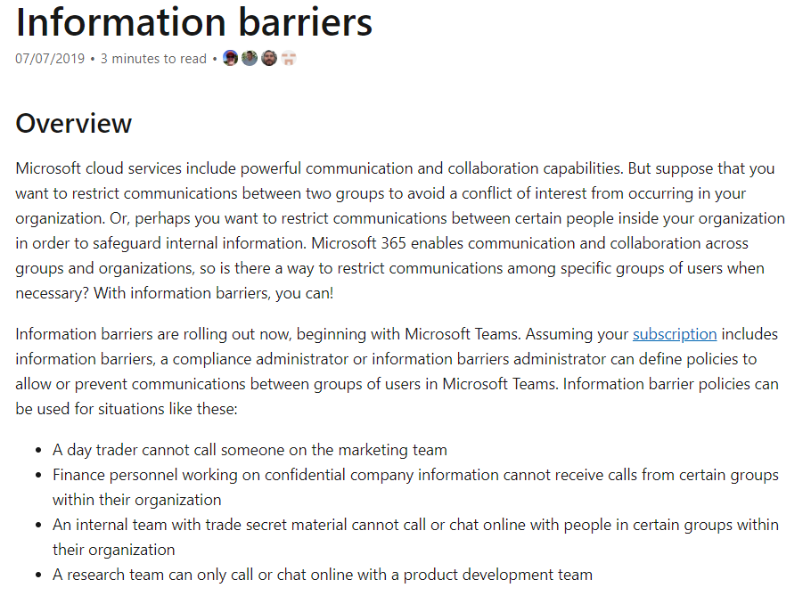
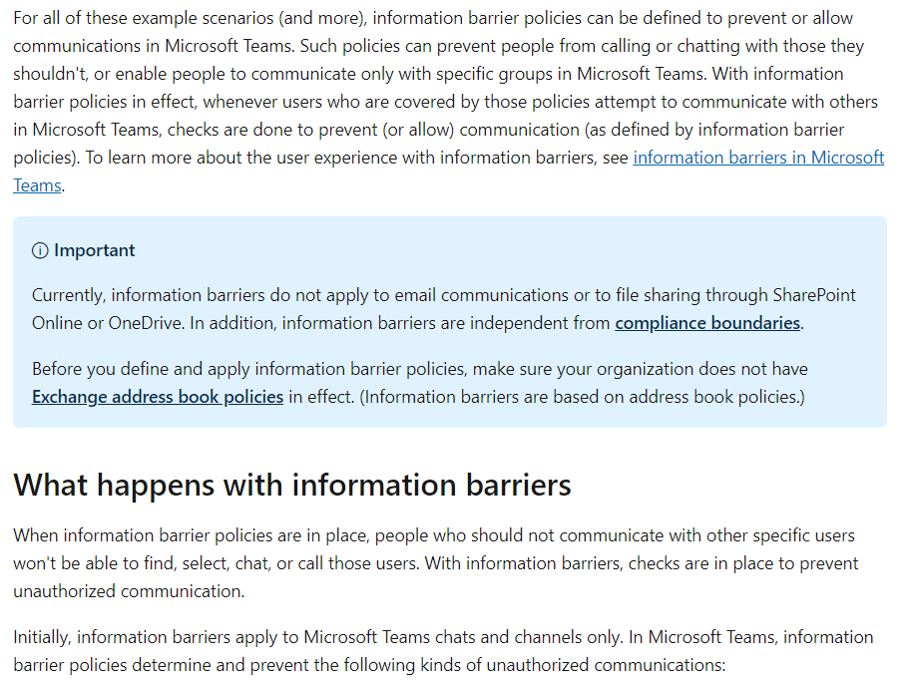
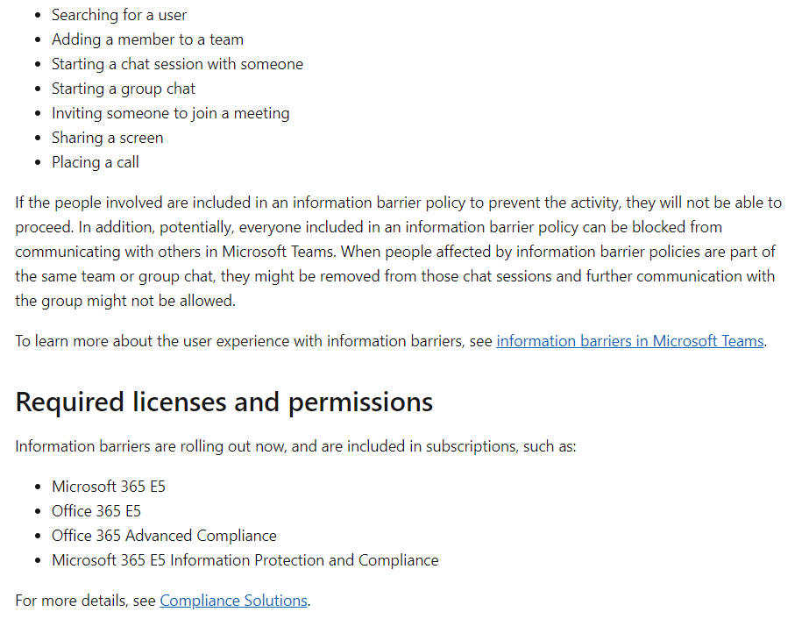
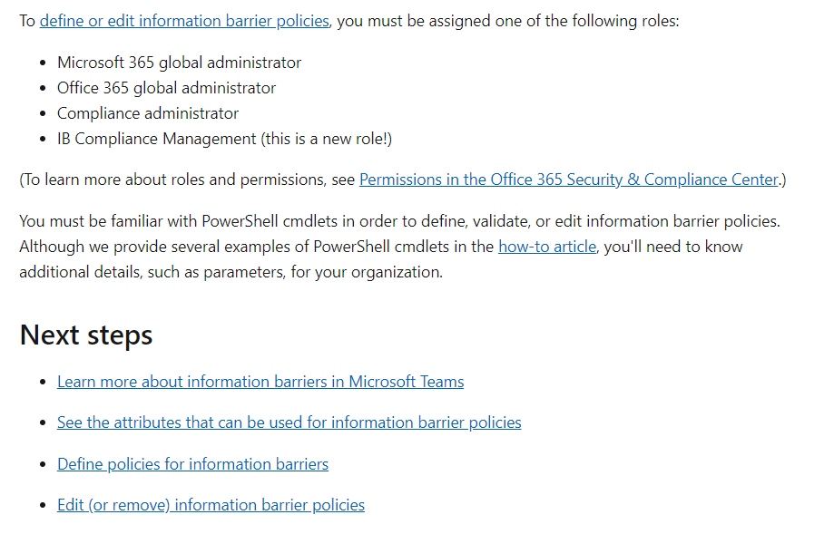
https://docs.microsoft.com/en-us/microsoft-365/compliance/information-barriers
Slides/Cards
Technical definition
Common scenarios
Technical details (with graphics)
Before and after Information Barriers (example from list of scenarios)
Licensing requirements
Administrator/role requirements
Content roadmap (visual)

