Slide 1
Reverse Engineering
Lecture 2
DJ Beyette
Slides dervied from 0x41deadbeef

Slide 2
Previous Lecture 1 Overview
Motivation for reverse engineering (RE). (Slides 8-10)
What is RE? (Slides 11-18)
What is a binary (executable)? (Slides 19-24)
How would you RE a binary? (Exercise)

Slide 3
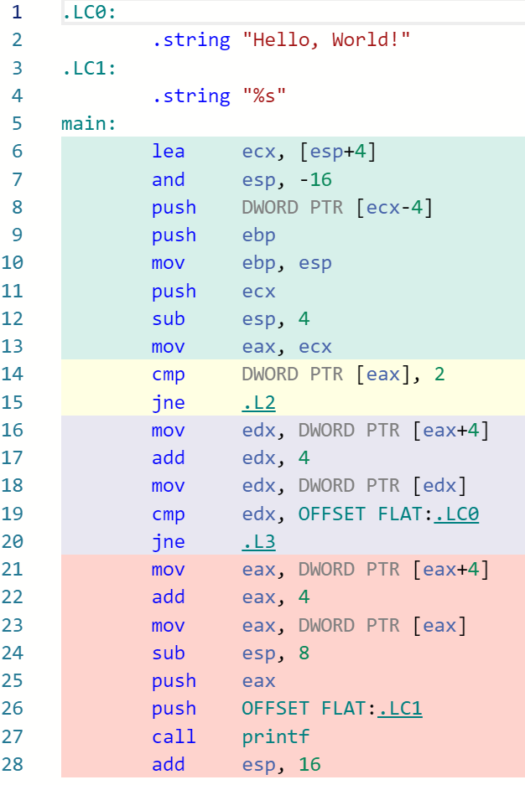
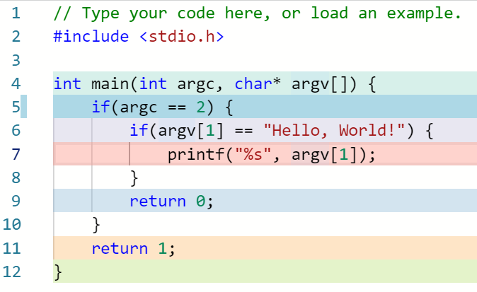
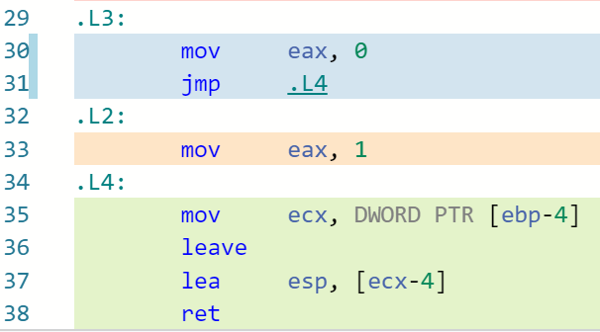
Reverse Engineering
Reversed Source Code
Q: Is the reversed sourced code always the same as original?
IA32 Assembly Code
Example made in godbolt

Slide 4
Static Binary Reverse Engineering
POI = Points of interest
Binary
Model loader? Memory? Routines?
Model Environment
POI?
Symbolic Execution
Disassemble
Binary
Assembly Code
POI?
Goal?
Hypothesis?
Strings?
Calls?
Data?
Update Confirm
Angr*
Review Results
Recover Assembly Logic
Q: Are you happy with this process? Q: What can we do different?

Slide 5
Dynamic Binary Reverse Engineering
POI = Points of interest
Binary
Observe I/O
Execute Binary
Goal?
Hypothesis?
Disassemble
Binary
POI?
Update
Confirm
Search I/O in binary strings?
Review Results
Break points at POI and run?
Load into GDB
Q: Are you happy with this process? Q: What can we do different?

Slide 6
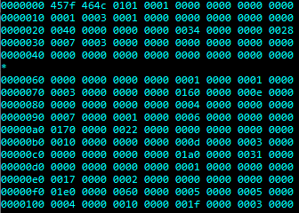
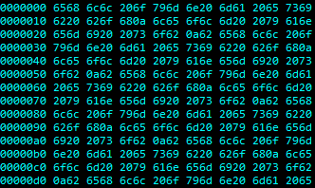
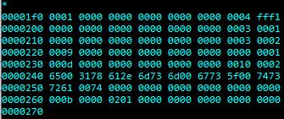
C Executable Raw Hexdump (Binary)
Text File Raw Hexdump
Vs.
What are some differences you see between these two hexdumps?
*
Null Bytes? (0x00)
Hex Range?
ASCII Range? 0x00 - 0x7f
What else?
How would you create a program to tell the difference?
grep - Checks first 1024 bytes contain null byte
Q: How is a Binary created?

Slide 7
How is a Binary created and executed?
Source Code
Compiler
Assembler
Object Files
Linker
C Code Files
Preprocessor
Run it!
Loader
Binary
Resolves preprocessor directives
e.g., #include #ifdef
Libraries

Slide 8
How would you reverse engineer a binary?
Your answer to this question will change throughout the course and likely be different from others.
Continue to reflect back on this question!

Slide 9
Lecture 2 Overview
How do we begin to ‘reverse engineer a binary’?
Binary compilation process
How do compiler settings affect the binary?
Exercise: Observe changes in the assembly with different compilers and settings. Use godbolt

Slide 10
How to begin reverse engineering a binary?
Reflect back on `text` vs `non-text` file example (slide 7)
How would you analyze an unknown object?
We must first understand what is a ‘binary’?
Google it if you don’t know!
Now what?
To begin analyzing a binary, we must look into:
Its environment
Frame of reference
How it is created?
How it is used?
Why do we want to analyze it?

Slide 11
Binary
Machine code: 1s and 0s
Structured
Pre-compiled
Pre-linked
aka: program/executable
Targeted for one operating system (OS)
Without understanding the intended OS/environment, we cannot analyze the 1s and 0s properly.
Let us make assumptions about our binary environment
environment: {‘language’: c, ‘compiler’: gcc, ‘os’: linux})

Slide 12
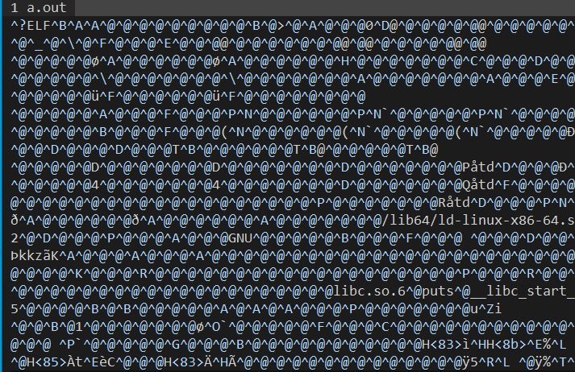
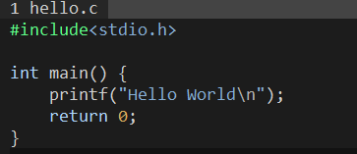
Example: How a Binary is created
(High abstraction)
Create hello.c source file
gcc hello.c
a.out
Q: What happened?

Slide 13
What happened?
gcc hello.c
Pre-processor
outputs hello.i
Compiler
outputs assembly as hello.s
Assembler
hello.s → machine code
hello.o object file
Linker
{hello.o, test.o, ..} → a.out
Link function calls
Program start/end logic
Source Code
hello.s
Assembler
hello.c
gcc -c hello.s
Preprocessor
gcc -S hello.i
gcc -E hello.c > hello.i
Object File
Compiler
Synthesis
gcc -O hello.o
hello.i
Linker
a.out
IR*
Analysis

Slide 14
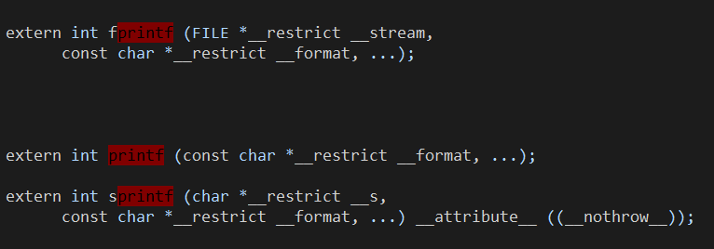
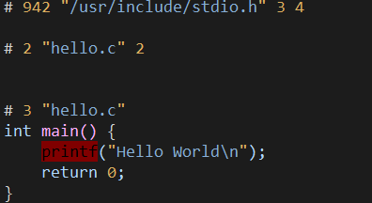
Pre-Processor
Resolve #include, #define, etc.. by replacing symbol with result
Comment removal
Conditional compilation: #ifdef, #if, #else, …
Output: .i file
Contains additional code from #include<stdio.h>

Slide 15
Compiler
hello.i
Compiler
Assembly Code
Dependent Optimization
Lexical Analyzer
Error Handler
&
Symbol Table
Code Generation
Syntax Analyzer
Independent Optimization
Semantic Analyzer
High/Low level Intermediate Representation (IR)
IR Code Generator
Q: What is IR? Symbol Table?

Slide 16
Linker
Linker
Object Files
Binary
Object File Structure
Headers
Code Chunk(s)
Data Chunk(s)
Relocatable obj
Executable obj
Shared obj
Linker
Function calls
Start/End Program
Resolve symbol references
Static? Dynamic?
Binary File Structure
Headers
Code Chunk(s)
Data Chunk(s)
dll/lib/exe

Slide 17
Q: Do you think understanding the creation process (i.e., compiler) of a binary is important?
How can we determine from the binary
Source code language
Compiler/version and arguments
operating system
Instruction Set Architecture (ISA)

Slide 18
Live Exercises
These examples will be appended to the lecture after class!
Go through slide 13 in your VMs! Inspect the files! Anything interesting?
Go to godbolt and start messing around! Do you notice any patterns? Uniqueness? Something odd?

Slide 19
Discussion
Q: What first steps do you think would be good when reversing a binary?

