Slide 1
Reverse Engineering
Lecture 1
DJ Beyette
Slides dervied from 0x41deadbeef

Slide 2
Course Goal
Build a foundation in reverse engineering (RE) to enable you to confidently continue and explore other RE courses, challenges, and career opportunities; regardless of the architecture or environment.
Highlight of topics
x86 architecture and assembly
Intermediate Representation (IR)
ELF Binaries
Static Analysis
Debugging
RE of codebreakers/small programs
Buffer overflow attacks
Symbolic Execution
Highlight of tools/frameworks
IDA Pro
GDB
Angr
AFL* (If time)

Slide 3

Course Knowledge Pentagon
Edge = intermediate knowledge
Center = no knowledge
Program Analysis
Reverse Engineering Foundation
x86
RE Tools and Techniques
c, c++, python3
Software Development

Slide 4
Expected Knowledge Pentagon
Starting Knowledge
Edge = intermediate knowledge
Center = no knowledge
Program Analysis
X86 and IR
RE Tools and Techniques
c, c++, python3
Software Development

Slide 5
Short self assessment - 10 minutes
Link

Slide 6
START OF LECTURE 1

Slide 7
Lecture Overview
Motivation for reverse engineering (RE). (Slides 8-10)
What is RE? (Slides 11-18)
What is a binary (executable)? (Slides 19-24)
How would you RE a binary? (Exercise)

Slide 8
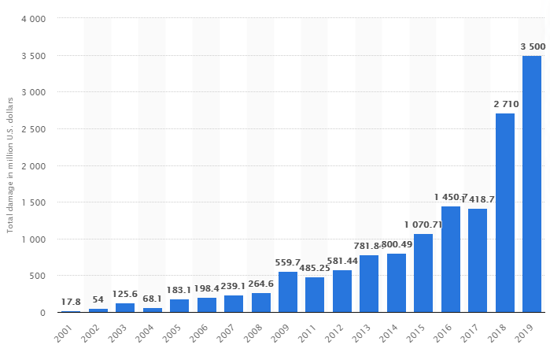
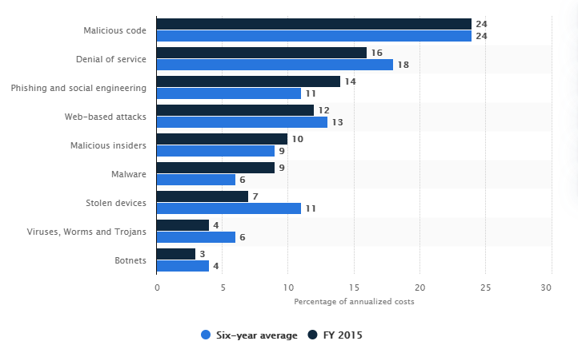
Why is RE important?
Cyber Crime Damage Report to IC3 2001- 2019
Attack Type
Source: Statista
Source: Statista
RE ~ min 36% of attack types!

Slide 9

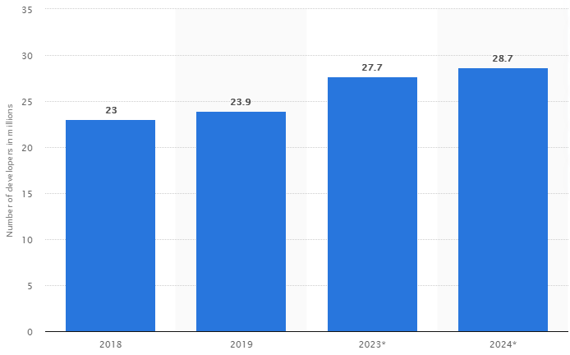
Vs
Number of Software Developers 2018 – 2024*
Source: Statista
Source: IC3 page 14
Q: Difficulty/time in program creation Vs reverse engineering?

Slide 10
Recent Cyber Attacks
SolarWinds Supply Chain Compromise - FIREEYE
GOA DoD Weapon system security vulnerability report - GAO
NotPetya attack - cost Merck company $1.3 Billion dollars - CROWDSTRIKE
Applications (i.e., web/phone) are more connected than ever
Speed of development has drastically increased
Not enough humans to review
1 in 5 open-source bugs are maliciously planted - ZDNET

Slide 11
What is Reverse Engineering?
“Reverse engineering is the process of discovering the technological principles of a device, object, or system through analysis of its structure, function, and operation.”[1] - wikipedia
Examples
Locks
Hardware
Binaries
Source Code
Course focus
Binary Reverse Engineering

Slide 12
What is binary reverse engineering (For our course)?
Recovering the or from
original source code
logic
machine code
Binary
Machine Code
Disassembler
Assembly Language
Original Source Code
Low level abstraction
High level abstraction
The process of outputting source code from a binary is called decompilation.
Decompiling is one technique of many in reverse engineering.
Q: What could 'logic' mean in this case?

Slide 13
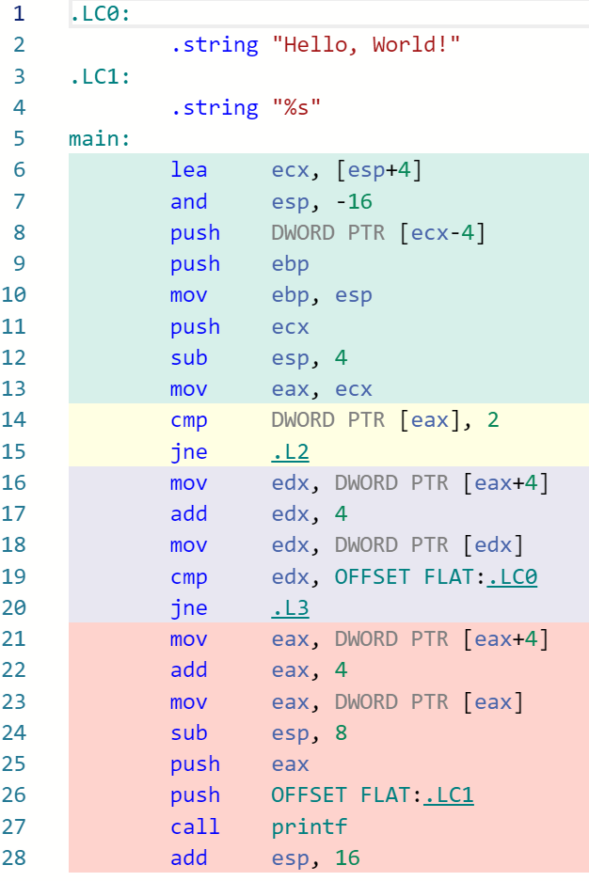
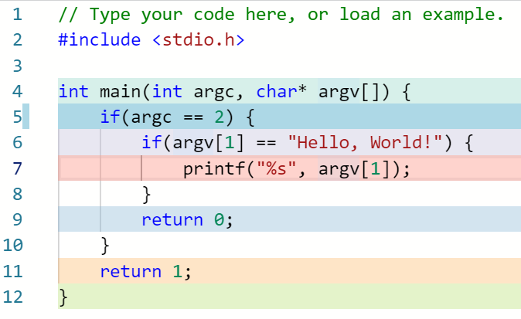
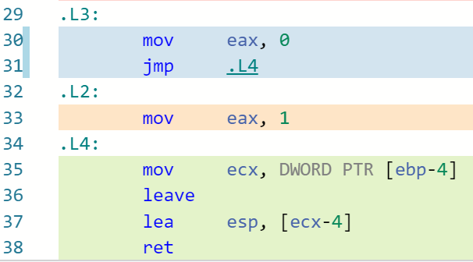
Reverse Engineering
Reversed Source Code
Q: Is the reversed sourced code always the same as original?
IA32 Assembly Code
Example made in godbolt

Slide 14
Reverse Engineering Approaches
Program Analysis
Static Analysis
Analyzing a program/binary without executing it.
Searching for patterns, memory references, ...
Dynamic Analysis
Analyzing a program through execution - generally in a virtual machine (VM)
Break points, GDB, or process monitoring
Example: Hybrid Analysis
Cuckoo Sandbox

Slide 15
Static Binary Reverse Engineering
POI = Points of interest
Binary
Model loader? Memory? Routines?
Model Environment
POI?
Symbolic Execution
Disassemble
Binary
Assembly Code
POI?
Goal?
Hypothesis?
Strings?
Calls?
Data?
Update Confirm
Angr*
Review Results
Recover Assembly Logic
Q: Are you happy with this process? Q: What can we do different?

Slide 16
Dynamic Binary Reverse Engineering
POI = Points of interest
Binary
Observe I/O
Execute Binary
Goal?
Hypothesis?
Disassemble
Binary
POI?
Update
Confirm
Search I/O in binary strings?
Review Results
Break points at POI and run?
Load into GDB
Q: Are you happy with this process? Q: What can we do different?

Slide 17
Static Analysis
Course Focus
Why?
Can we always run a binary safely or successfully?
Malware
Anti-debugging defenses
Anti-sandboxing defense
Benefits of static analysis Vs Dynamic analysis?
Static analysis can enumerate all possible code traces
Discover errors not found in testing
Inside out approach vs outside in
Cost efficient
Cons of static analysis
State space explosion?
To many possible code traces. How to reduce?
Complex vulnerabilities hard to catch
Depth of interaction in application?

Slide 18
Recap: What is Binary reverse engineering?
Binary Reverse Engineering
Recovering source code or logic from a binary
Static Vs Dynamic Analysis
Motivation for reverse engineering?
Q: What is a Binary?
Q: How is it created?

Slide 19
Binary Files
First look
Sequence of bytes
Every file can be viewed as binary
‘text’ vs ‘non-text’?
Text file Vs:
Image
Executable
Unicode
Encoding?
utf-8, utf-16, …?
ASCII?
Structure of Binary file vs text file?
Q: How could you determine if a file was a text file vs image/executable?

Slide 20
Text File
Sequence of unicode characters (e.g., utf-8)
How to determine?
Figure out encoding type and decode entire file?
Binary (executable)
Structured data
Header
Text
Code
….?
Read by application
Loaded by the OS
Q: Are you satisfied with these descriptions?

Slide 21
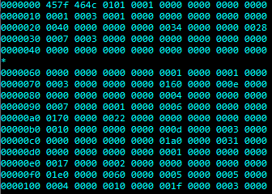
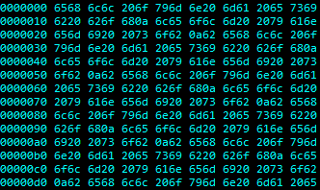
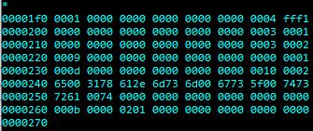
C Executable Raw Hexdump
Text File Raw Hexdump
Vs.
What are some differences you see between these two hexdumps?
*
Null Bytes? (0x00)
Hex Range?
ASCII Range? 0x00 - 0x7f
What else?
How would you create a program to tell the difference?
grep - Checks first 1024 bytes contain null byte
Q: How is a Binary created?

Slide 22
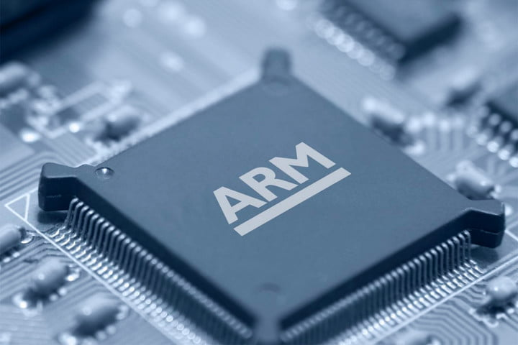
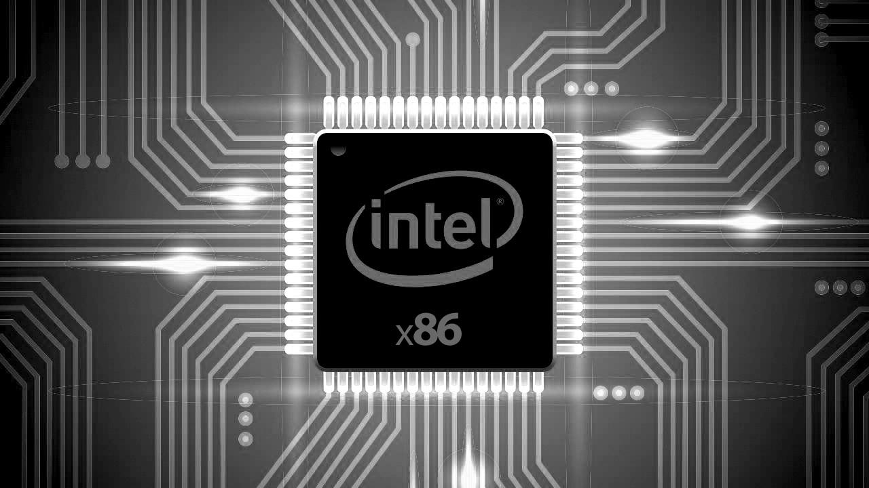

Binary files have the lowest level of abstraction
Machine Code
Numerical Language
Processed directly by CPU
Specific to CPU
Class Focus is on x86/64 Intel
Why?
Different Instruction Set Architectures (ISA)

Slide 23
How is a Binary created and executed?
Source Code
Compiler
Assembler
Object Files
Linker
C Code Files
Preprocessor
Run it!
Loader
Binary
Resolves preprocessor directives
e.g., #include #ifdef
Libraries

Slide 24
Q: Are all binaries the same?
Q: Can they be ran in the same environment?
What does this tell you about binaries?
Executing a binary requires the correct environment.
What is an environment
OS? CPU?
How to model environment

Slide 25
Recap:
Binary Files
Structured
Code, text, header, ...
Loaded by OS and used by application
Environment matters!
Compiled from source code to machine code
How?
Compiler
Assembler
Linker
Loader loads binary into memory
Can run it now!
Q: How to reverse engineer a binary?

Slide 26
Exercise 10 minutes
What steps would you perform to reverse engineer a binary?
Upload pictures into discord channel #lecture-exercises

Slide 27
What we covered
Motivation for RE.
What is RE.
What is a binary? (First look*)
How would you reverse engineer a binary?

Slide 28
Discussion
What is your main goal from the course?
What connections do you see between reverse engineering and…
Your current programming knowledge?

Slide 29
NEXT LECTURE OVERVIEW
Slide 27
Types of binary files
Compiler
Linker
Loader
Intermediate representation (IR)

