Slide 1
PlugMap: EV Route Planning To Alleviate Range Anxiety
By Caleb Walter Bowden
The University Of Huddersfield

Slide 2
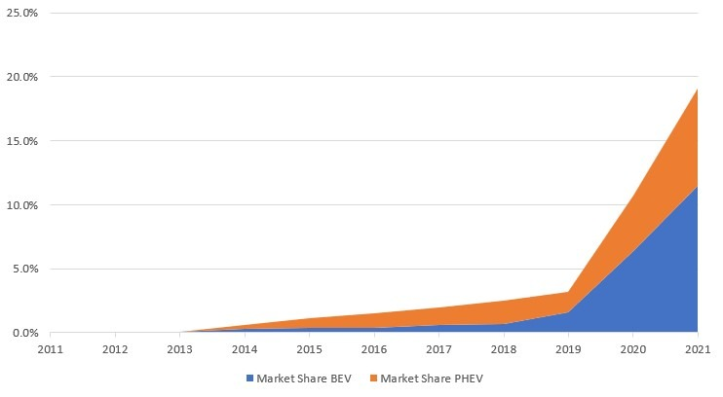
Background Information about electric VEHICLES
Growing need for comprehensive EV charging infrastructure.
Increasing adoption of electric vehicles (EVs) for sustainability.
Importance of effective route planning due to range limitations & small infrastructure.
Recent improvements to battery life & fast charging for longer trips.
Transitions to EVs driven by environmental needs and reducing fossil fuel reliance. (UK to have zero emissions by 2030)
Figure 1: Showing increase in EVs in the UK

Slide 3
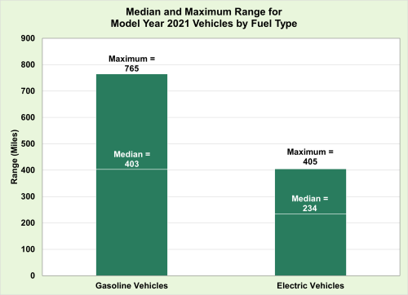
Problem Statement
Defining range anxiety: The fear of running out of battery before reaching a destination.
Current gaps in EV route planning: There are no current route algorithms that specifically target range anxiety.
Infrastructure Gaps: Deficiencies in current EV charging network
Consumer Hesitation: Range Anxiety deter potential EV buyers making it harder for the EV transition.
Environmental Impacts: The transition to electric vehicles is crucial for reducing carbon emissions and mitigating climate change.
Figure 2: Showing a comparison between CEVs & BEVs ranges

Slide 4
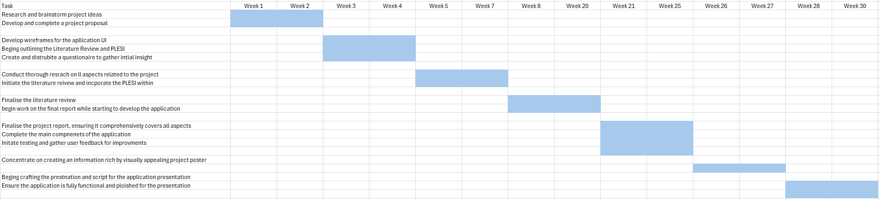
Project Aim & Plan
Aim: To develop a simple mobile application to reduce range anxiety using routing algorithms & real-time data with a clean and minimal user interface which can be used by a variety of different age groups.
Project Plan:
Figure 3: Showing a simple Gantt chart for planning the project

Slide 5
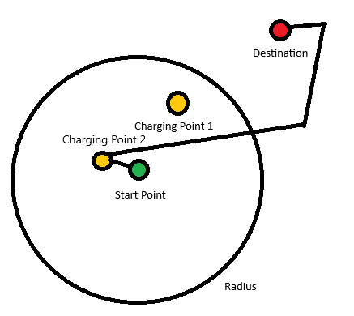
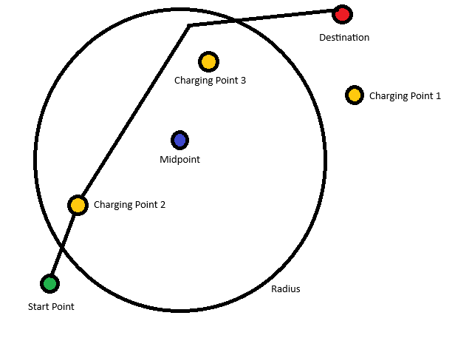
Innovation (ALGORITHMS used)
Midpoint algorithm
First finds the midpoint of the trip.
Converts the midpoint into a set of geo coordinates.
Creates a large radius around the midpoint. (size is depended on the cars current charge state which is calculated as Battery Capacity (kWh) * State of charge (%) * Efficiency (mi/Kwh)
Finds the closest charger within the radius to the start point that is assessable.
Adds the charger into the route and finds the fastest route from start -> charger -> destination.
Closest charger algorithm
Creates a radius around start point.
Finds closets charger within the radius that is assessable.
Adds the charger into the route and finds the fastest route from start -> charger -> destination.
This algorithm is used if the charge is below a certain % and cannot get to a midpoint charger.
Figure 4: Depicting how the Midpoint algorithm works
Figure 5: Depicting how the closets charger algorithm works

Slide 6
Innovation (real-time information & user interface)
APIs Used For Real-Time data
Open Charge Maps API: Collects real-time data on chargers. Open, closed, private, public, free, available, under maintenance & paid
Google Directions API: Finds the fastest routes from A to B
These 2 APIs are used together to collect data to be passed through to the algorithms to get the best route.
User Interface
Pills: Tells the user ETA, charge when at destination & Miles to destination
Polyline: A blue navigational polyline to navigate the user to a destination.
Markers: Destination & charging markets displayed on the map.
Search Functionality: Search the address of your destination.
Settings Page: Select cars charging type, mpKwh & current charge.

Slide 7
APPLICATION DEMO
Show the application in use

Slide 8
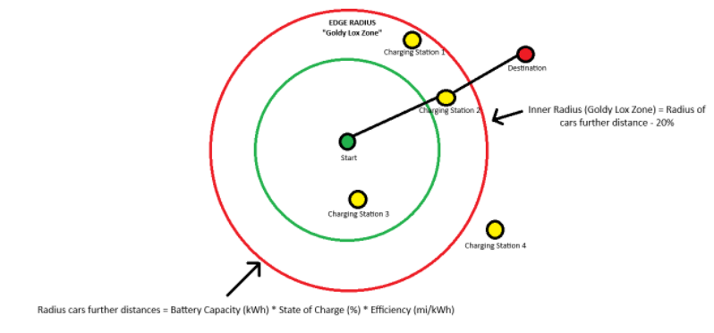
Evaluation Of the product
UI evaluation: The UI was a success it was simple and easy to use it was also not distracting towards the driver using a blue polyline to navigate the driver to the destination and showing information about the trip in pills at the top of the screen. However, the following could not be implemented due to time constraints & complexity.
  Voice Navigation
  Different turning signal prompts with signs & speed limits
  Tracking the car to the destination point
Edge Algorithm: During development, a more suitable algorithm was found however due to time constraints it could not be added to the final product
  With this algorithm it is near impossible to run out of battery on route.
  Algorithm below will repeat itself when it hits a charging station.
  Charging stations will be found in the “goldy lox” zone of the two radiuses as in here is the most optimal charging stations to reduce range anxiety. If no charger is found the algorithm will create another zone until it finds a charging station.
Other Important Information: The current algorithm does not include real-time traffic data, weather data & gradient data. All this data could be useful when trying to calculate a better location to charge. Due to time constrictions this could not be added
Current Algorithms performance: The current algorithm that has been implemented does work correctly and successfully reduces range anxiety. It is also much faster at finding routes and navigating as it is much more light weight.
Figure 6: Showing how the edge algorithm works

Slide 9
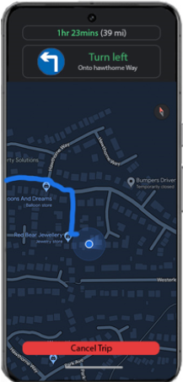
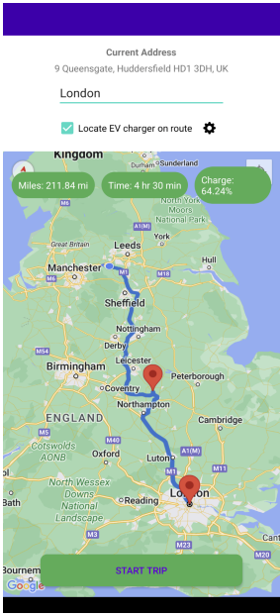
Conclusion
Algorithm used: Implemented algorithm does work as intended although there are some flaws to it that could be improved & fixed. However, the implemented algorithm does decrease range anxiety within EV users.
UI: The UI that was designed and implemented also fits the specification of the project as it is simple to navigate and easy to use for all age ranges.
Although the original wireframes do differ slightly from the product the general Idea was still brought across with a simple and non-distracting UI for drivers.
In conclusion the product & project was a success as it completes the required specifications & a successfully elevates range anxiety. While having a decent UI that is non distracting and simple.
Figure 7: Showing the wireframe UI
Figure 8: Showing the product UI

Slide 10
Questions
Any questions?

