Slide 1


Slide 2
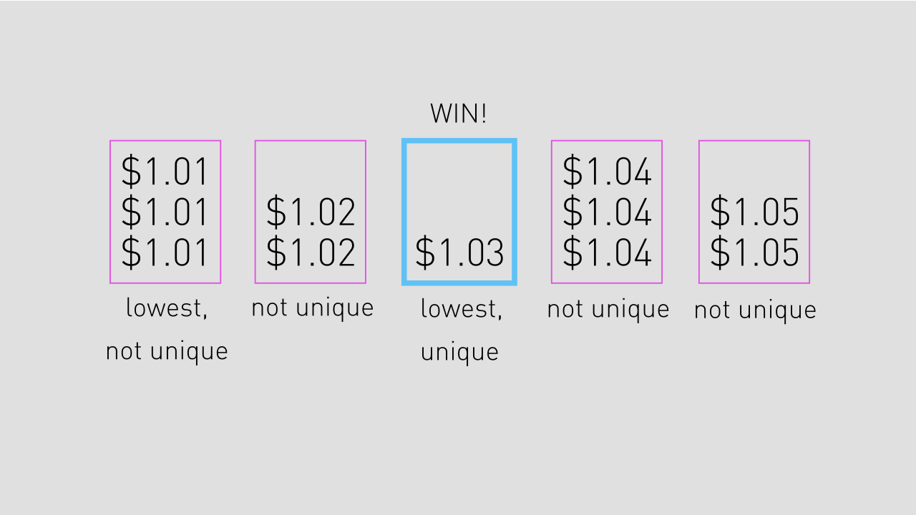

HOW IT WORKS

Slide 3
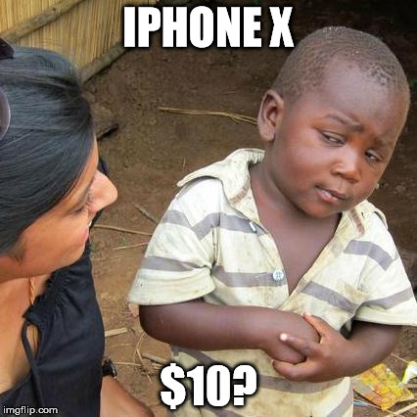

Slide 4
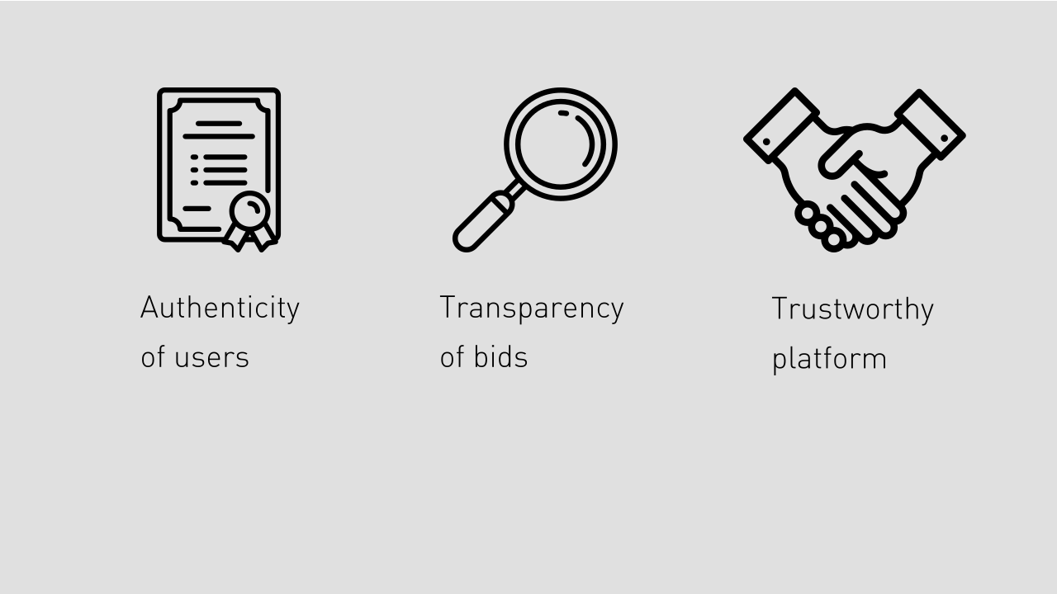
THE SOLUTION

Slide 5
PROOF OF CONCEPT

Slide 6


Slide 7
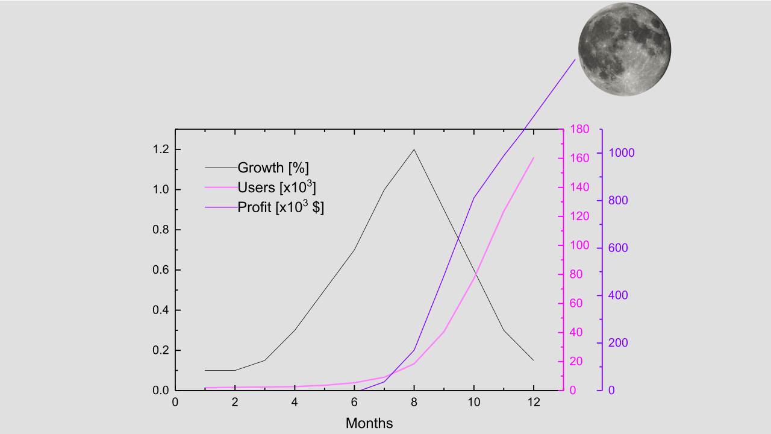

Slide 8

ROADMAP

Slide 9
QUESTIONS

Slide 10
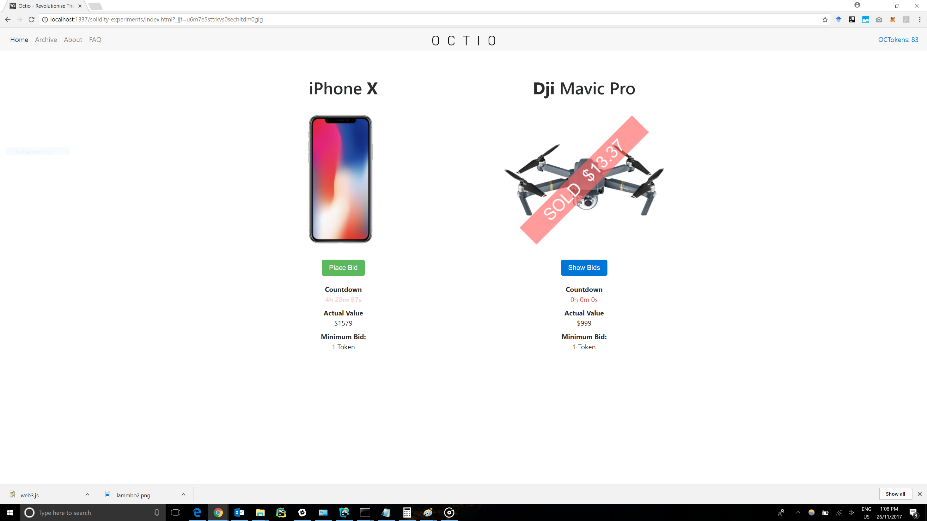
PROOF OF CONCEPT

Slide 11
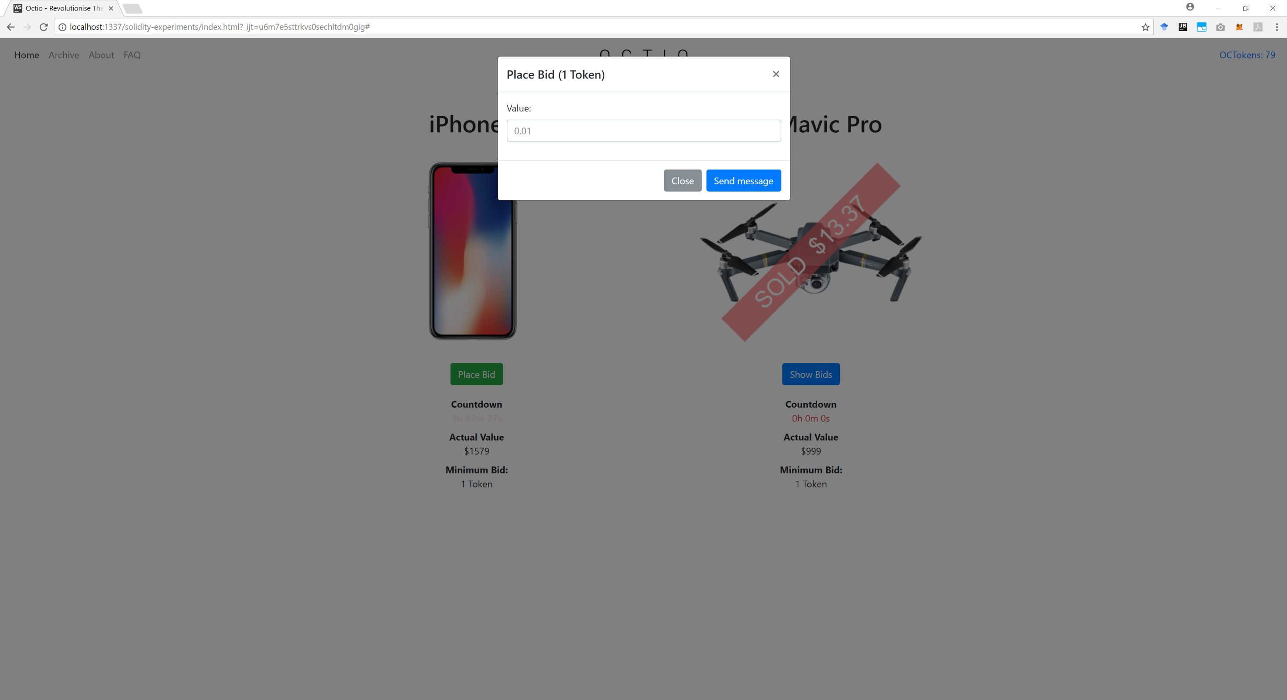
PROOF OF CONCEPT

Slide 12
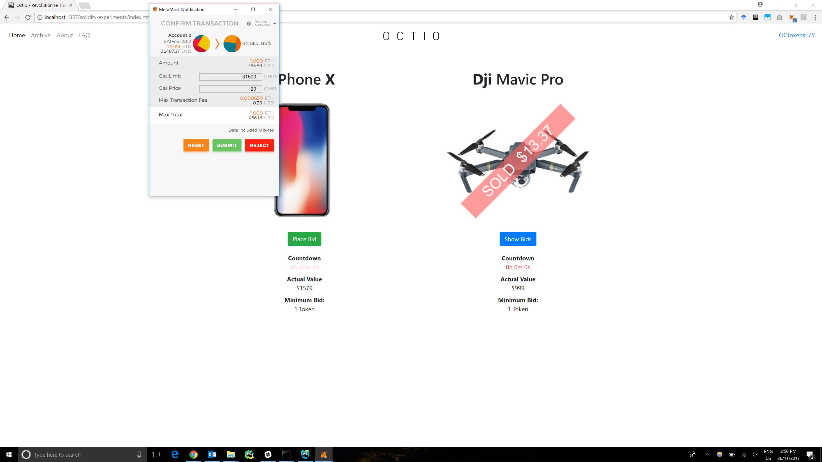
PROOF OF CONCEPT

Slide 13
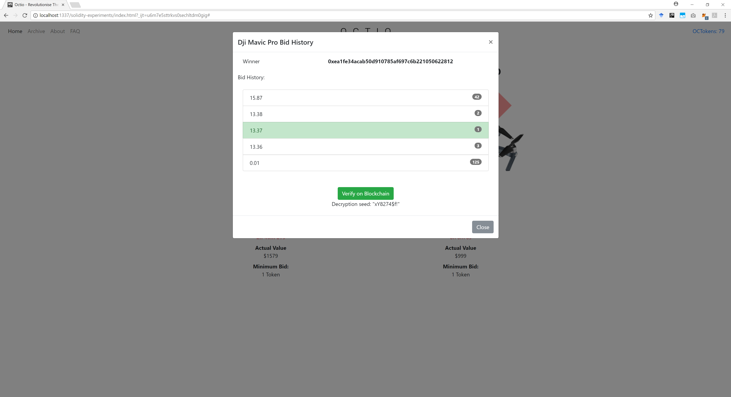
PROOF OF CONCEPT

