Slide 1
The Technology Value Stream
Understanding Lead Time, DevOps Ideals, and Accelerating Delivery
Based on The DevOps Handbook (2nd Ed.) by Gene Kim, Jez Humble, Patrick Debois, and John Willis
By William Renard

Slide 2
What is the Technology Value Stream?
Represents the flow of work from idea to customer value
Encompasses all stages:
Business objective/Concept idea
Development (Usually with an Agile based process)
Testing
Deployment
Operations
Goal: Deliver value quickly, safely, and reliably in a measurable fashion.

Slide 3
Lead Time vs. Processing Time
Lead Time is noted as one of two variables for measuring performance in a Technology Value Stream, the Processing Time is an element of Lead Time between when work starts, and when work is completed (Kim et al., 2021). Lead time begins whenever a ticket is created until the work starts and completes at which point the entire process has elapsed (Kim et al., 2021).
Lead Time:
Total time from feature request to delivery
Includes wait times, handoffs, and delays
Processing Time:
Time actively spent working on the feature
Excludes delays or time in queues
Lead Time > Processing Time
DevOps aims to reduce lead time while keeping processing time efficient.

Slide 4
The Common Scenario (Legacy Approach)
Deployment lead times can take weeks or months, this is especially common in larger organizations where bureaucracy plays a role in limiting the flexibility and speed at which an organization can move on from the start point to working on something and then lastly to finishing the project (Kim et al., 2021).
Causes:
Manual handoffs between teams
Long approval chains
Infrequent releases
Environment drift
Pain points:
High risk of failure during deployments
Difficult rollback processes
Slow feedback loops

Slide 5
Our DevOps Ideal
Deployment lead times of minutes. The idea is that developers receive fast, constant feedback and testing of their code changes to ensure that merges at the end of a cycle will result in error free code that passes all tests to prevent downtime and bug fixes (Kim et al., 2021).
Achieved through:
CI/CD pipelines
Automated testing
Infrastructure as code
Cross-functional teams
Results:
Faster innovation
Safer deployments
Real-time customer feedback

Slide 6
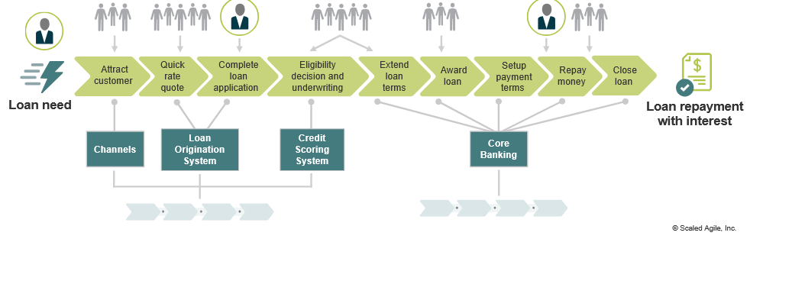
Visualizing the Technology Value Stream
Image from ScaledAgile.com

Slide 7
Key Takeaways
Shortening lead time is more impactful than only speeding up coding.
DevOps practices transform deployment from months to minutes.
Value stream thinking helps organizations identify waste and improve flow.
High-performing teams automate, collaborate, and continuously improve.

Slide 8
References
Kim, G., Humble, J., Debois, P., & Willis, J. (2021). The DevOps handbook: How to create world-class agility, reliability, & security in technology organizations (2nd ed.). IT Revolution Press.
Scaled Agile, Inc. (n.d.). Development value streams. Scaled Agile Framework. https://framework.scaledagile.com/development-value-streams/

