Slide 1
An Application Package Configuration Approach to Mitigating Android SSL Vulnerabilities
Vasant Tendulkar
NC State University
tendulkar@ncsu.edu
William Enck
NC State University
enck@cs.ncsu.edu

Slide 2
Introduction
Smartphones are integral to our daily lives
Applications deal with a variety of sensitive user data
Sensitive personal data needs to be protected from eavesdropping
SSL = de facto standard for securing communication over the internet
Notes:
SSL Protocol is synonymous with communicating via a secure channel over the web

Slide 3
Recent research on SSL in non-browser software
Georgiev et al., The most dangerous code in the world: validating ssl certicates in non-browser software. CCS '12
Fahl et al., Rethinking SSL development in an appified world. CCS’13
Their findings:
SSL certificate validation is completely broken in many critical applications and libraries
Android applications are vulnerable to Man in the Middle attack
Notes:
These two papers were presented at ACM CCS last fall.
Fahl et al. highlighted that Android apps are vuln to MITM
And Georgiev et al.

Slide 4


SSL in Non-browser software
Traditionally, SSL was mostly used in browsers and email clients
Handful of applications were thoroughly verified
Now, SSL verification logic has moved to smartphone applications
Any application can change the verification logic
Then
Now
Notes:
This was seen by Fahl et al.
Applications implementing insecure SSL verification logic.
So the problem is that developers are somehow messing with the SSL verification logic.

Slide 5
Recent research on SSL in non-browser software
Suggested Solutions:
Modify existing classes in Android to force SSL verification
Enforce SSL verification within an application
Implement SSL pinning in Android
Notes:
Fix slide
But these are too complicated. They restrict developer flexibility and force them to learn newer APIS on top of already existing APIs
We looked at creating SSL connections in Android

Slide 6
Using SSL in Android
Create a connection using default Android APIs
UrlConnection
HttpsUrlConnection
WebView.loadUrl
URL u = new URL("https://www.google.com");
URLConnection uc = u.openConnection();
URL u = new URL("https://www.google.com");
HttpsURLConnection h =(HttpsURLConnection) u.openConnection();
WebView wv = (WebView)findViewById(R.id.webview);
wv.loadUrl("https://www.google.com");
Notes:
We looked at how easy it is to create an SSL connection
How easy it is to create an SSL connection.
Just two lines using default APIs.
Allows a connection only if
SSL certificate is genuine and valid
The issuer CA is trusted by Android
Root CA certificate must be present in Android
Does not have support for using self-signed certificates

Slide 7
Our Hypotheses
H1: Developers use self-signed certificates during either debugging or at deployment and add custom SSL verification code to accommodate these certificates
H2: Developers use SSL Pinning to make the application more secure and customize SSL verification to only trust the pinned certificate

Slide 8
Proposed Solution
Push the customization of SSL verification logic to the application package manifest
Makes it declarative and easy to modify
It is easy to remove if the customization is temporary
Solution approaches:
Linking application debugging with SSL verification
Allowing SSL Pinning as an Application manifest policy
Notes:
If our hypothesis is true, here is how we would fix these problems
Do not change the code, change the policy

Slide 9
Linking application debugging with SSL verification
Android uses a debug flag in the manifest to denote that the application is in debug phase
android:debuggable=“true”
Notes:
Why not link debug flag to ssl verification
Debug flag is added during dev stages
It is removed before deployment automatically
Android SDK 8 onwards does this
This will allow devs to use any certificate during dev and change to correct one before deployment
They would have to test the whole app one final time before deployment after using the correct cert

Slide 10
Allowing SSL Pinning as an Application manifest policy
<!-- SSL Pinning Configuration-->
<uses-SSLPinning useDefaultTrustStore=true >
<!-- Self-Signed Server Certificate Fingerprint-->>
<SSCert name="mycert" algo="SHA-1” val="B8:01:86:D1.."/>
<!-- Issuer Certificate Authority Fingerprint-->>
<SSCert name="cacert" algo="SHA-1" val="93:E6:AB:22.."/>
</uses-SSLPinning>
Notes:
Fahl et al mention this as a solution in their paper ---
However, their solution would require dev to mention all certs that they trust
We enhance the solution with a small change
We allow the dev to use def root store as well

Slide 11
Hypotheses…revisited
H1: Developers use self-signed certificates during either debugging or at deployment and add custom SSL verification code to accommodate these certificates
H2: Developers use SSL Pinning to make the application more secure and customize SSL verification to trust only the pinned certificate(s)

Slide 12
Experiment Methodology
We focus on vulnerabilities introduced due to custom verification code added by the developer
We do not include SSL code introduced by advertisement or analytics libraries
Notes:
In prior research they did not differentiate between ssl due to ads and code.

Slide 13
Why developers customize SSL
Most common reasons:
Developer is using a self-signed certificate
Developer is using a certificate signed by a CA not yet trusted by Android
Developer does not know how to use SSL
Developer wants to use the same certificate on multiple servers
Notes:
Talk about the solutions provided for most of these questions
Which techniques they gave
Next slide on the techniques we found

Slide 14
Code Patterns for Insecure SSL verification
The Trust-All or Any Certificate pattern
TrustManager TA = new X509TrustManager(){
public void checkServerTrusted(X509Certificate[] c, String at) throws CertificateException
{
}
};
// <- Empty Code Block = No certificate verification
Notes:
Explain this pattern
Rest of the patterns are in the paper

Slide 15
Why developers customize SSL
Most common reasons:
Developer is using a self-signed certificate
Developer is using a certificate signed by a CA not yet trusted by Android
Developer does not know how to use SSL
Developer wants to use the same certificate on multiple servers
Notes:
Talk about the solutions provided for most of these questions
Which techniques they gave
Next slide on the techniques we found

Slide 16
Experiment I – Analysis of Open-Source Apps
Obtain source code for 240 open-source applications from F-Droid
Analyzed the certificate verification logic in the applications
Analyzed the SSL certificates used by the application
Verified against root CA store of Android ver. 2.3.3, 4.0, 4.1, 4.2
Results:
26 out of 240 applications use SSL
10 out of the 26 applications use insecure certificate verification logic
6 applications do not verify any certificate
3 applications do not verify server hostname
1 application does neither
Only 2 applications use self-signed certificates
Notes:
To download the ssl certs, we visited each production webserver used within the application
Dev said this
This refers back to our hypo 2
This could be solved by our solution 2

Slide 17
Experiment II - Analysis of Play Store applications
Obtained 13,000 applications from Google Play Store in January 2013
Identified 4,985 applications that use SSL
Categorized apps based on where SSL was used
src_only
src_and_ads
ads_only
Verify SSL certificate used by the application
Verified against root CA store of Android ver. 2.3.3, 4.0, 4.1, 4.2
Randomly selected 200 applications for manual analysis
Notes:
Graph of 200 applications

Slide 18
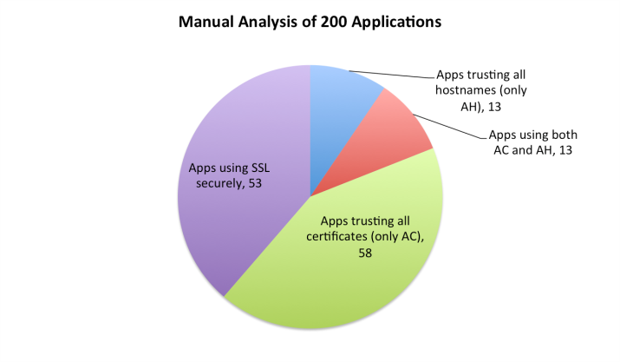

Manual analysis of Play Store applications
Decompiled applications to Java source using Dare and Soot
137 out of 200 applications use SSL in non-advertisement code
84 applications use insecure SSL verification code
Only 5 applications use self-signed certificates, rest 79 applications use genuine, valid SSL certificates
Notes:
Graph Here
Highly probable that they use debugging reason

Slide 19
Analysis of Google Play Store applications
3,165 applications out of remaining 4,785 used SSL in non-advertisement code
Used Androguard to obtain source-code of classes using SSL in these applications
Pruned known implementations of insecure SSL verification and analyzed the remaining code for each application
Results:
1,805 applications out of 3,165 applications bypass SSL verification within the application
Only 124 applications out of these 1,805 applications use alternative certificates
Rest 1,681 applications use genuine, valid SSL certificates
Notes:
Graph of 200 applications

Slide 20
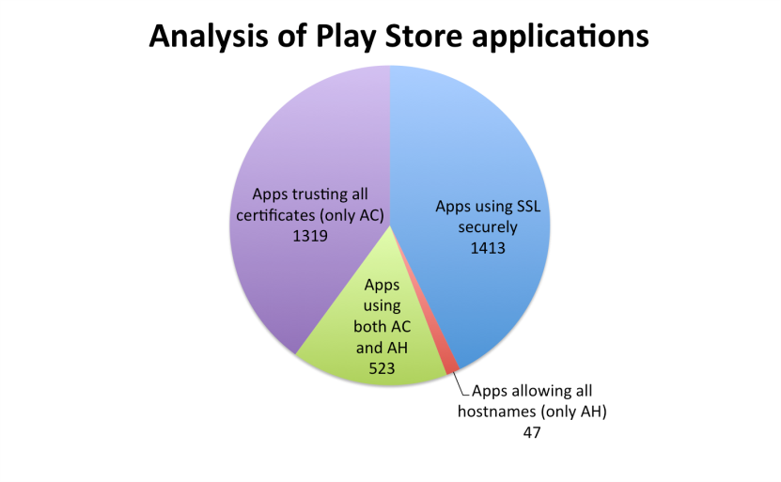
Results
3,302 applications using SSL in non-advertisement code
57.2% applications using insecure SSL certificate verification logic
1,319 applications trusting all certificates
47 applications trusting all hostnames
523 applications trusting both
Notes:
Here, we say that a majority of these applications do not need to customize SSL code.
Our takeaway is that they are using genuine SSL certificates and can do so with default Android APIs.

Slide 21
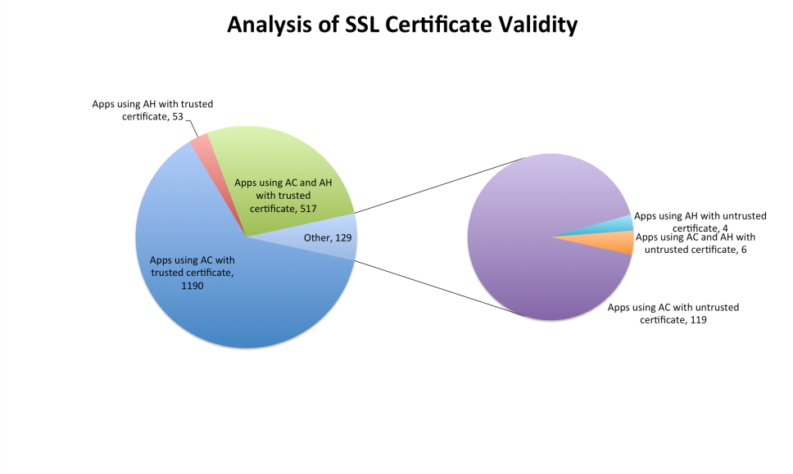
Results

Slide 22
Conclusion
Investigated Man-In-The-Middle SSL vulnerabilities in Android applications
Identified insufficient API support for commonly used features as the driving reason for developers writing custom SSL verification code
Proposed two application package configuration based solutions to prevent MitM vulnerabilities
Demonstrated that more than 50% of applications using SSL in non-advertisement code would benefit from our solutions

Slide 23

Thank you
Vasant Tendulkar
Department of Computer Science
North Carolina State University
Email : tendulkar AT ncsu.edu
Questions?
Notes:
And with that I thank you.
If you have any questions I will be happy to answer them

